Slide 1
Notes:
Equipping Christian Witnesses:
With support from the WELS Conference of Presidents, this two-year capital campaign will celebrate the 2020 25th anniversary of MLC. The title, “Equipping Christian Witnesses,” reflects not only the mission of our institution—to train a corps of Christian witnesses to meet WELS ministry needs—but also the three main parts of this campaign.

Slide 2
Notes:
STUDENT RECRUITMENT | STUDENT FINANCIAL AID | STUDENT FACILITIES
We will re-energize our RECRUITMENT of students for the public ministry opportunities in the WELS.
We will provide even more FINANCIAL AID so that every student who wants to train for ministry can do so.
And we will equip these students with enhanced and enlarged FACILITIES that will be more appealing to prospective students and more useful for current students.
By the grace of God, EQUIPPING CHRISTIAN WITNESSES will allow Martin Luther College to serve the WELS more effectively.

Slide 3
Notes:
The first pillar of our campaign focuses on the spiritual gift of encouragement.
For many of our students, it was just one person’s encouragement that motivated their decision to become a pastor or teacher.
That person may have been another pastor or teacher, a spiritually mature member of their congregation, a grandparent they admire, their loving parents, or a trusted friend.
We humbly ask you to encourage prospective students as well. Why? Because we need many more Christian witnesses.
And please, don’t forget to encourage those students who already seem to be on that path toward ministry, or who are already at MLC or Wisconsin Lutheran Seminary!
(PRESENTER – If you have your own story of someone encouraging you, please share that as well.)
We are facing both . . .
• a concerning number of current vacancies in our congregations and schools and
• an exciting and almost unimaginable number of open doors to new ministries.
MLC enrolls about 750 on-campus undergraduate students. We pray that number could grow to 900 or even 1,000 students.
We know that higher enrollment numbers are required to meet the numbers in need: the thousands of souls in existing WELS congregations who are needing a new pastor or teacher and cannot get one
as well as the hundreds of thousands across the world who are asking for biblical instruction . . . and the multitudes who do not even realize that they are lost.

Slide 4
Notes:
Let’s watch this video with Paul Prange (WELS Administrator for Ministerial Education) explaining the need for more called workers.

Slide 5
Notes:
The Holy Spirit has opened huge doors for us in Asia, Africa, and the Americas.
Most recently, the Hmong Fellowship Church in Vietnam—more than 100,000 souls—asked that we provide them with ministerial training.
At the invitation of the communist government of Vietnam, we are building a theological training facility in Hanoi.
The Spirit has also opened more doors in our country:
• Seventeen new home missions were approved in 2018, many connected to schools or preschools. These ministries need workers.
• WELS urban schools, spurred by Parental Choice laws, are outgrowing their facilities and their faculties. Milwaukee alone has capacity for an additional 150 teachers.
• WELS preschools—almost 400 of them!—are proving wonderful grounds for the gospel to spread.
• Campuses of Divine Savior Academy in Florida and Texas enroll 1,000+ students and are still growing. These schools could use 100 teachers or more over the next few years.
For several years, we’ve also had an increasing demand for more pastors and teachers because large numbers of baby boomers are retiring, and we simply don’t have enough candidates to replace them.

Slide 6
Notes:
Here is a video with some thoughts from Matt Zeng about reaching nontraditional students.
Matt is an MLC ’19 graduate and current Wisconsin Lutheran Seminary student.

Slide 7
Notes:
How can you help recruit students who might become your next pastor, teacher, or staff minister?
You probably can identify a couple students right now in your own mind.
Take some time to encourage them to think about the public ministry.
(PRESENTER – If you have your own story of someone encouraging you, please share that.)
Here are some samples you could use.

Slide 8
Notes:
We have an online form available where you can submit the name of a student you feel would be a good candidate for the ministry.
We will reach out and ask permission to send the student information about MLC so they can consider ministerial training for their future.

Slide 9
Notes:
Our second pillar addresses student financial aid.
College debt is a concern across our nation.
We at MLC are especially concerned, because we know that our graduates are not entering positions that will allow them to pay off college loans quickly.

Slide 10
Notes:
Here is the data. Since 2015, about 75% of our students have graduated with debt, and that debt averages $25,000.
By God’s grace, our tuition, room & board is much less than other private institutions.
Our efforts at reducing student debt have been recognized nationally.
MONEY Magazine, College Factual, and other rankings have placed us at or near the top of their “Best Value” lists.
Still, those debt figures are cause for concern and prayer. We want our students to graduate with as little debt as possible,
and we never want cost to deter a prospective student from pursuing their dream of ministry training.

Slide 11
Notes:
One avenue to help reduce that debt is the Congregational Partner Grant Program (CPGP). In this pillar of the campaign, we’d like to establish a solid foundation for the CPGP, fully funding MLC’s CPGP Matching Fund for years to come.

Slide 12
Notes:
Through CPGP, MLC matches dollar for dollar, up to $1,000, the gift a congregation gathers to apply to the tuition of their student at MLC.
As a renewable effort, CPGP can provide four or five years of financial aid support—up to $10,000 to each student—in addition to the other financial aid the student receives.

Slide 13
Notes:
Many students like Faith have expressed their gratitude for this program.

Slide 14
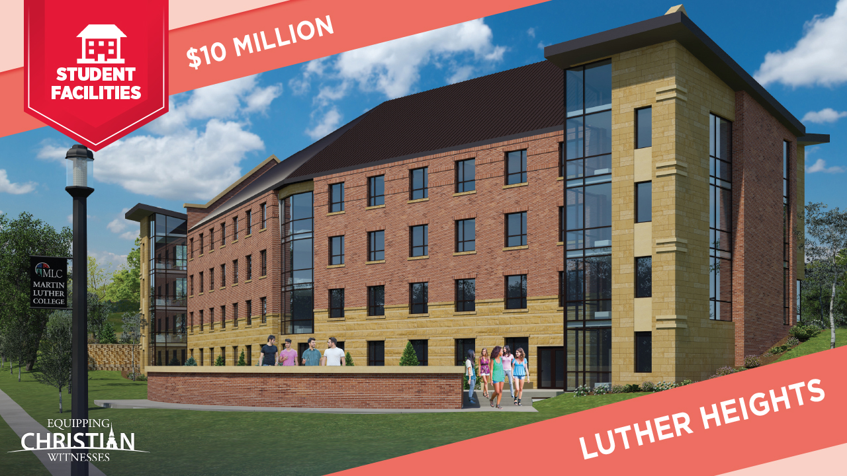
Notes:
Our final pillar is Student Facilities.
As a major undertaking of this campaign, we want to build a new residence hall and renovate our current dormitories to meet the needs of the next generation.
Admissions counselors report that the campus visit is the most important factor in the prospective student’s college decision-making process.
As these visiting prospects walk around campus, the amenities provided in a college residence hall can make a big impact on them.
Generally, our visitors love the Christ-centered culture of MLC, the beautiful chapel, the well-tended grounds, the welcoming faculty, and the friendly and dedicated students.
Our campus facilities, however, are in need of an update! Almost all our buildings are more than 50 years old.
We are grateful to the Christians of past generations who gave so generously to make them a reality.
Unfortunately, buildings are not timeless, even if the Word spoken within them is.

Slide 15
Notes:
Luther Heights will allow all students to live on campus. (In recent years, some students have been compelled to live in alternative, off-campus housing because of our lack of space.)
Luther Heights will also provide rooms for the prospective students who visit us. (Sometimes these groups can be quite large!)
And if God so blesses our campaign, Luther Heights will provide a home away from home for the expanding enrollment we are anticipating.

Slide 16
Notes:
This 3D Rendering of Luther Heights will help give you a clear picture of the proposed building.

Slide 17
Notes:
We’re excited about the summertime possibilities that a new residence hall opens up for us.
During the hot summer months, the comfortable accommodations of Luther Heights—with its air-conditioning and semi-private bathrooms—would allow us to comfortably host larger events for the greater synod.
Here are a few groups that could benefit from use of this facility.

Slide 18
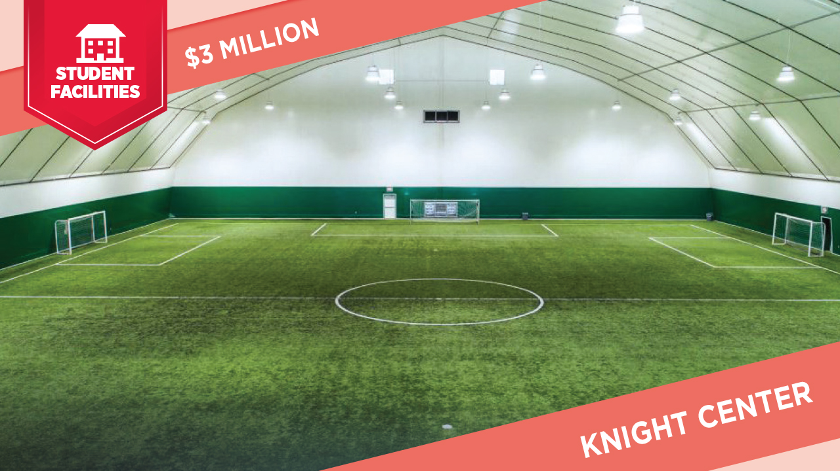
Notes:
Another facility we are hoping to build is the Knight Center.
Athletics and physical education are an important part of the Martin Luther College experience.
For those students training to be PE teachers and coaches in WELS schools, those programs are an integral part of their development as future called workers.
One of our basketball players said it well. He said he was thankful MLC provided him the opportunity to use all his gifts to the fullest and to “grow into the Christian man I want to be.”
For many years, however, we have not had adequate athletic space for our student body, our teams, or visiting teams.

Slide 19
Notes:
The new Knight Center will meet these pressing needs of today and help us offer expanded opportunities tomorrow.
Though New Ulm has some indoor options available, it’s not enough. There is high demand for them when the weather is bad.
Specifically, the Knight Center will . . .

Slide 20
Notes:
This 36,000-square-foot facility will provide for many of our athletic department’s needs: locker rooms, batting cages, golf simulators, and artificial turf equal to 60 yards of a football field.
The Knight Center will also enhance recruitment and retention. MLC exists in a competitive marketplace. Many, perhaps most, 18-year-olds are not certain they want to be a pastor, teacher, or staff minister.
They will often choose a Christian college that will help them continue to discover and develop their gifts while they make their vocational decisions.
We would like that college to be MLC. We would like to show them that we care about the full development of all their God-given gifts, including their athletic gifts, and we will supply the facilities that support that development.

Slide 21
Notes:
Two of our student athletes share their thoughts in this short video.

Slide 22
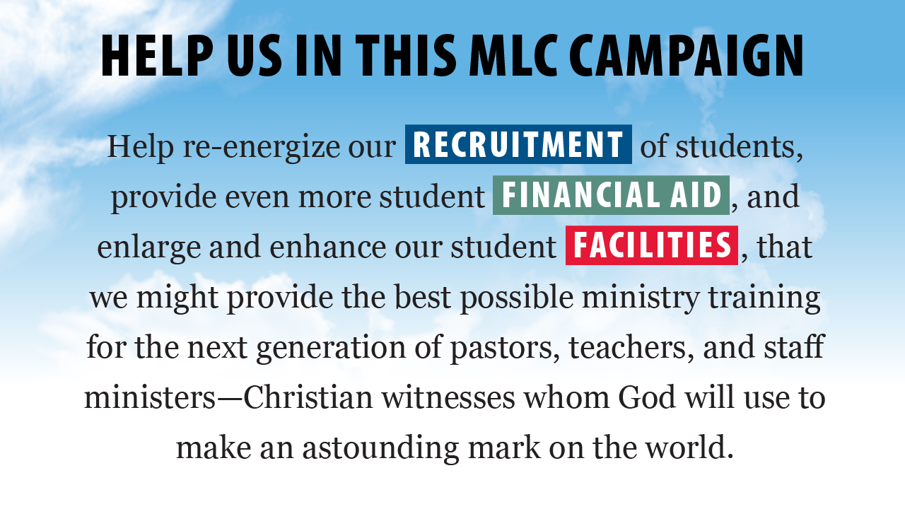
Notes:
You can see that we’re excited about the extraordinary opportunities God is presenting to us today through Equipping Christian Witnesses.
Perhaps God has placed you in a position where you can help us.
We realize he has already blessed the world through your support of your church, your example for the next generation, and your charitable giving to those less fortunate.
Might you be able to help MLC too?
We thank you for your faithfulness, your prayers, and your financial support.

Slide 23
Notes:
The EQUIPPING CHRISTIAN WITNESSES (ECW) toolbox is the place where you can find all ECW promotional materials, campaign updates, graphics, and videos.
Original files from our posts, articles, emails, and videos will be saved here for your personal viewing or sharing with others.
You have permission to download files to help you promote ECW with your friends, family, and fellow congregational members.
Revisit the toolbox often to see what’s new!

Slide 24
Notes:
There are many ways you can give to this campaign, either online, via check, or over the phone.
The Mission Advancement Office at MLC and our Christian Giving counselors are here to help you.

Slide 25
Notes:
Thank you for learning more about this campaign with us!

