Slide 2
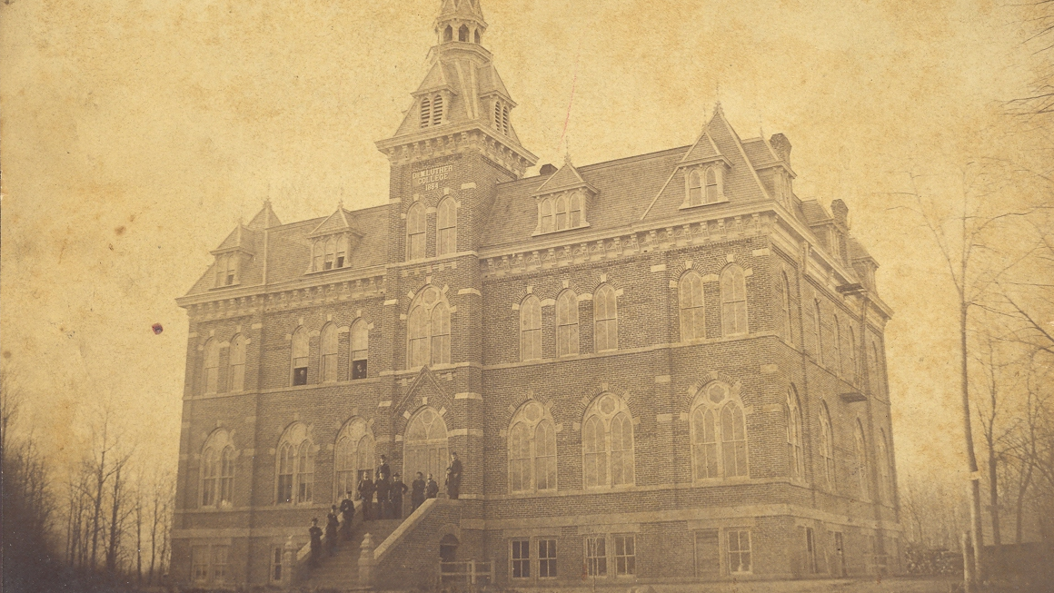
The 140th Anniversary Celebration of
Old Main
1884-2024

Slide 3
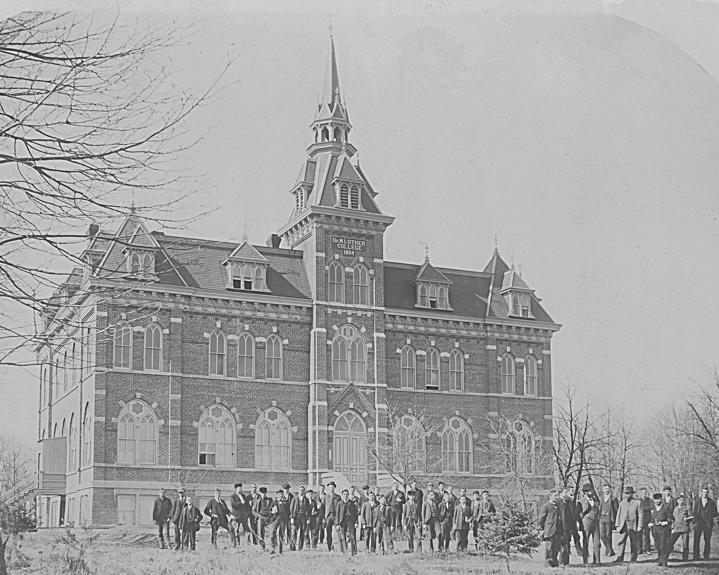
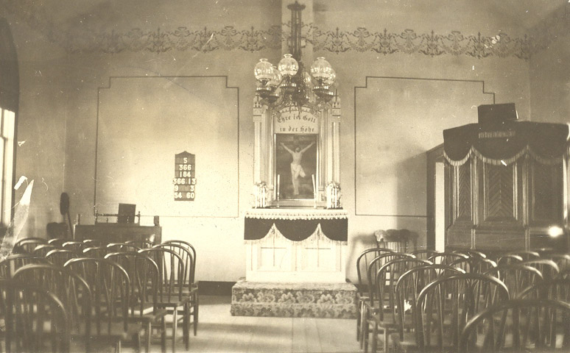
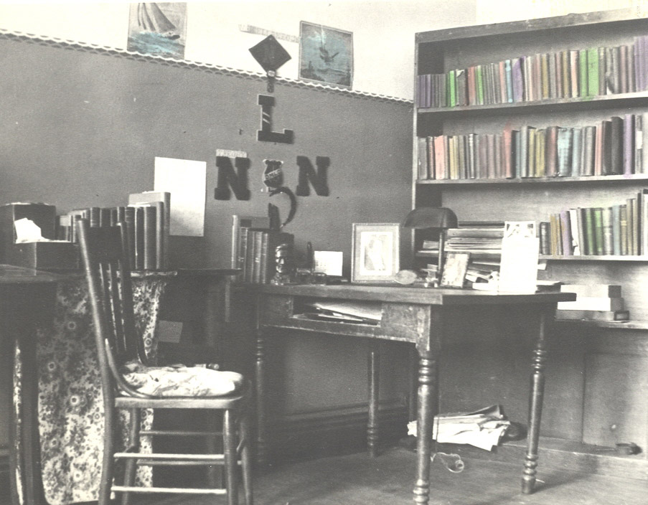
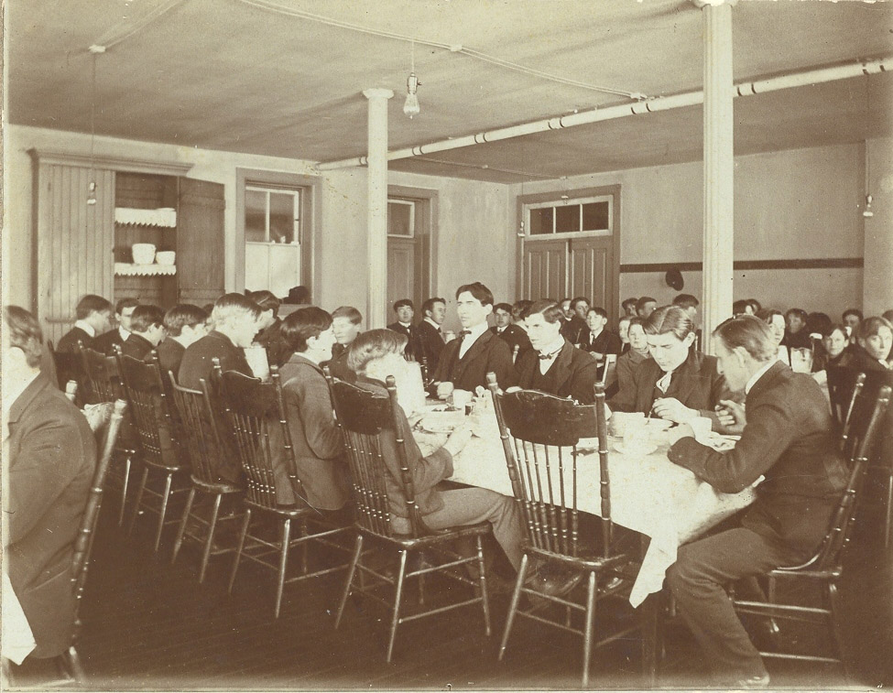
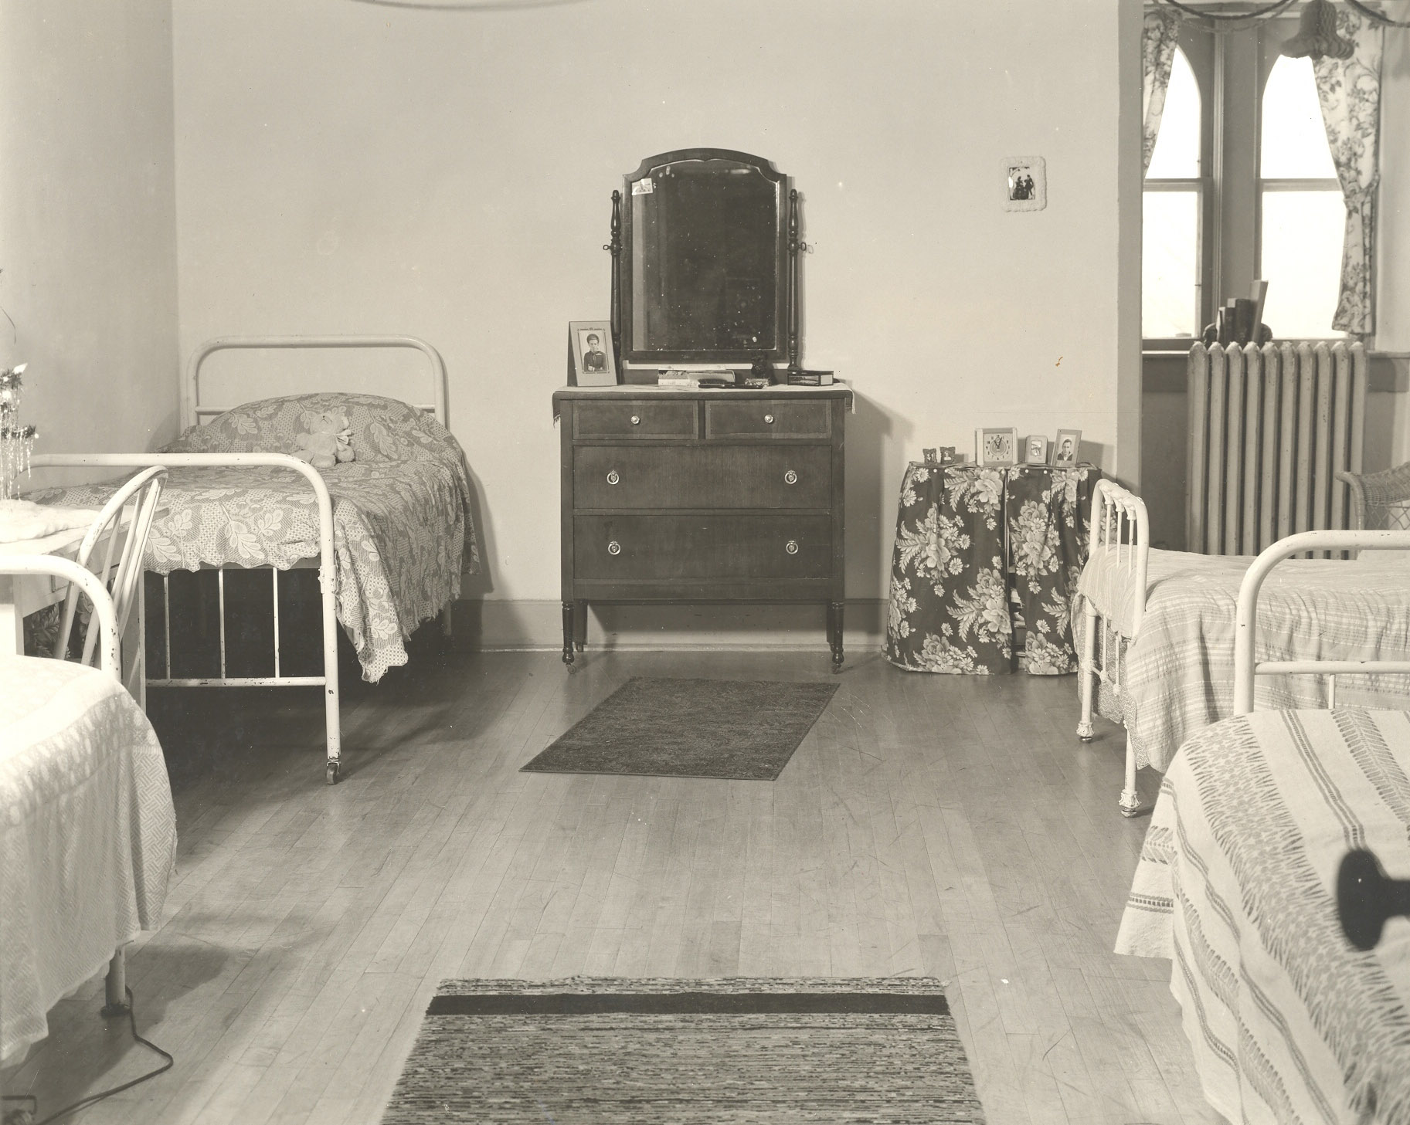
Over the last 140 years, Old Main has been home to a chapel, a dining hall, dorm rooms, classrooms, and offices.

Slide 4
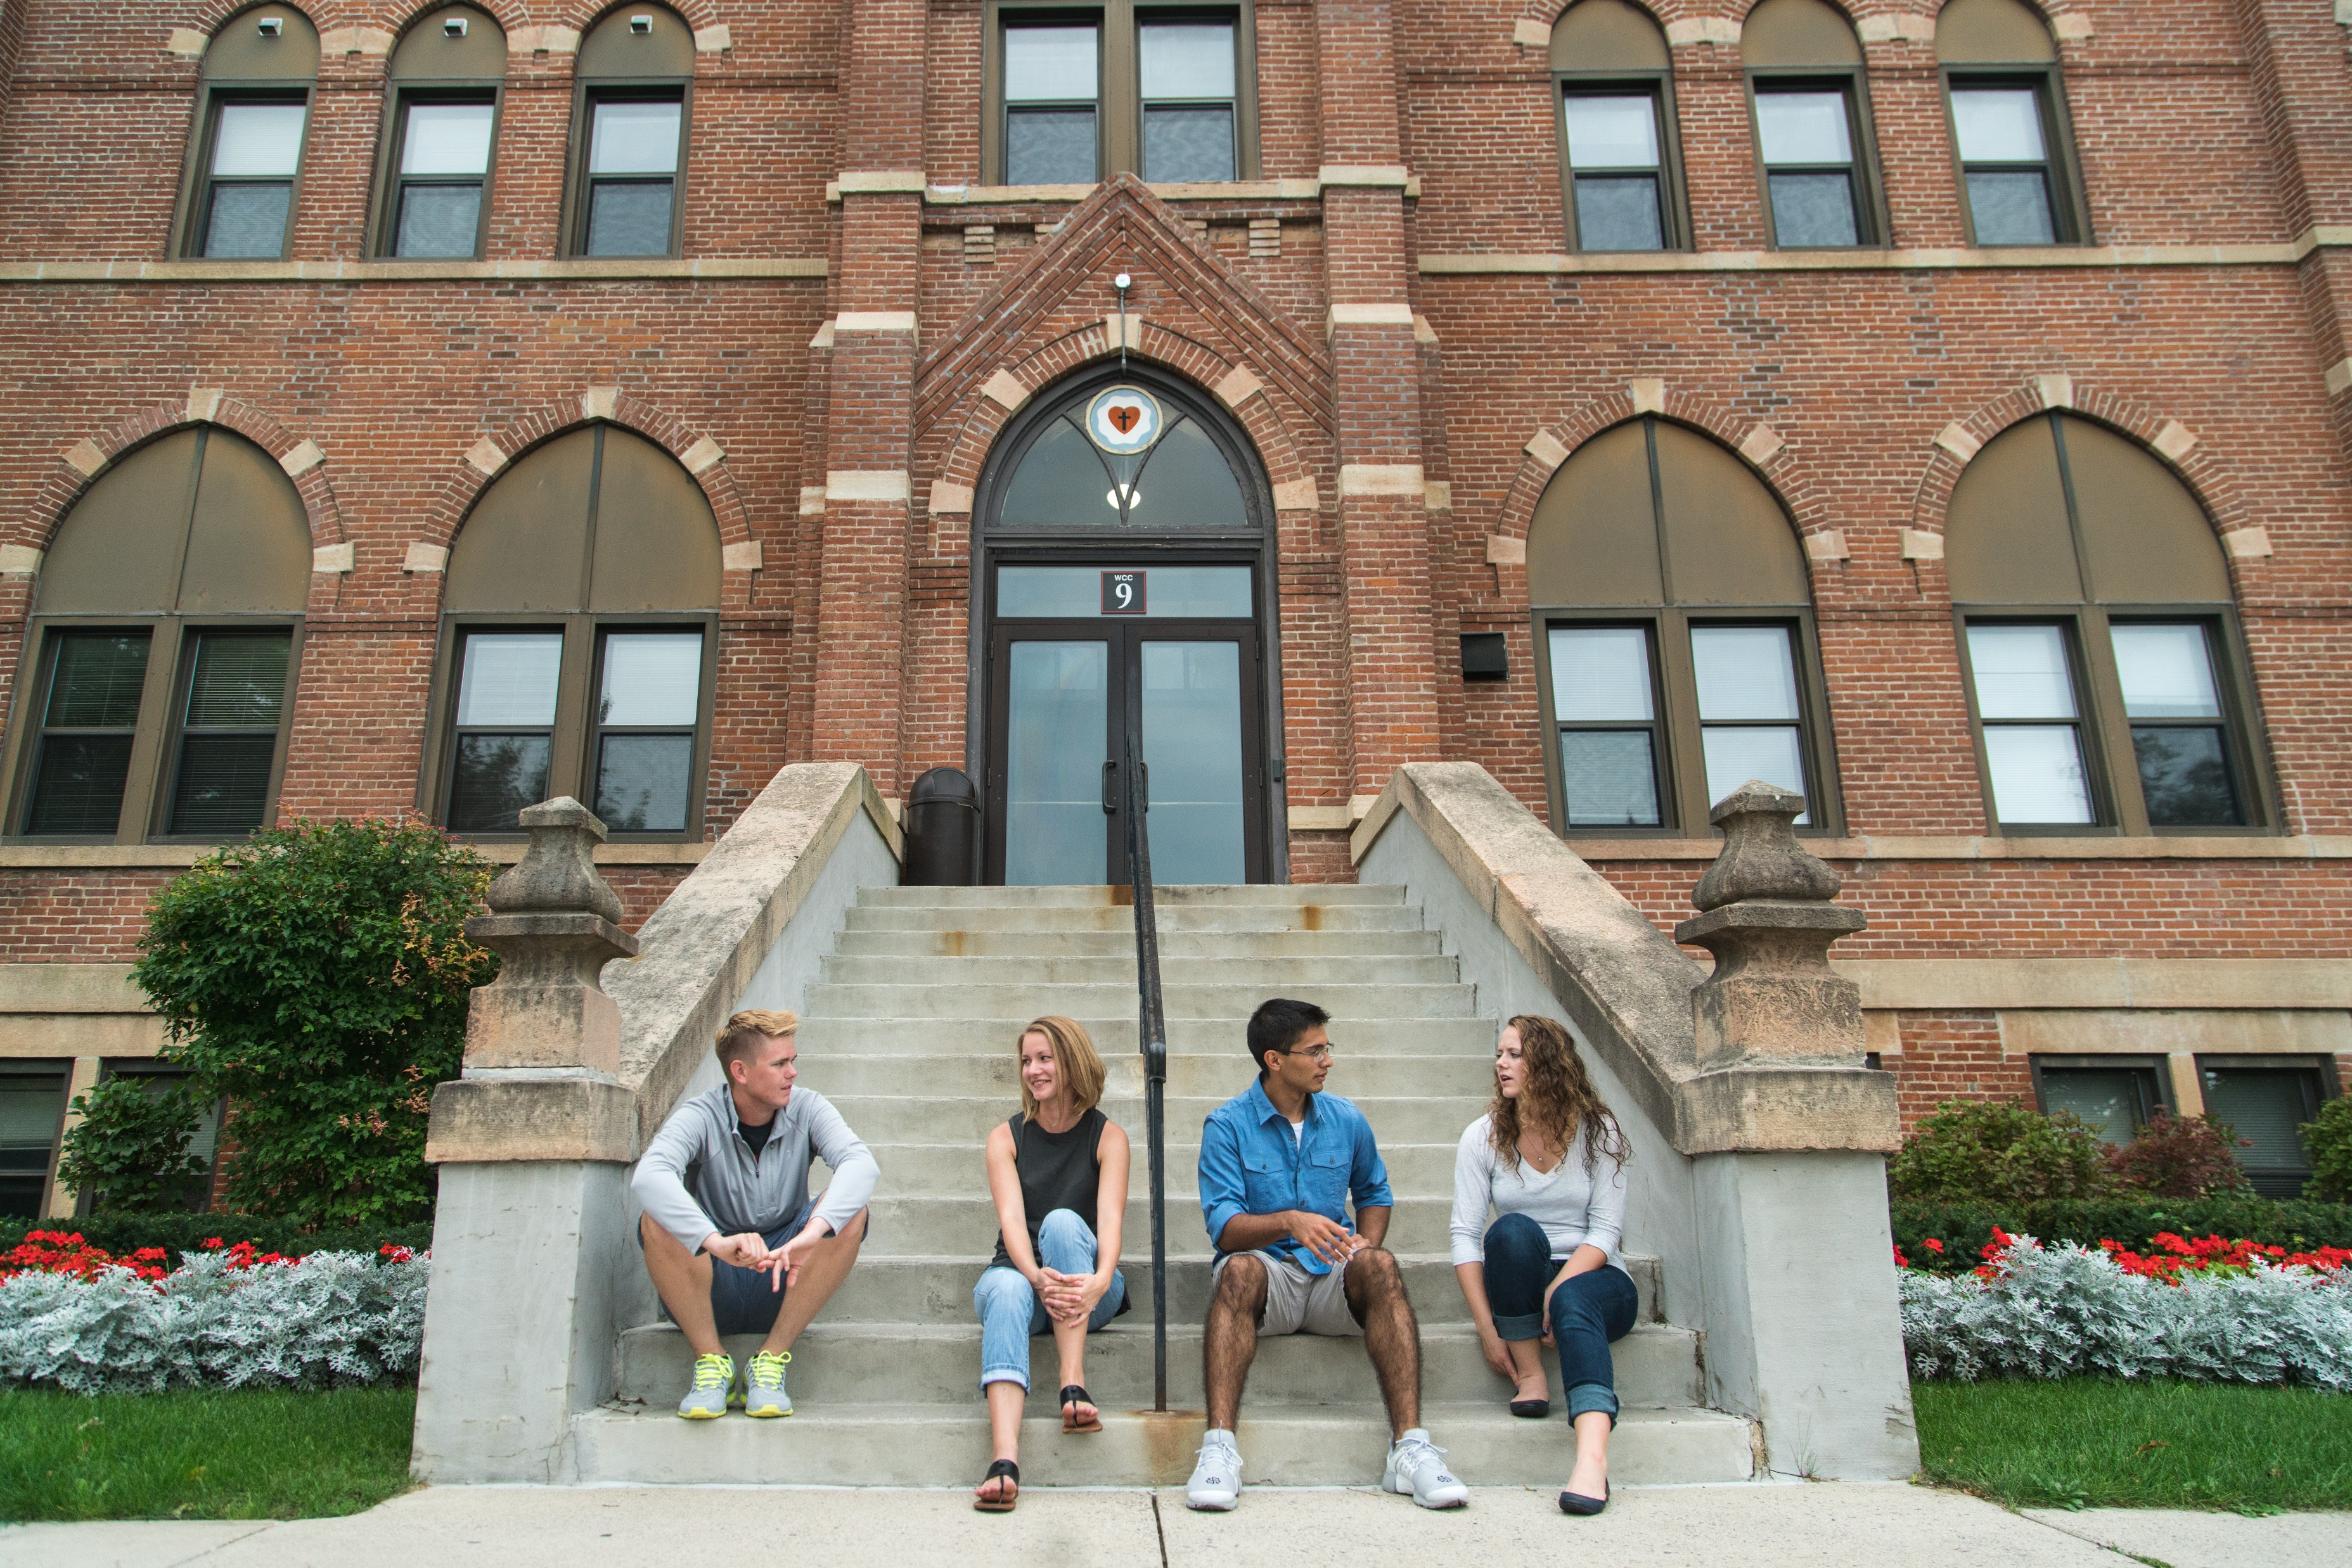
Old Main is an iconic campus building that has welcomed generations of students, faculty, staff, and visitors. It stands as an enduring symbol of MLC’s mission and history.
Old Main serves as
the backdrop to countless memories and milestones.

Slide 5
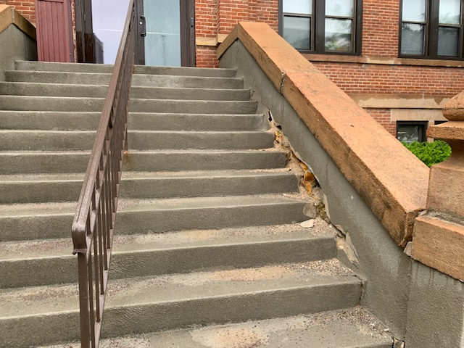
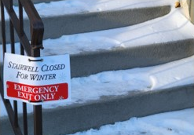
The condition of the entrance, however, does not match the grandeur of the building.
The concrete is dissolving, and the sides are leaning, making it unsafe, especially in the winter.
Years of temporary measures have left the entrance in need of a permanent solution.

Slide 6
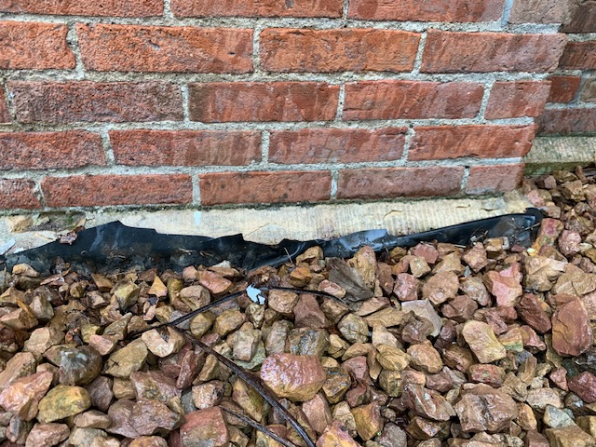
The foundation along the front face of Old Main is a source of water problems.
A rubber roofing liner added beneath the landscape is not a viable long-term solution.

Slide 7
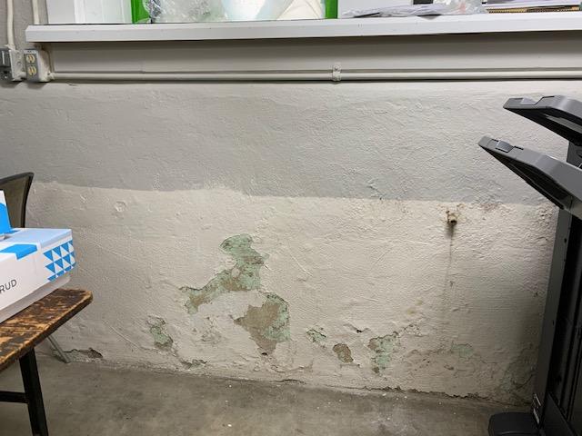
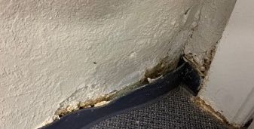
The interior of the foundation walls shows water damage.
We need waterproofing for the entire front foundation wall, down to the footing level.

Slide 8
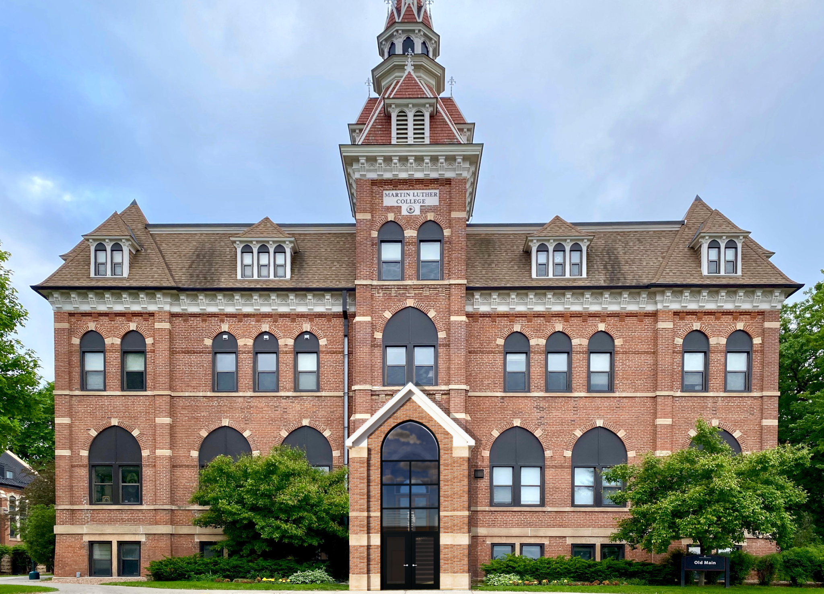

Slide 9
We plan to replace the entrance stairway and repair the foundation along the front of the building.
The new design honors the heritage of the old building while creating an aesthetically pleasing covered entrance that provides protection from the elements.
Notes:
A digital rendering of what the ascetically pleasing brick canopy will look like.

Slide 10
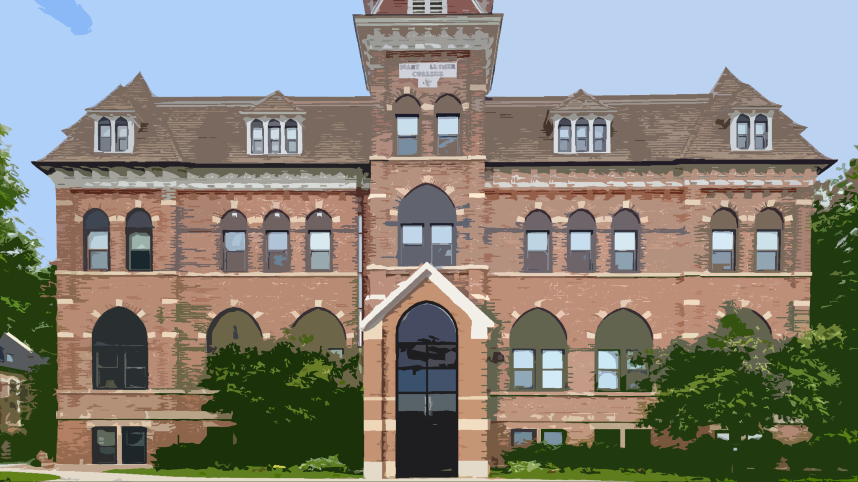
Restoring the Entrance Is No Small Task!
The estimated cost for this critical project is
$650,000
This will cover
Foundation repairs & waterproofing
Replacement of the stairway
Covered entrance

Slide 11
How Will This Project Be Funded?
MLC has budgeted $100,000.
A Generous Donor has agreed to match all gifts dollar for dollar up to $275,000!
MLC Alumni Association, Emeriti, Faculty, and Staff have already given donations.
We invite you to join them!

Slide 12
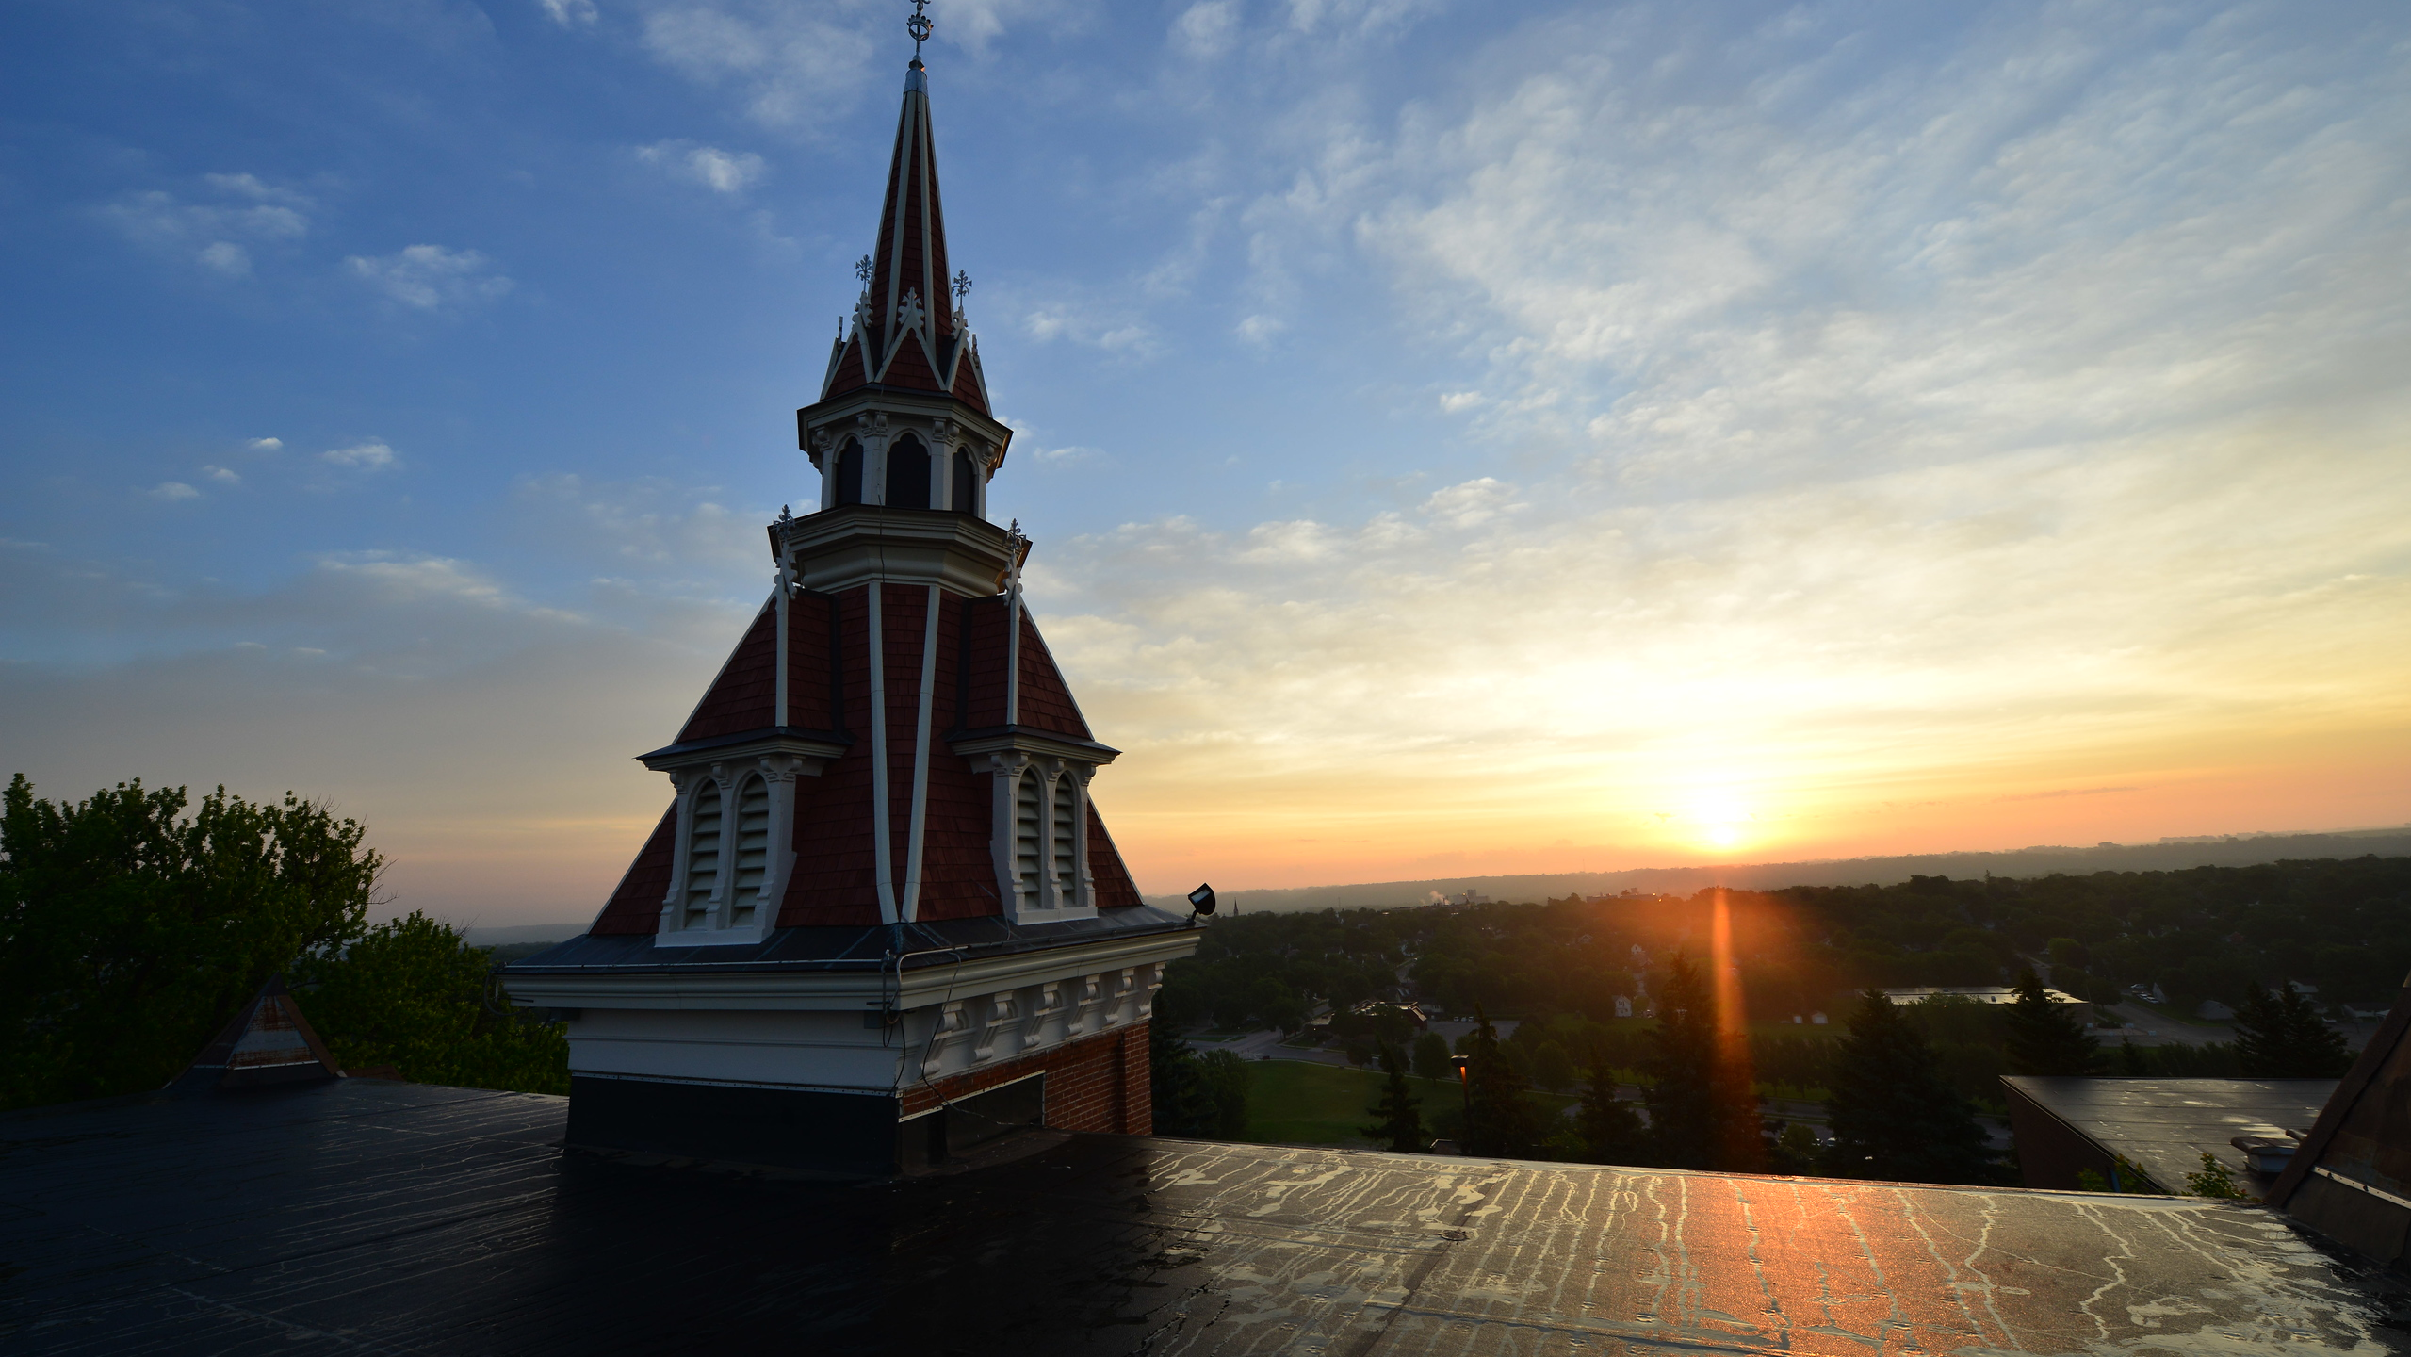
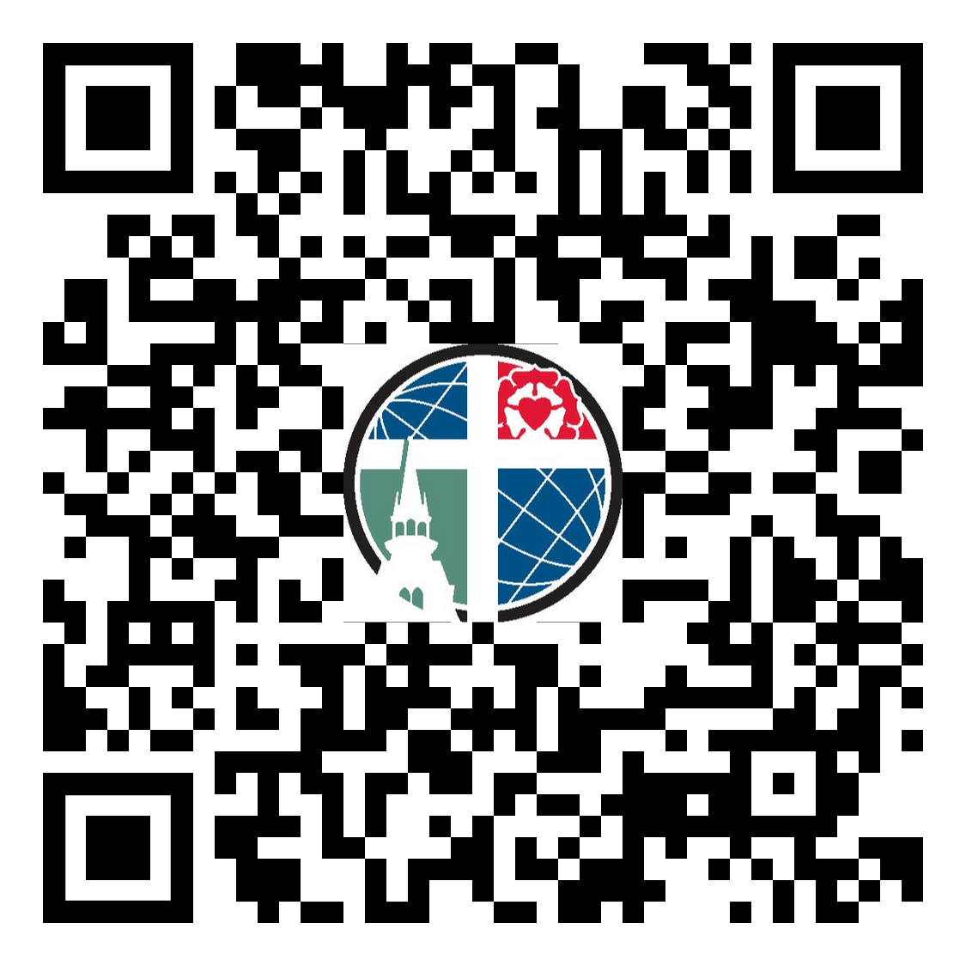
Would you help us
preserve Old Main
for future generations?
Would you help us
preserve Old Main
for future generations?
DON’T FORGET– Your donation will be matched dollar for dollar!
DON’T FORGET– Your donation will be matched dollar for dollar!

