Slide 1


Slide 2
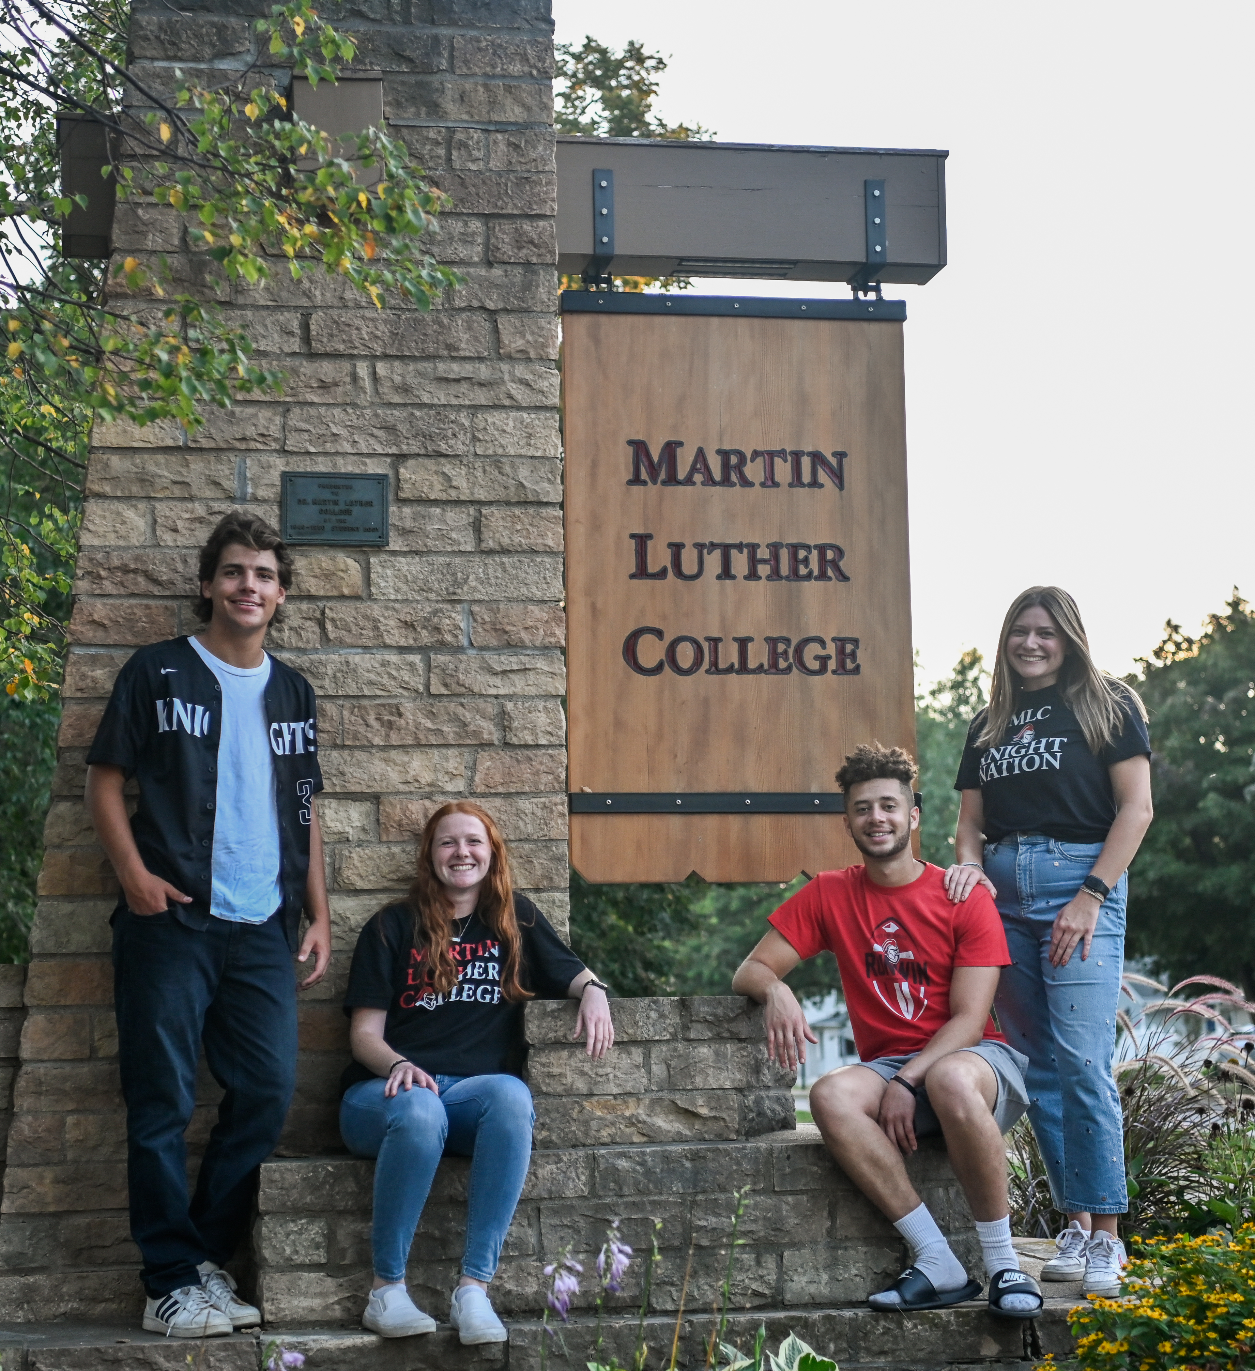

614 Students on Campus

Slide 3
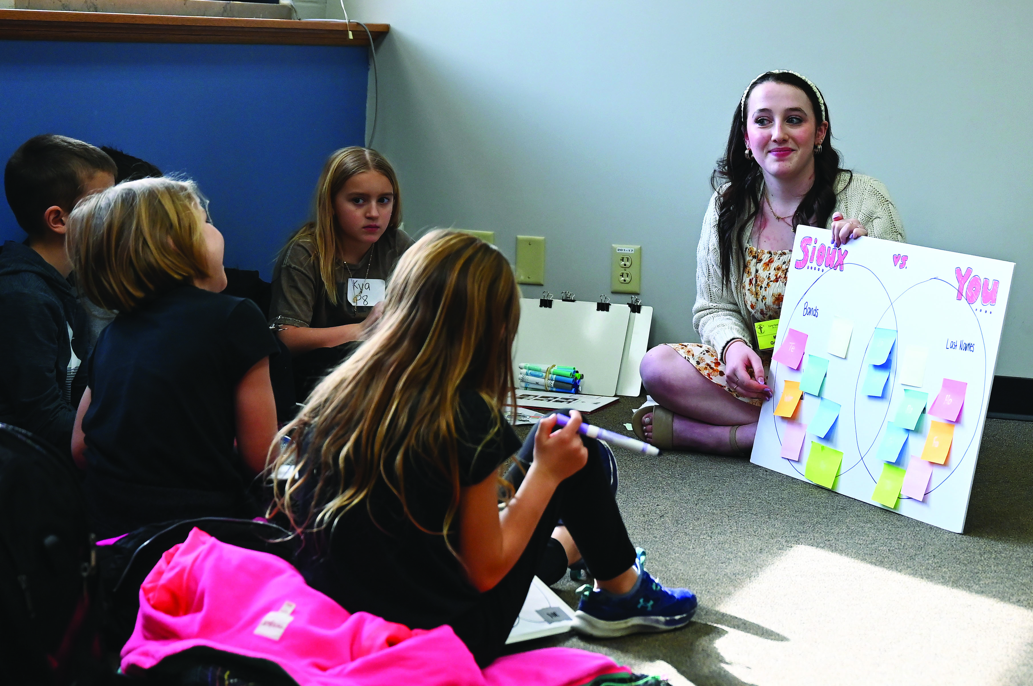
461 Education &
Staff Ministry Students

Slide 4
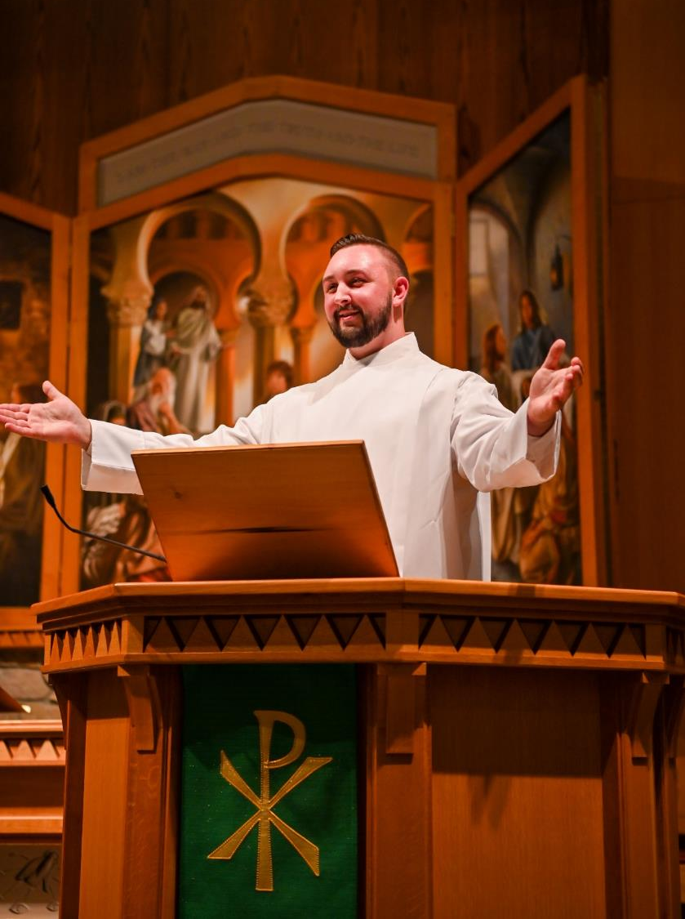
153
Preseminary
Students

Slide 5
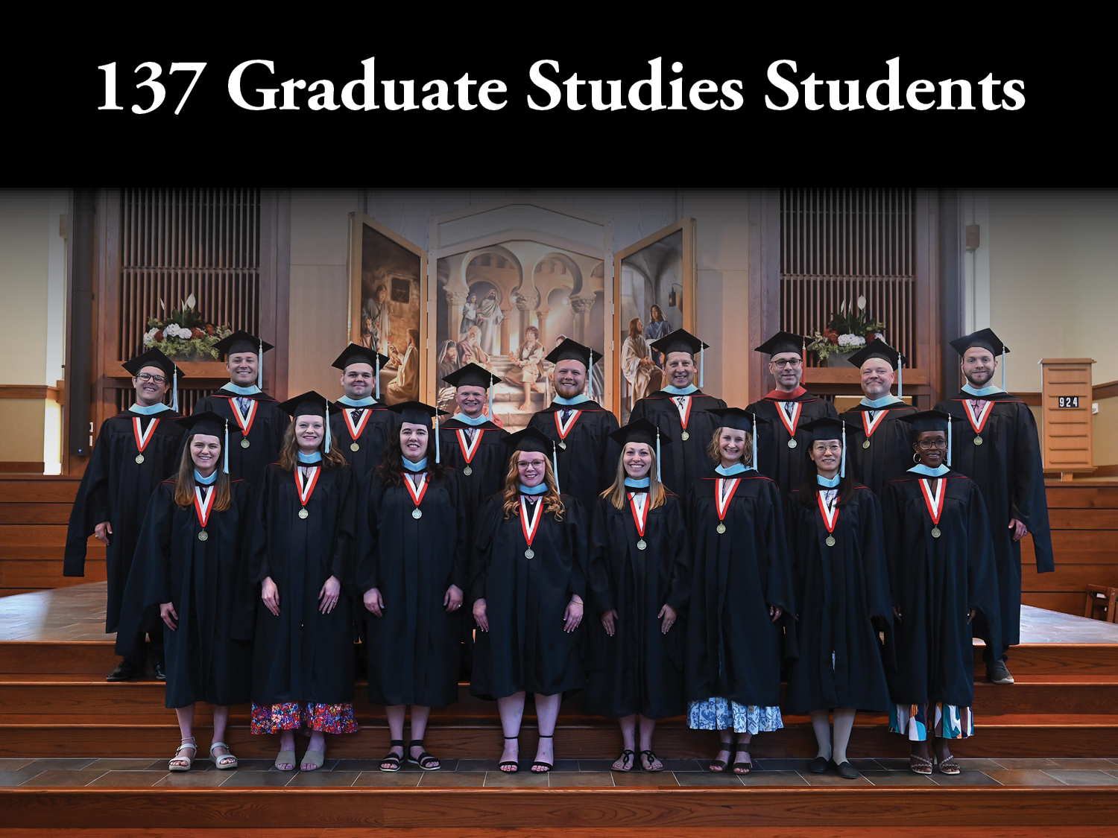

Slide 6
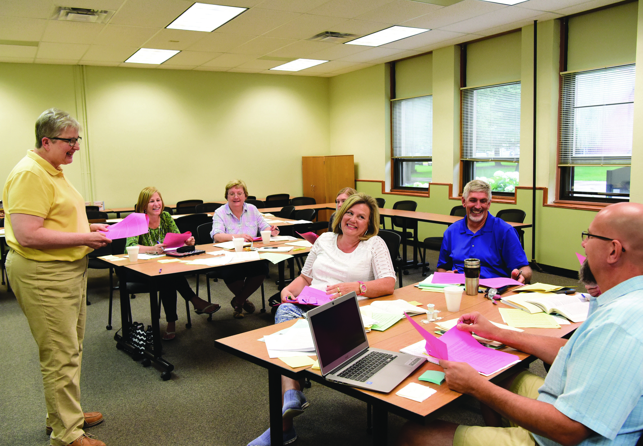
1,017 Continuing Education Students

Slide 7


Slide 8
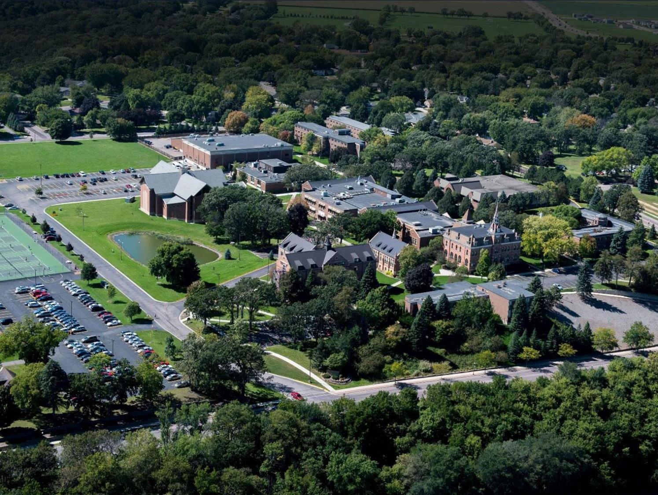

1,644 Total Students Served

Slide 9
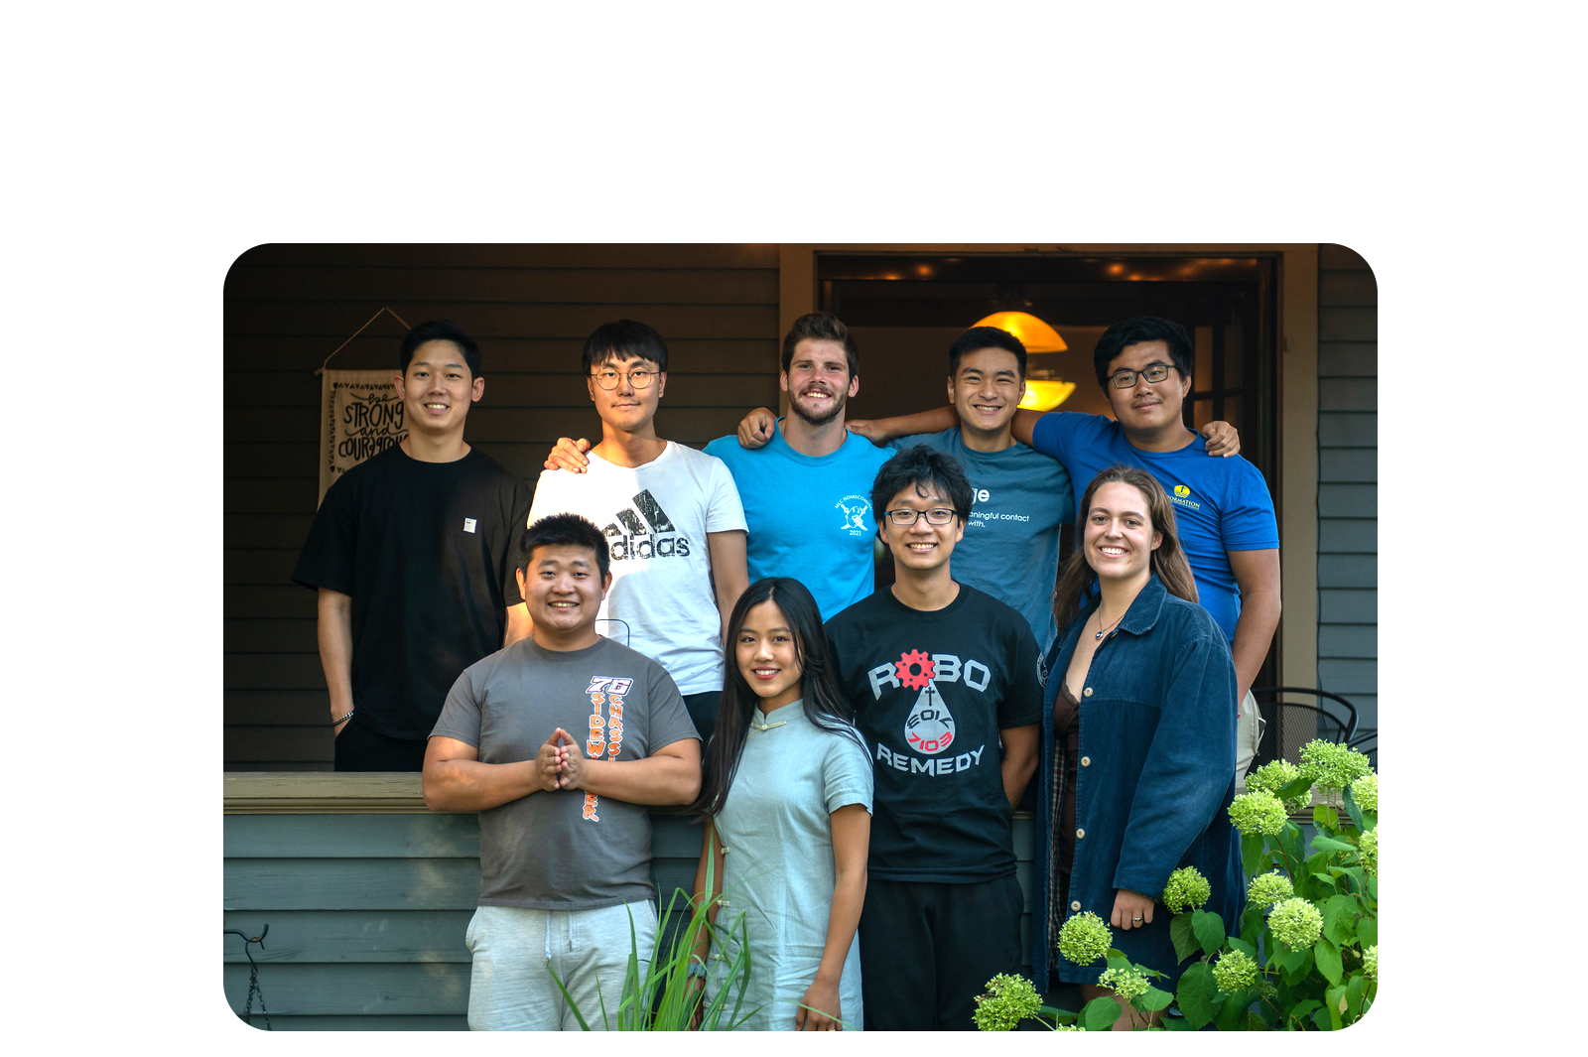
6 Countries & 27 States

Slide 10
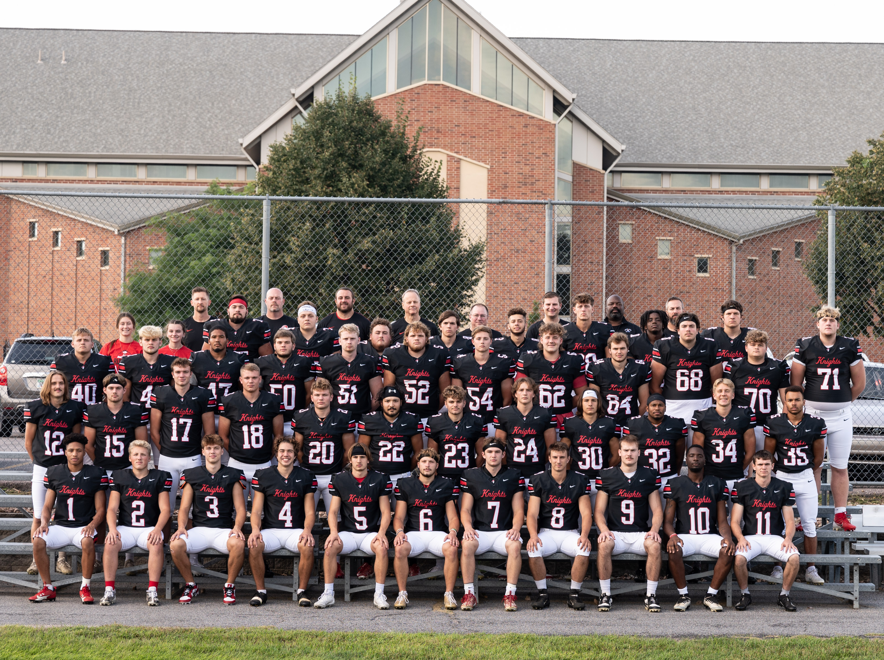
NCAA Division 3

Slide 11
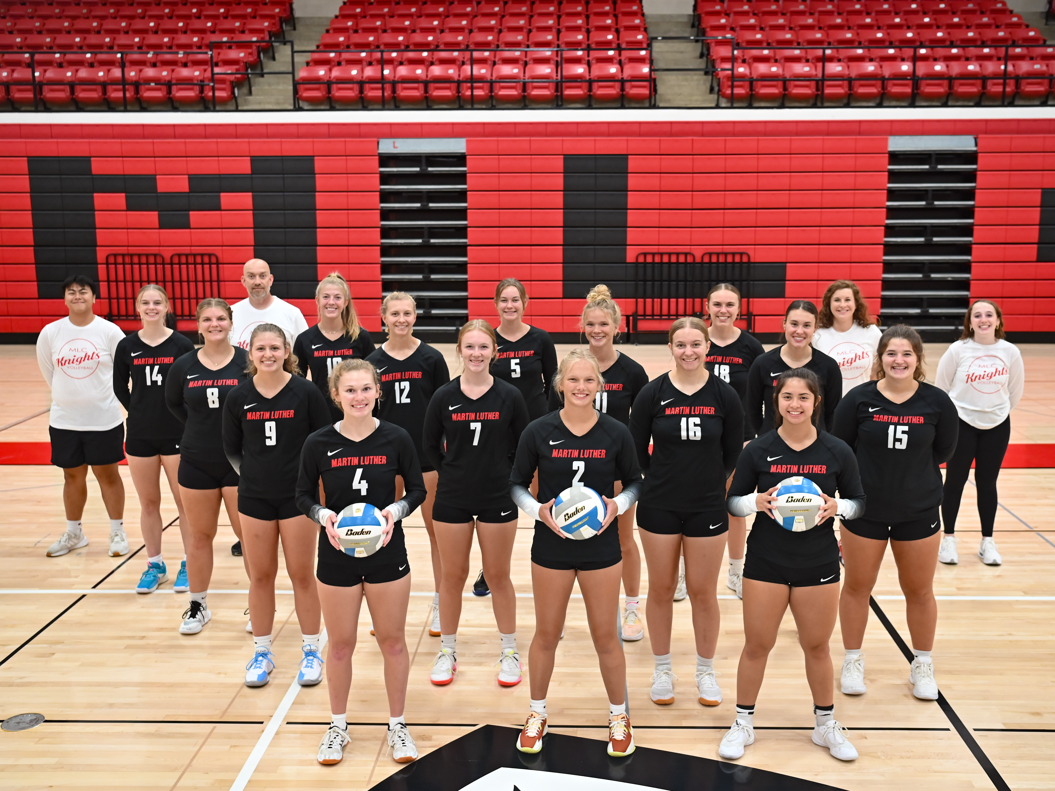
18 Intercollegiate Sports

Slide 12
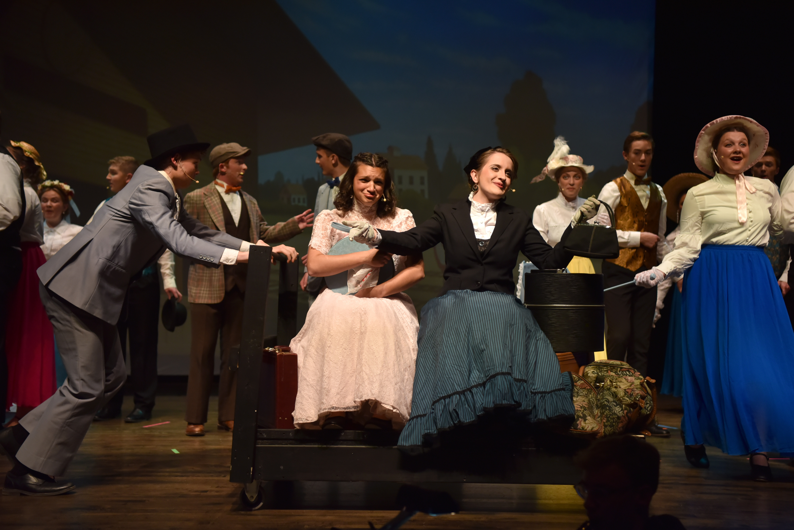
Four Dramatic Performances

Slide 13


Slide 14
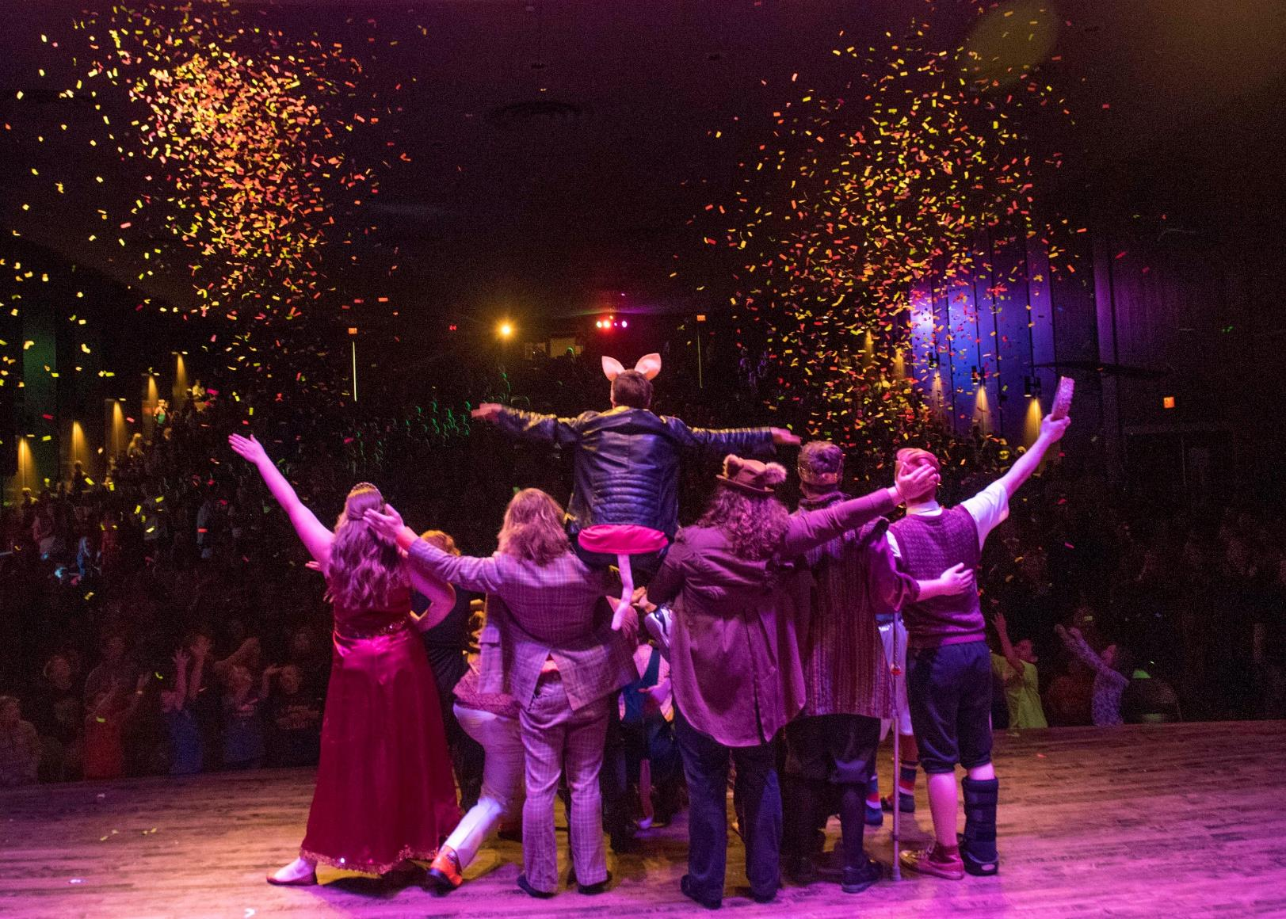
5,000+
Attend Children’s Theatre!

Slide 15
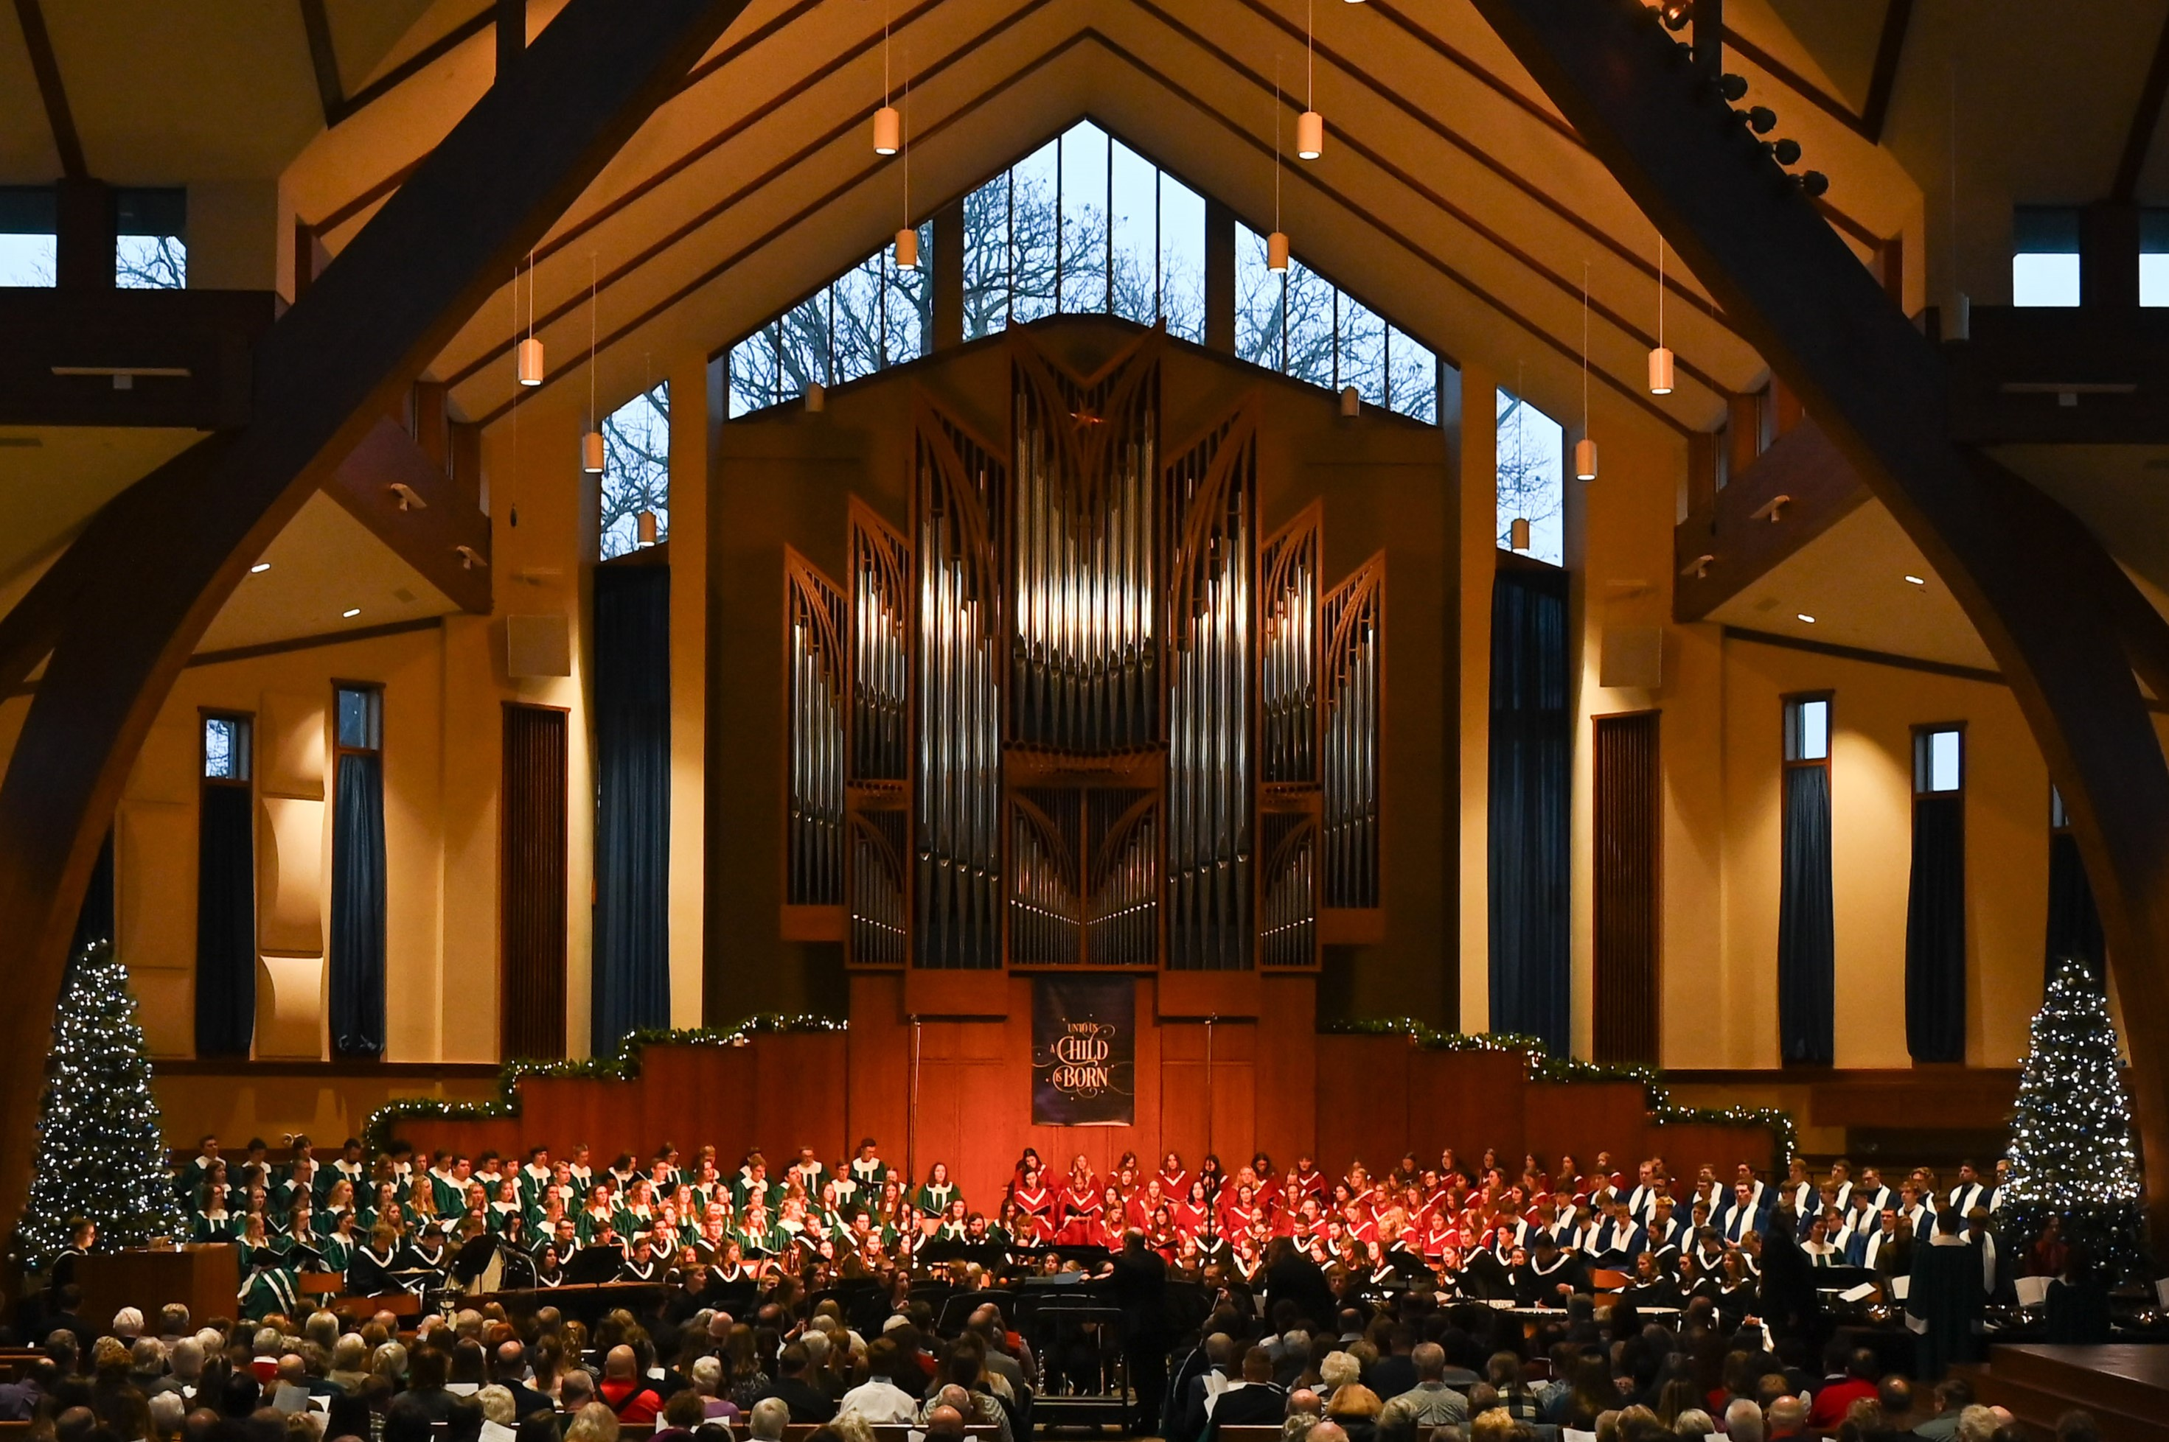
Four Choirs

Slide 16
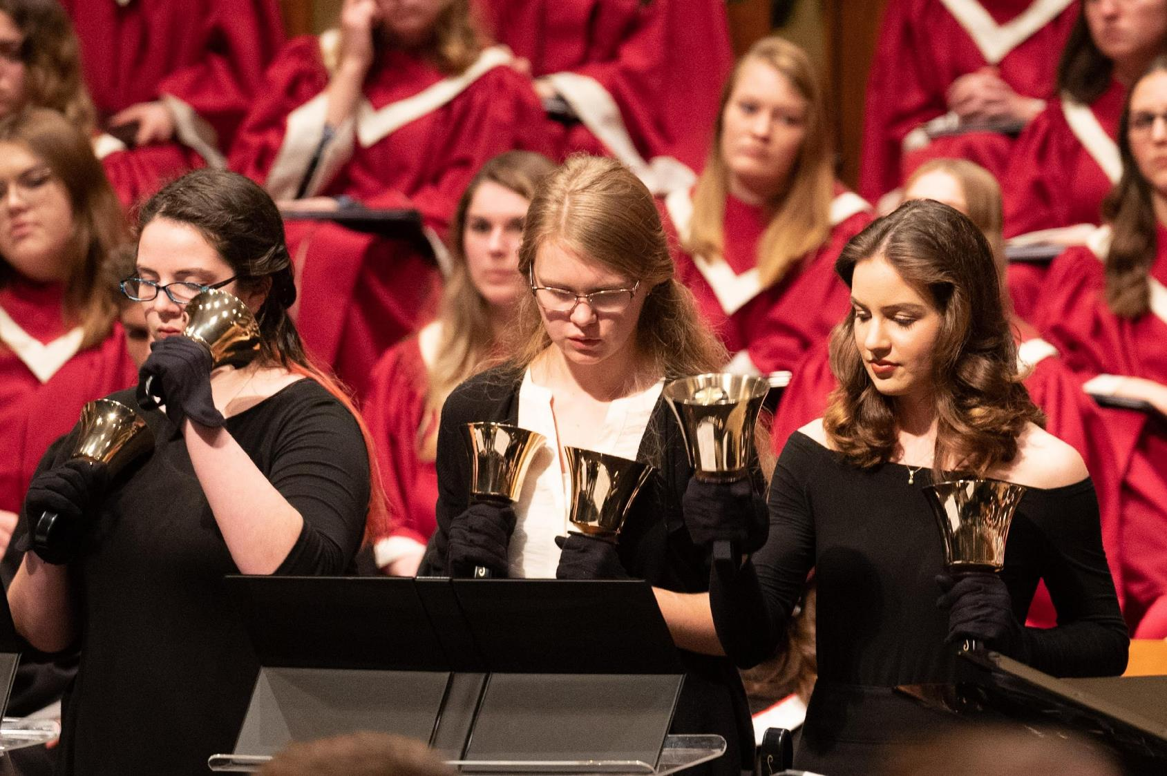
Handbell Choir

Slide 17
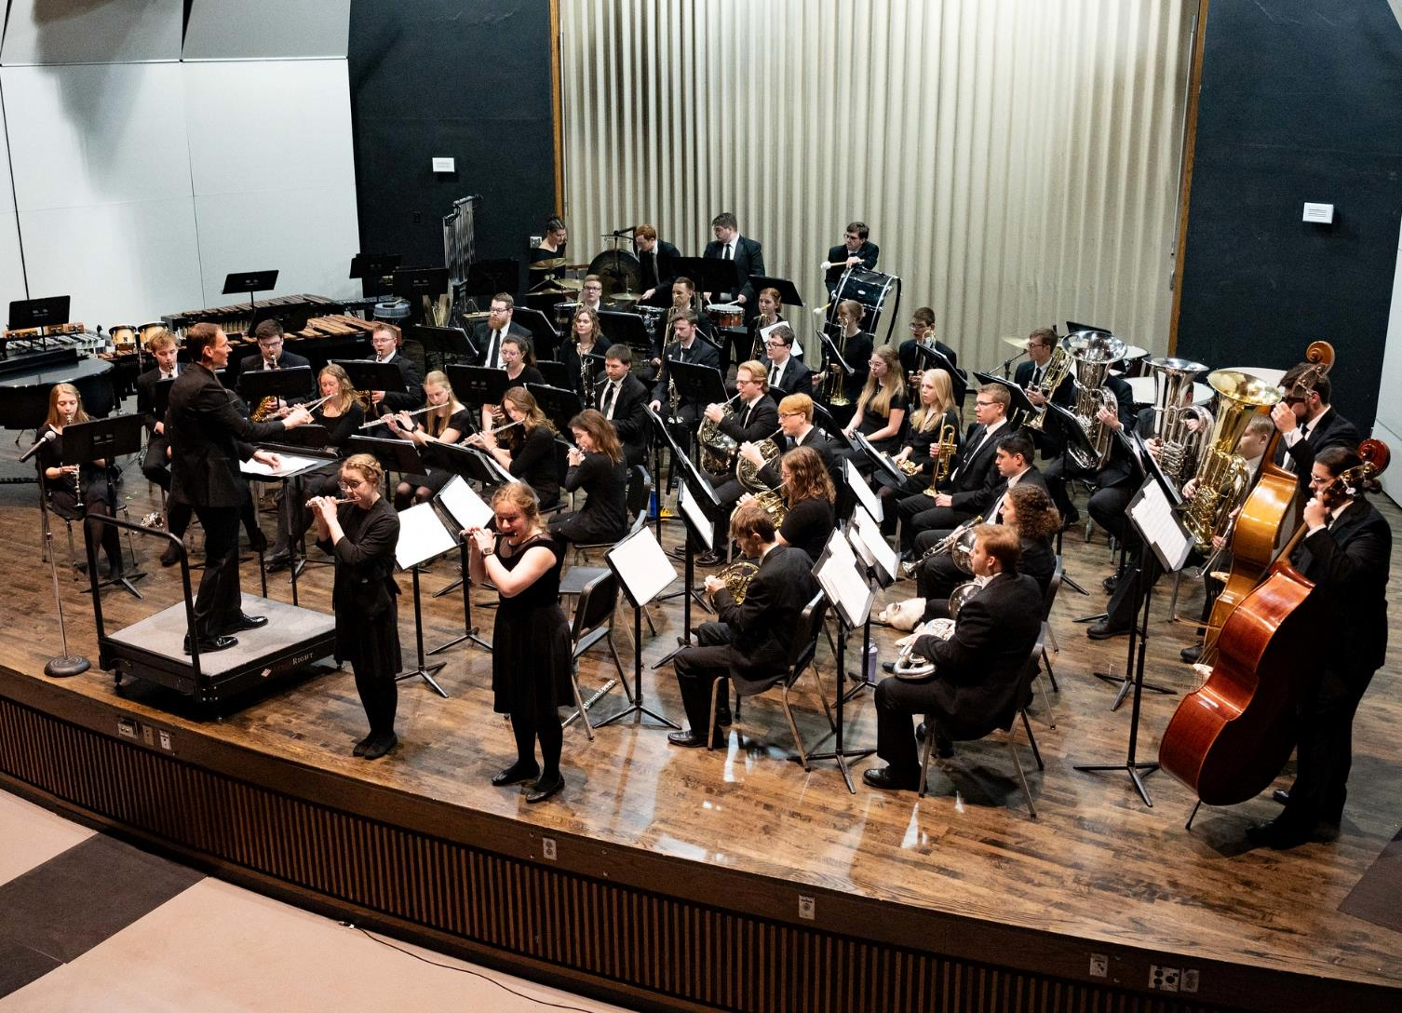
Touring Wind Symphony

Slide 18
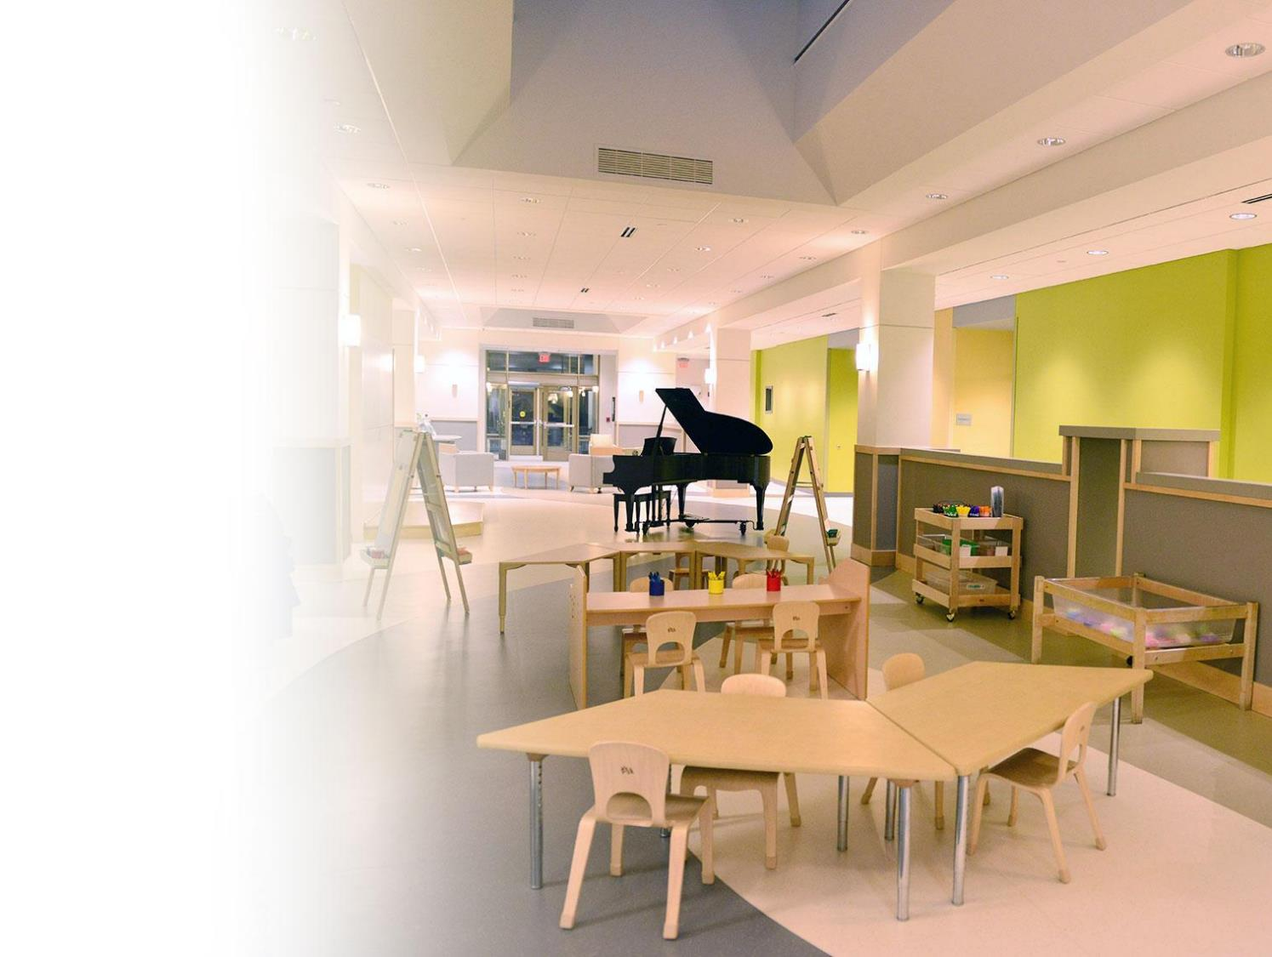
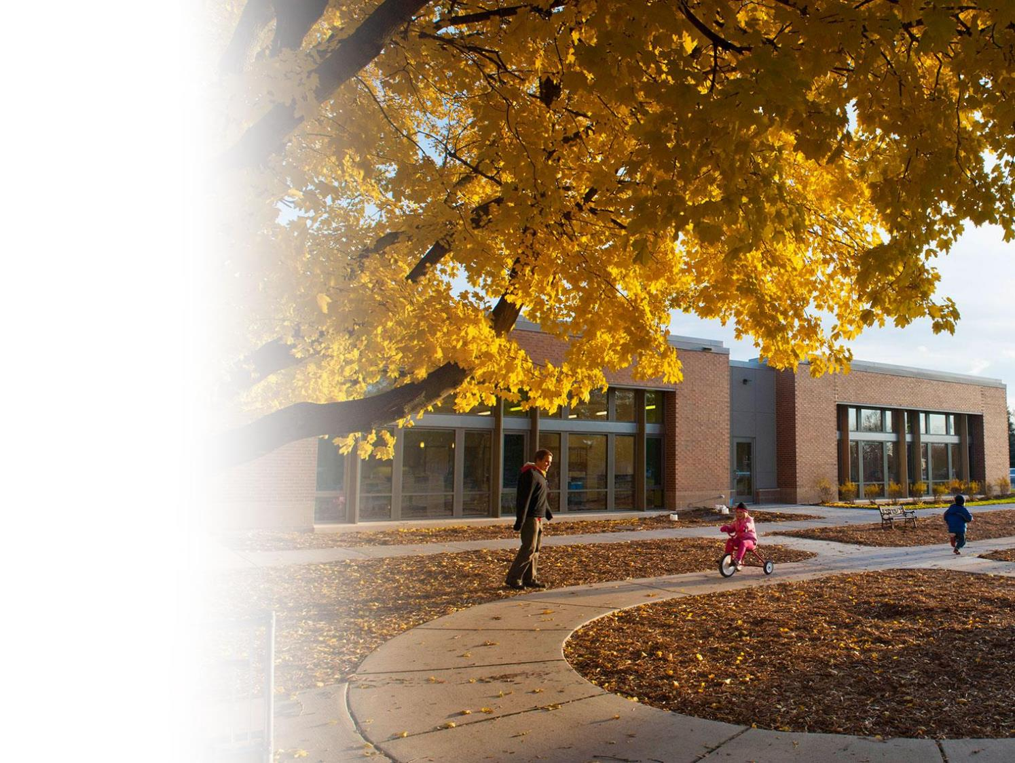
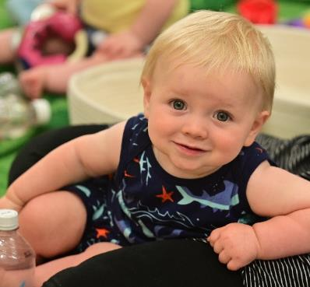
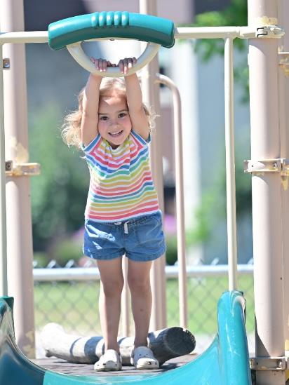
Early Childhood
Learning Center

Slide 19
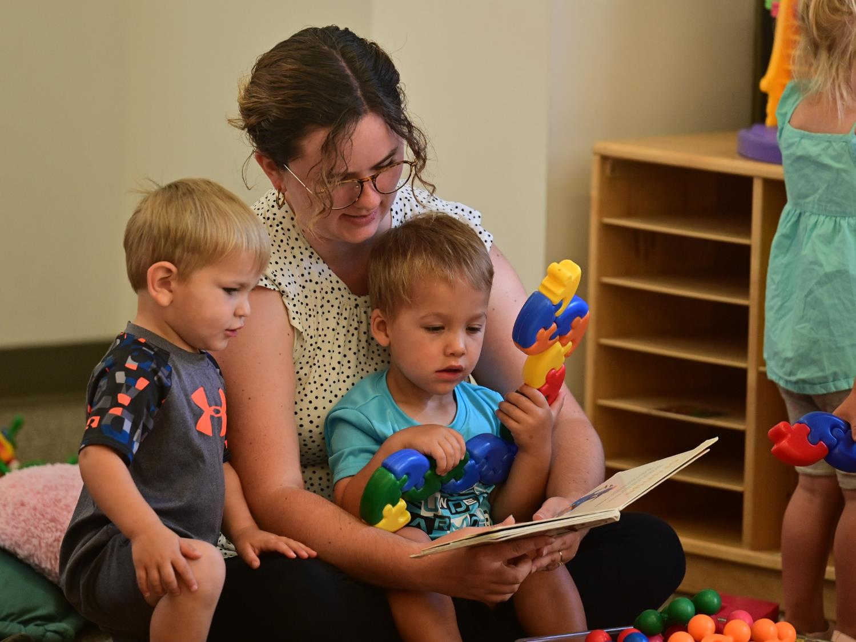

Slide 20
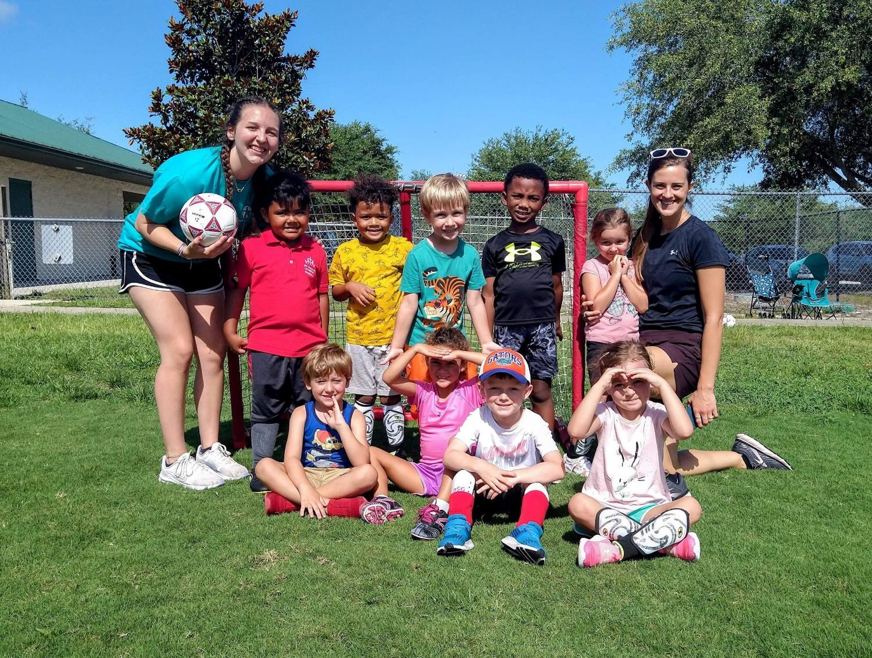
Hands-On Learning

Slide 21
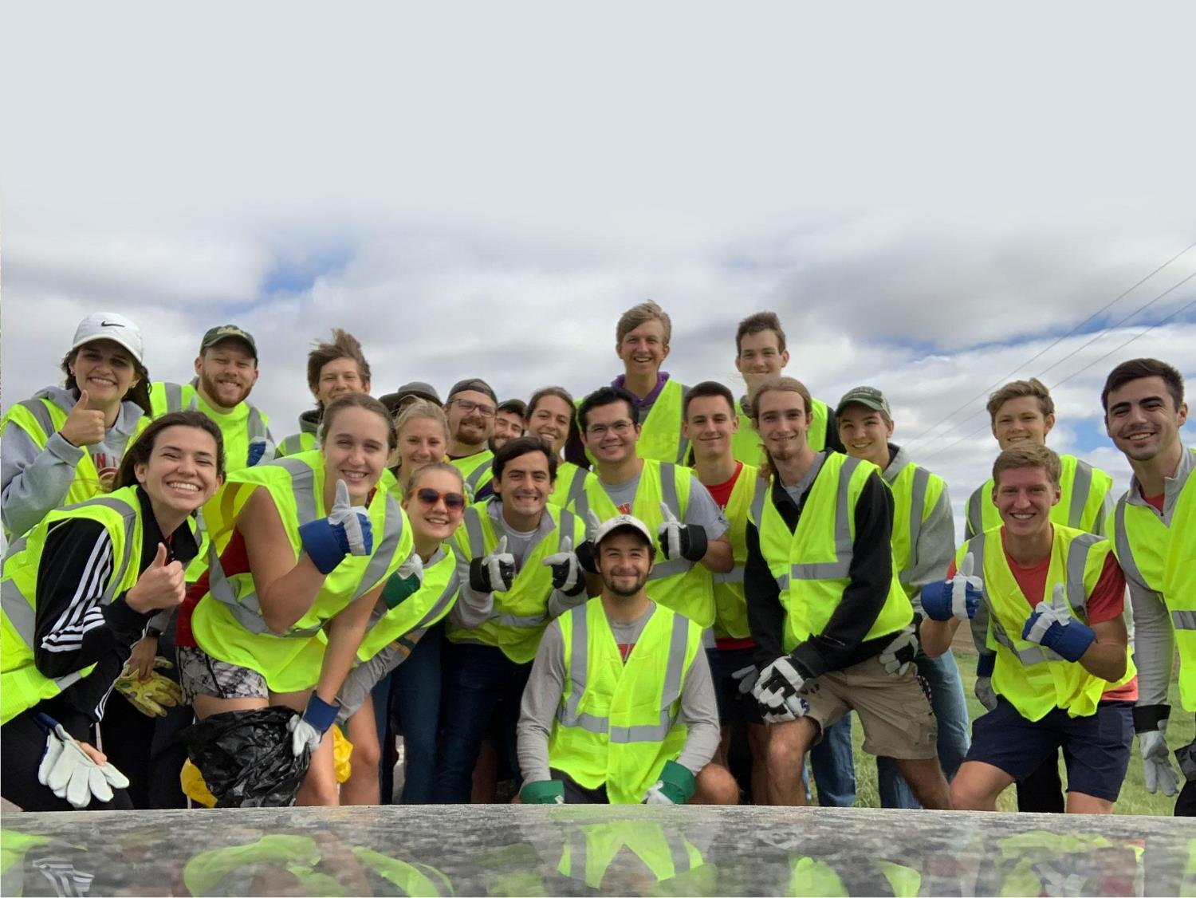
Active Student Groups

Slide 22
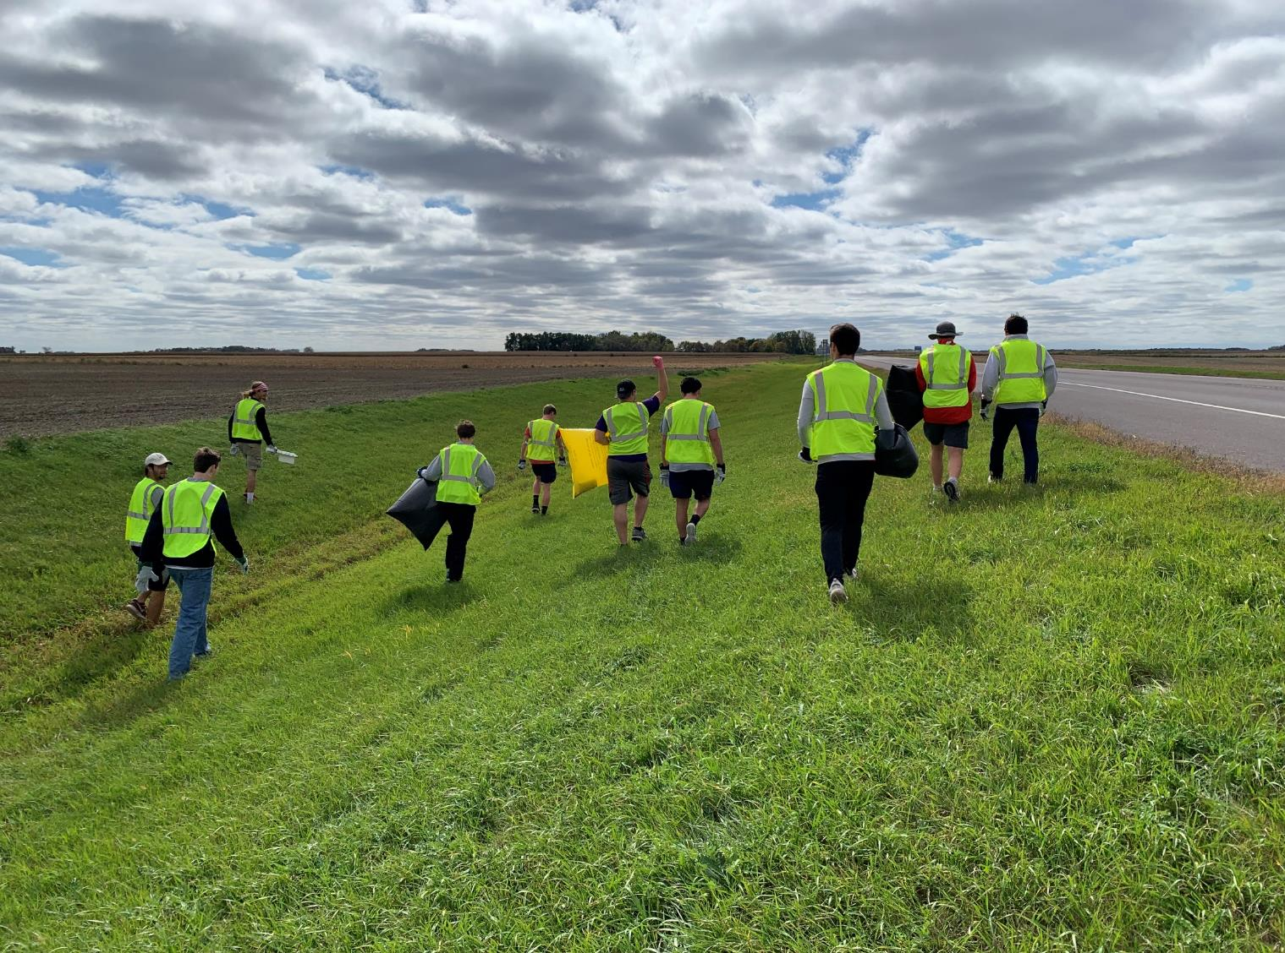

Slide 23
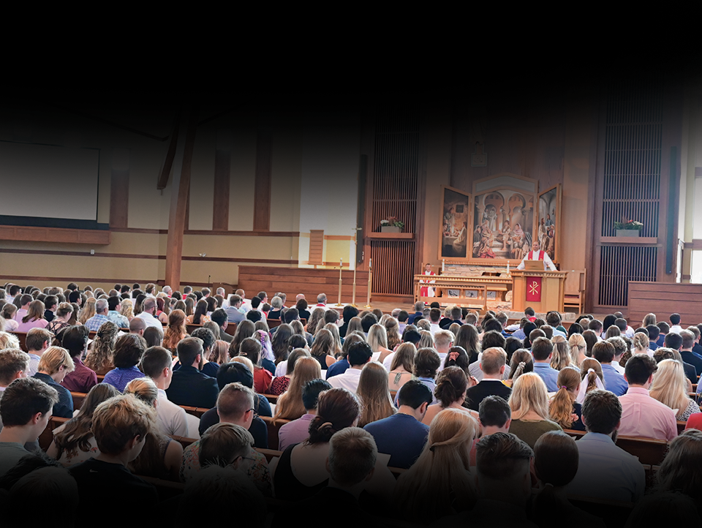
Daily Worship
Notes:
Talk about what students get to do on campus…
Most important: Worship in chapel twice (to 3x a day!!!)
God’s Word is the center of our campus in class and out.

Slide 24
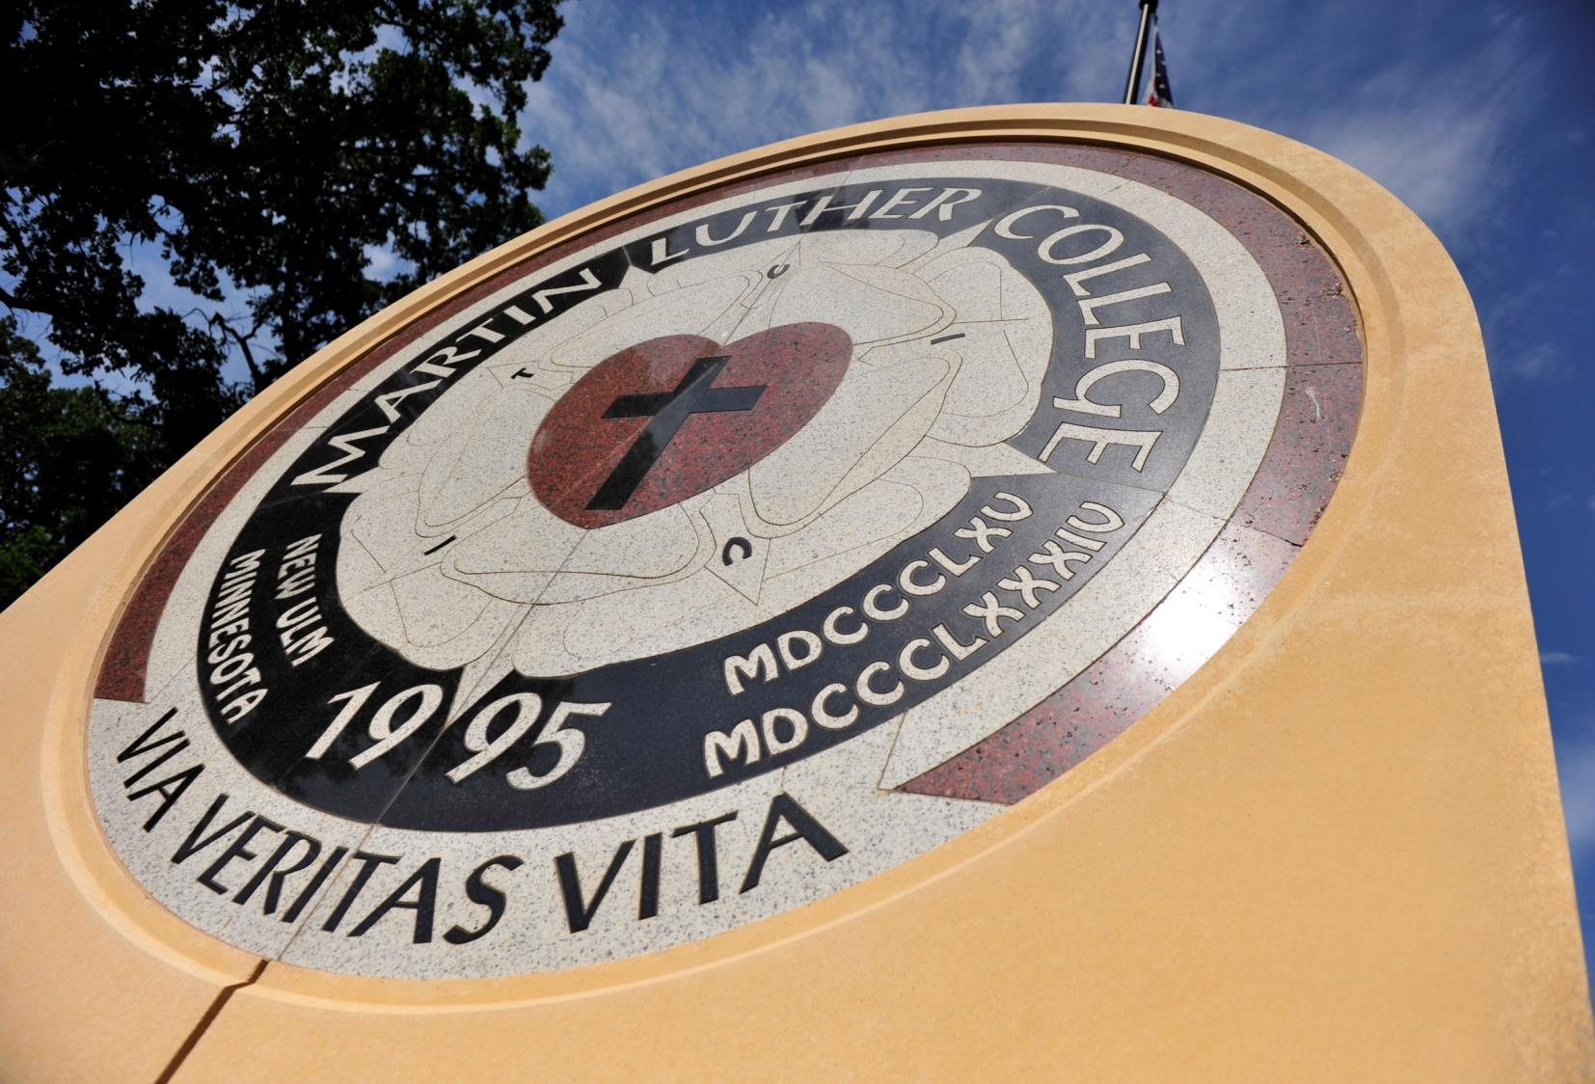

Slide 25
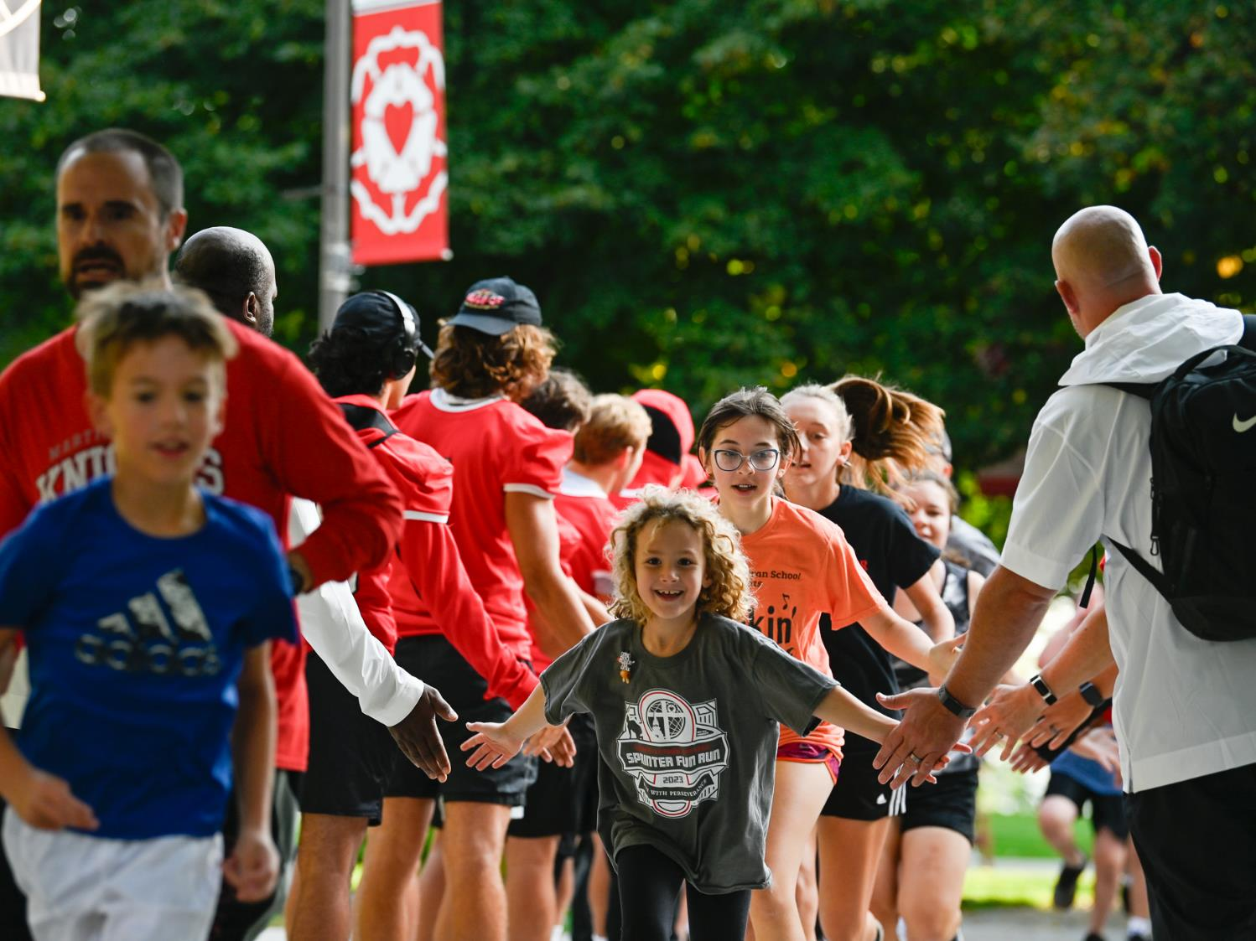
Homecoming

Slide 26
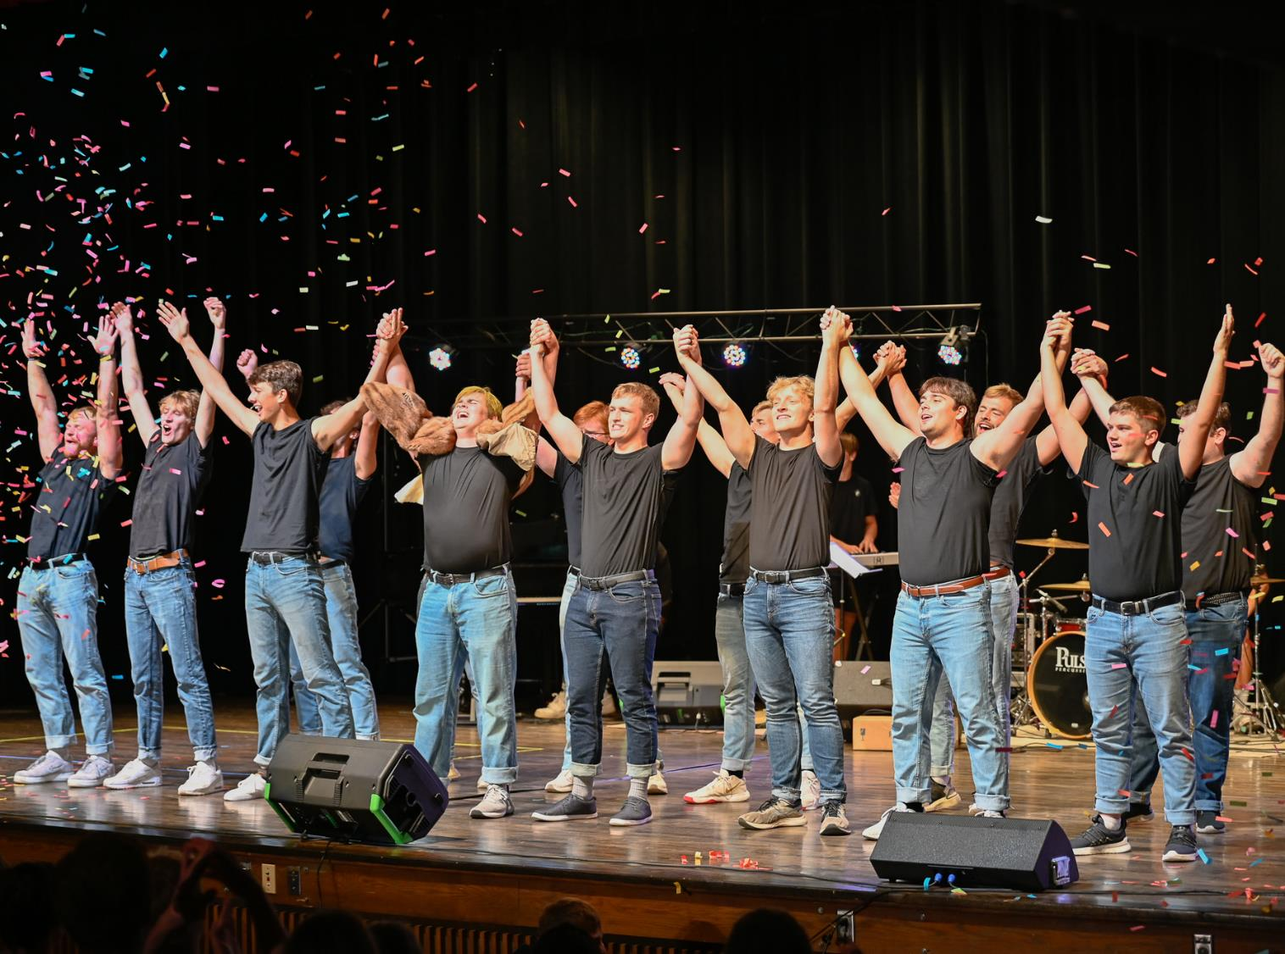

Slide 27
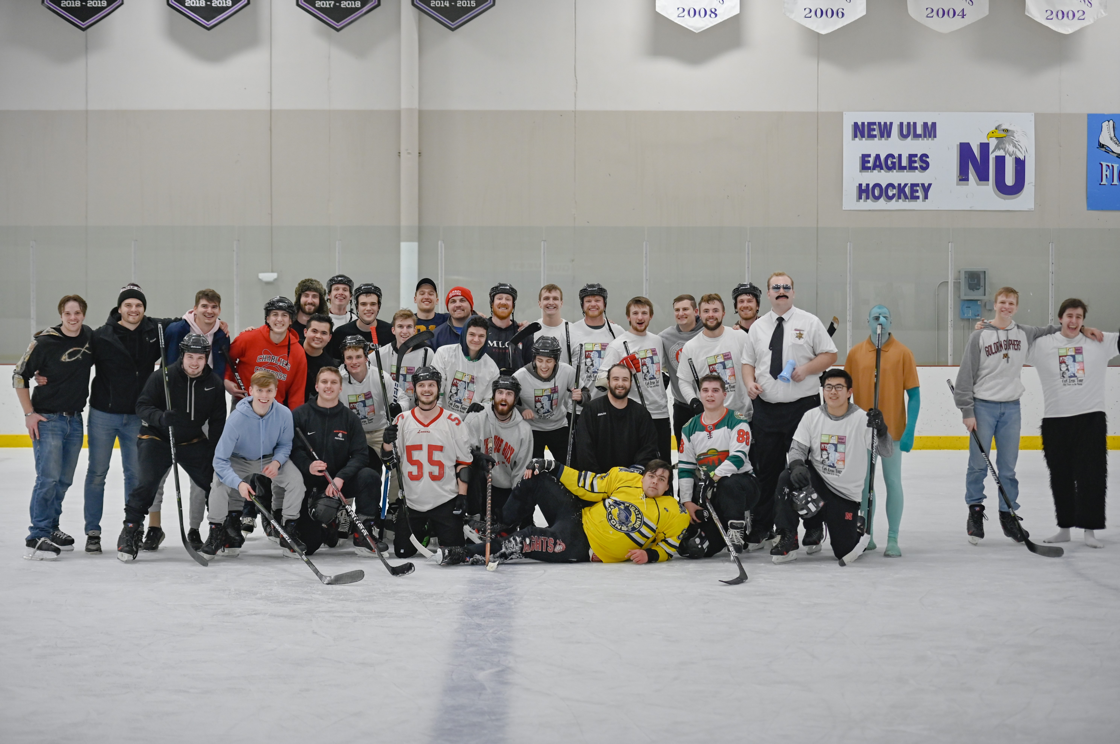
Winter Carnival

Slide 28
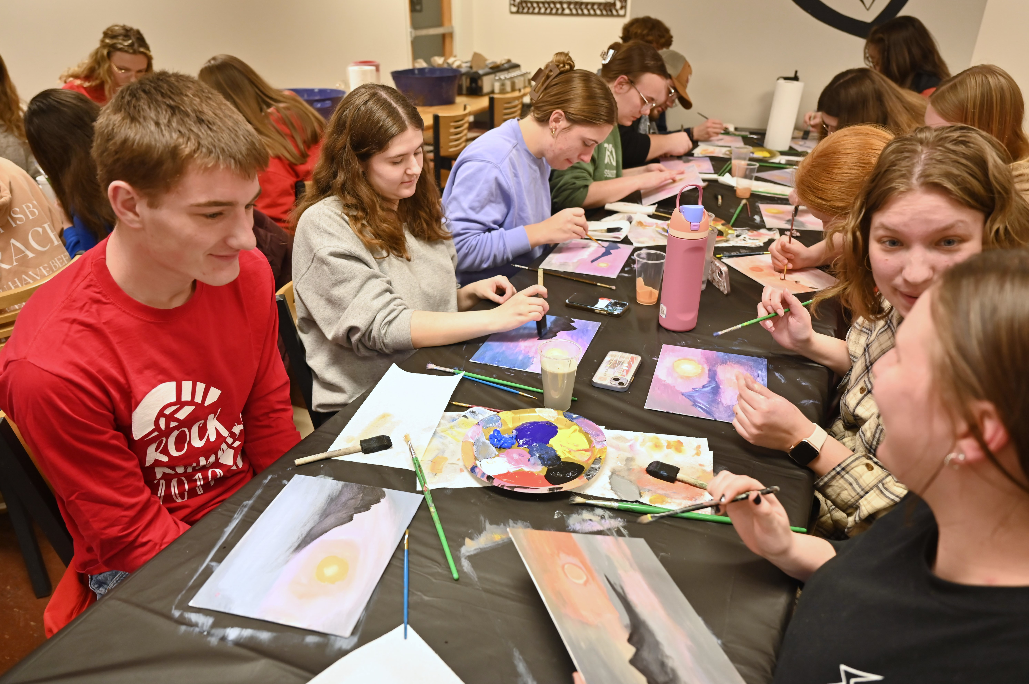

Slide 29
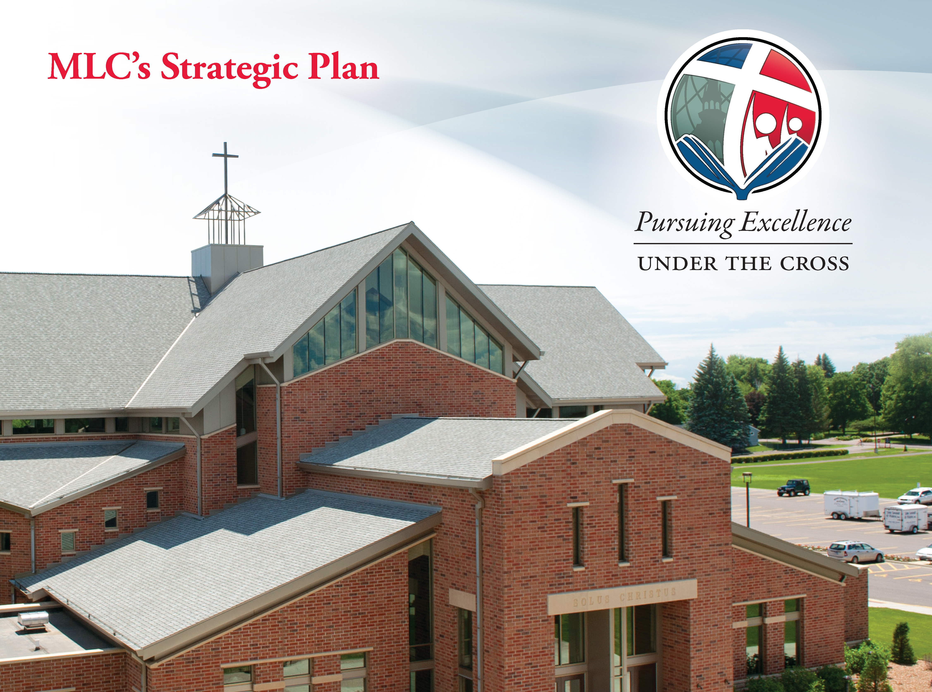

Slide 30
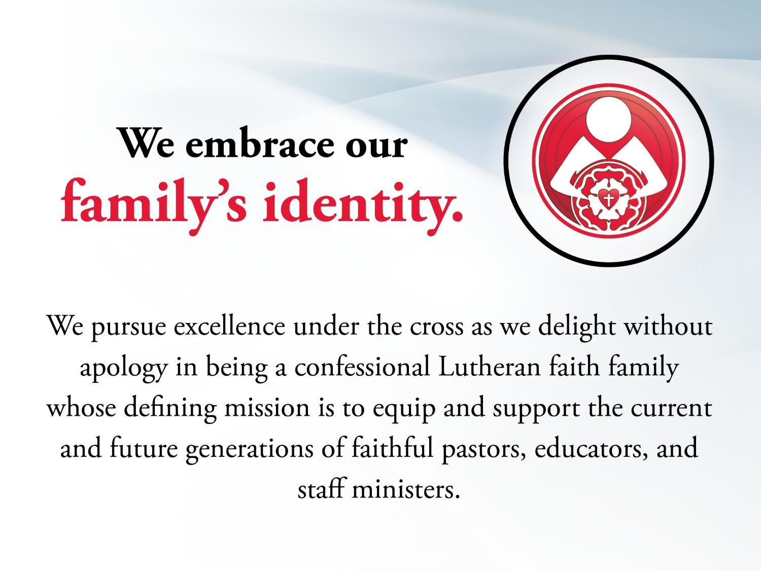

Slide 31


Slide 32


Slide 33


Slide 34
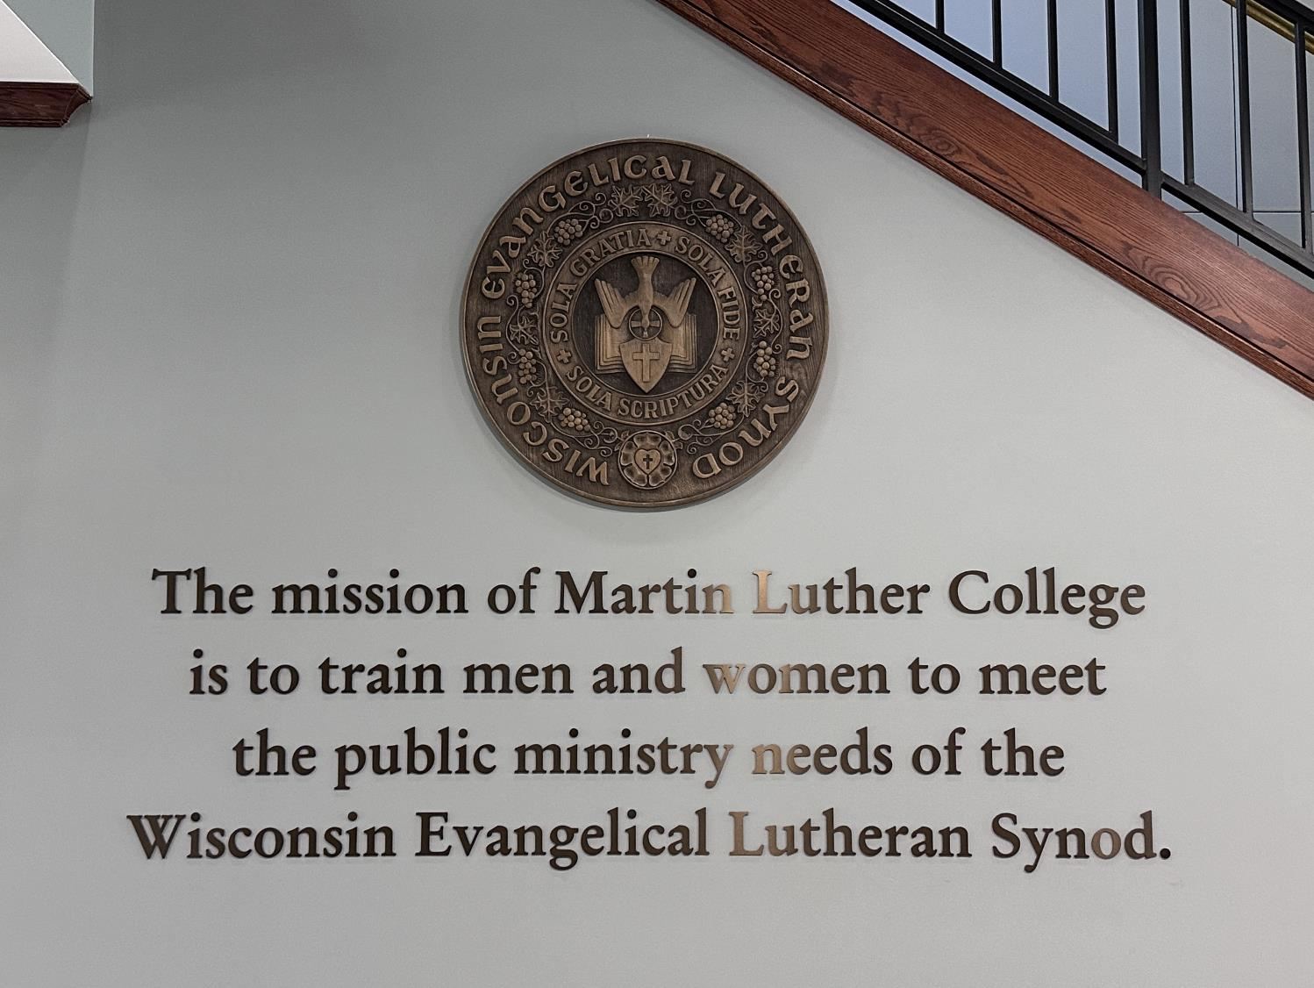

Slide 35
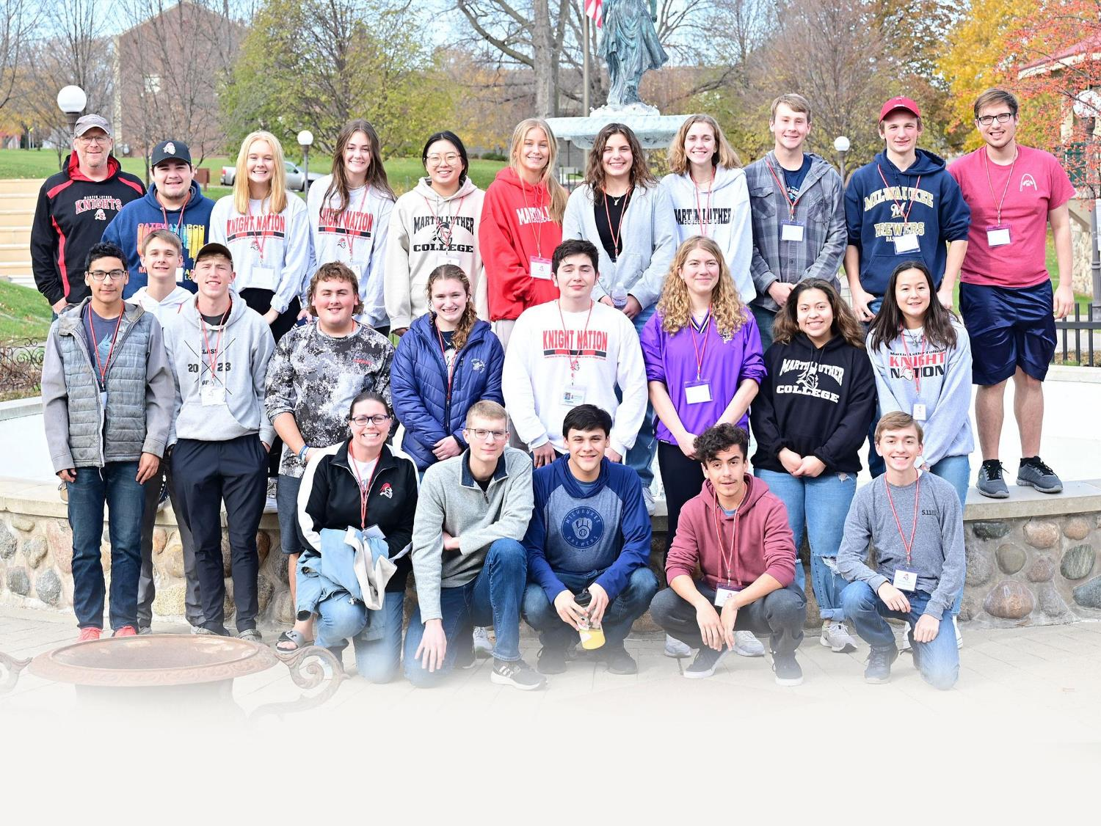
We love welcoming
high school visitors

Slide 36
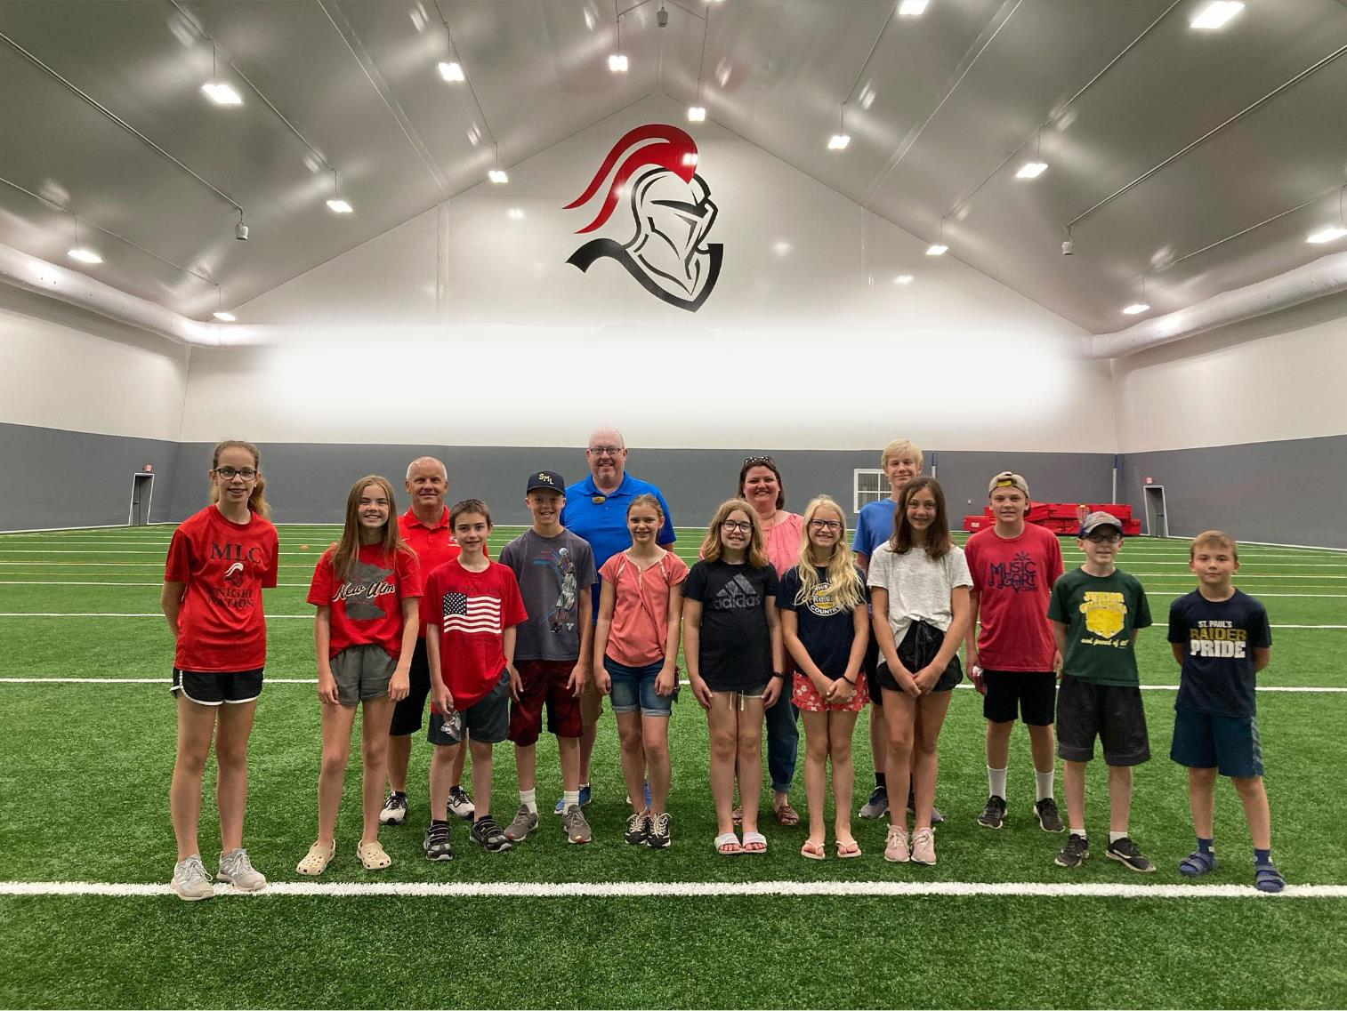
Elementary school groups

Slide 37
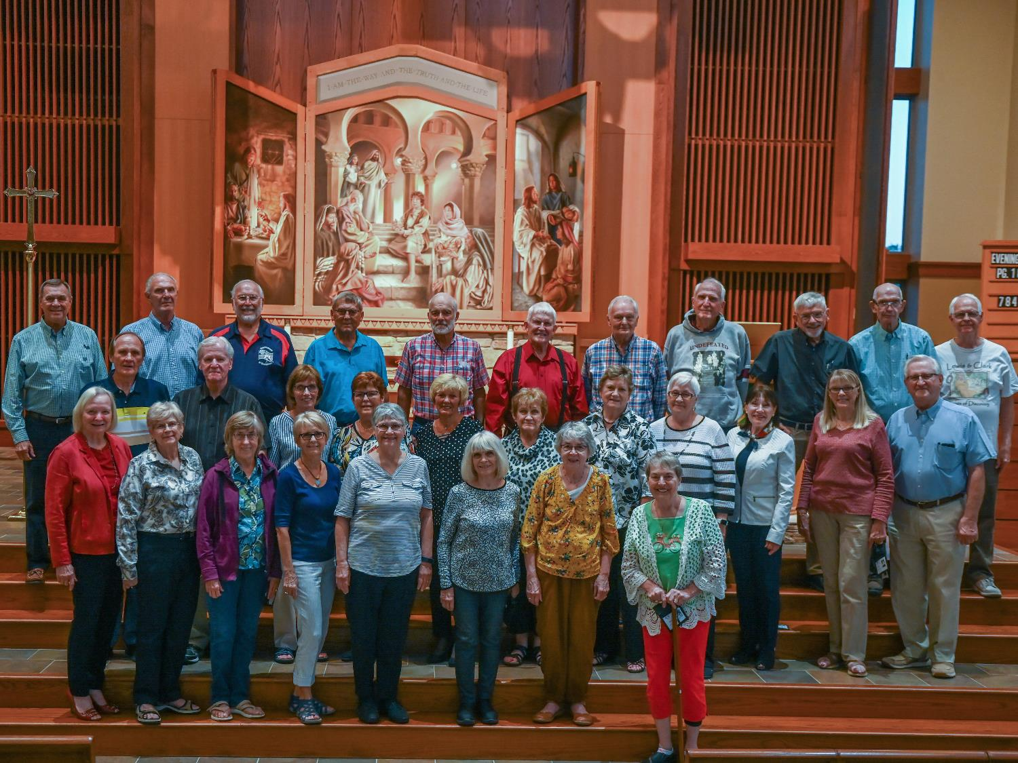
Reunion Groups

Slide 38
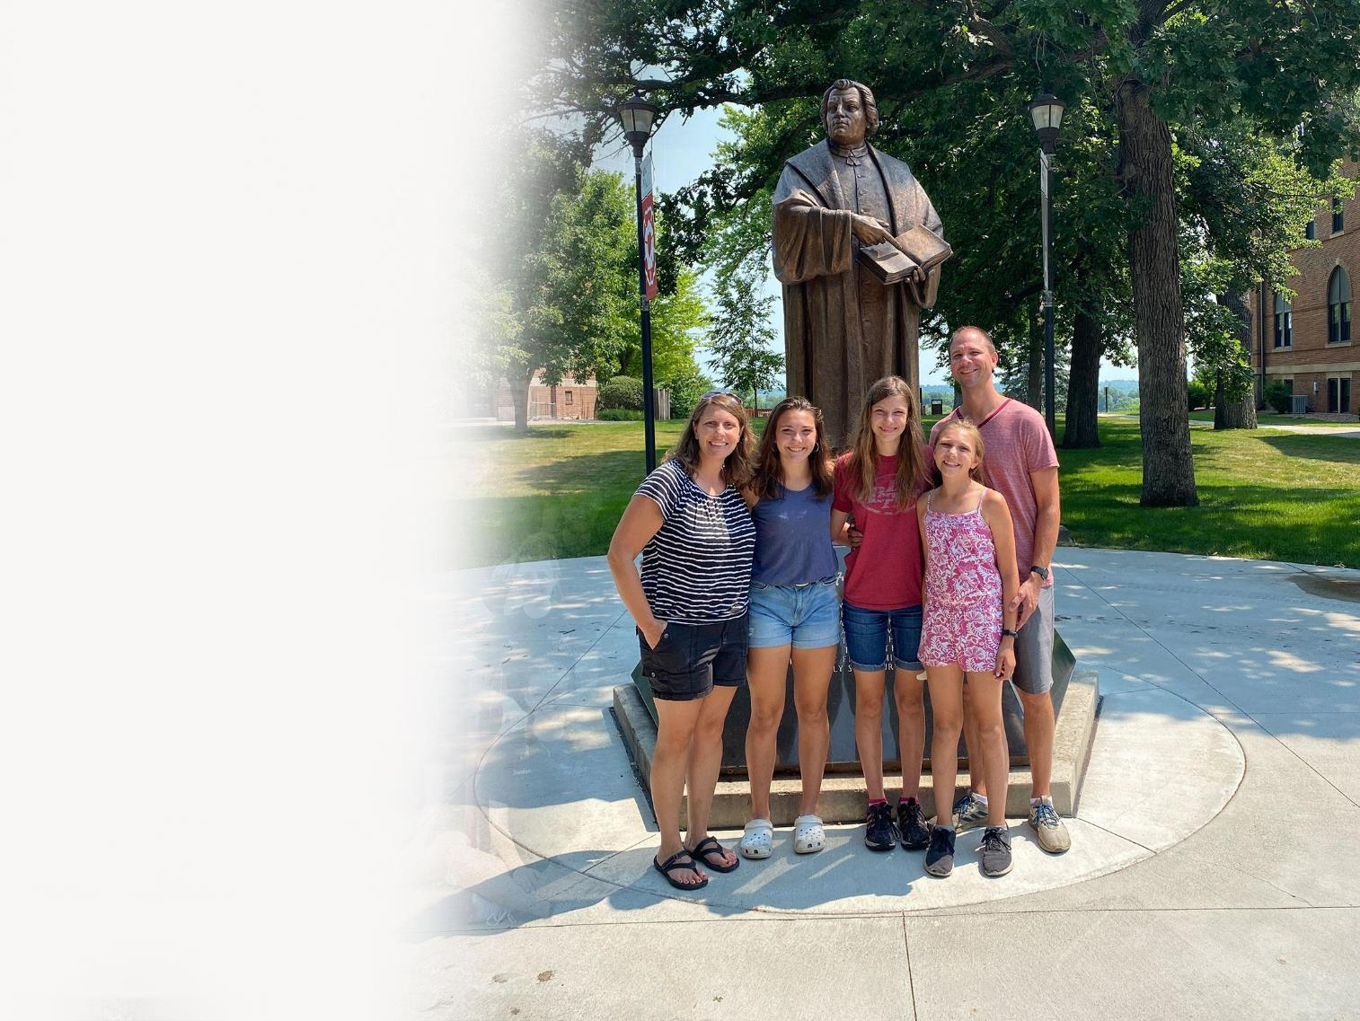
Families

Slide 39
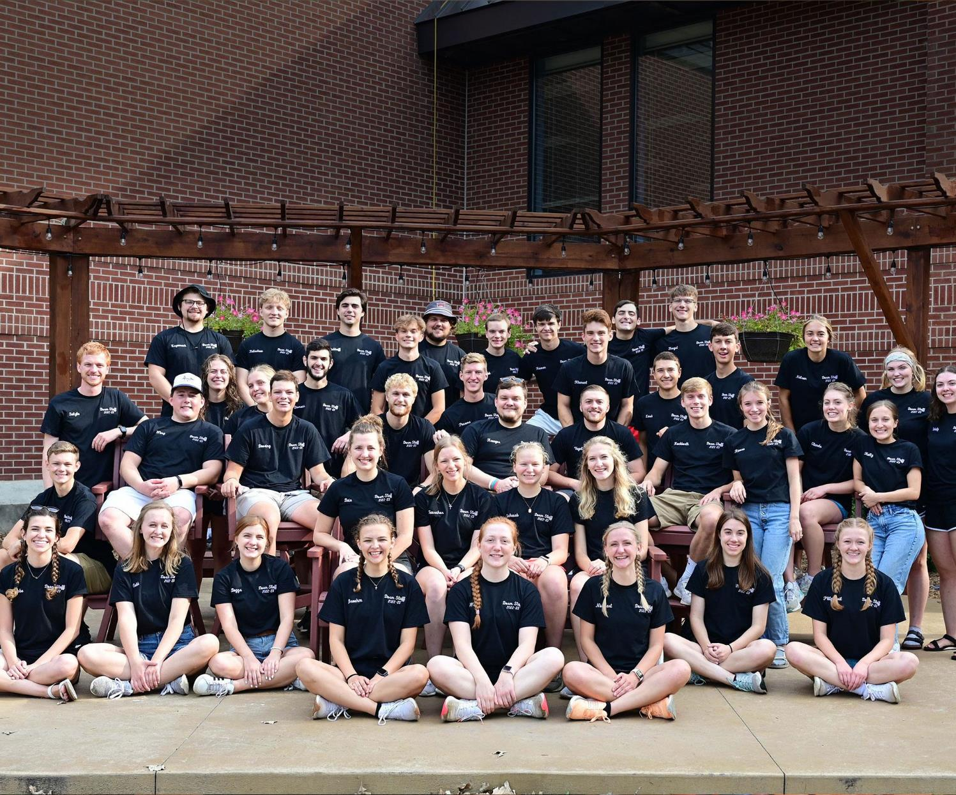
Come see us anytime

Slide 40
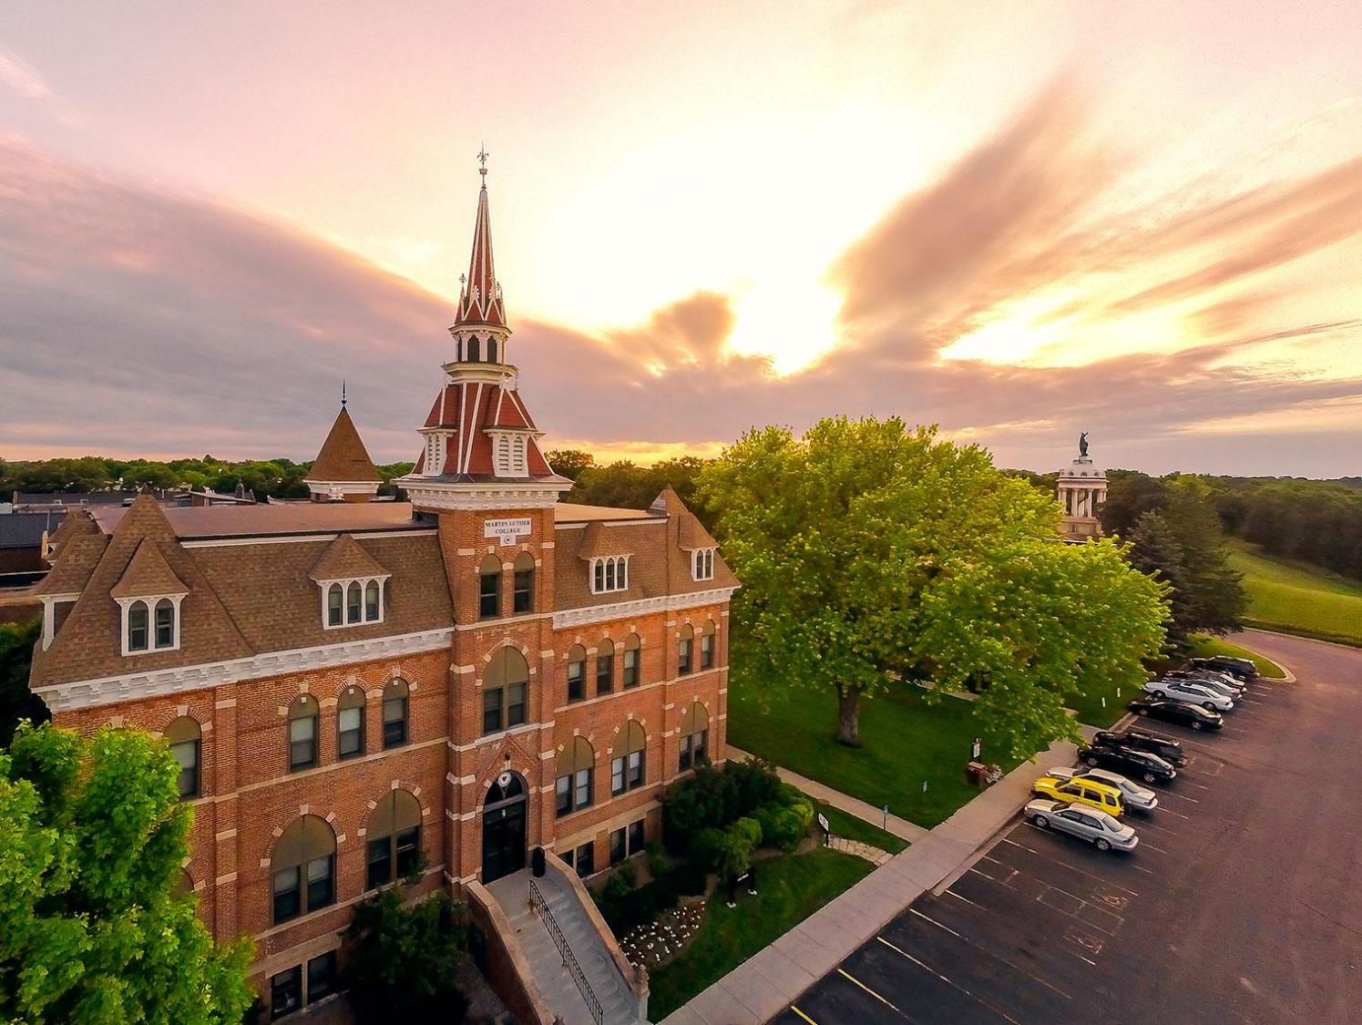

Slide 41

Notes:
I wanted to be in the ministry, and the place to go was Martin Luther College.

