Slide 3
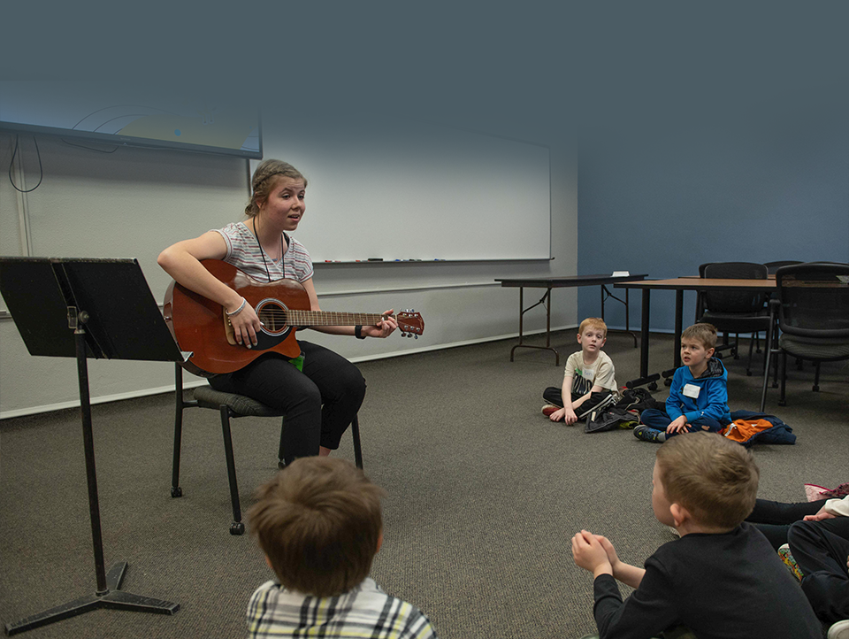
465 Education & Staff Ministry Students

Slide 4
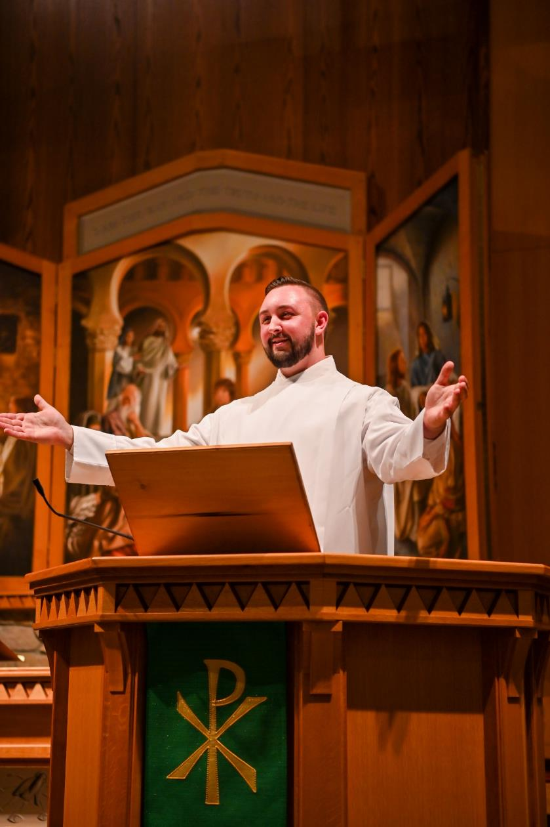
155
Preseminary
Students

Slide 6
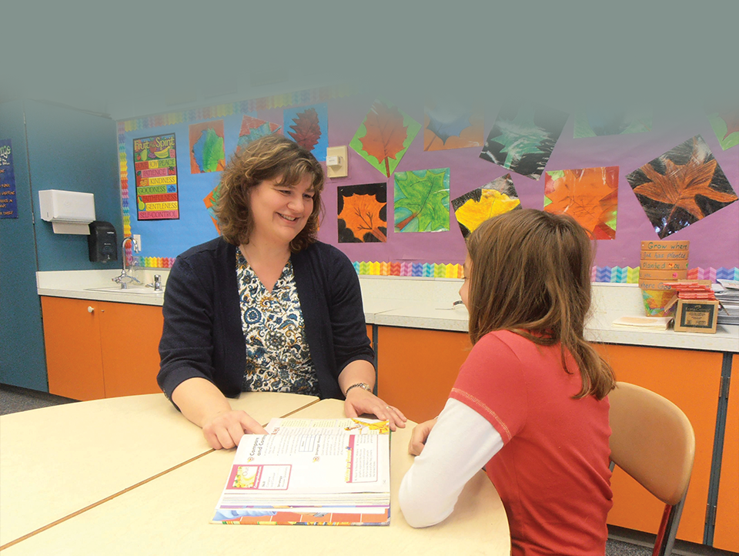
1,145 Continuing Education Students

Slide 7
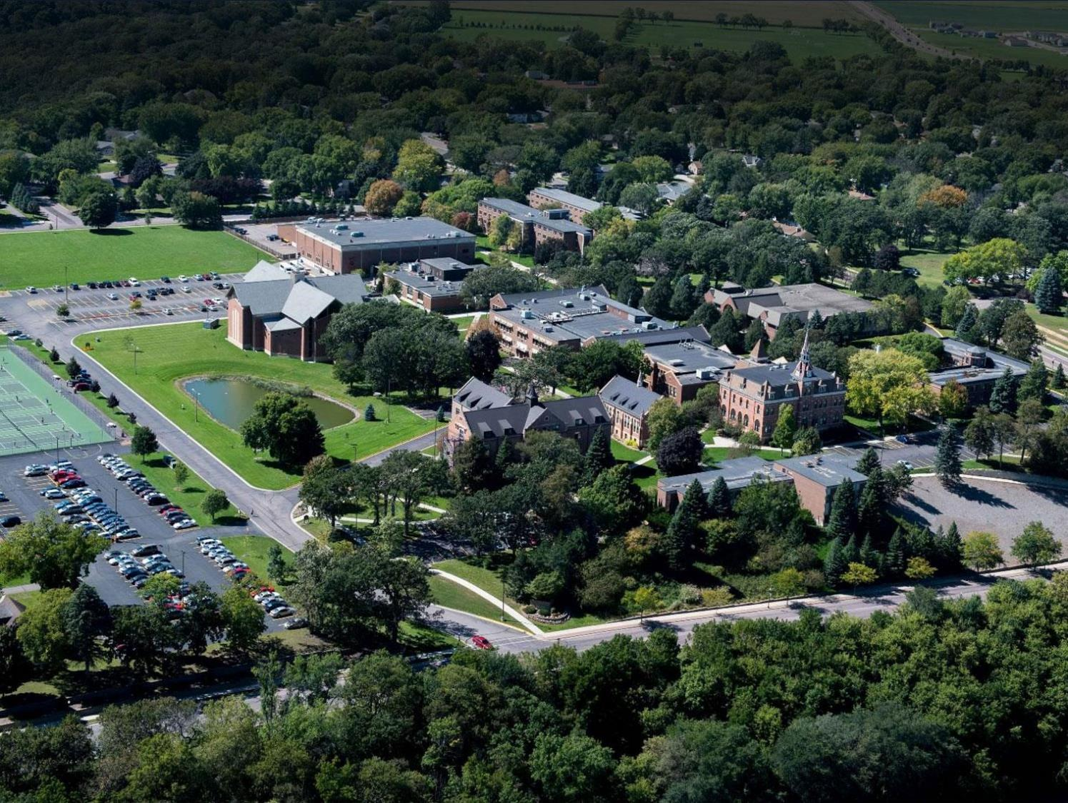
1,772 Total Students Served

Slide 8
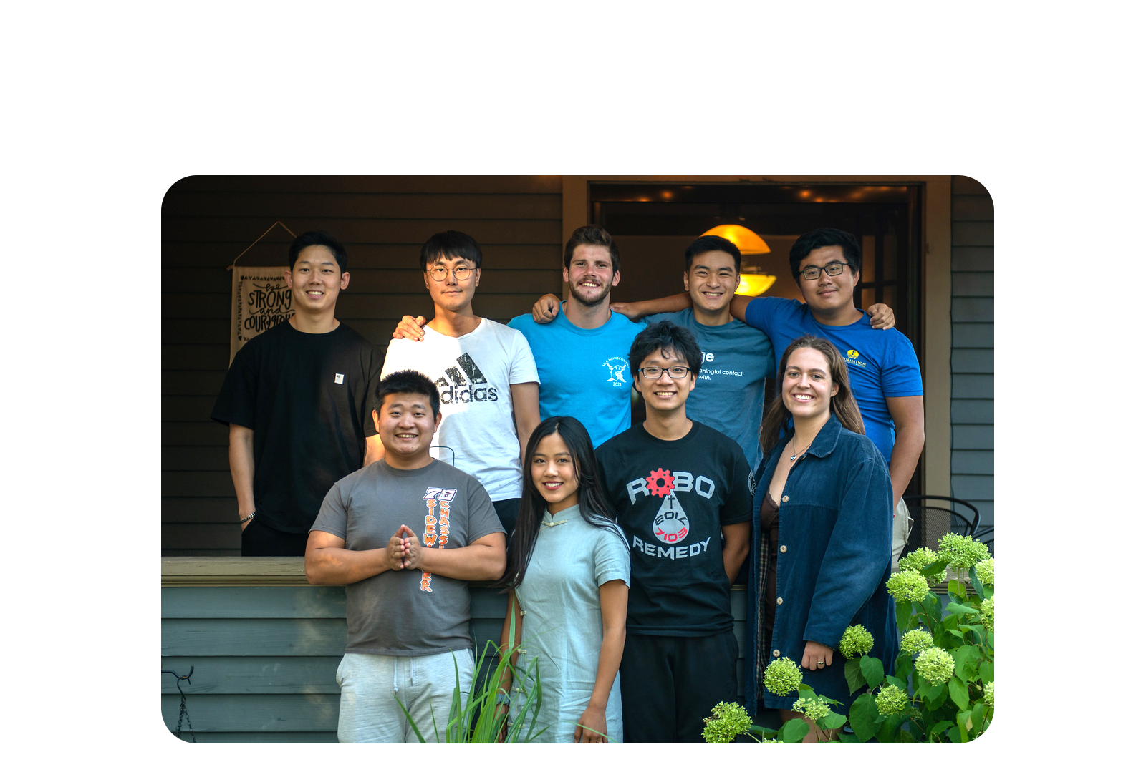
5 Countries & 28 States

Slide 9
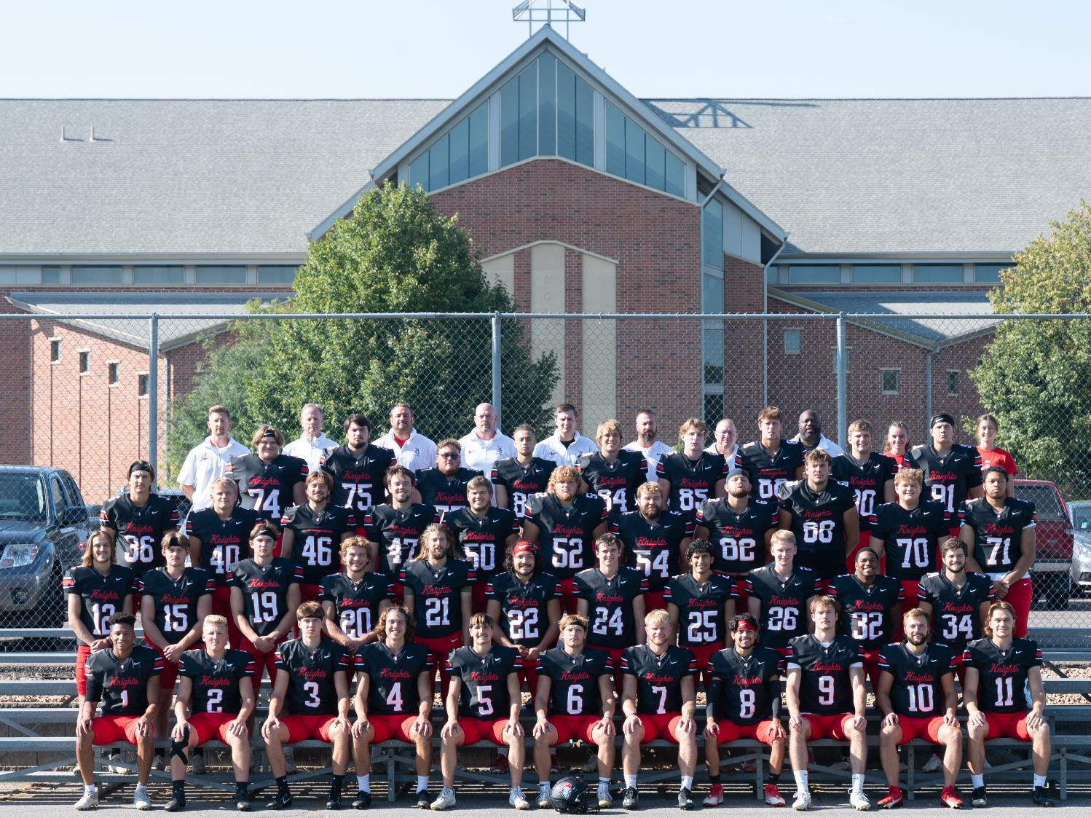
NCAA Division 3

Slide 10
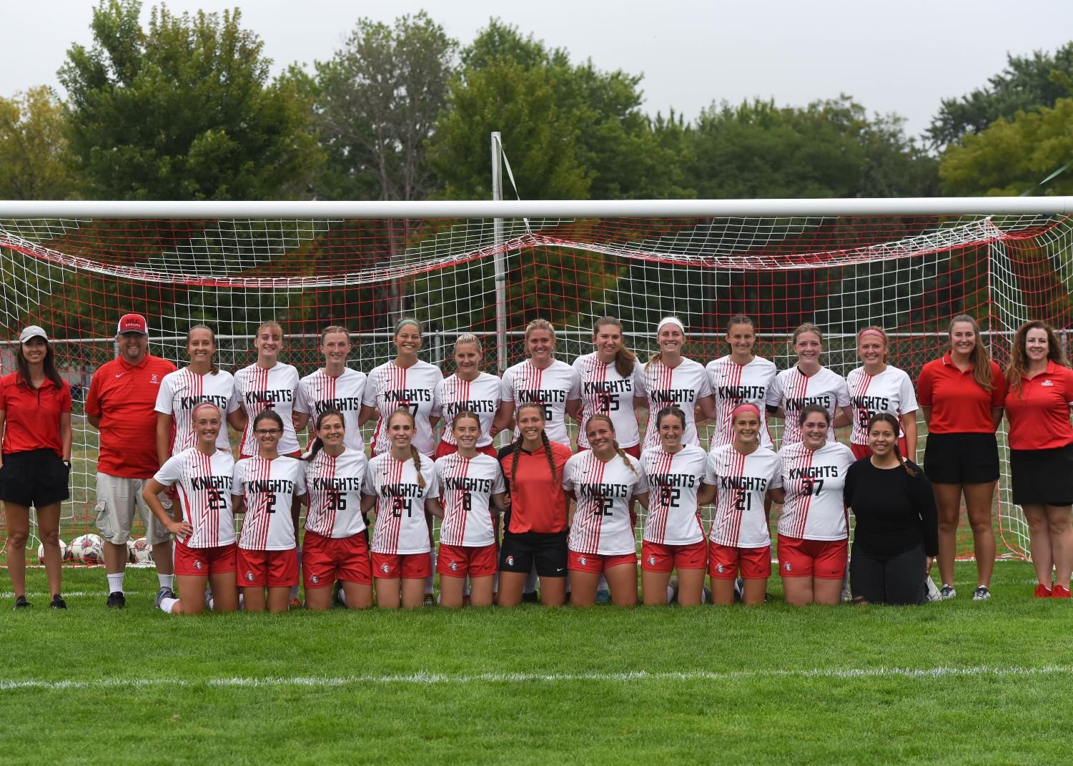
16 Intercollegiate Sports

Slide 11
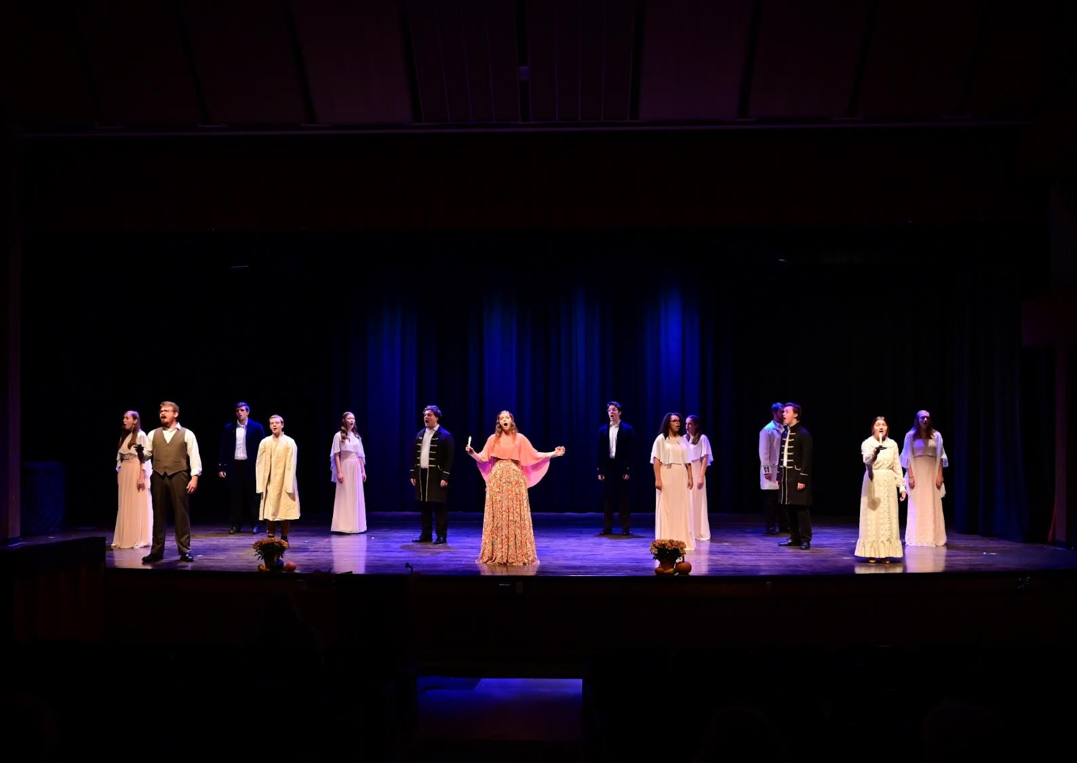
Four Dramatic Performances

Slide 13
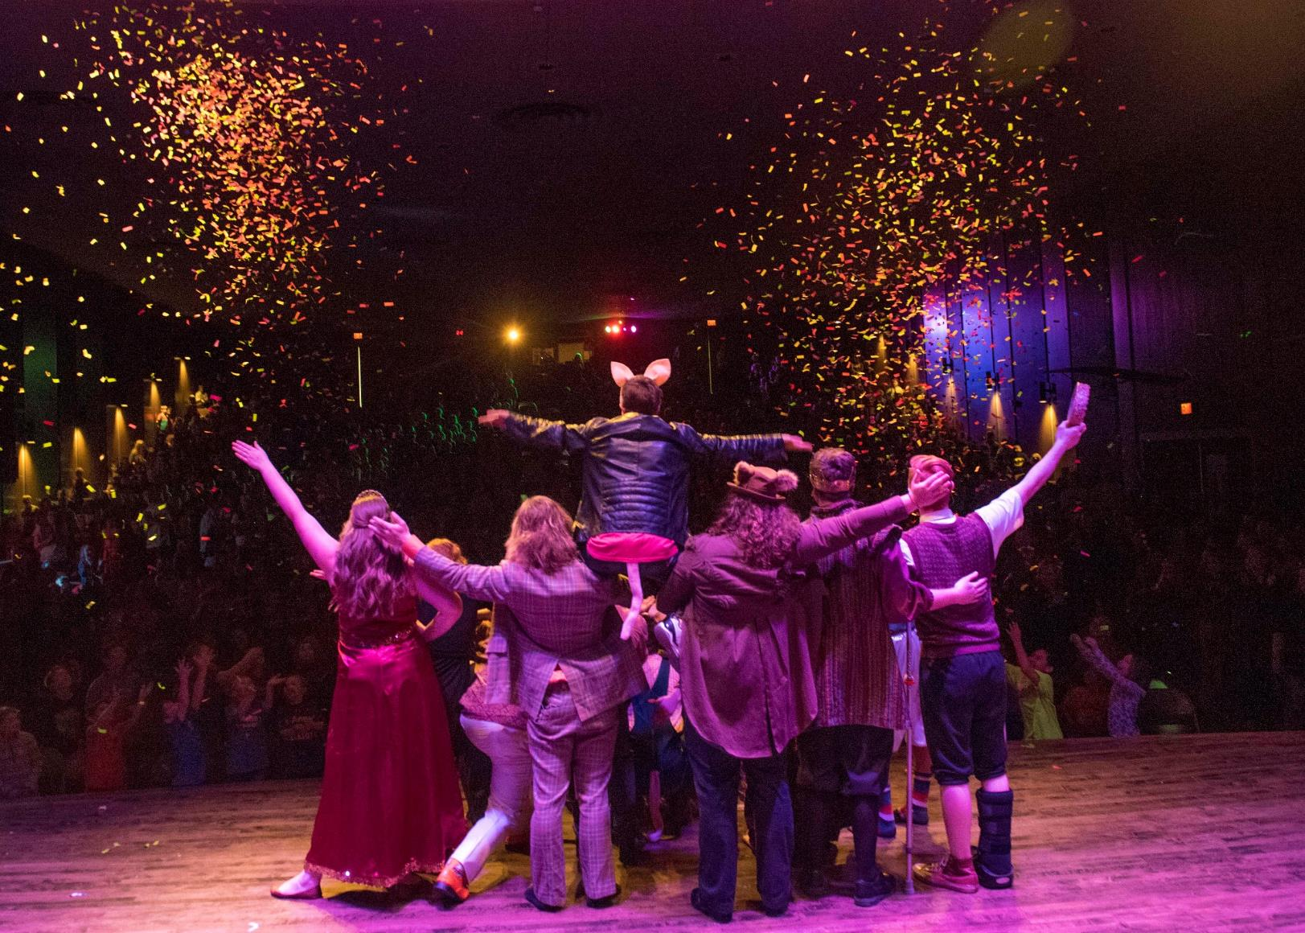
5,000+
Attend Children’s Theatre!

Slide 14
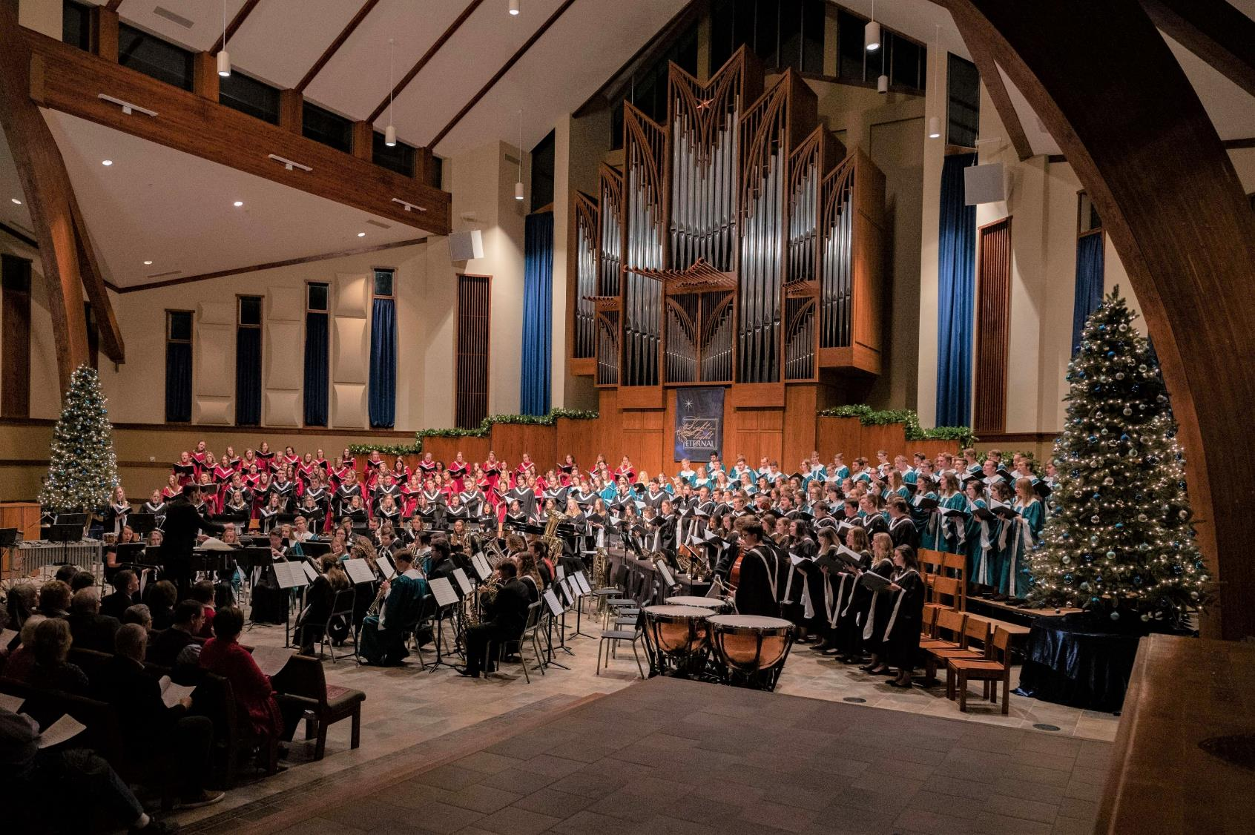
Four Choirs

Slide 15
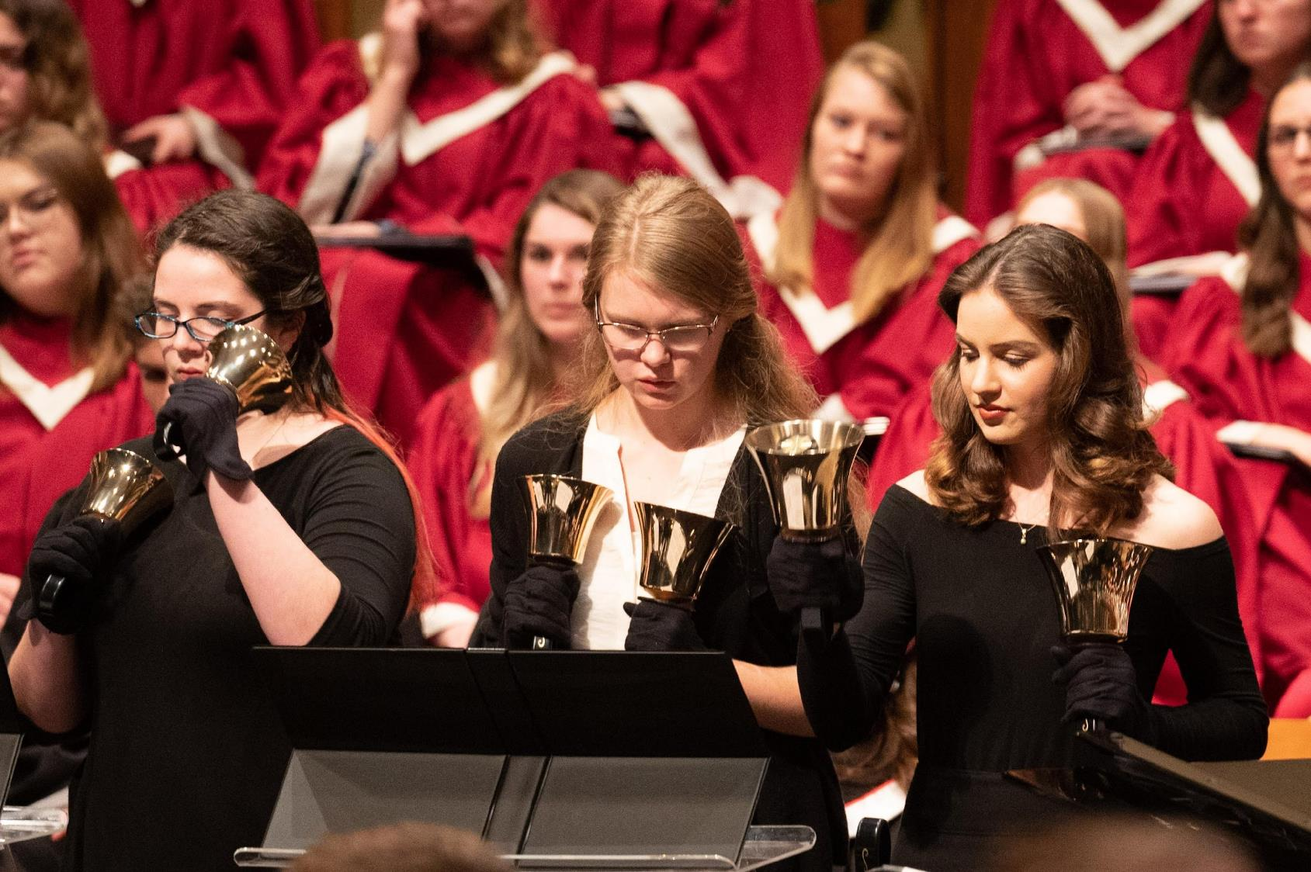
Handbell Choir

Slide 16
Touring Wind Symphony

Slide 17
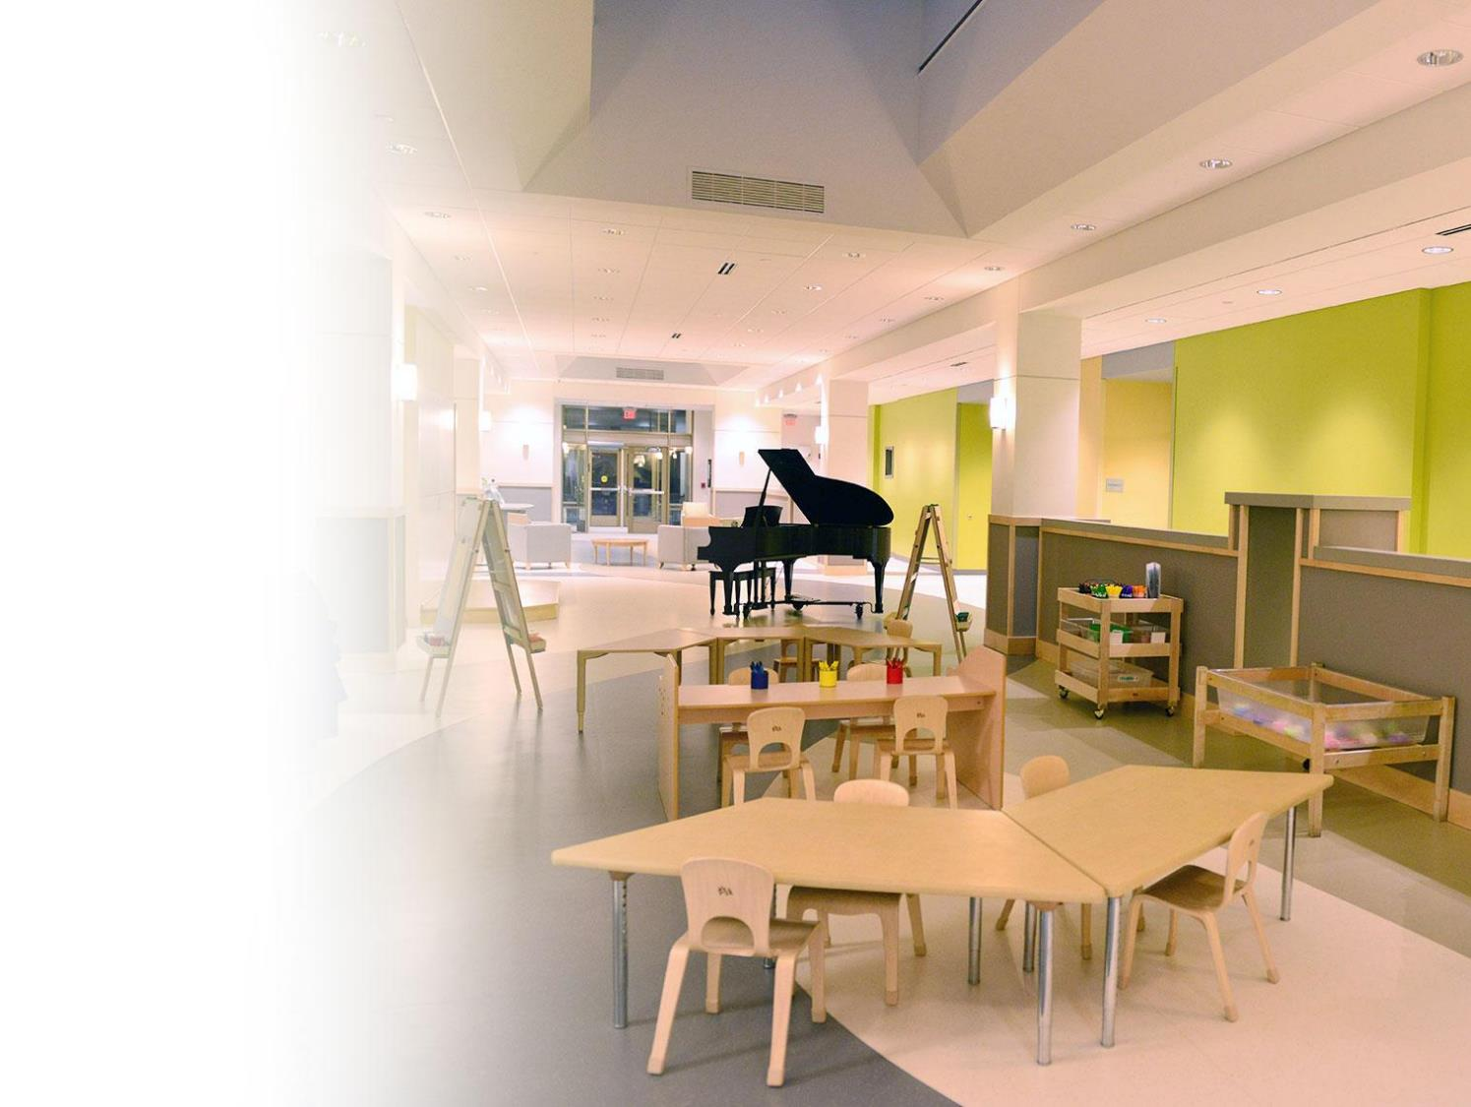
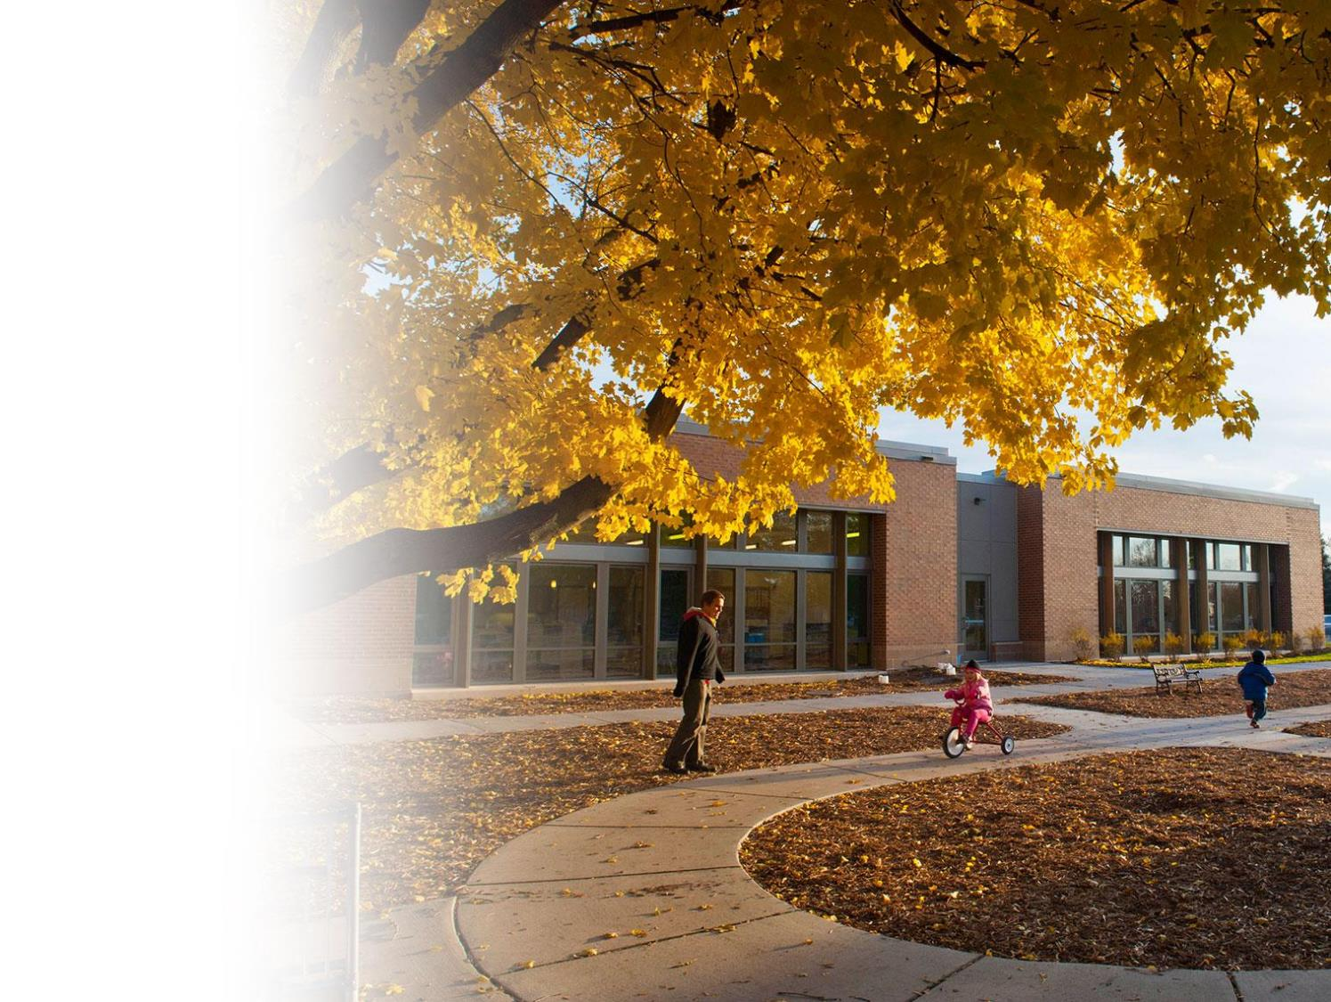
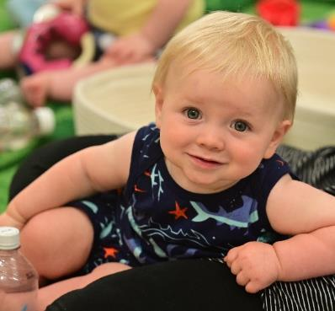
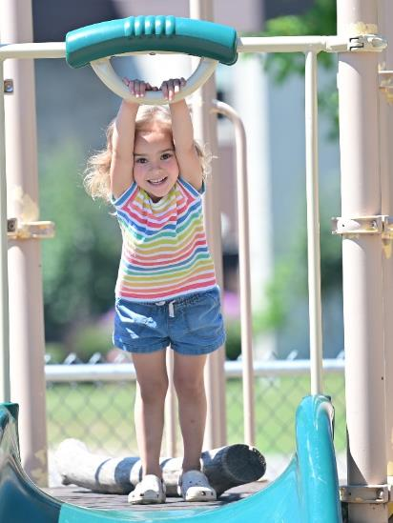
Early Childhood
Learning Center

Slide 18
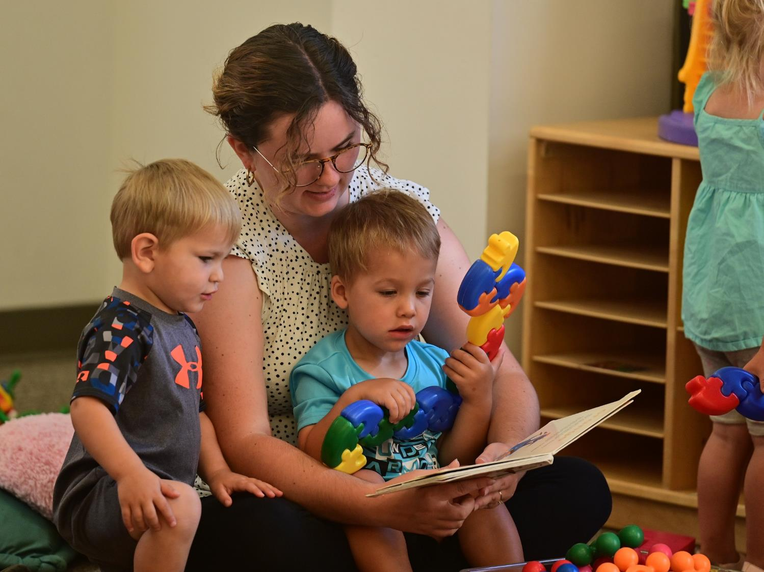

Slide 19
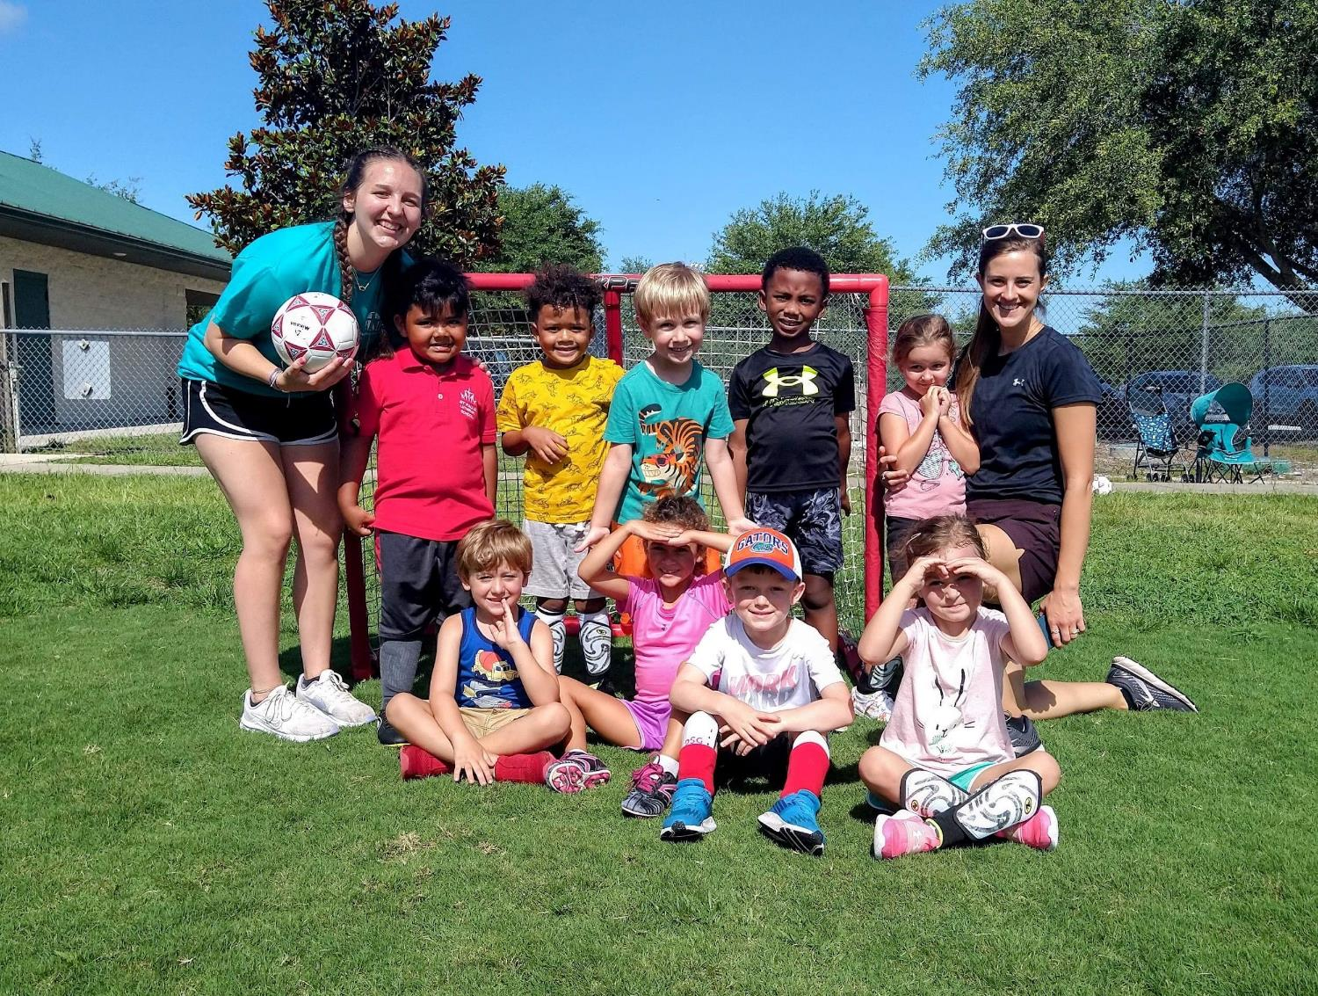
Hands-On Learning

Slide 20
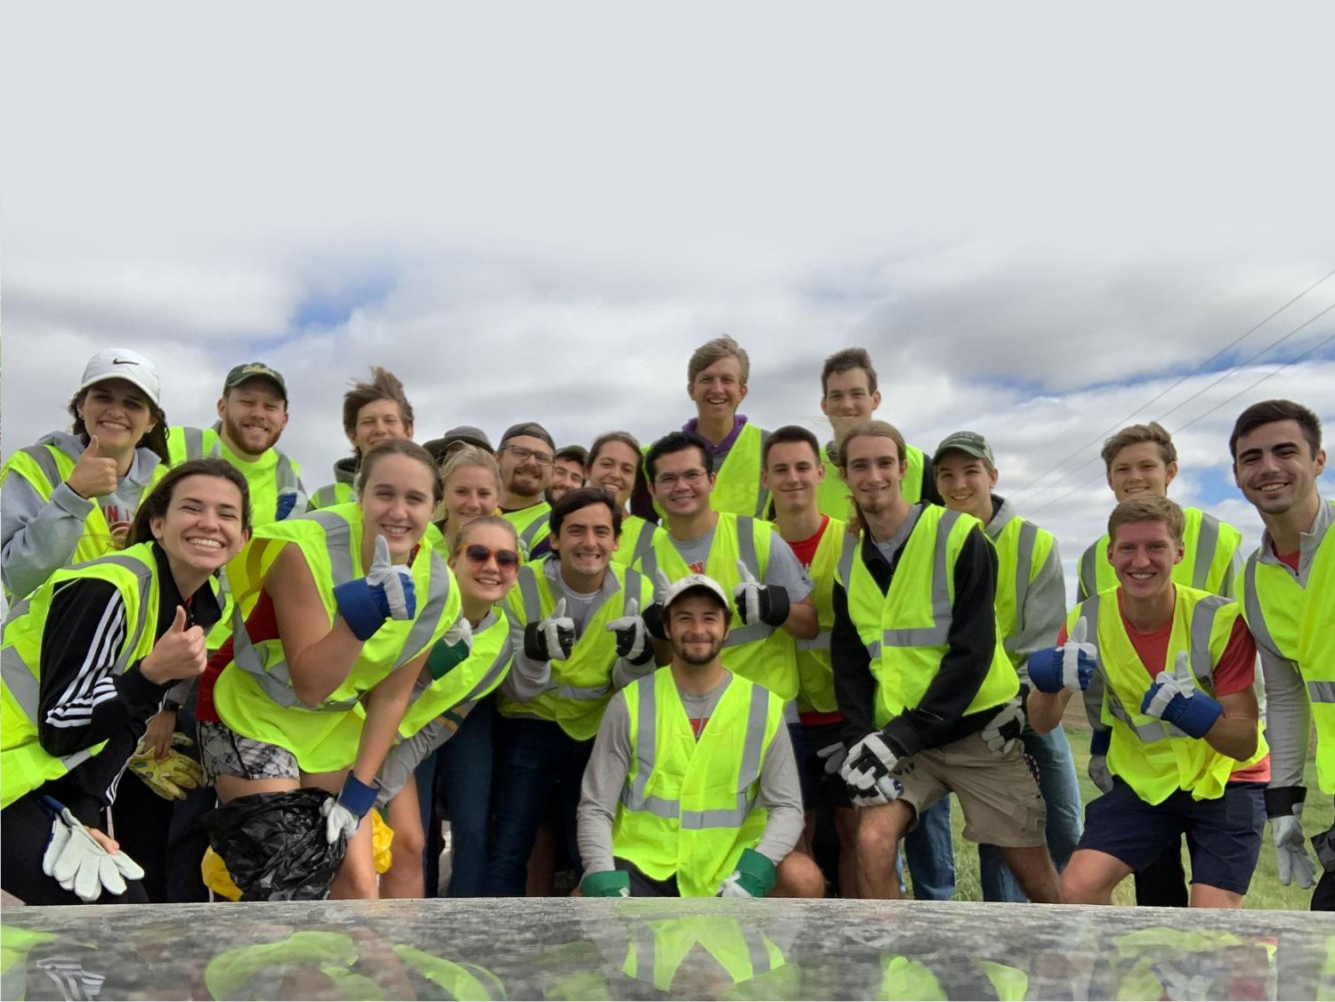
Active Student Groups

Slide 21
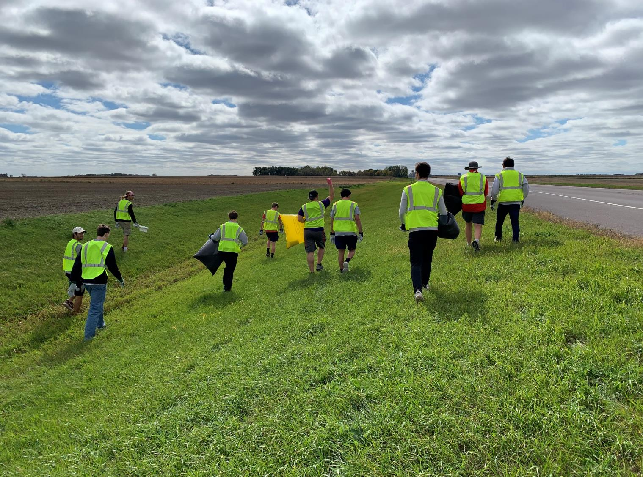

Slide 22
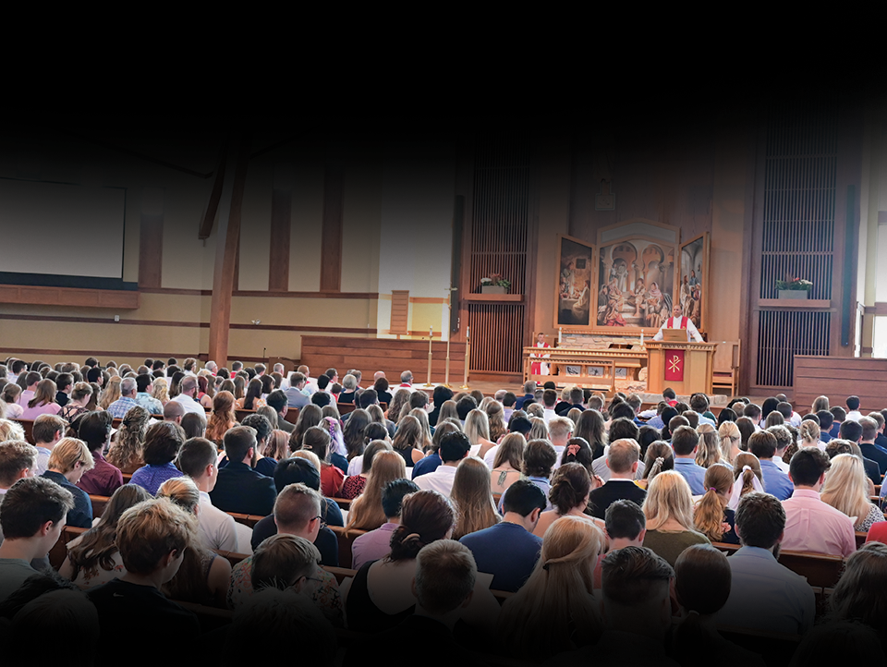
Daily Worship
Notes:
Talk about what students get to do on campus…
Most important: Worship in chapel twice (to 3x a day!!!)
God’s Word is the center of our campus in class and out.

Slide 23
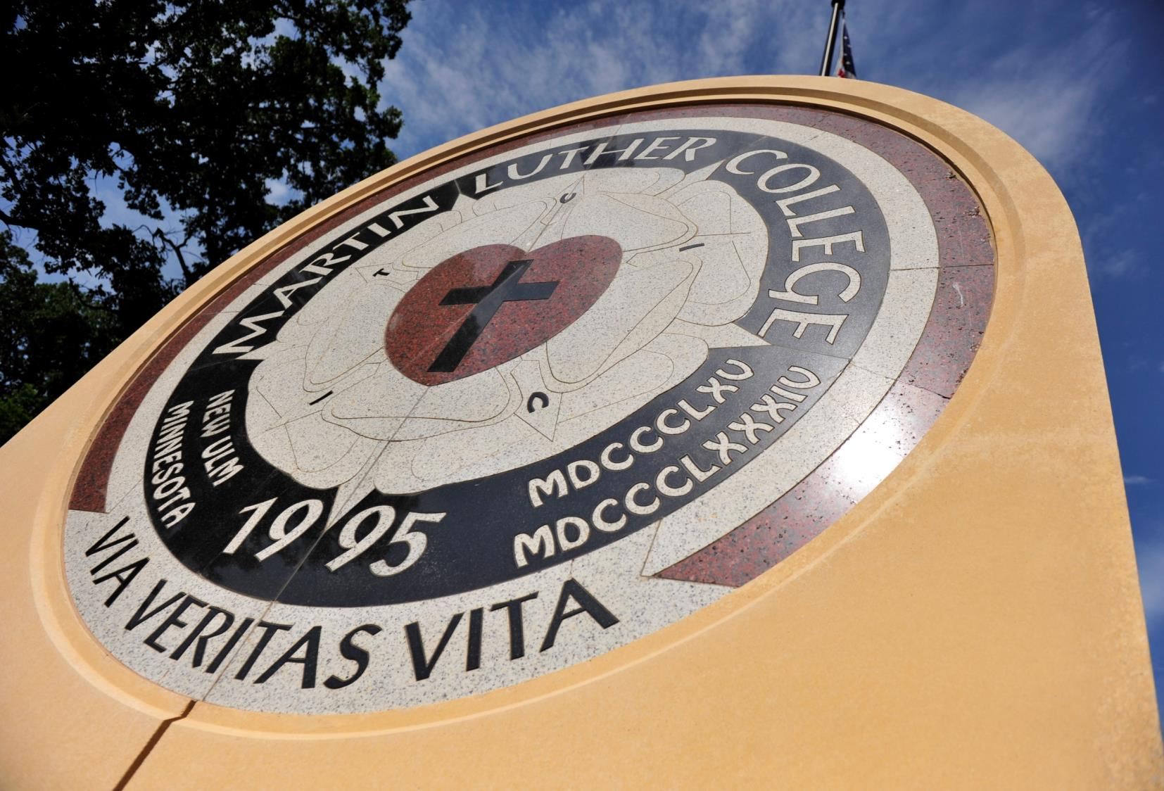

Slide 24
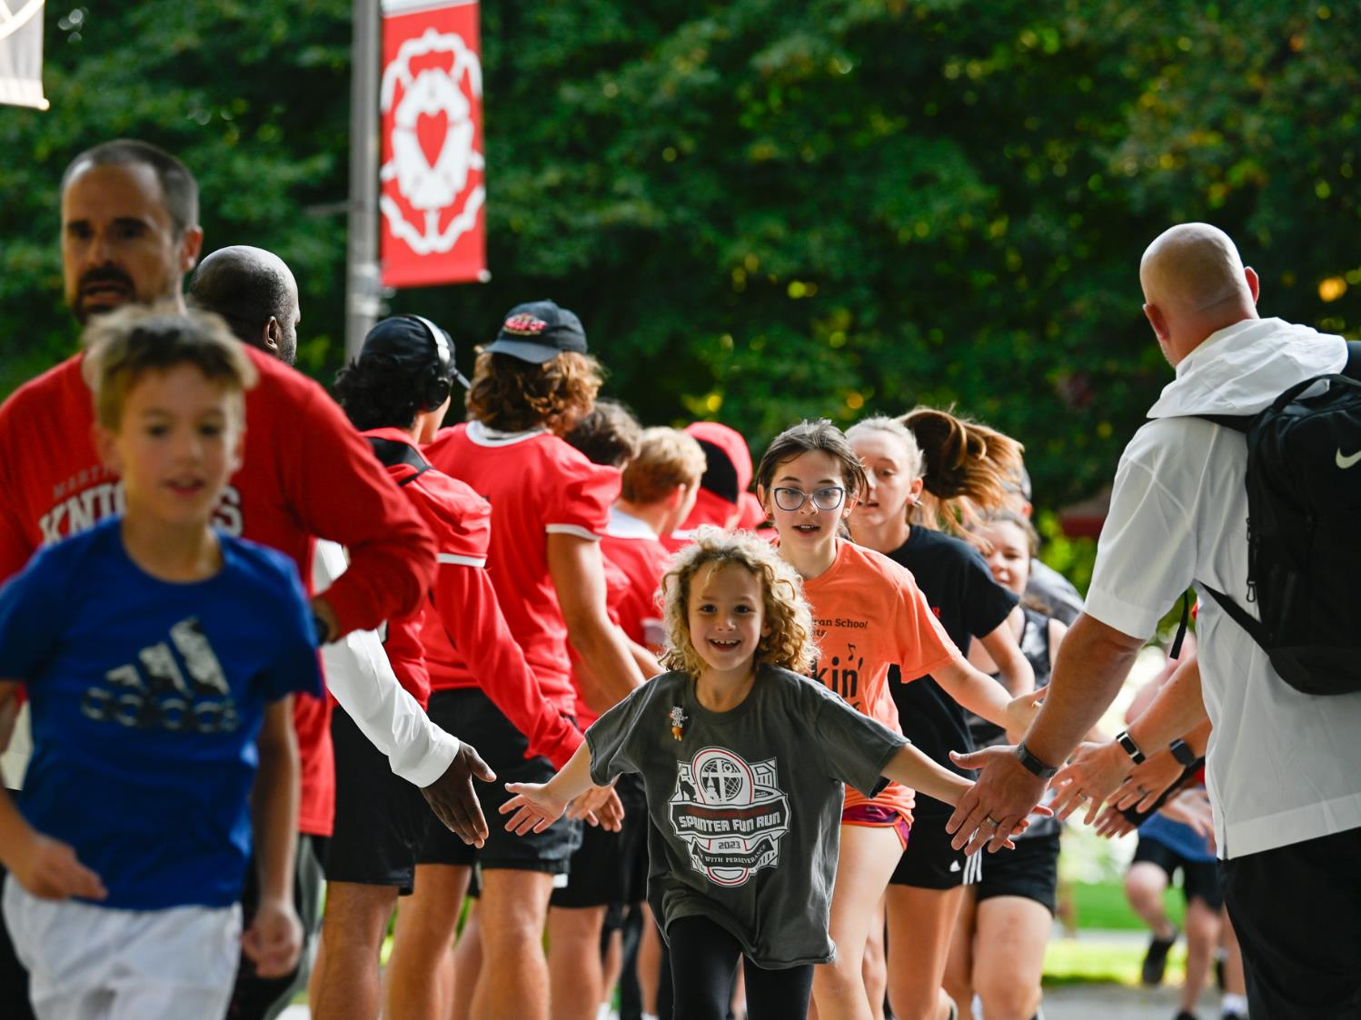
Homecoming

Slide 25
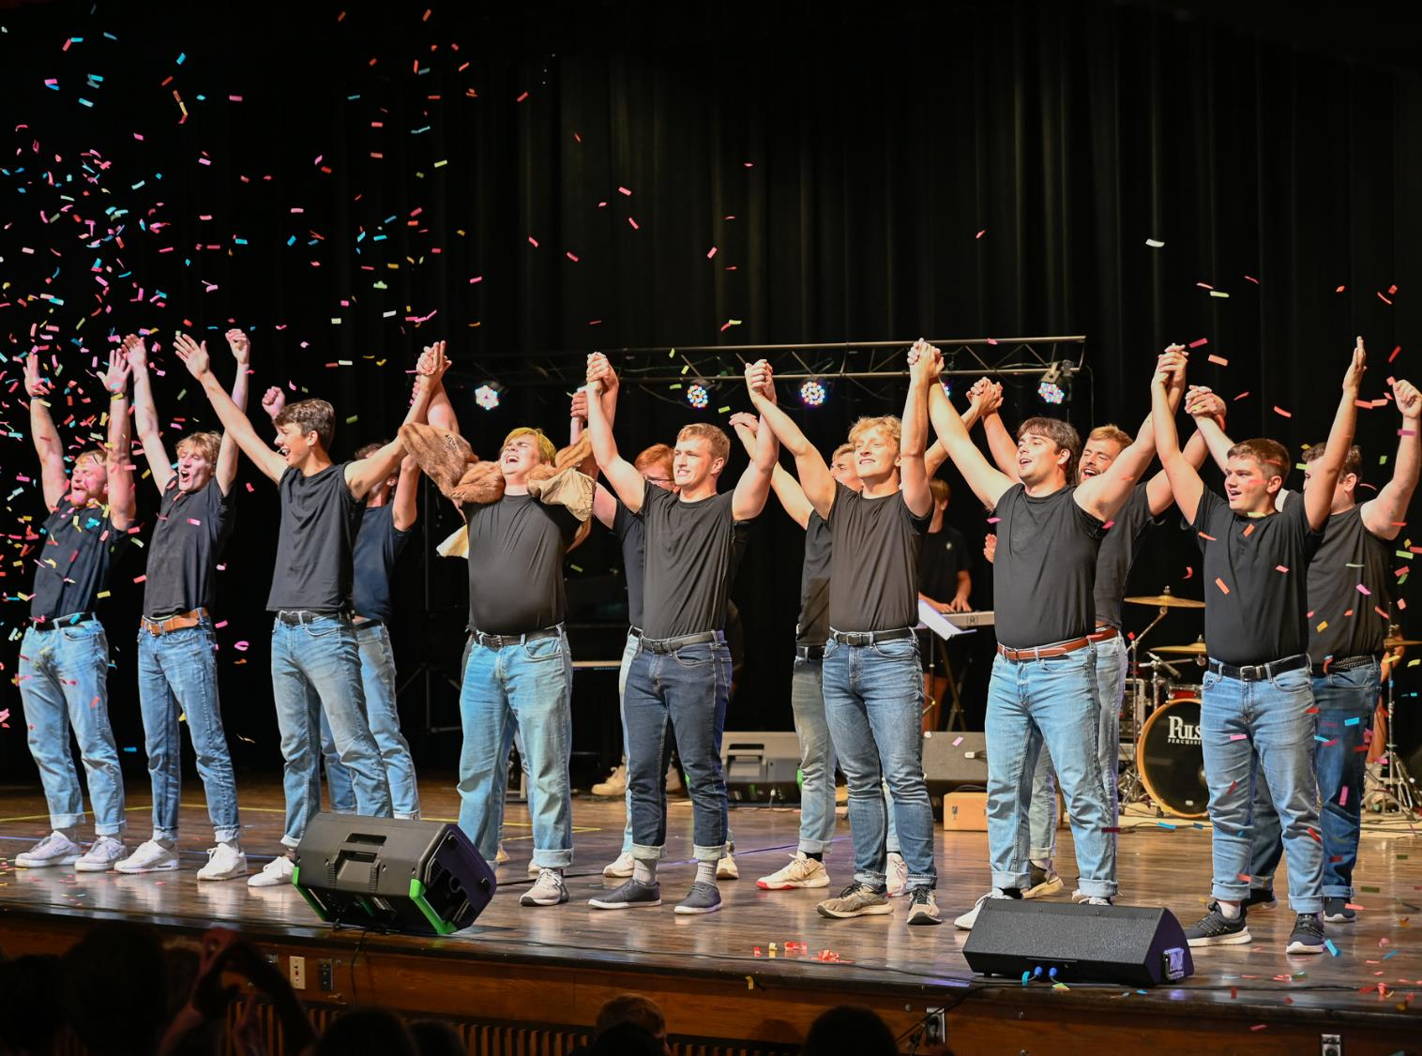

Slide 26
Winter Carnival

Slide 27
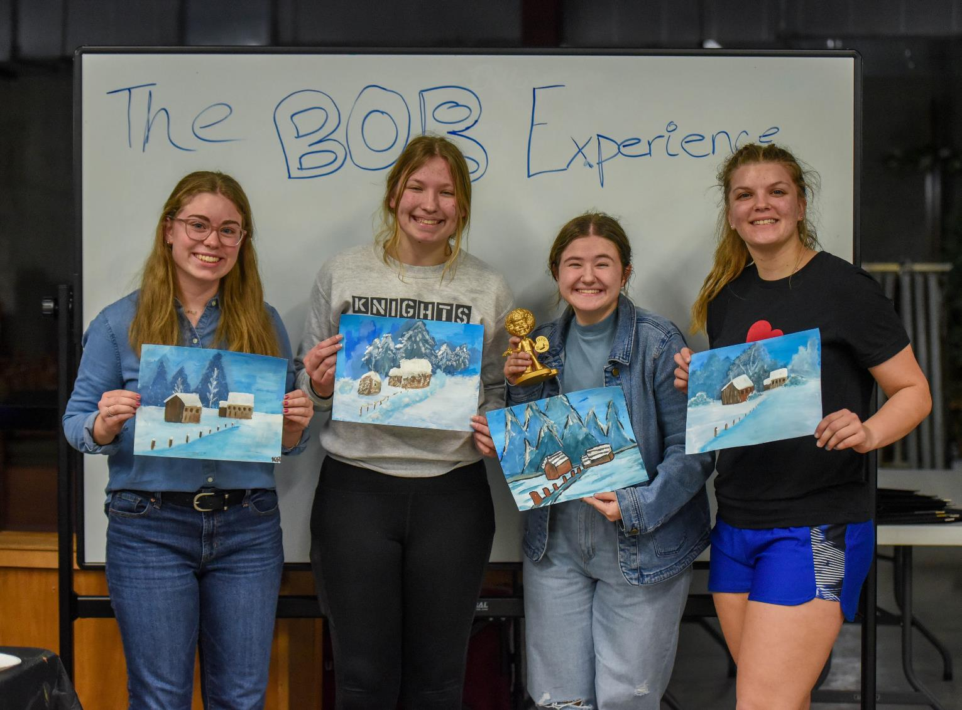

Slide 34
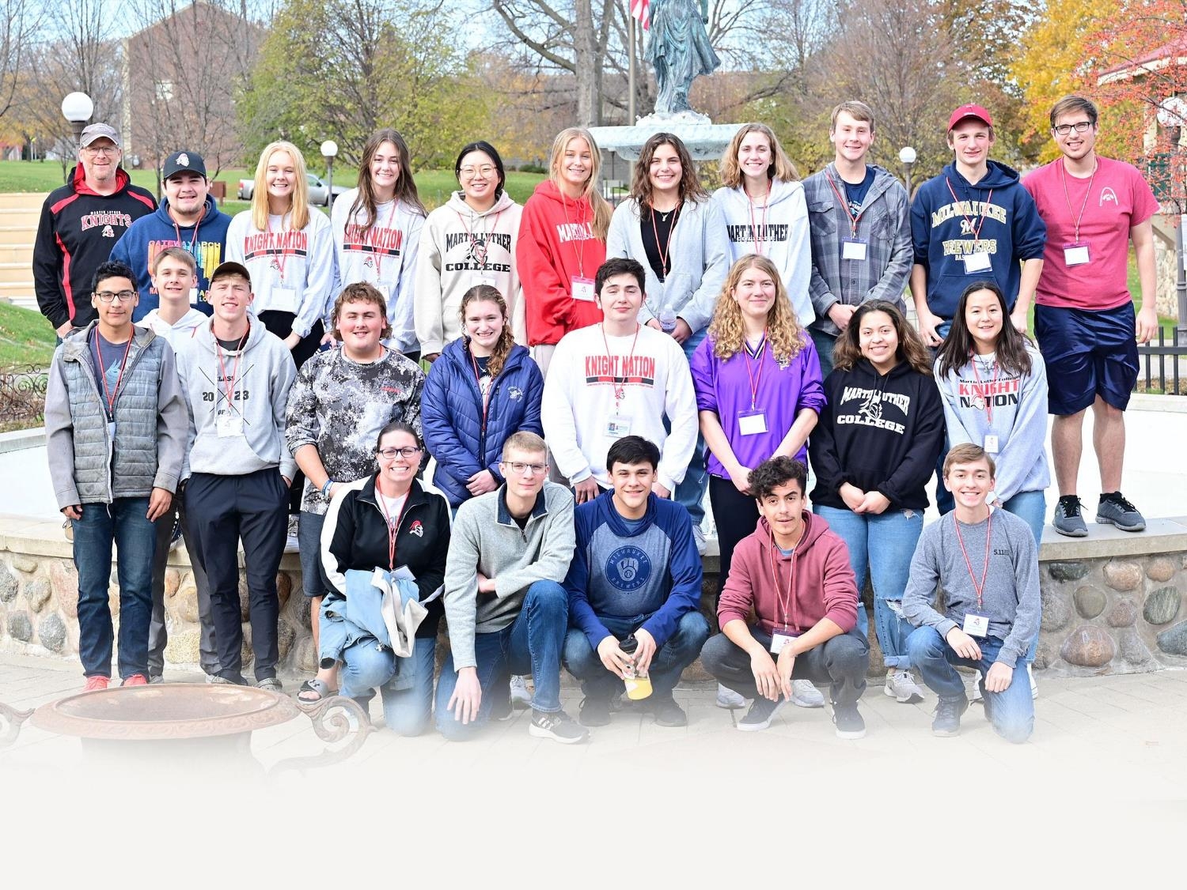
We love welcoming
high school visitors!

Slide 35
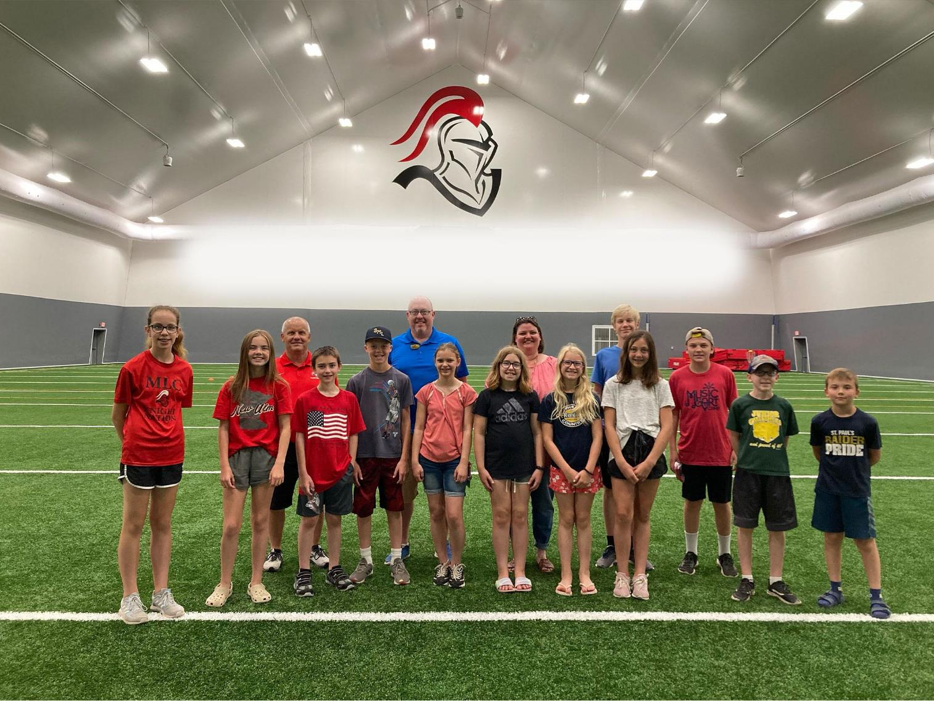
Elementary school groups!

Slide 36
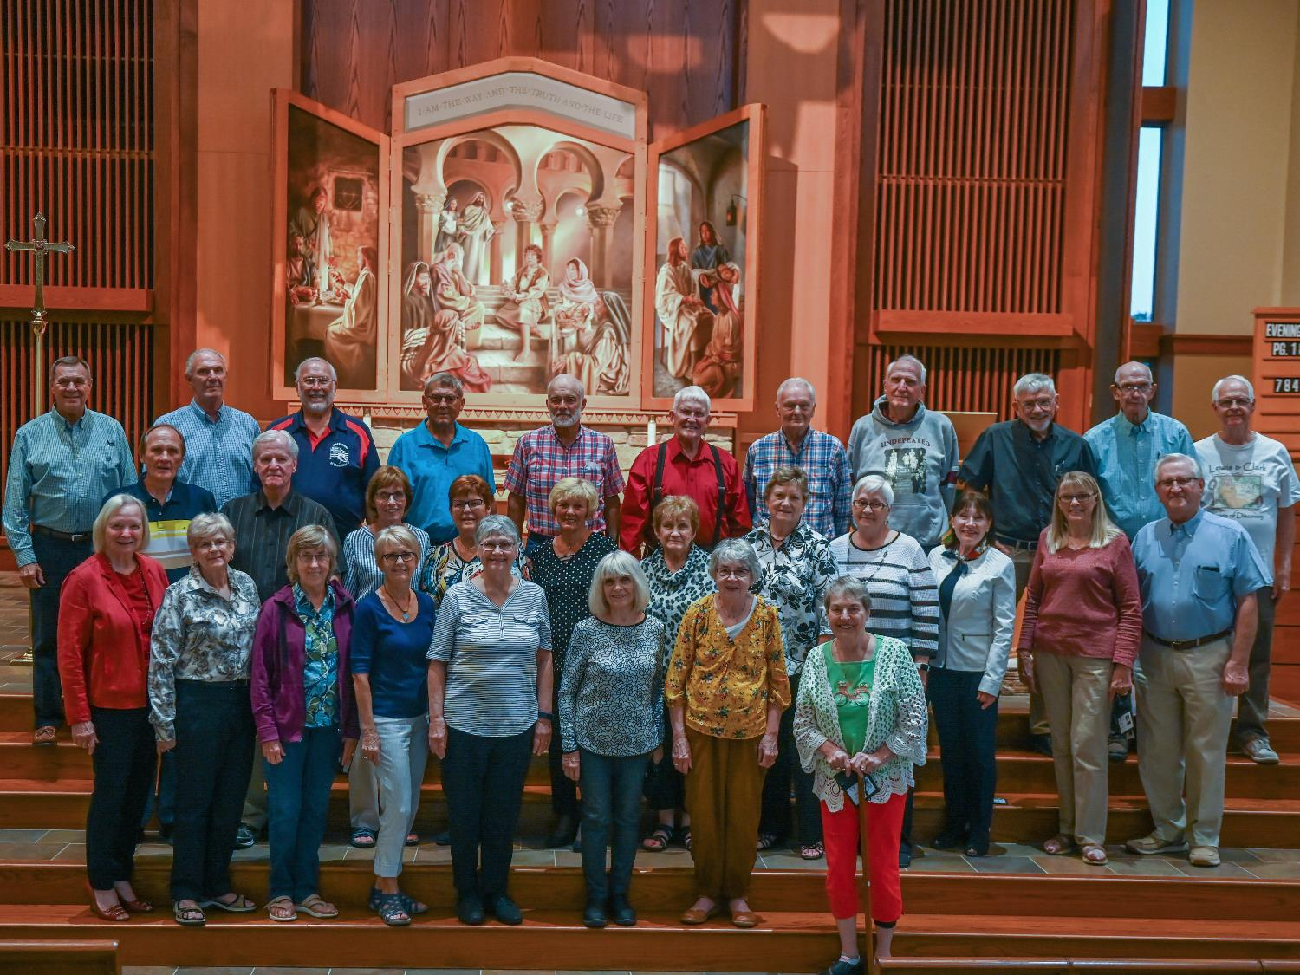
Reunion Groups!

Slide 37
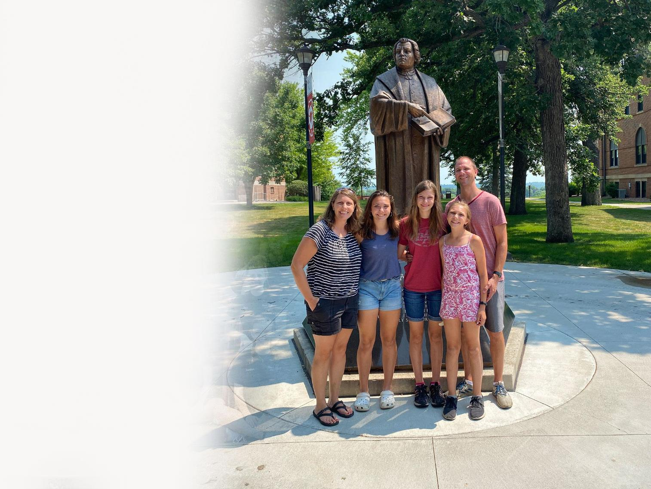
Families!

Slide 38
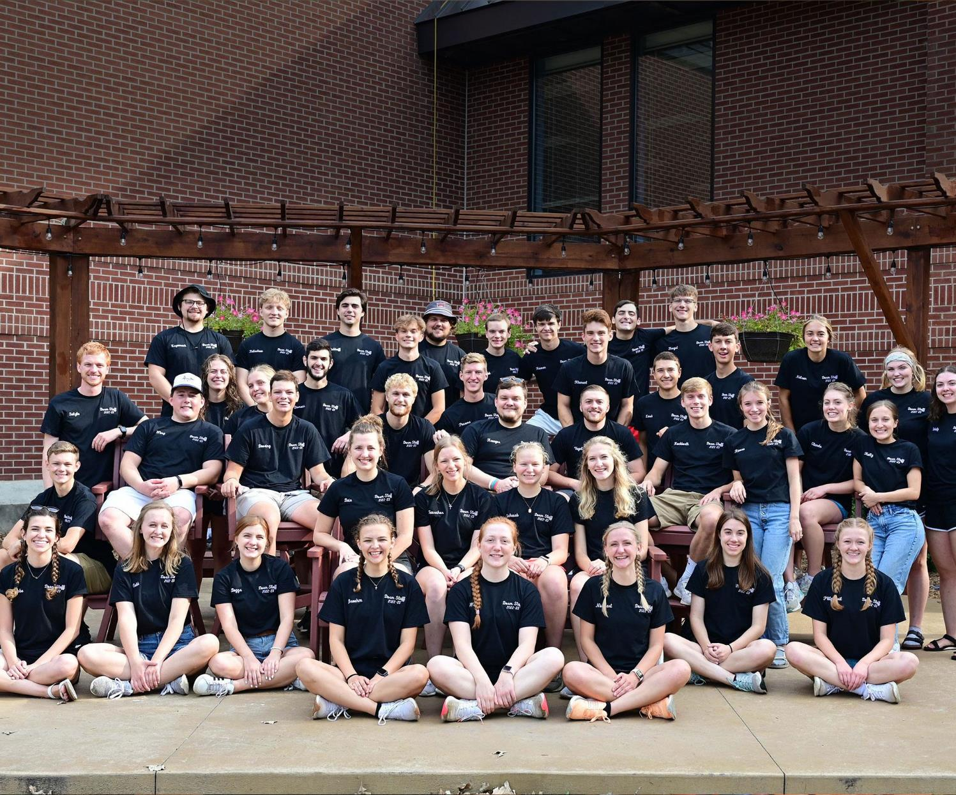
Come see us anytime!

Slide 39
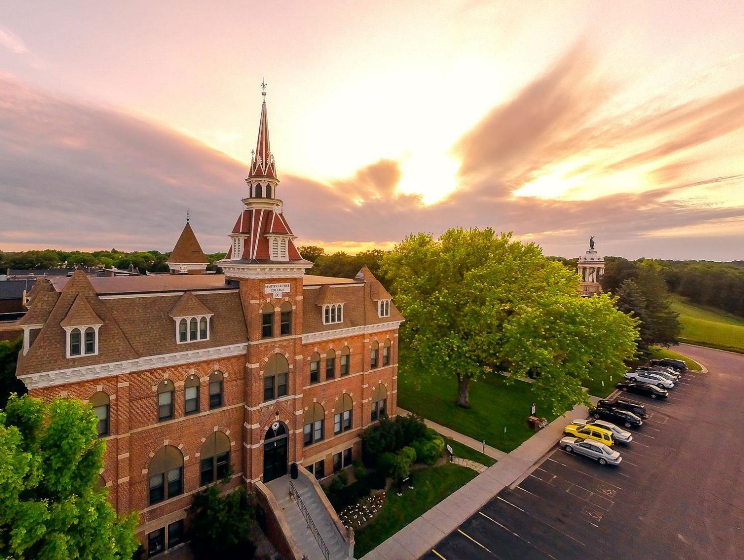

Slide 40
Notes:
I wanted to be in the ministry, and the place to go was Martin Luther College.

