Slide 3
31 States
172
Pre-seminary
1%: Home
742 on campus
34%: LPS & MLS
50%: ALHS
15%: Public
550/6
Education+ S.M.
9 Countries/ 14 Students
Notes:
742 is undergrad opening enrollment as of 9 Sept 16; 172 in the preseminary track, 550 in the educational tracks, and 6 in staff ministry track (though there are more in staff ministry track who also double major by taking an educational track
31 states represented, 9 foreign countries that total 14 international students this year
34% of the student body comes from the 2 WELS prep schools; 50% from the 20+ area Lutheran high schools; 15% from public schools or other; 1% from home schooling

Slide 4
Notes:
2016 - Undergrad = 742, Graduuate Studies & Cont. Ed. = 1044

Slide 5
• Preseminary Studies - 172
Seniors 30
Juniors 37
Sophomores 51
Freshmen 48
Part time 6

Slide 7
• Early Childhood Education
• Elementary Education
• Secondary Education
- Communication Arts & Literature
- Mathematics
- Instrumental Music
- Vocal Music
- Physical Education
- Chemistry
- Life Science
- Physics
- Social Studies
- Spanish

Slide 9
• Staff Ministry
• Parish Music

Slide 11
Notes:
Last year over 1000 people were served by graduate studies and continuing education; in our formal masters degree programs there are slightly over 100 enrolled; the majority of our continuing education efforts involve summer school sessions – on campus and satellite locations and online courses; we also have webinars for continuing education, and the certificate programs and post bac program also falls into this numerical category

Slide 13
• Leadership Emphasis 30
• Instruction Emphasis 40
• Special Education Emphasis 20
• Educational Technology Emp. 24
Since 2008, 92 graduates of this program!

Slide 15
Very recently approved by the state in 2015
Track for LES Principal 9
Track for ECM Director 6

Slide 17
Was the former Master of Arts in Religion at WLS, now transferred to MLC.
The program is still under development.

Slide 19
Different from synod certification; provides course work to allow DMLC grads to gain licensure
Some courses can do “double duty” and transfer credits into the MSE

Slide 21
Continued blessings from the Savior in this effort – now in its fourth year.
NTI now in all 12 districts.
Stats for 2016.
159 new teachers served
111 mentors
123 WELS schools served

Slide 25
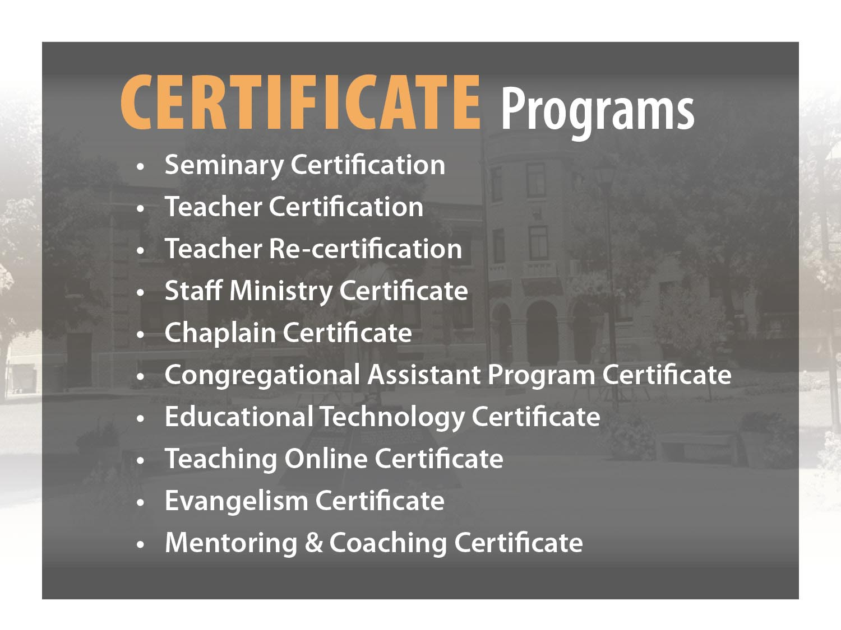

Slide 33
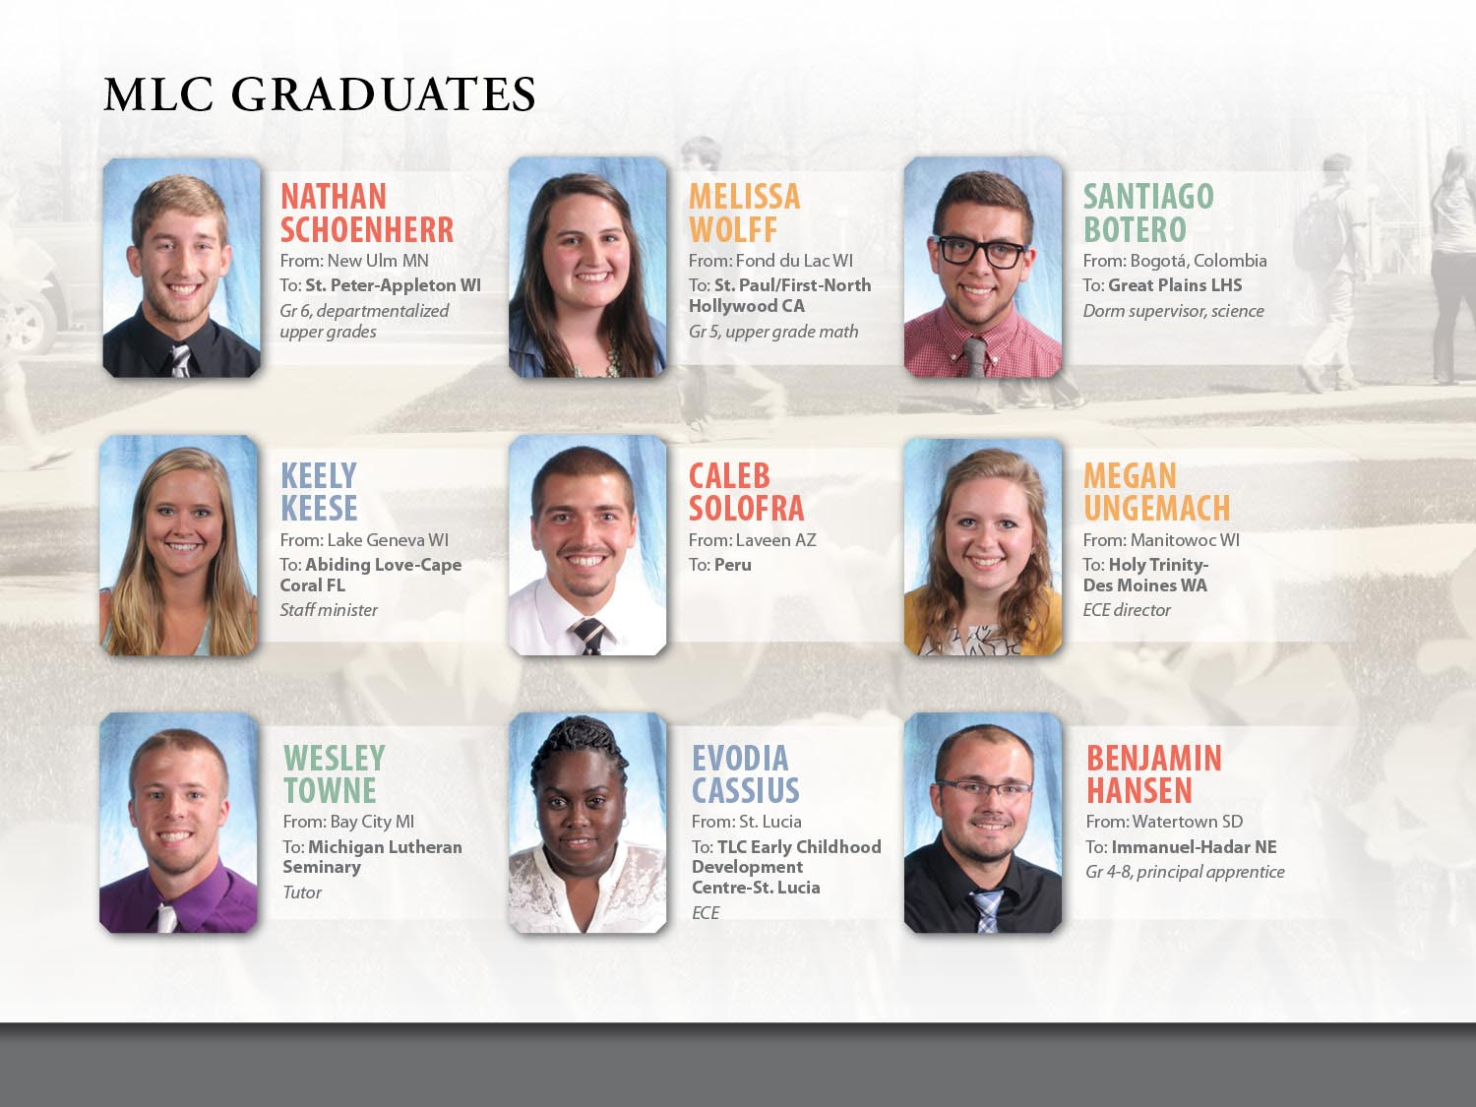

Slide 35
Notes:
Totals are from the MLC $20M budget: 18%=$3.6M, 51%=$10.2M, 7%=$1.4M, 6%=$1.2M

Slide 39
2016-17 Cost Comparison to Upper Midwest Institutions
Estimates based on each institution’s web posting for in-state freshman taking 18 credits/semester with mid-level room & board.
Tuition & Fees Room & Board Total
UW-Eau Claire $8,800 $6,900 $15,700
MSU – Mankato $7,966 $8,430 $16,396
UW-Madison $10,415 $8,804 $19,219
Martin Luther College $13,980 $5,510 $19,490
U of Minnesota $13,790 $9,314 $23,104
Michigan State $12,576 $10,696 $23,272
U of Michigan $13,856 $10,554 $24,410
Concordia-St. Paul $21,250 $8,500 $29,750
Bethany Lutheran $25,440 $8,020 $33,460
Wisconsin Lutheran $27,040 $9,250 $36,290
Valparaiso $39,450 $15,950 $55,400
39

Slide 40
2016-17 Cost Comparison to Great Plains & Mountain State Institutions
Estimates based on each institution’s web posting for in-state freshman taking 18 credits/semester with mid-level room & board.
Tuition & Fees Room & Board Total
Adams State $9,153 $7,950 $17,103
UN – Lincoln $8,627 $10,670 $19,297
Martin Luther College $13,980 $5,510 $19,490
Arizona State $10,184 $10,394 $20,578
U of Arizona $11,400 $9,840 $21,240
Colorado State $10,558 $10,794 $21,352
Colorado Mesa U $11,682 $10,105 $21,787
Colorado U $11,091 $13,194 $24,285
Grand Canyon U $17,050 $8,400 $25,450
Concordia-Seward $30,400 $8,100 $38,500
U of Denver $45,288 $12,021 $57,309
40

Slide 41
2016-17 Cost Comparison to Pacific Coast Institutions
Estimates based on each institution’s web posting for in-state freshman taking 18 credits/semester with mid-level room & board.
Tuition & Fees Room & Board Total
Cal. State Long Beach $6,460 $11,682 $18,142
Martin Luther College $13,980 $5,510 $19,490
Cal. State – San Marcos $7,269 $13,240 $20,509
U of Washington $11,839 $11,310 $23,149
Cal Baptist $29,422 $8,060 $37,482
San Diego Christian $28,100 $10,974 $39,074
Pt. Loma Nazarene $32,900 $9,330 $42,230
Pacific Lutheran U $34,440 $10,100 $44,540
Biola University $36,696 $9,704 $46,400
Seattle Pacific U $38,520 $10,824 $49,344
U of San Diego $45,540 $12,302 $57,842
41

Slide 42
We always thank God for all you, mentioning you in our prayers.
The gifts of God’s people through the CMO and direct gifts allow MLC to strive to keep costs low. In 2016…
#4 in Nation USA Today
Best 10 Colleges for the Money
Top 10 in Nation Washington Monthly
Best-Bang- for-Your-Buck Bacc. Colleges
#5 in Nation MONEY Magazine
50 Most Affordable Private Colleges

Slide 44
MLC LADIES’ AUXILIARY Purpose:
To promote greater interest in MLC
To promote Christian fellowship among the women of WELS and among congregations
To give financial support to MLC
To support the MLC family through prayer
Auxiliary activities:
MLC Food Bank
Orientation Hospitality Tent
Student Events – Bingo Night
Campus projects

Slide 45
MLC LADIES’ AUXILIARY Campus Projects:
Three Standing Projects: Scholarships, Library, Outreach Activities
Annual Projects:
iPads for Teaching w/ Technology $2,495
Residence Hall window treatments $1,250
Stage projected backdrop $2,600
ECLC cots $1,242
CPR adult manikins $469
Fitness Center treadmill $4,400
Spanish Immersion grants $2,000
Financial Literacy Program grants $1,000
Edger for grounds maintenance $480
Semester Abroad grants $2,000
World Music Drumming Curriculum $2,060
International Services Office improvements $430
Aerobic area TV’s and DVD players $750
and more!

Slide 46
MLC LADIES’ AUXILIARY How can you help?
BE AN AMBASSADOR of Martin Luther College! In your home congregation, let others know about the important work carried out at MLC, and ask your members to pray for our ministry.
SPREAD THE WORD about Auxiliary Projects! Share our annual project list through your congregational newsletter, bulletins, and displays. Provide opportunities for your congregational members to adopt a project or help fund one that they like.
SUPPORT THE STUDENTS AT MLC!
Promote our college through our bulletin inserts and magazines. Consider participating in our Congregational Partner Grant Program or the Auxiliary Befriend an MLC Student program.

Slide 48
Ask the Lord . . .
to encourage our students through his Word
to bless our graduates in their teaching ministries or their additional training at Wisconsin Lutheran Seminary
to inspire more high school students to consider ministerial training at Martin Luther College

Slide 49
Tell your friends and family . . .
how God is working through MLC to meet the ministry needs of Lutheran churches and schools
how we are partnering with you to fulfill our Lord’s Great Commission
Follow our posts on social media and share our ministry with your friends – especially on MLC Day!

Slide 50
Please support us through . . .
your continued congregational mission offerings
an additional gift directly to MLC, if you are so moved
“Your generosity will result in thanksgiving to God.” (2 Corinthians 9:11)

