Slide 1
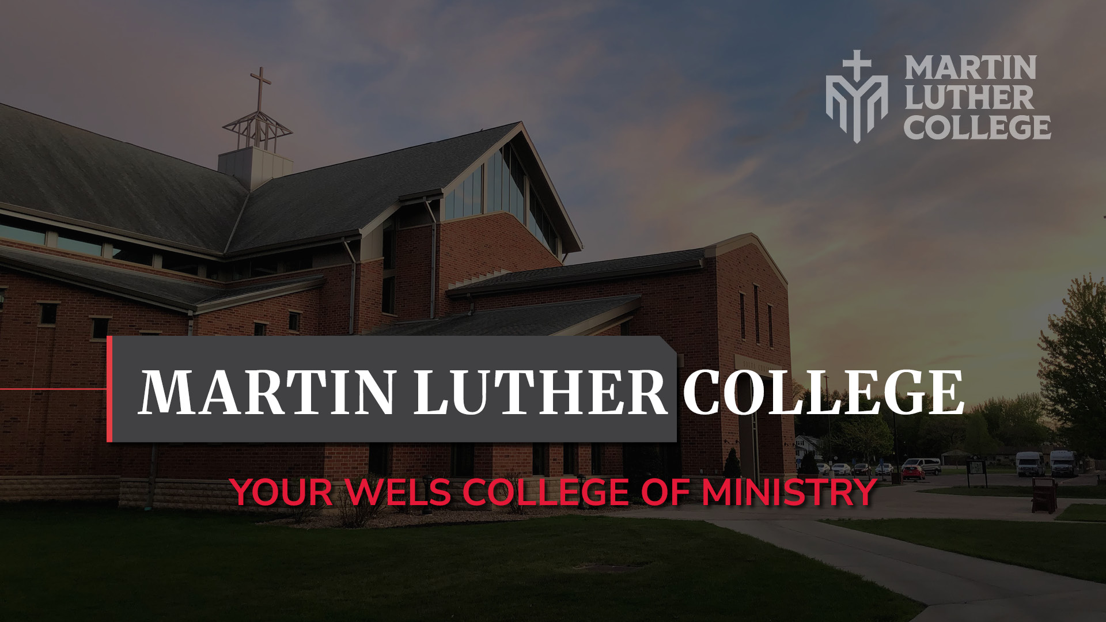
Notes:
Martin Luther College is Your WELS College of Ministry.

Slide 2
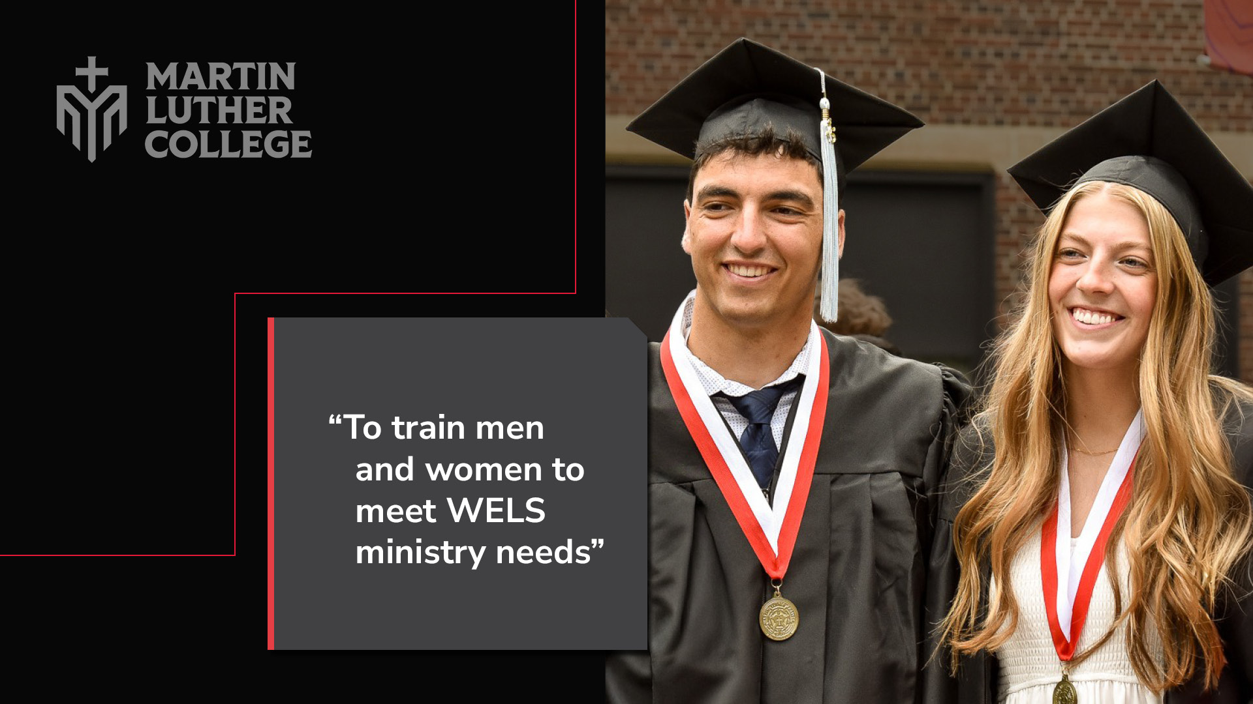
Notes:
We exist to train men and women to meet the ministry needs of WELS congregations and schools.

Slide 3
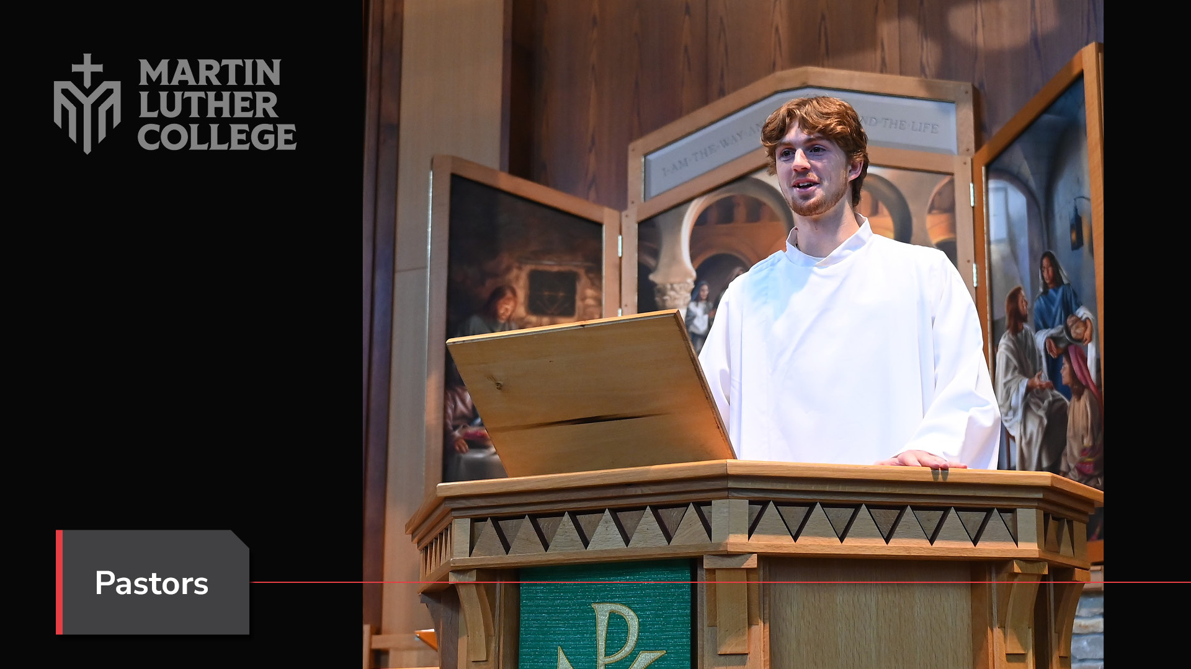
Notes:
That means we train future pastors . . .

Slide 4
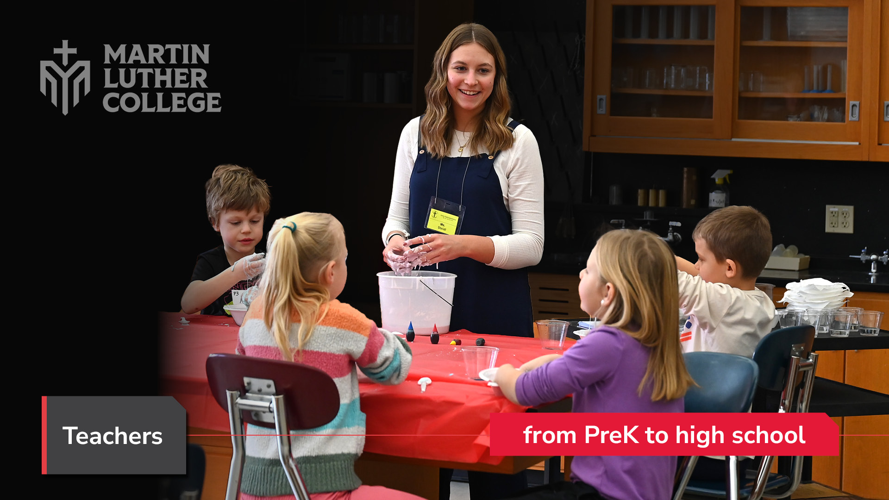
Notes:
. . . and teachers – from preschool to high school.

Slide 5
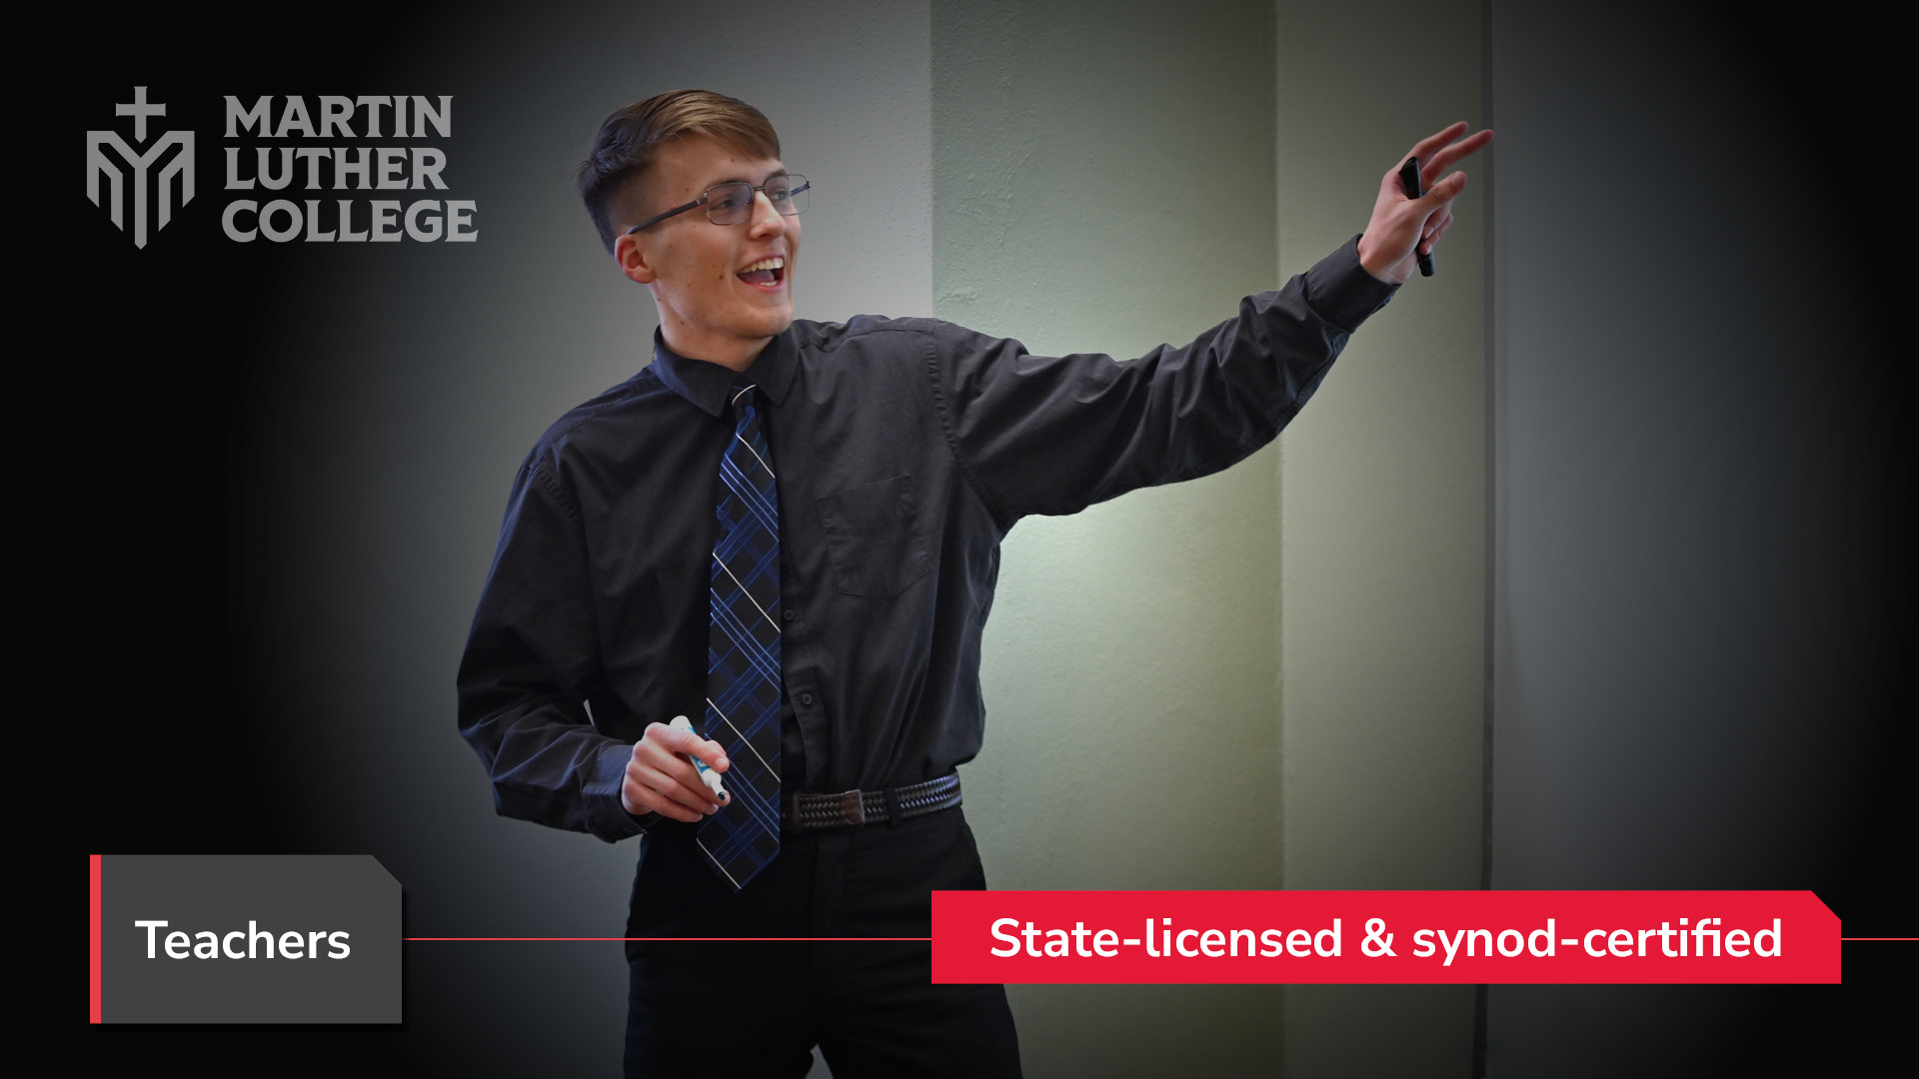
Notes:
Our teachers are eligible for synod certification and state licensure. This distinguishes us from every other college.

Slide 6
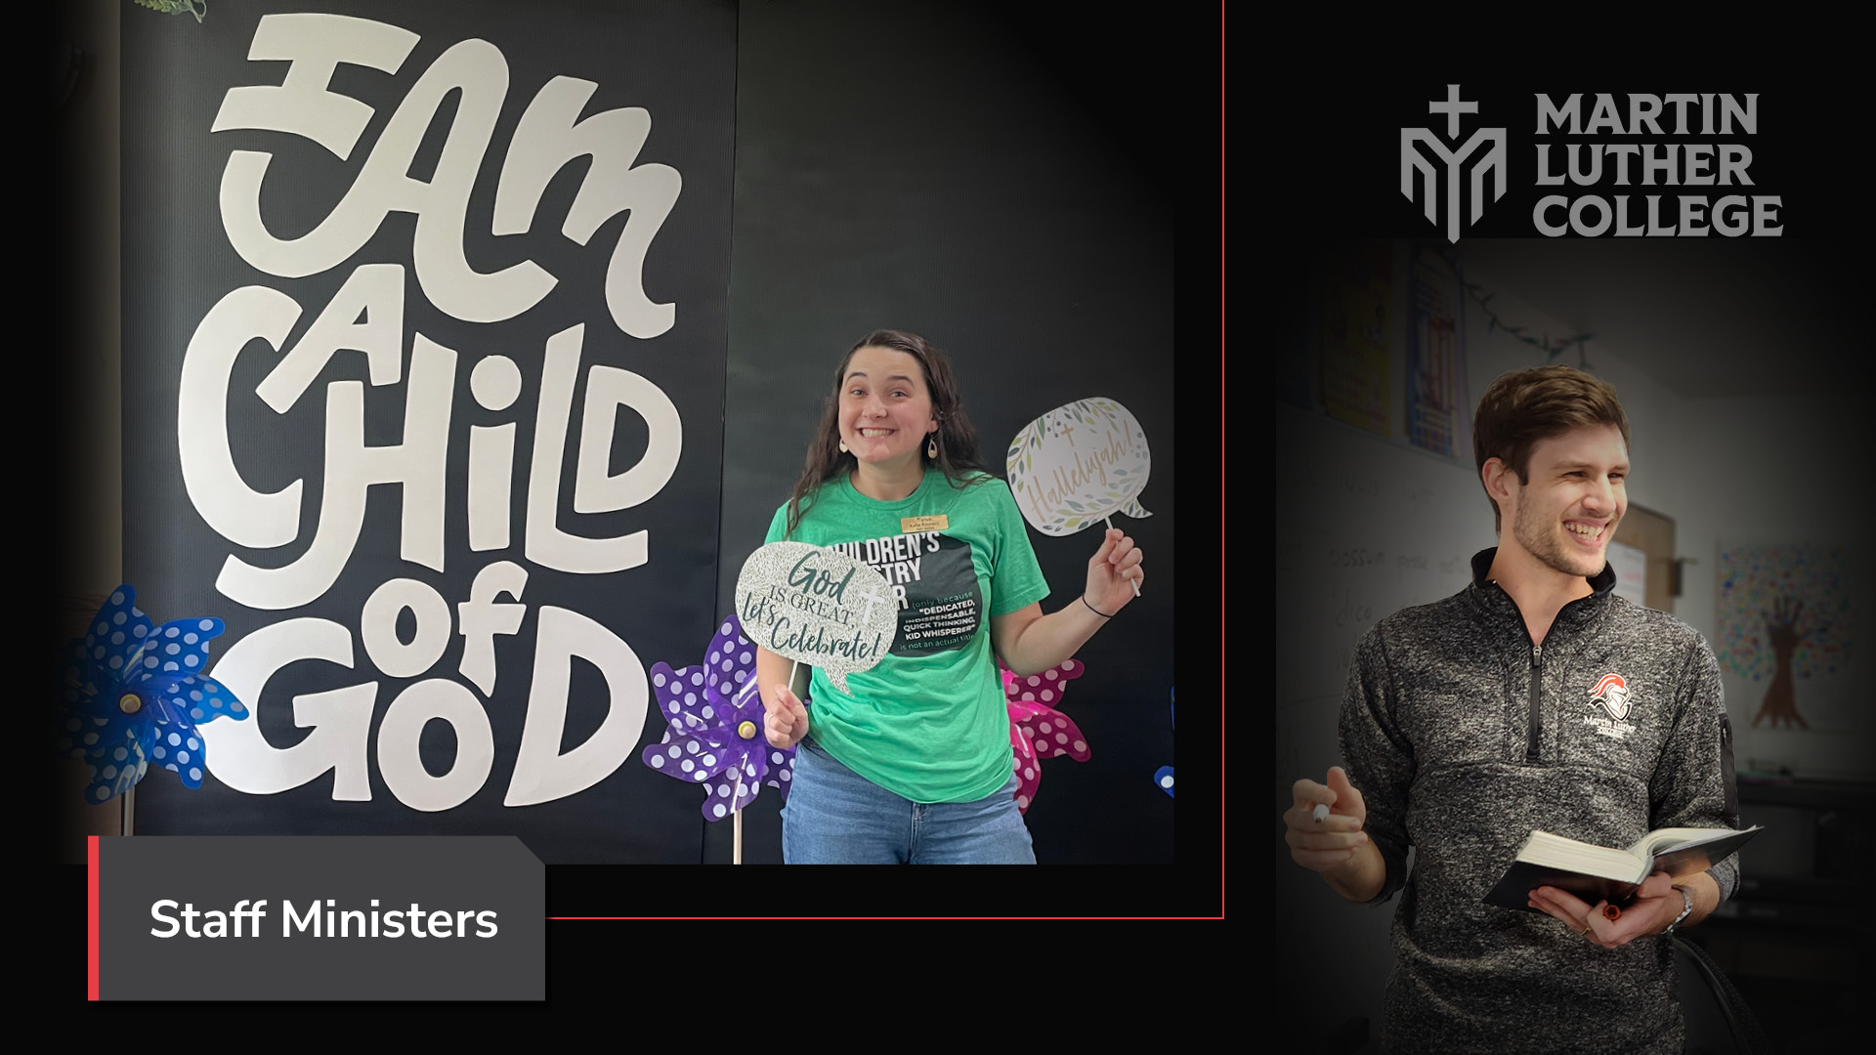
Notes:
We also train staff ministers, who serve in family ministry, youth ministry, worship coordination, and more.

Slide 7
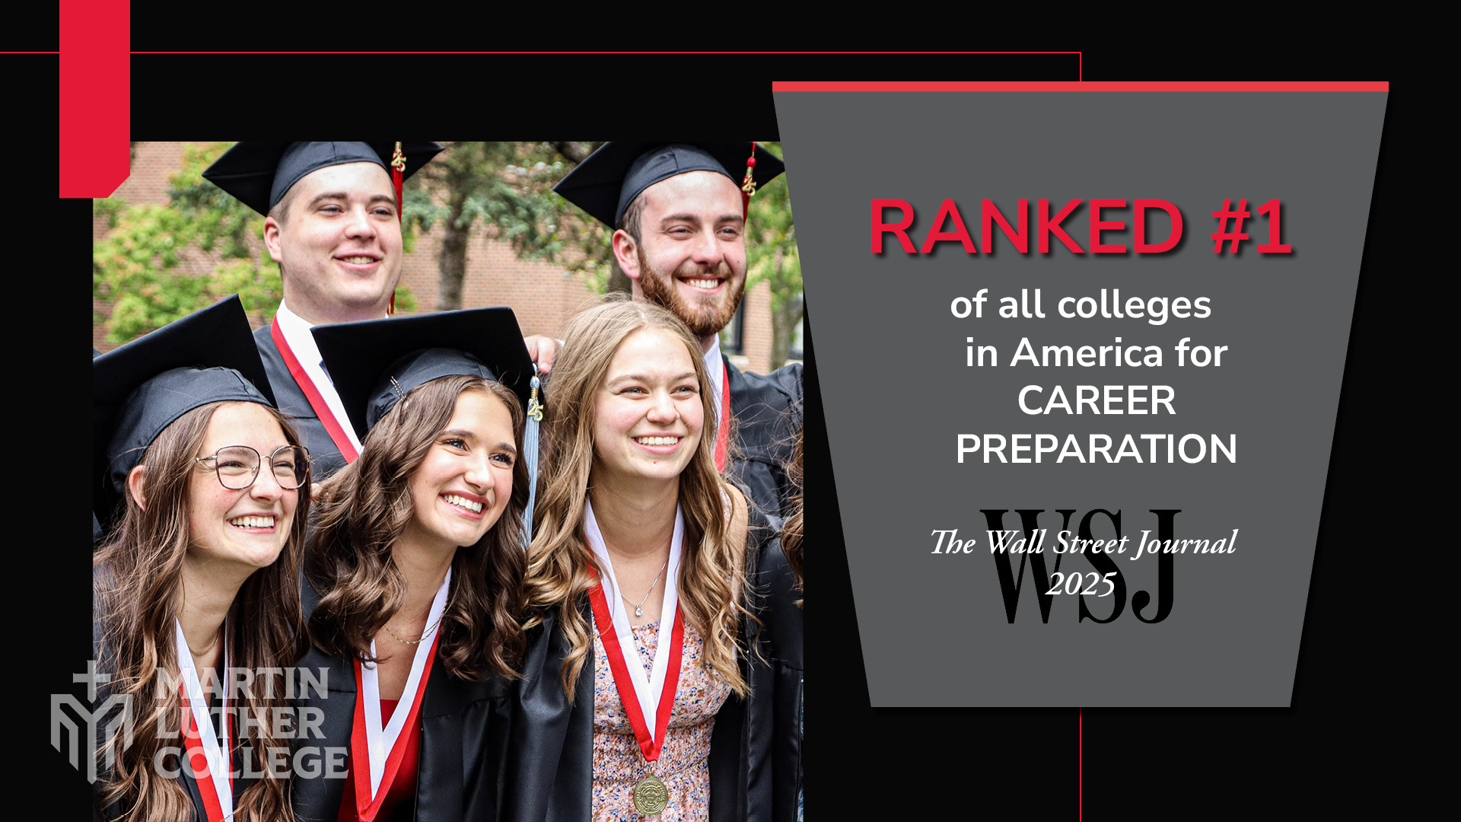
Notes:
We do this so well that in 2025, the Wall Street Journal ranked us #1 of all colleges in America for Career Preparation.

Slide 8
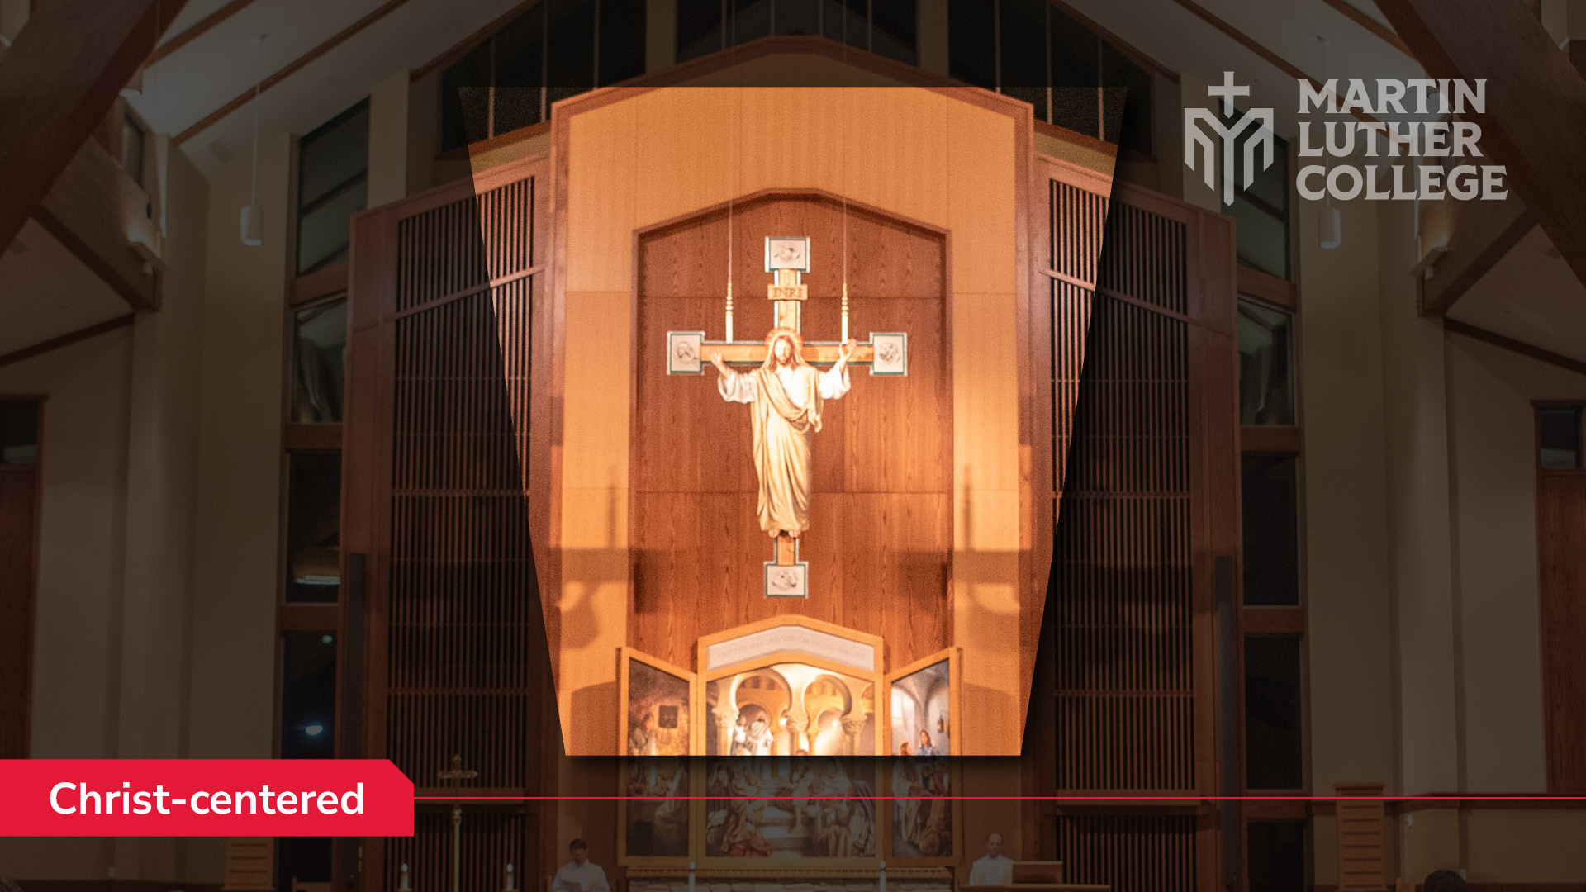
Notes:
Of course, Christ is the center of our campus life and our ministry training.

Slide 9
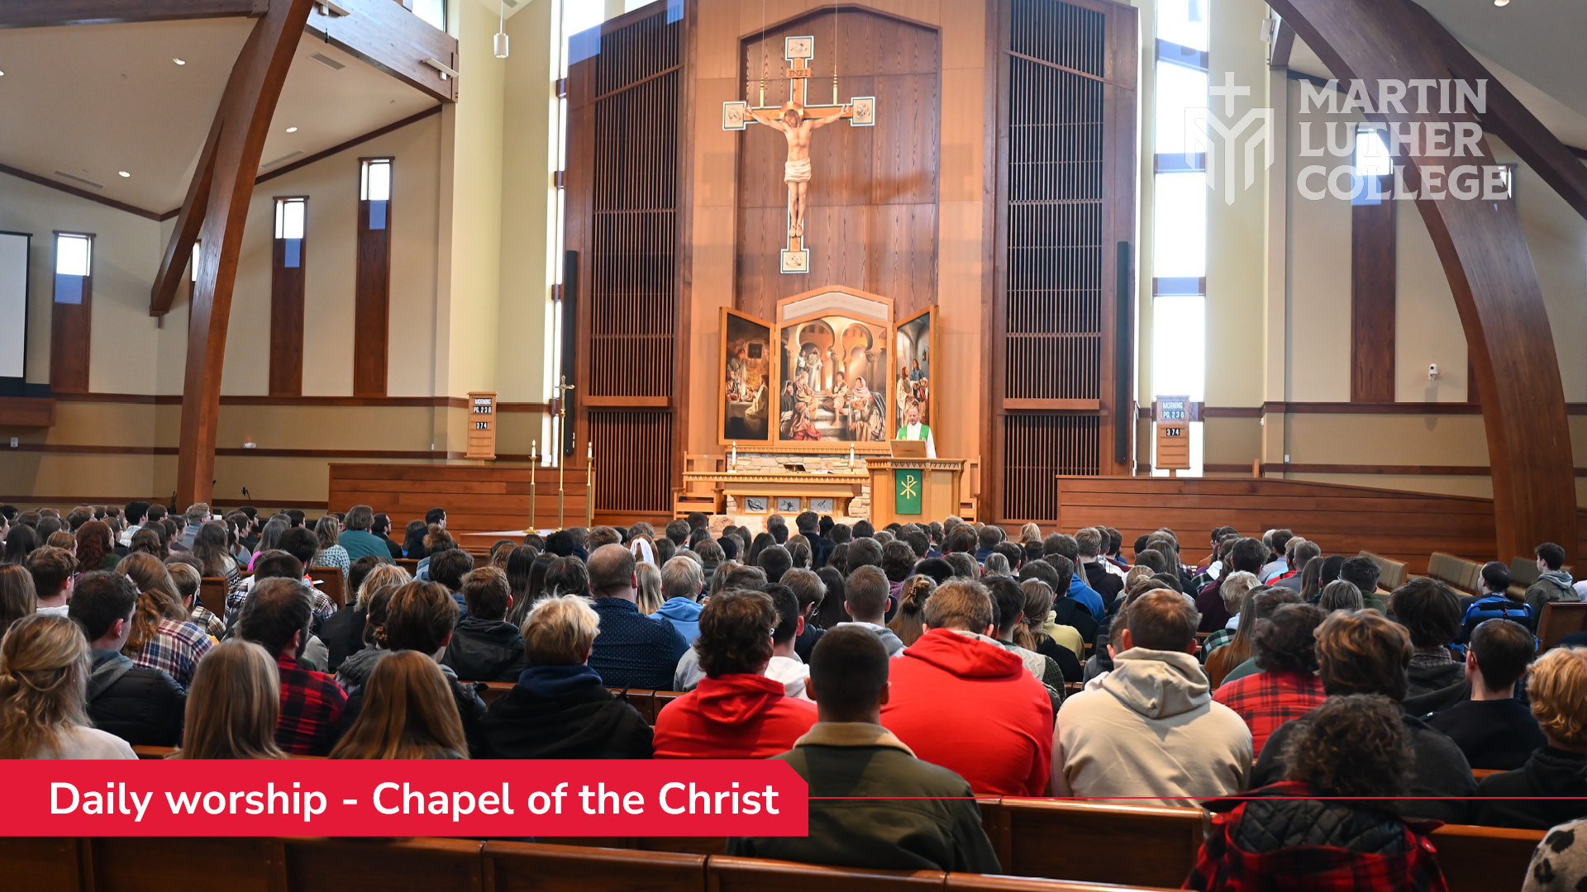
Notes:
Students worship twice a day in the beautiful Chapel of the Christ.

Slide 10
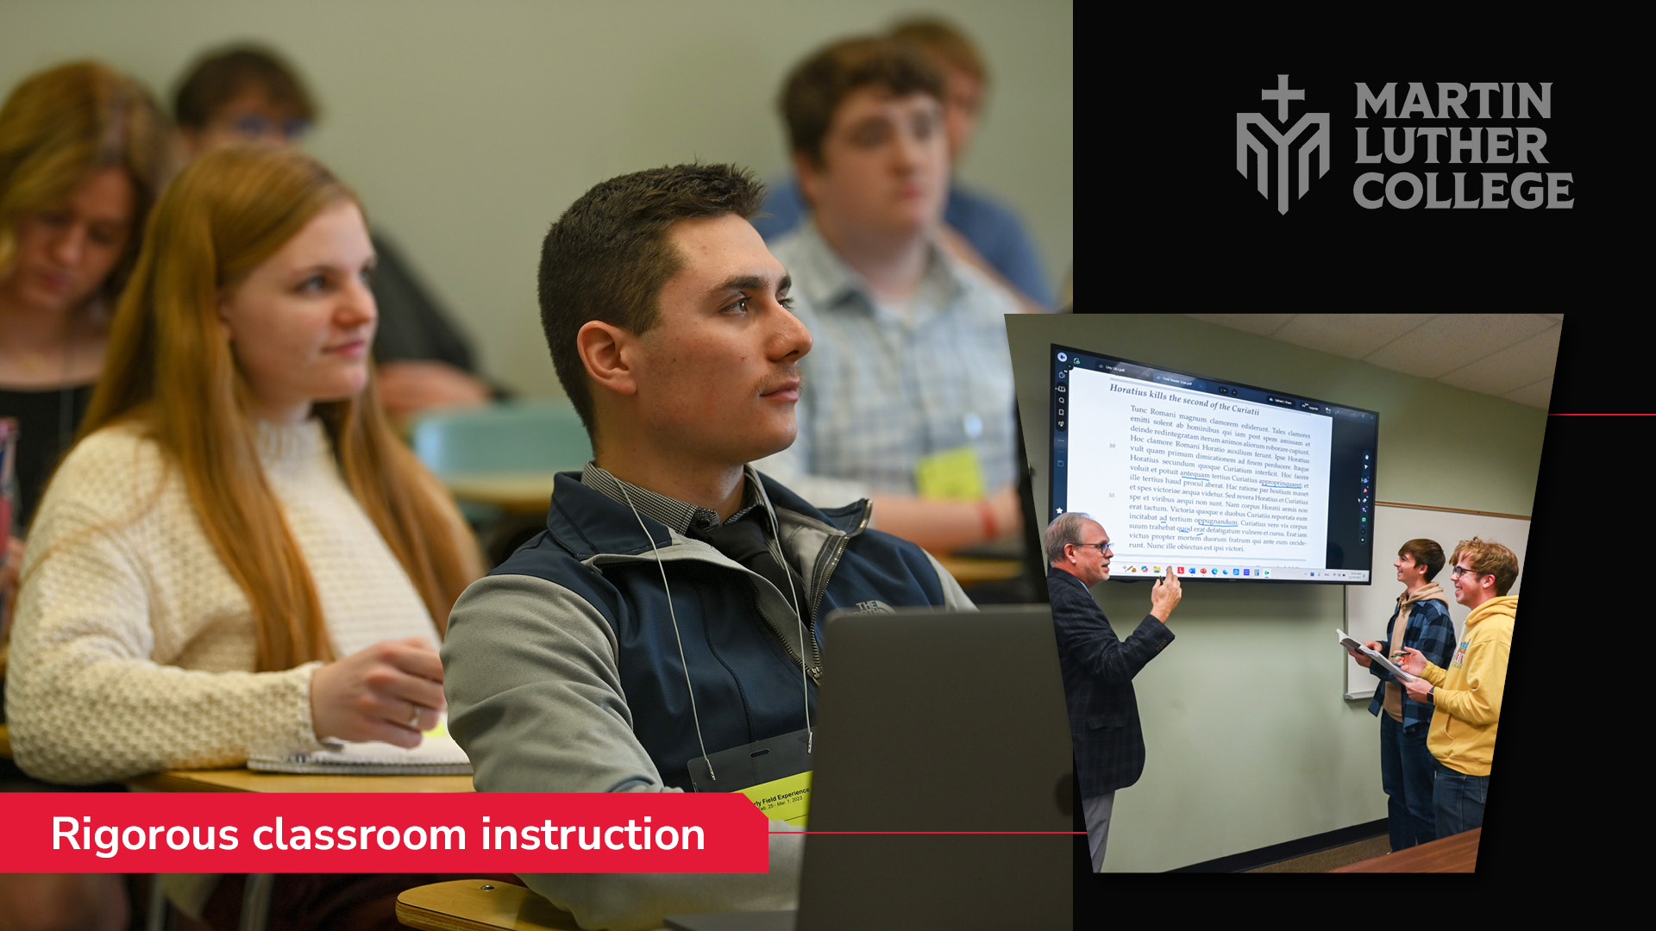
Notes:
They study theology, all the general subjects like English, history, math, and science . . . as well as Greek and Hebrew for the future pastors and professional education courses for the future teachers.

Slide 11
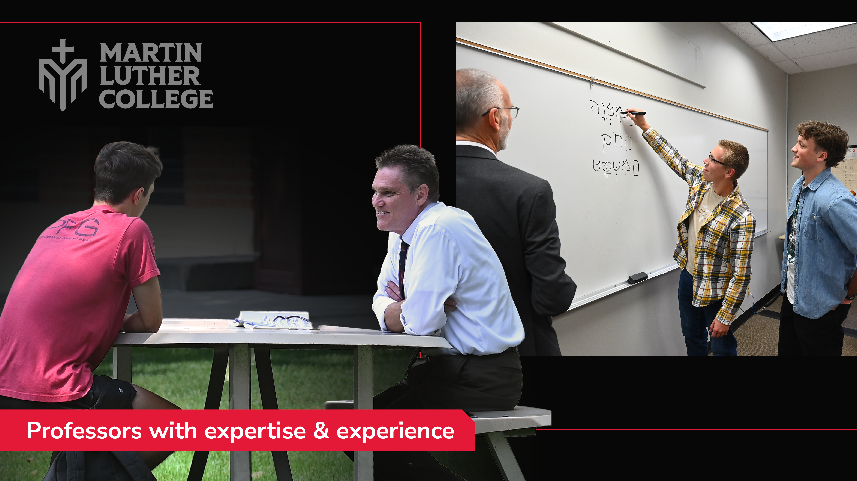
Notes:
Our talented professors not only have subject expertise, they also have ministry experience to share.

Slide 12
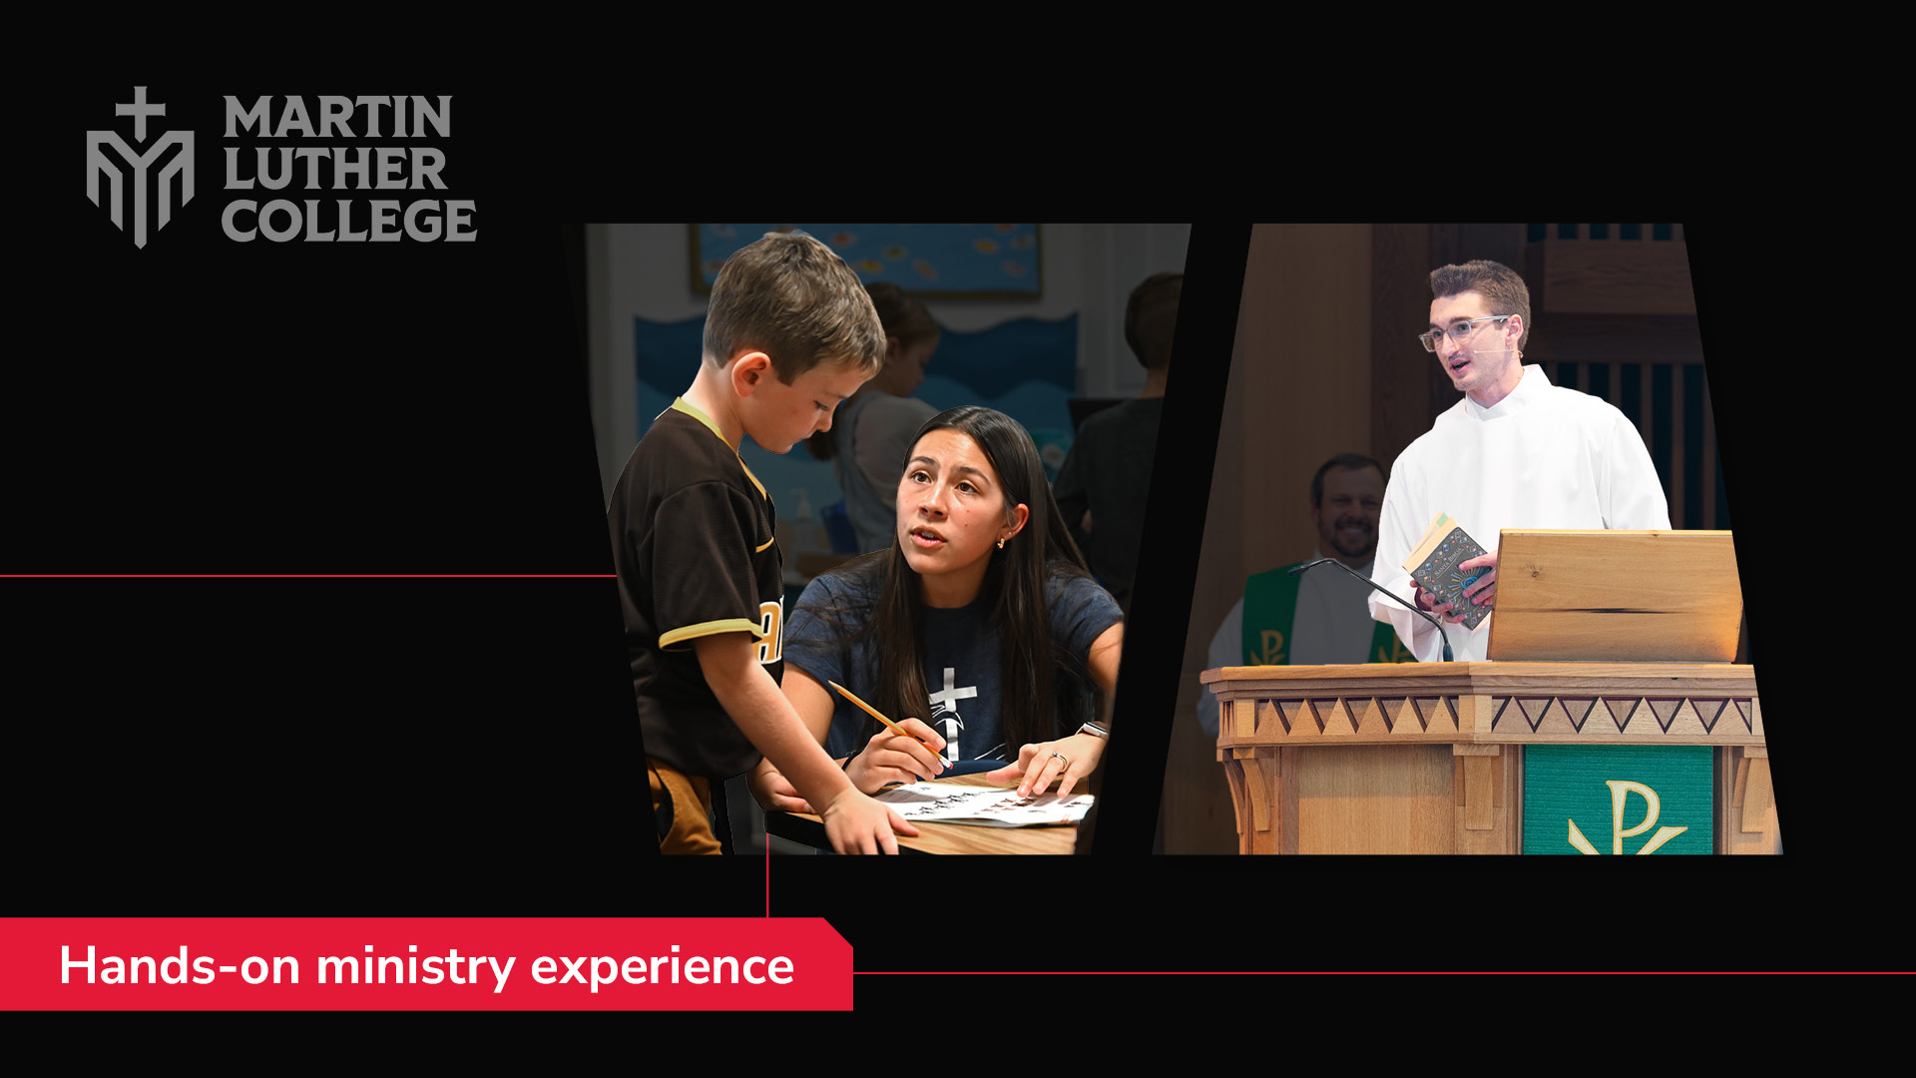
Notes:
Our students are also required to do experiential learning—hands-on training.

Slide 13
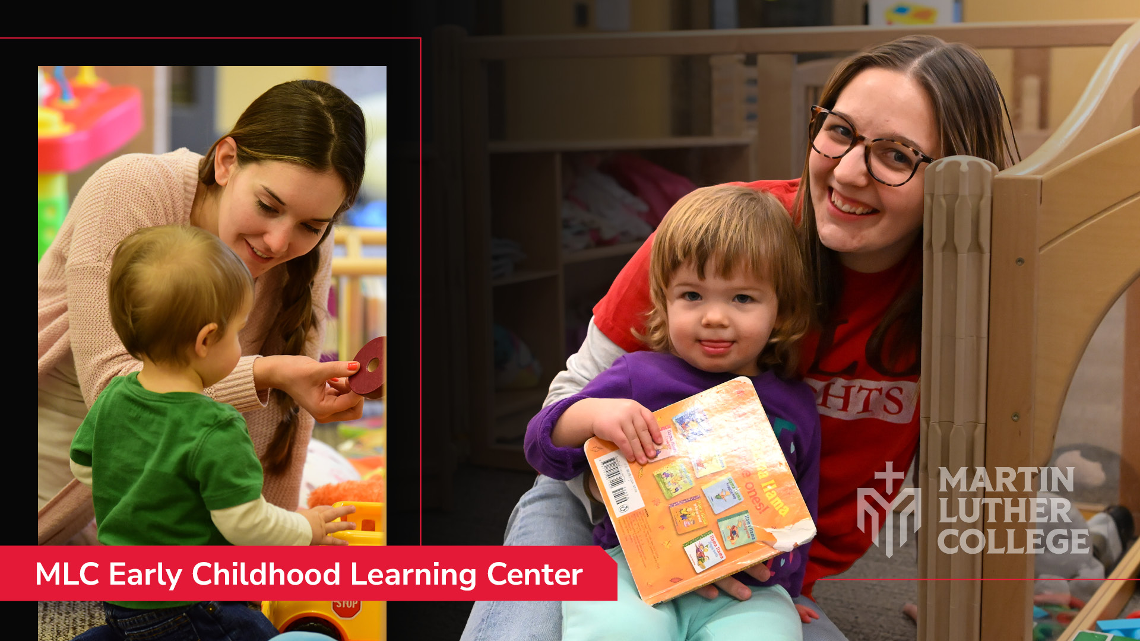
Notes:
Early childhood education majors, for instance, complete much of their student teaching at our own Early Childhood Learning Center.

Slide 14
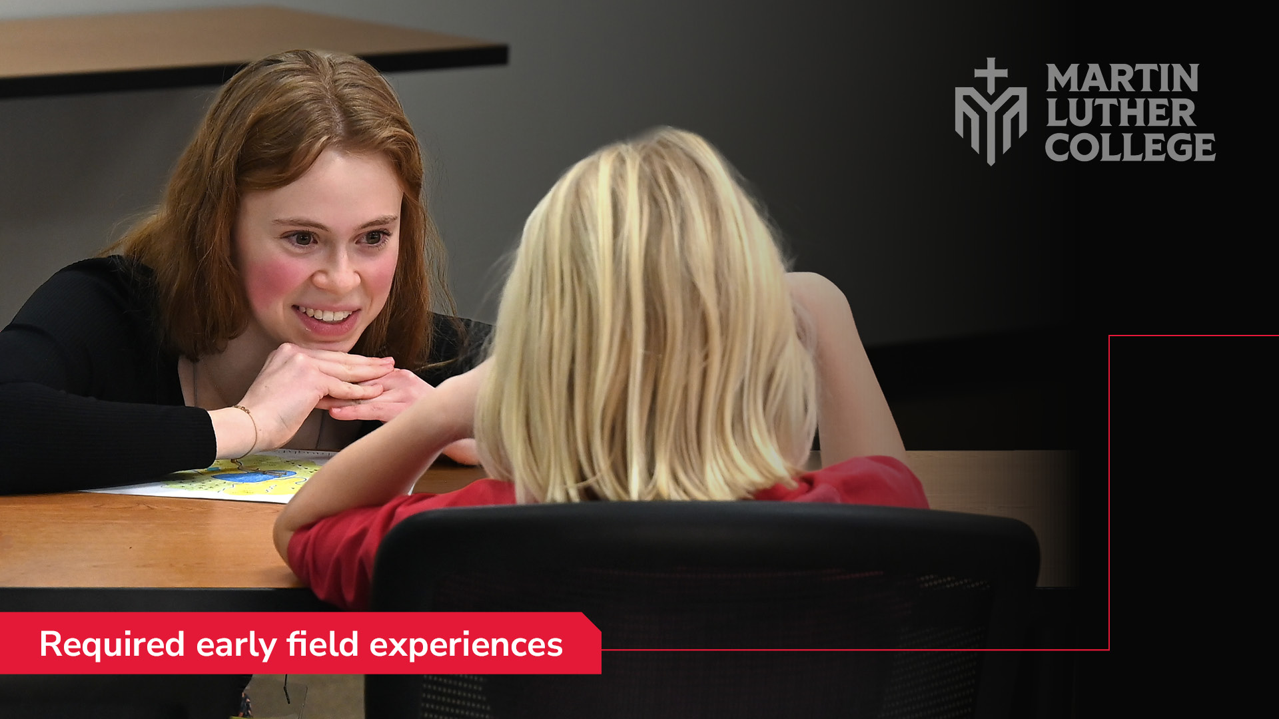
Notes:
All students complete required early field experiences . . .

Slide 15
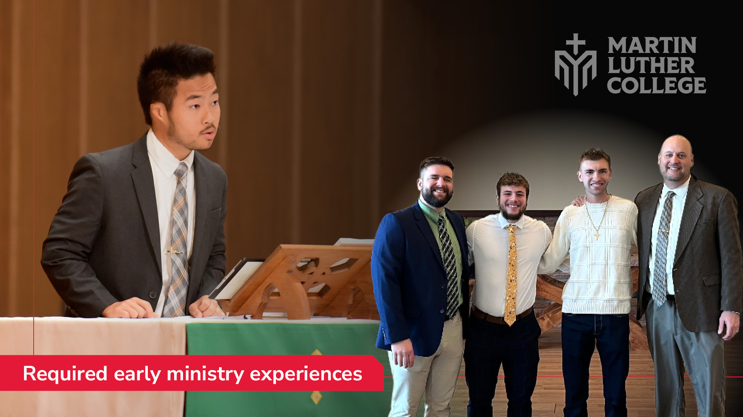
Notes:
. . . or early ministry experiences at congregations and schools all over the country.

Slide 16
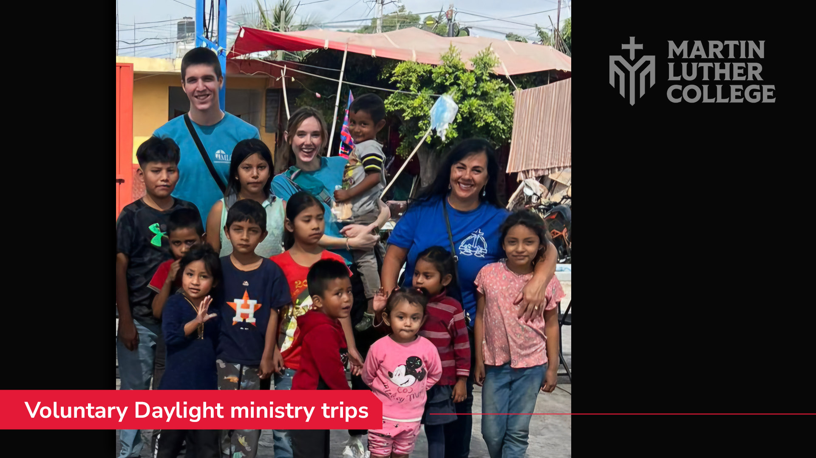
Notes:
Many of our students also complete voluntary Daylight ministry experiences, assisting with vacation Bible school, Easter for kids, worship, evangelism, and more all over the country—and sometimes the world.

Slide 17
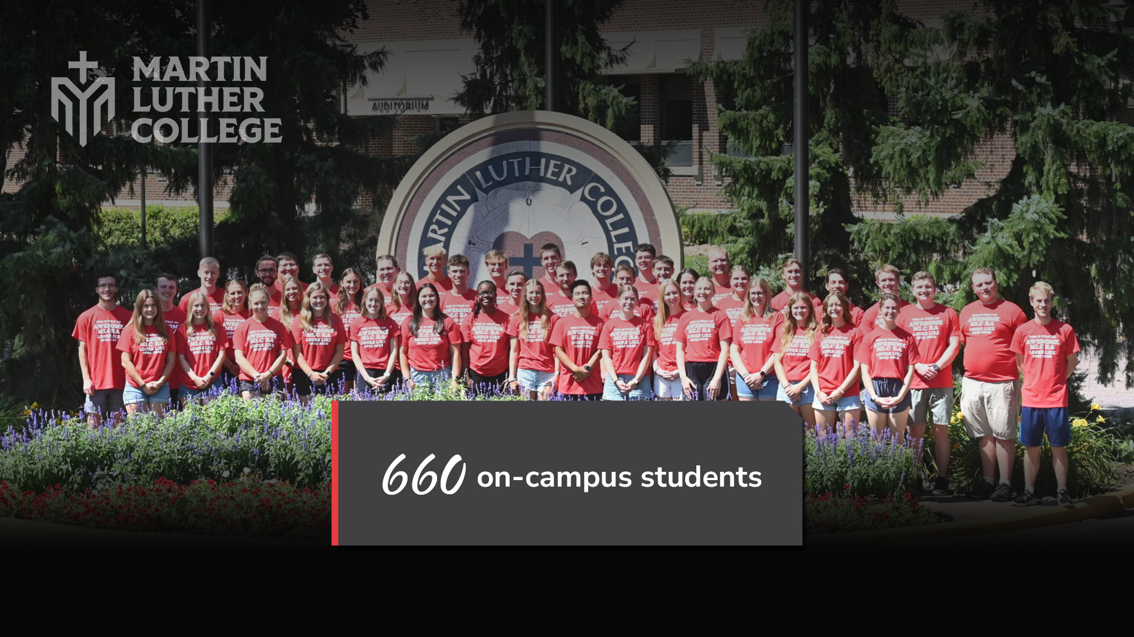
Notes:
On campus this year we have 660 undergraduate students preparing for ministry.

Slide 18
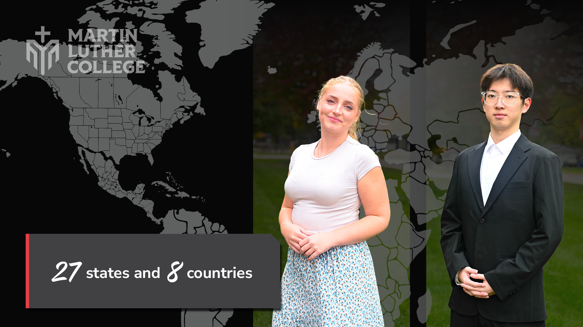
Notes:
They come from 27 states and 8 countries.

Slide 19
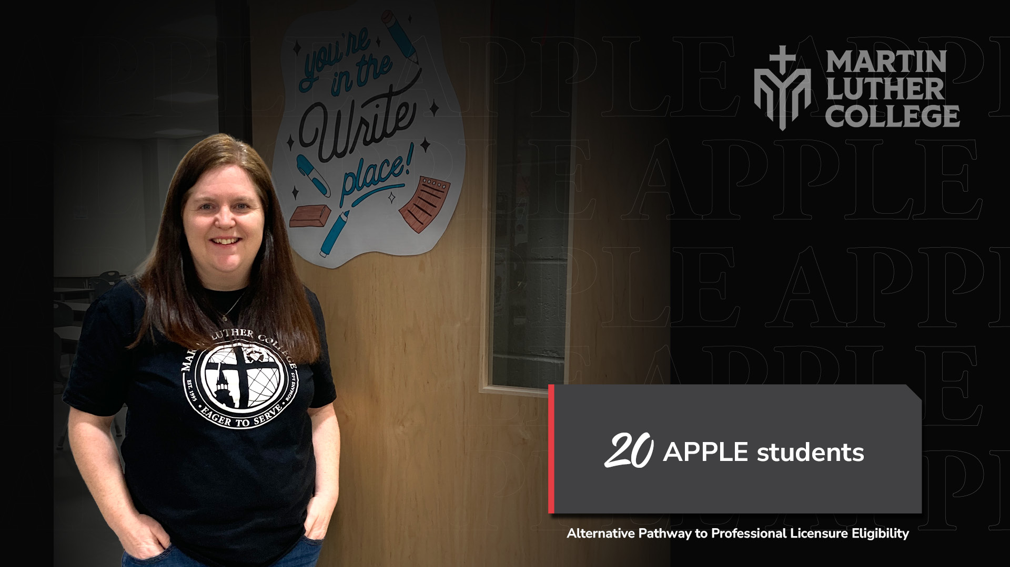
Notes:
We also have 20 adult learners enrolled in our new online APPLE program.

Slide 20
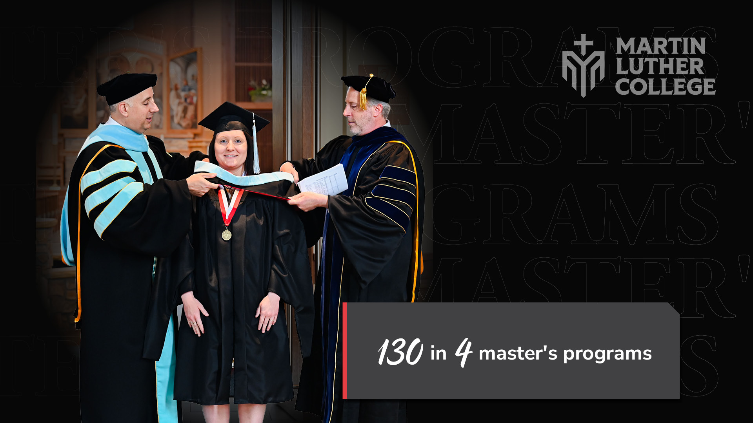
Notes:
And we don’t train only undergraduates. We also provide education on the graduate level. Today 130 graduate students are completing degrees in four different master’s programs.

Slide 21
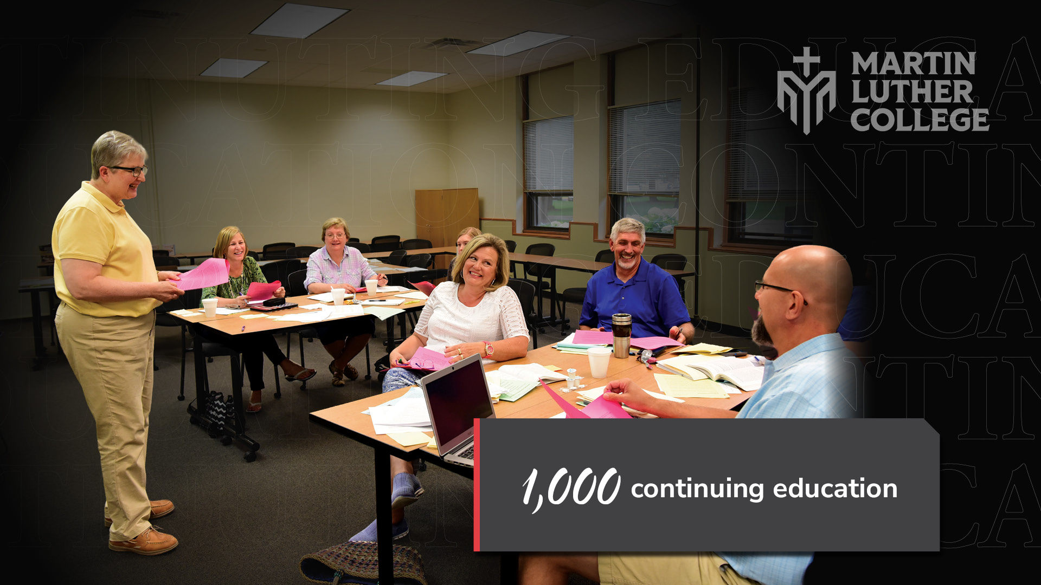
Notes:
We also teach another 1,000 people in continuing ed workshops, webinars, satellite courses, and more.

Slide 22
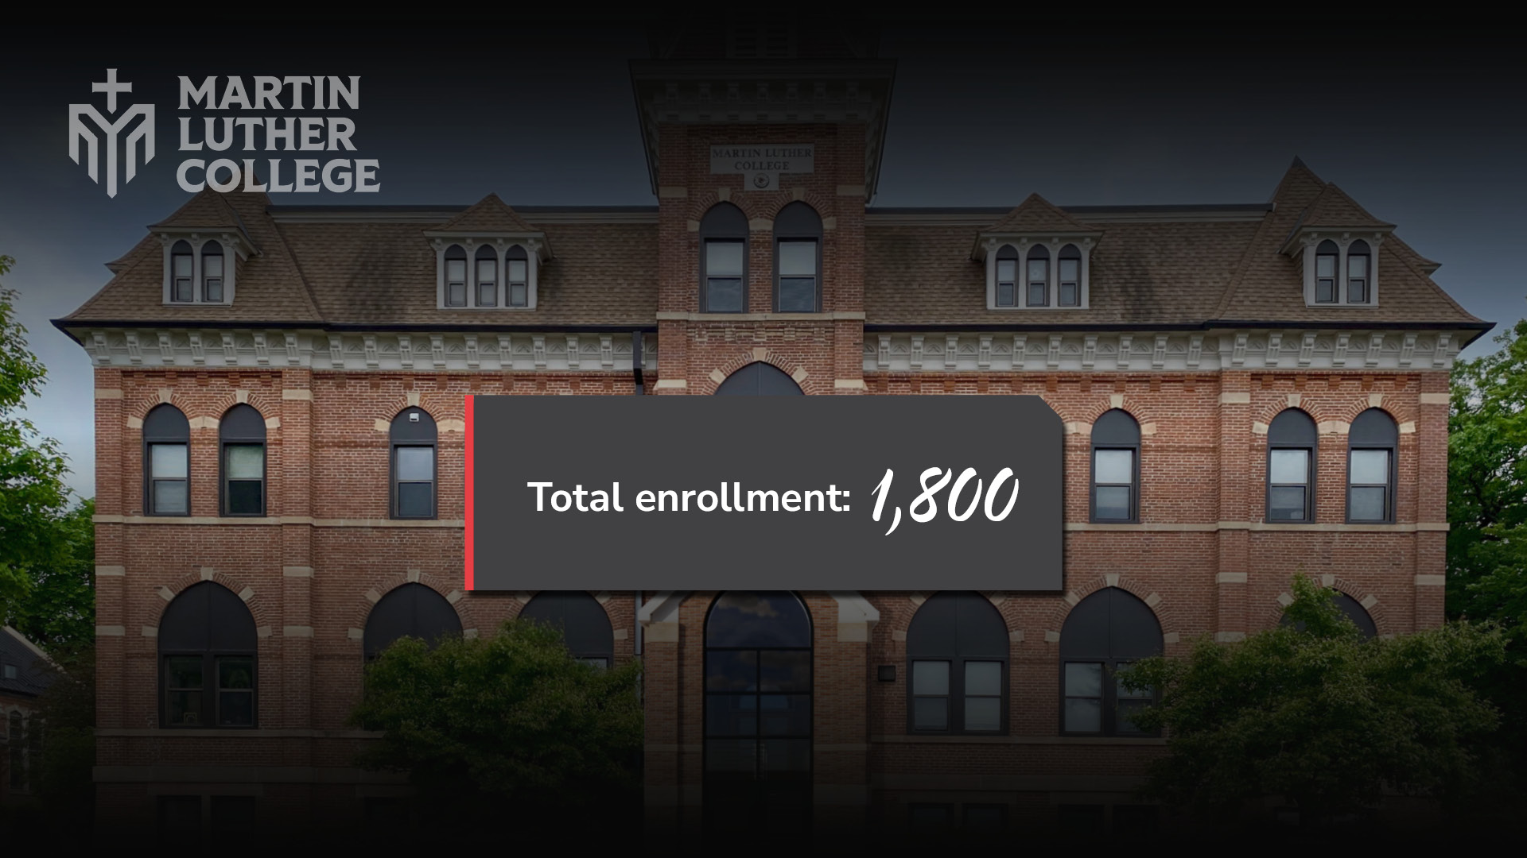
Notes:
That means we’re educating about 1,800 students.

Slide 23
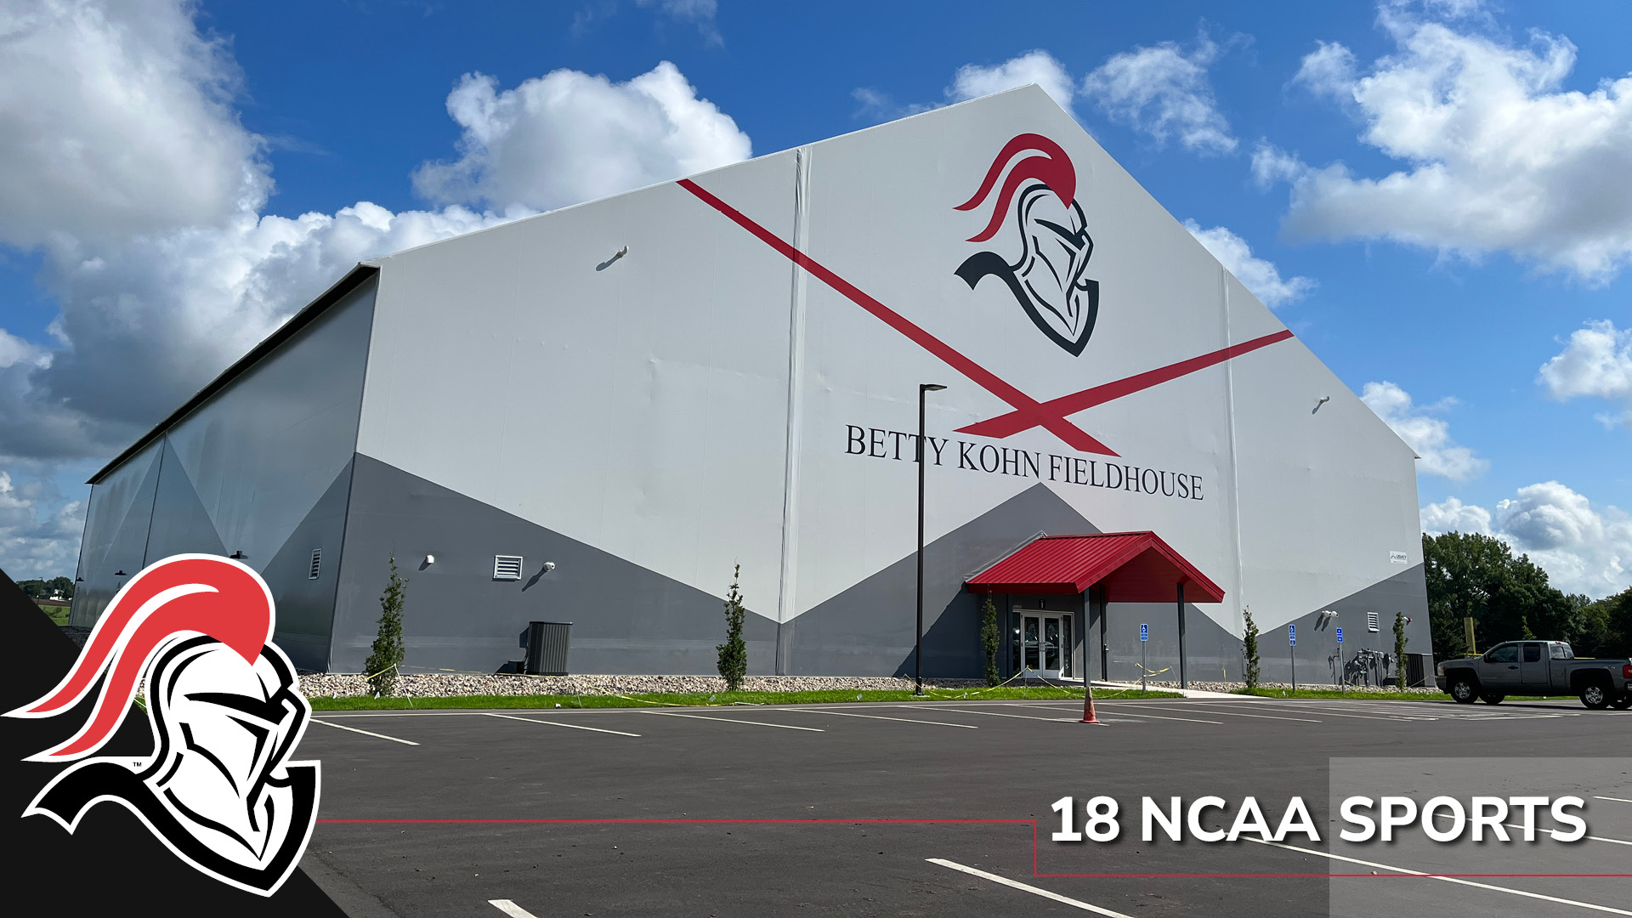
Notes:
What is campus life like? Students compete in 18 NCAA DIII sports.

Slide 24
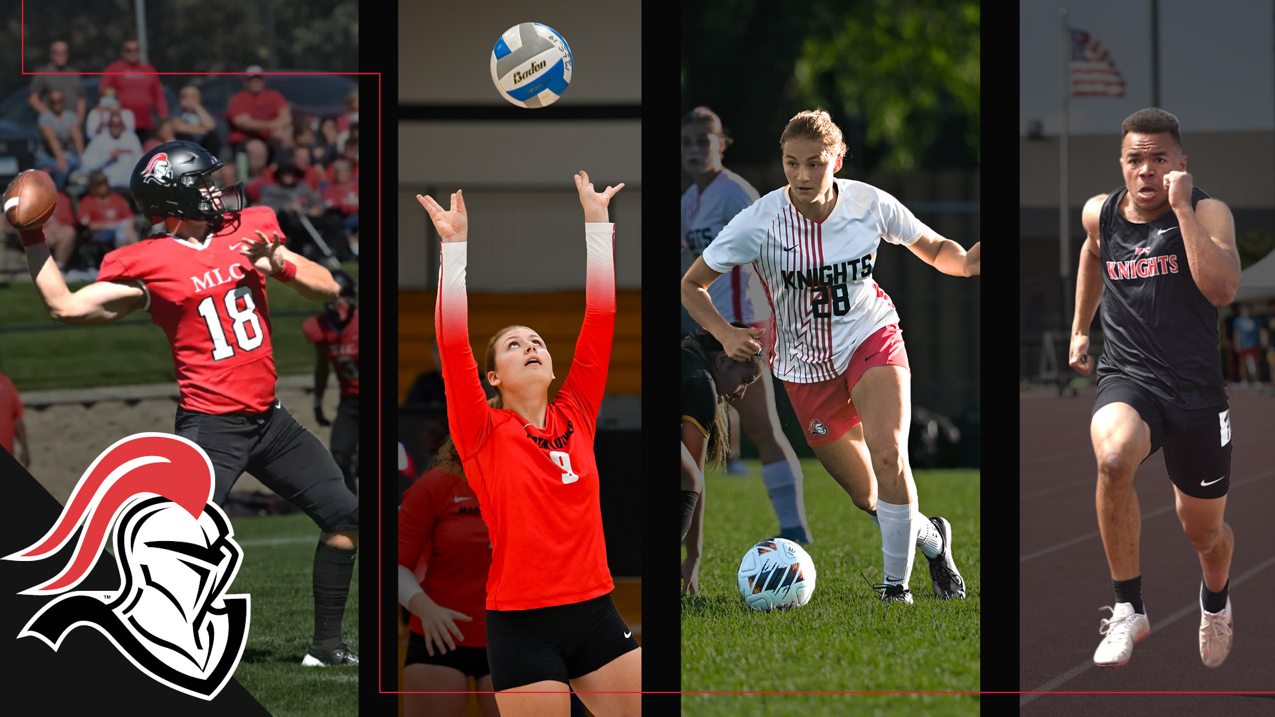
Notes:
[sports slides – to go through quickly]

Slide 25
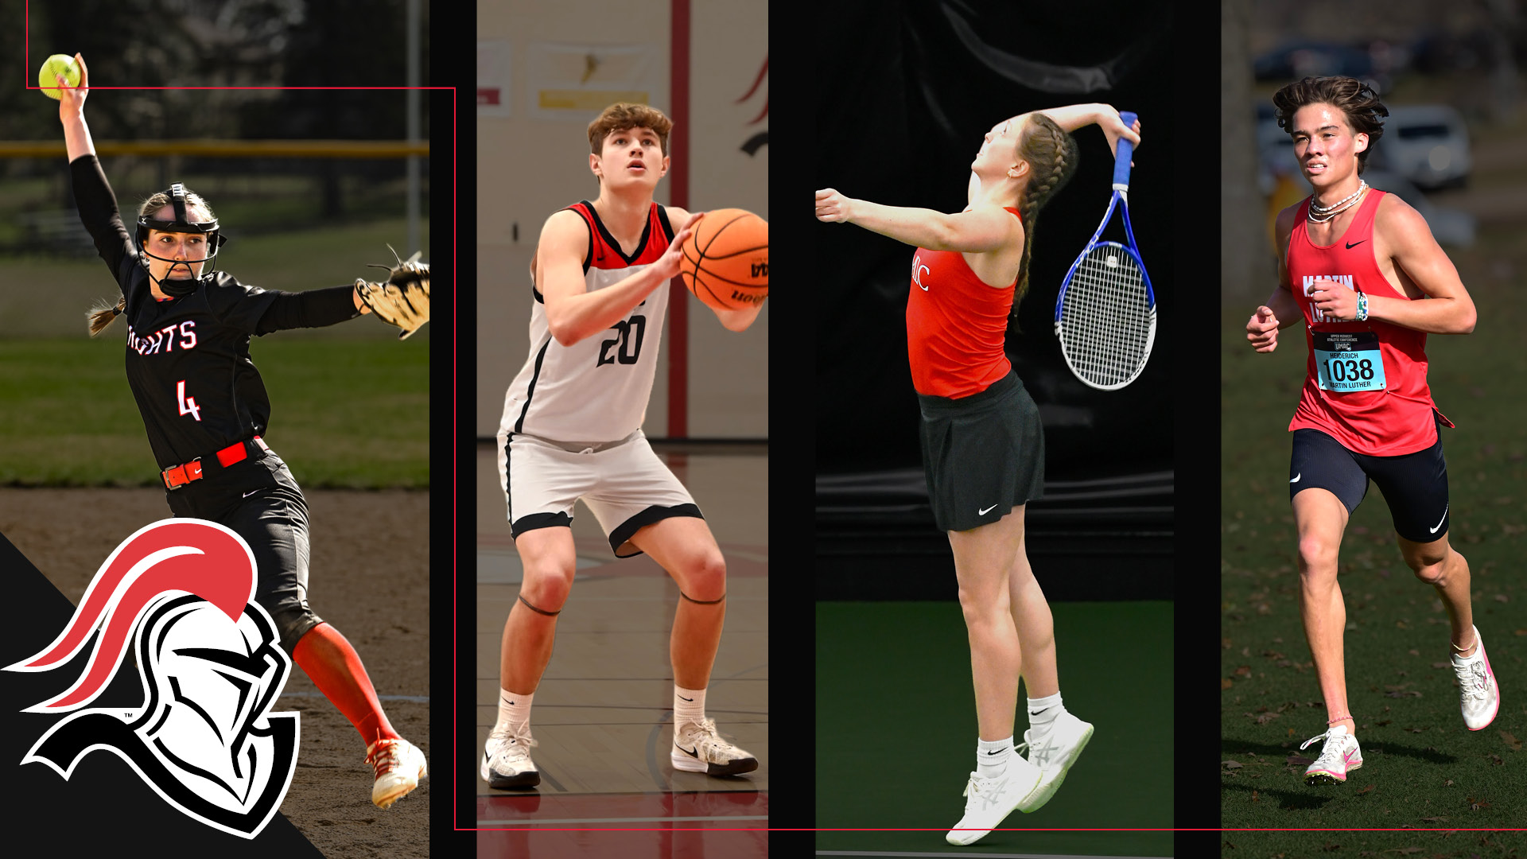
Notes:
[sports slides – to go through quickly]

Slide 26
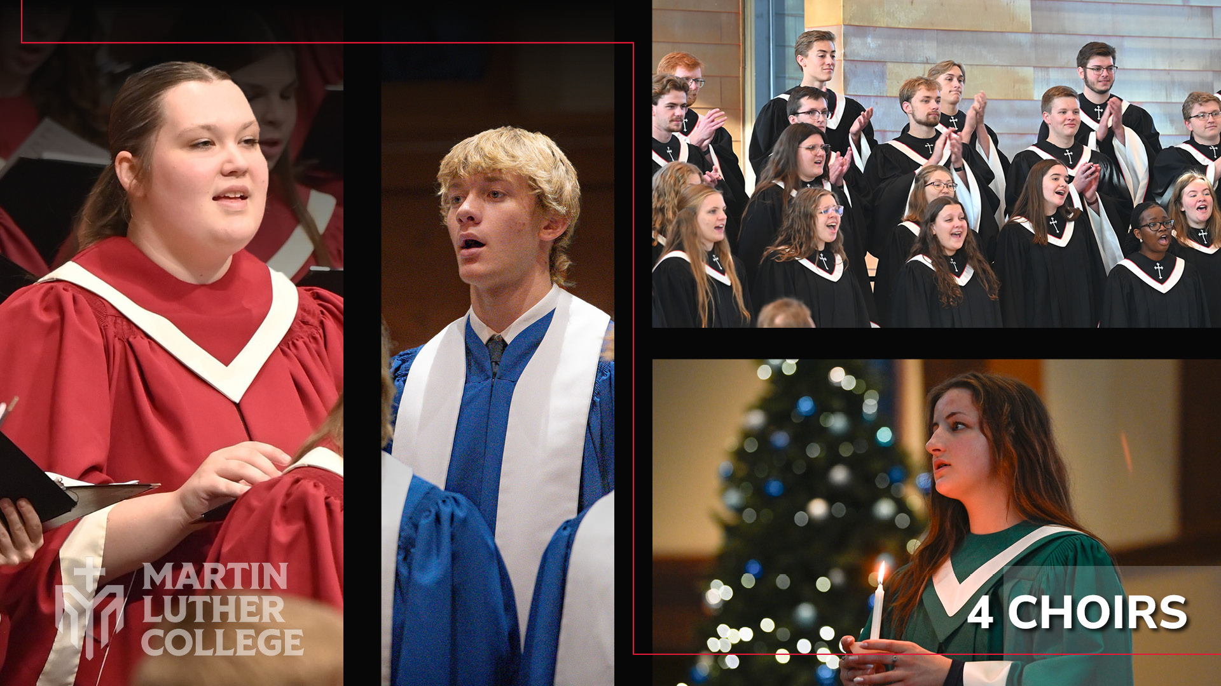
Notes:
They sing in four auditioned choirs, including the College Choir, which tours the country.

Slide 27
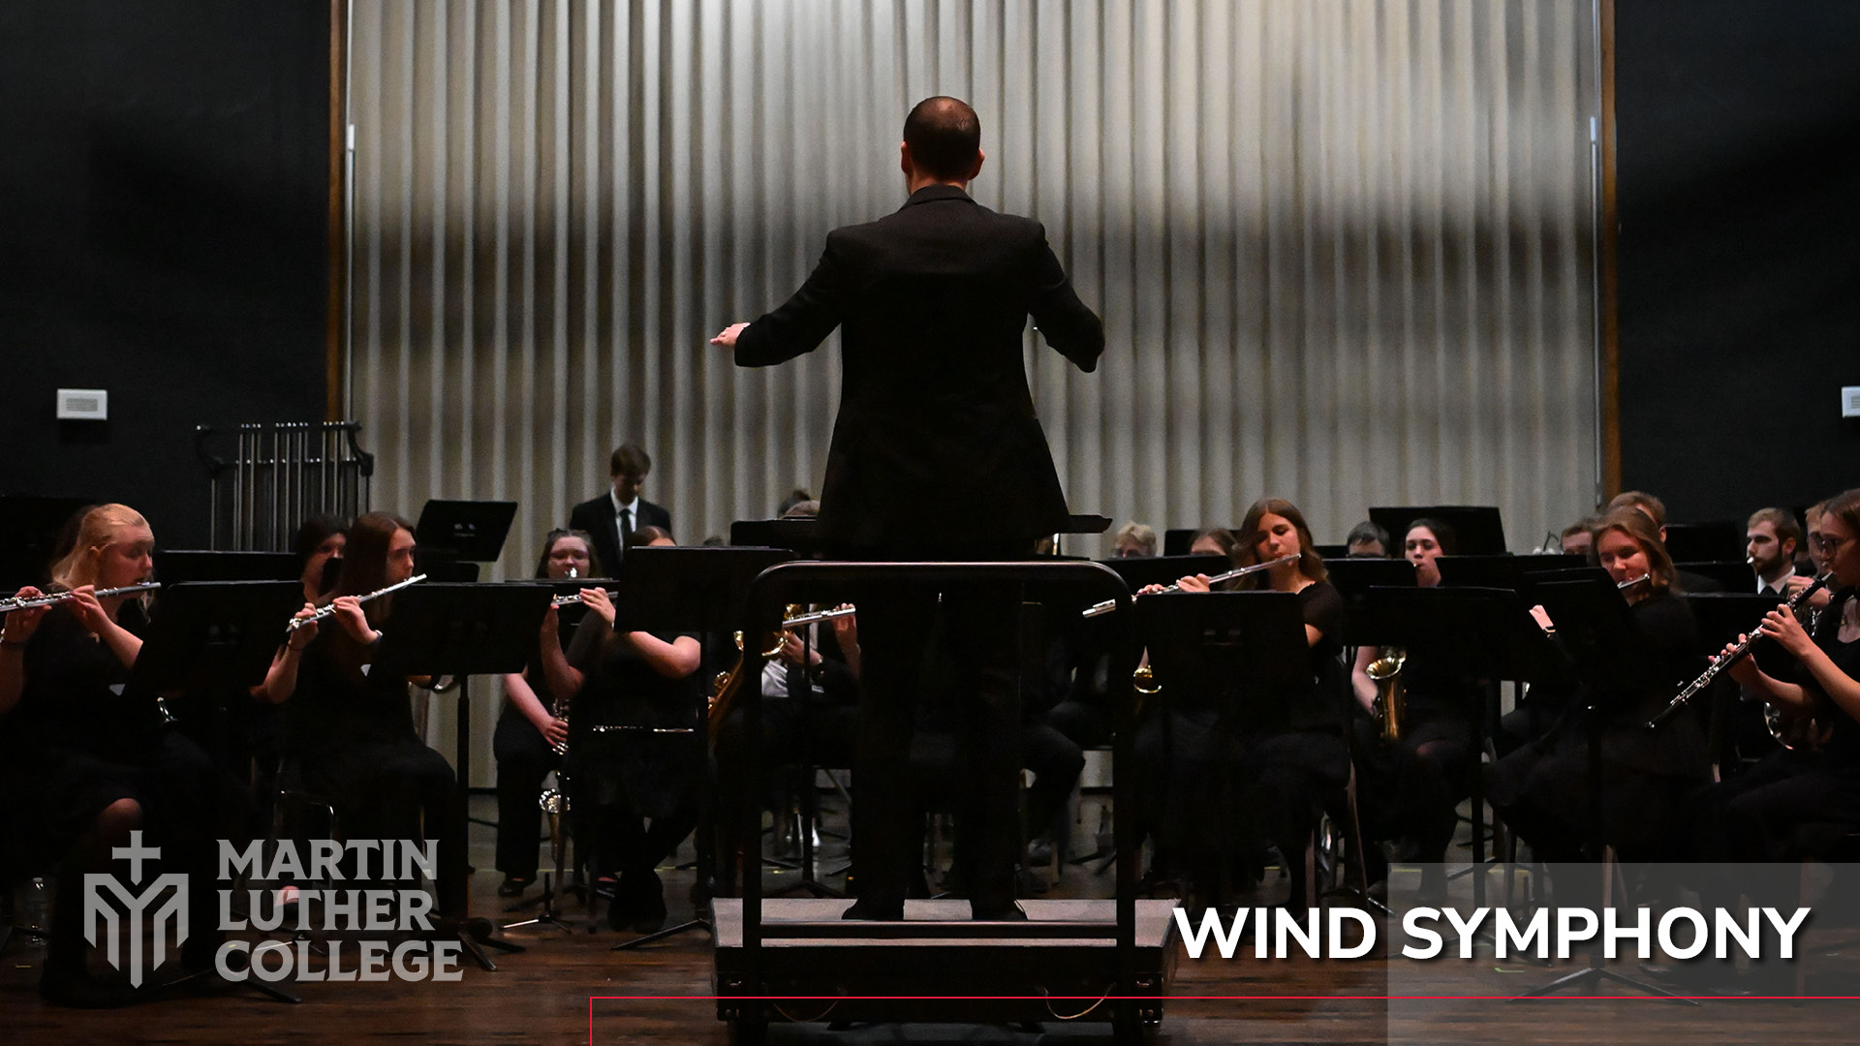
Notes:
They play in our Handbell Choir and our Wind Symphony, which also takes an annual tour.

Slide 28
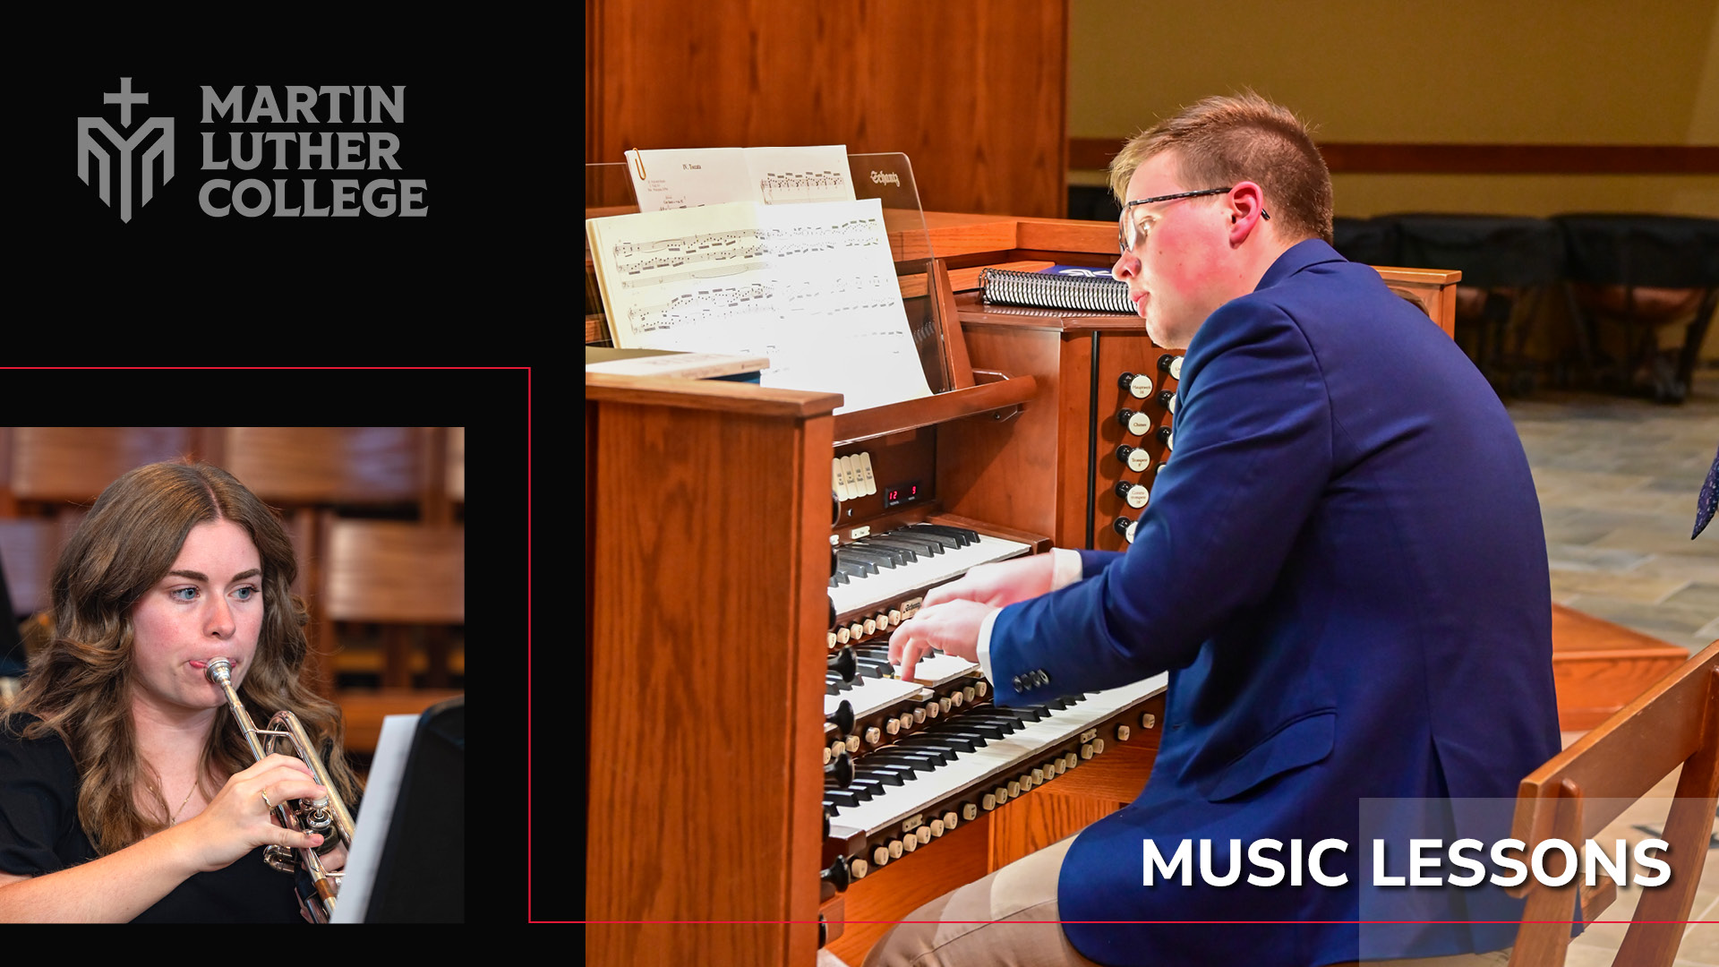
Notes:
And many take lessons in piano, organ, voice, and wind and string instruments.

Slide 29
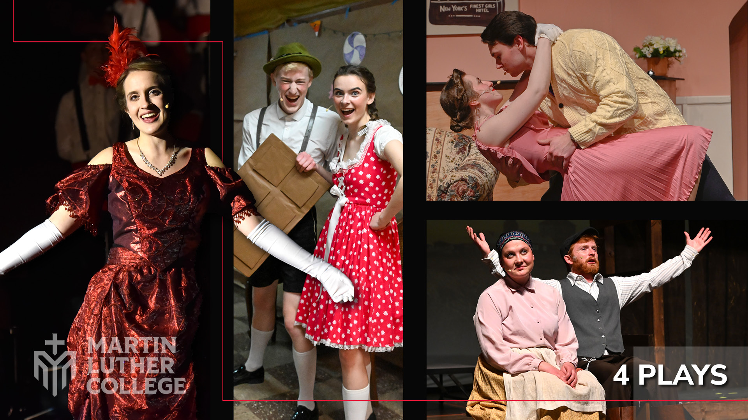
Notes:
Many students participate in Forum, our drama club, which stages four plays a year.

Slide 30
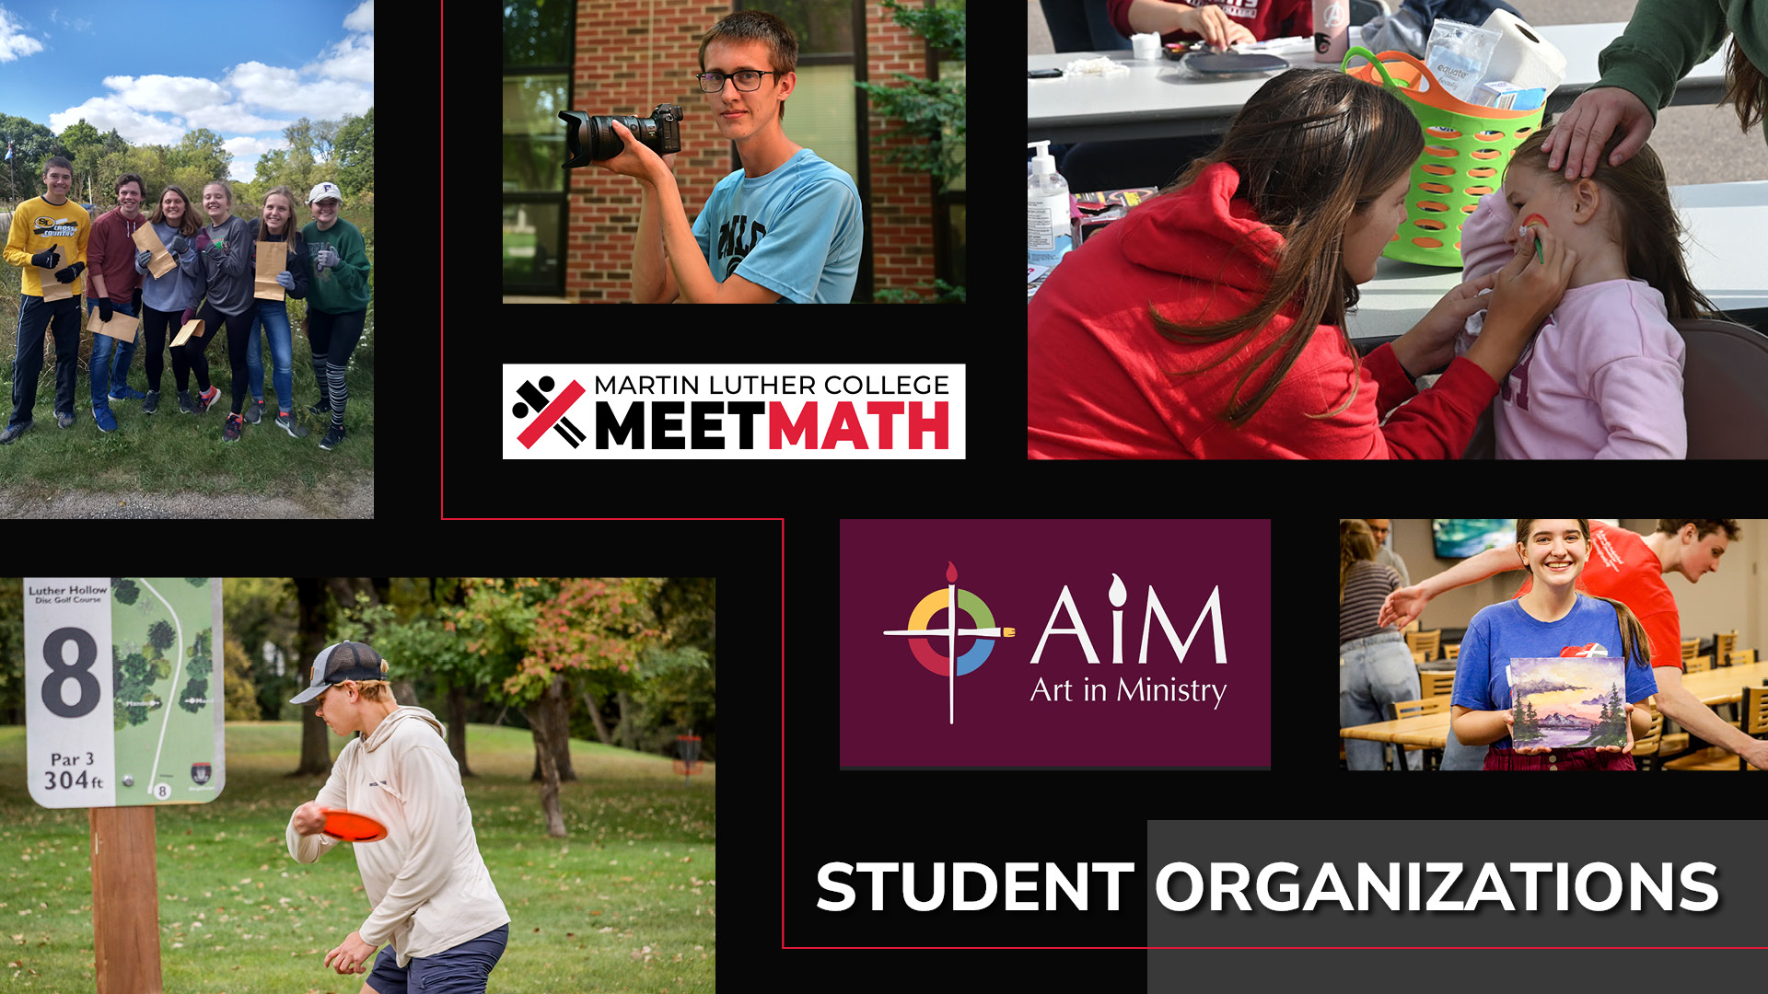
Notes:
Student organizations and clubs develop their talents and add a lot of fun to the week—everything from Student Senate to Pickleball Club.

Slide 31
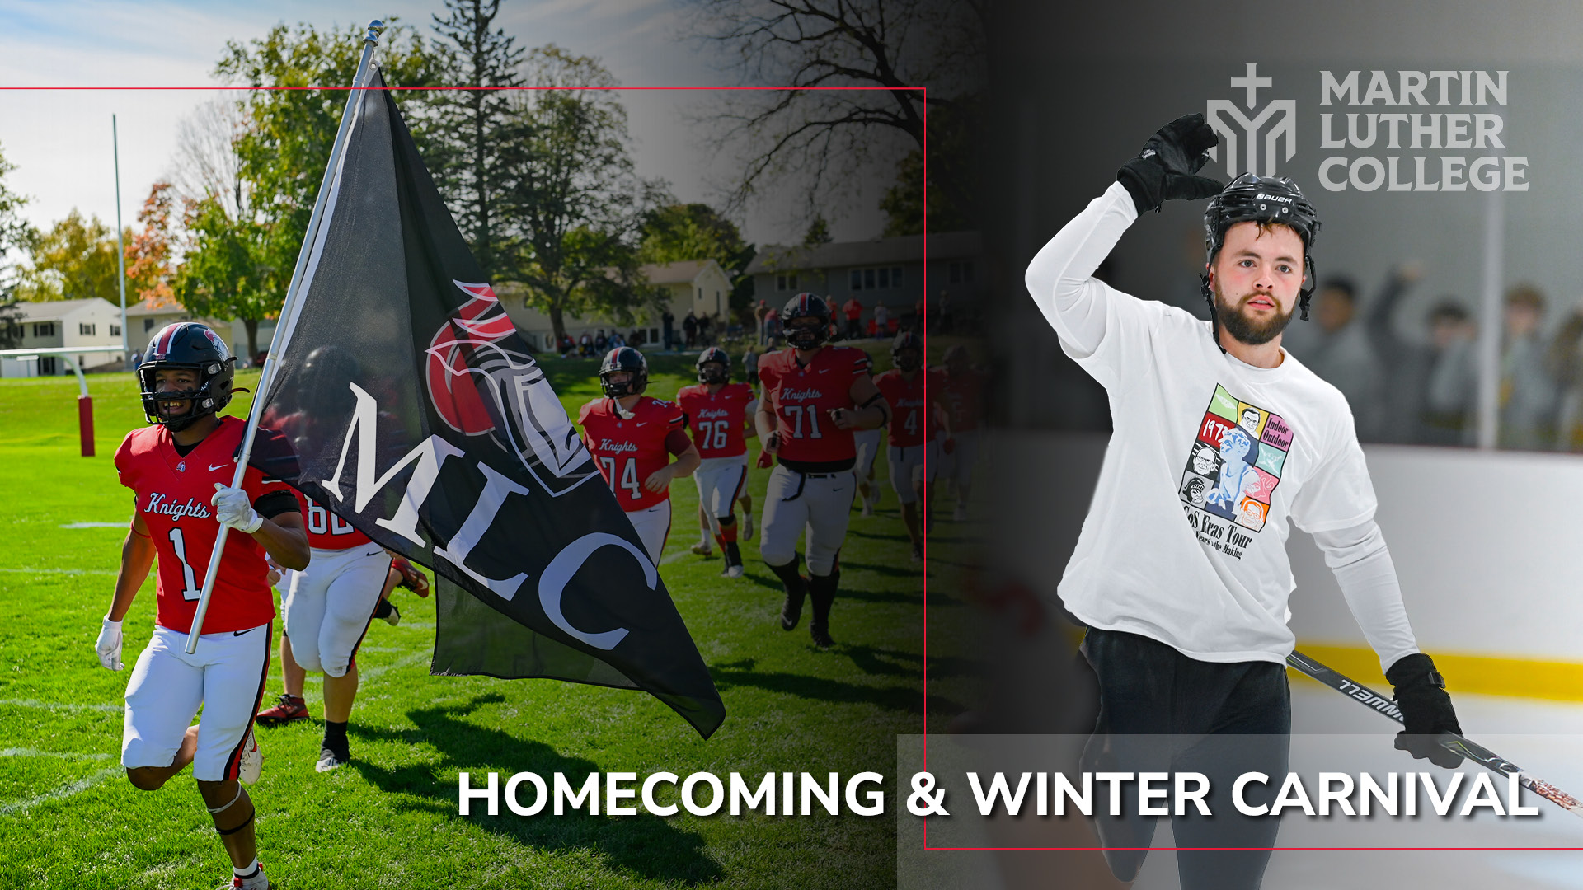
Notes:
And of course, they enjoy Homecoming & Winter Carnival, traditions we’ve enjoyed for generations.

Slide 32
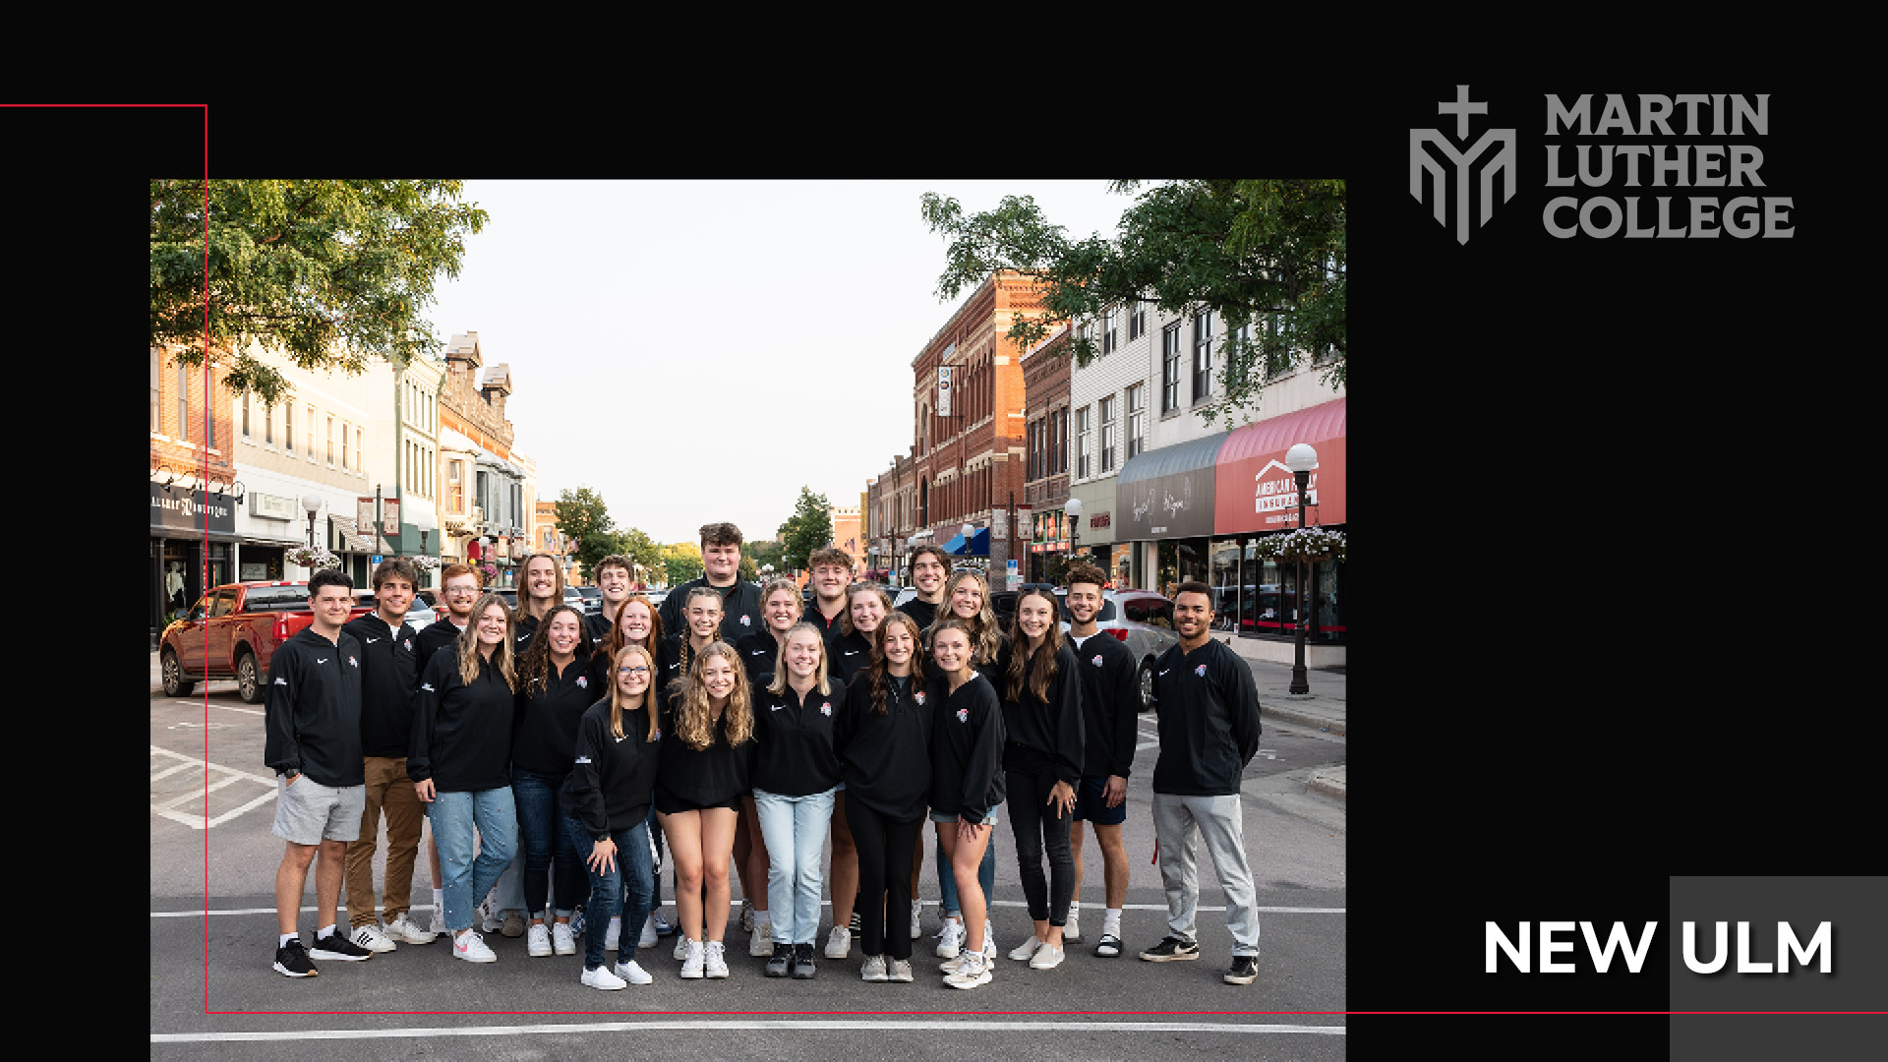
Notes:
Our students are also active in New Ulm, a safe and welcoming community that is regularly ranked as one of the “Best Small Towns in America.”

Slide 33
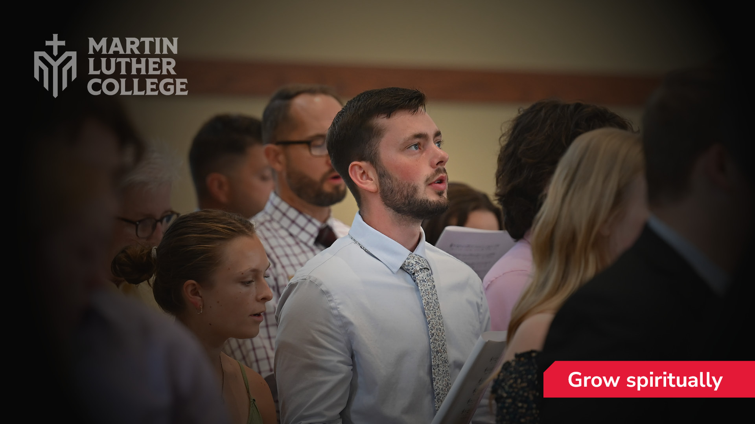
Notes:
All these different aspects of campus life play a role in the ultimate goal of training our students for ministry training. Our students are growing spiritually . . .

Slide 34
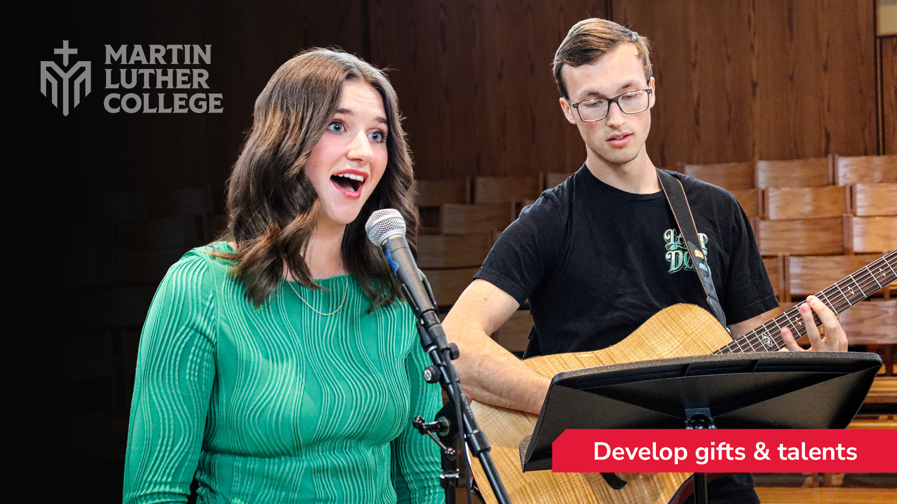
Notes:
. . . and discovering and developing their gifts in the classroom, on the court, and in the concert hall.

Slide 35
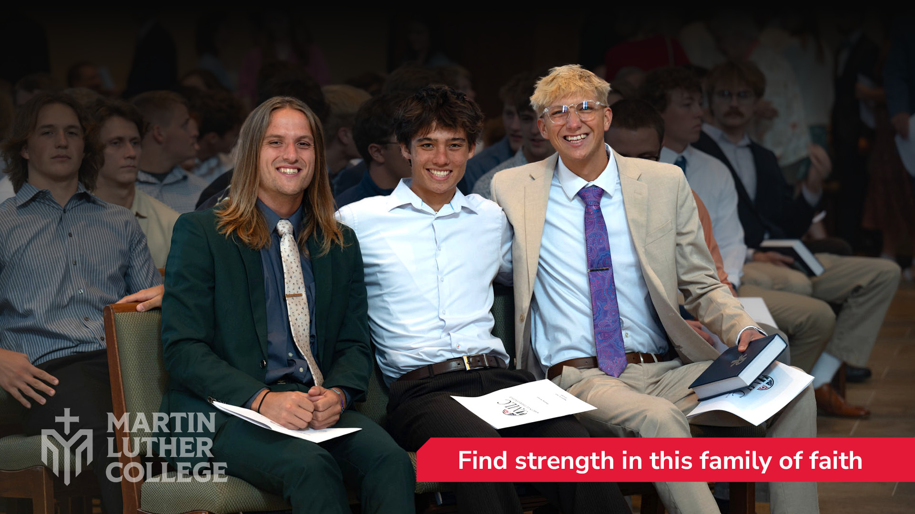
Notes:
They’re also enjoying Christian community as they find strength in this family of faith.

Slide 36
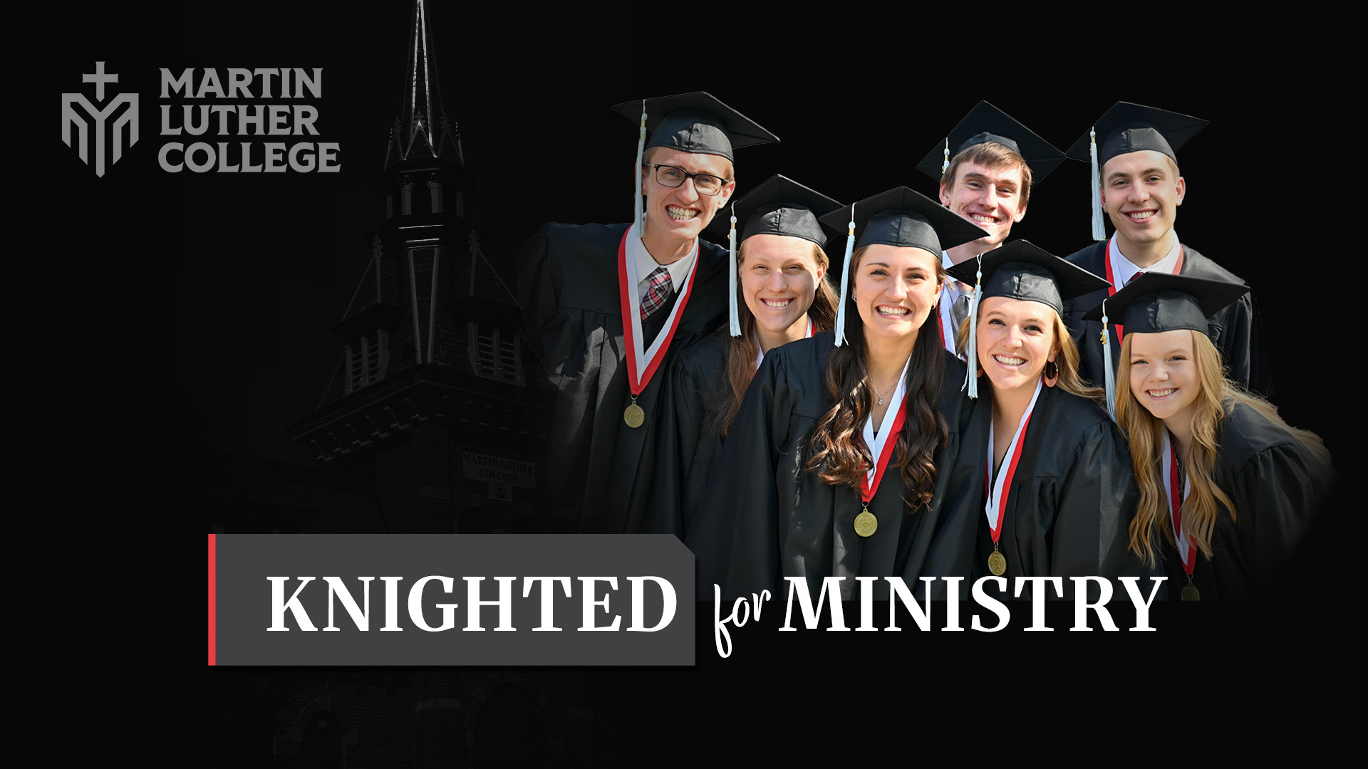
Notes:
Here at MLC, by the power of the gospel, they are being Knighted for Ministry.

Slide 37

Winter Carnival
February 1 - 7
MLC Golf Classic
New Ulm Country Club
MLC OpenLearning
FREE Virtual Conference
June 16 - 17, 10:00 am - 1:30 pm
Spring Choir Tour:
Arizona, Utah, & Nevada
March 5 - 14
2026-27 MLC School Year Begins
August 22
Notes:
[This slide can be edited!]

