Slide 2
731 STUDENTS ON CAMPUS

Slide 3
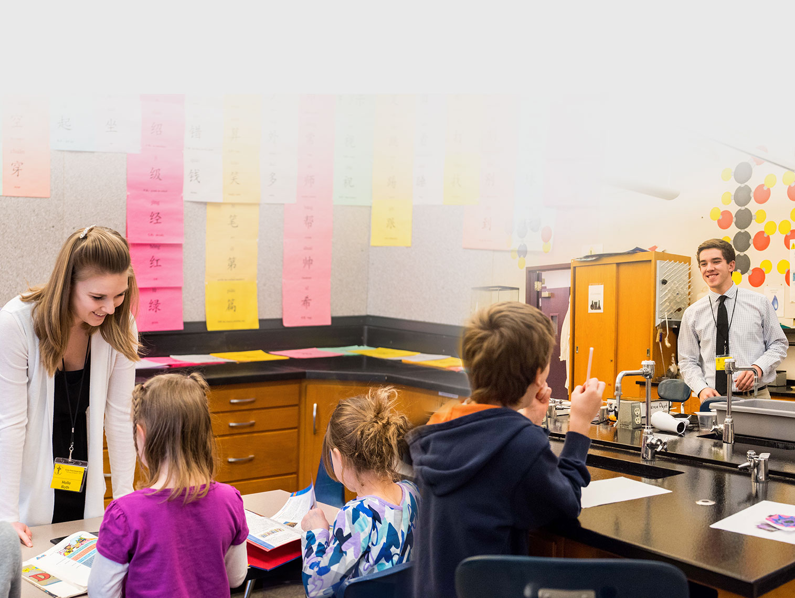
554 EDUCATION & STAFF MINISTRY STUDENTS

Slide 4
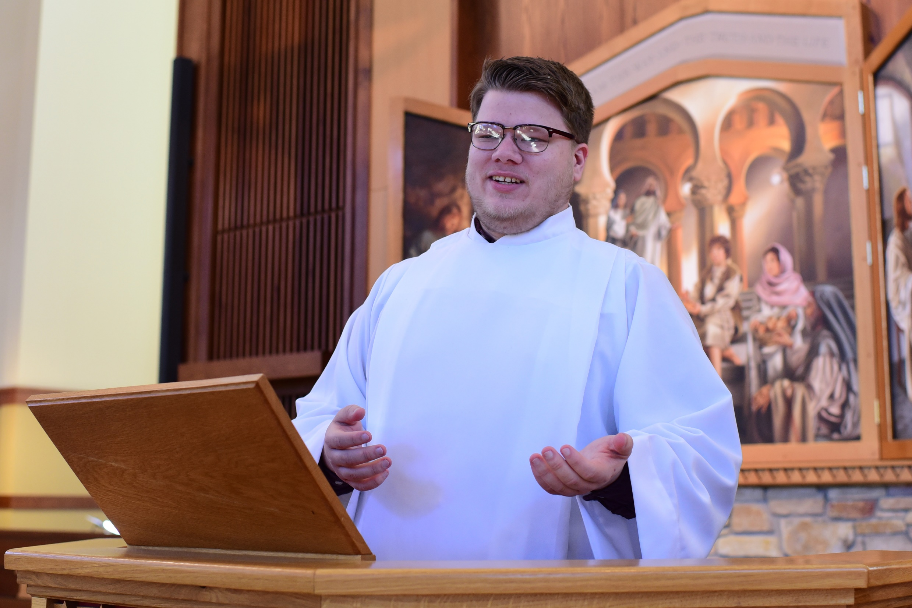
177 PRESEMINARY STUDENTS

Slide 5
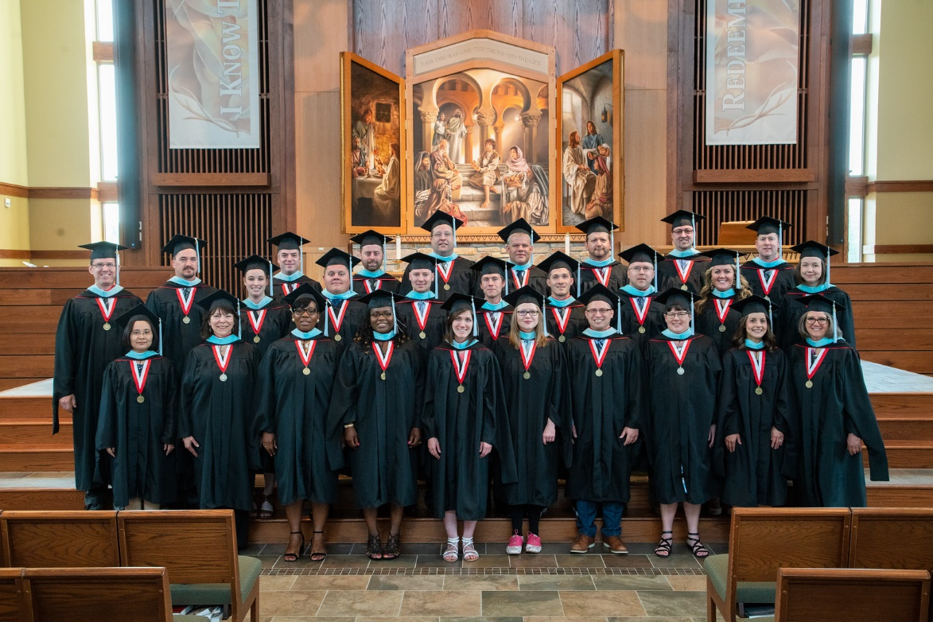
129 Graduate Studies Students

Slide 6
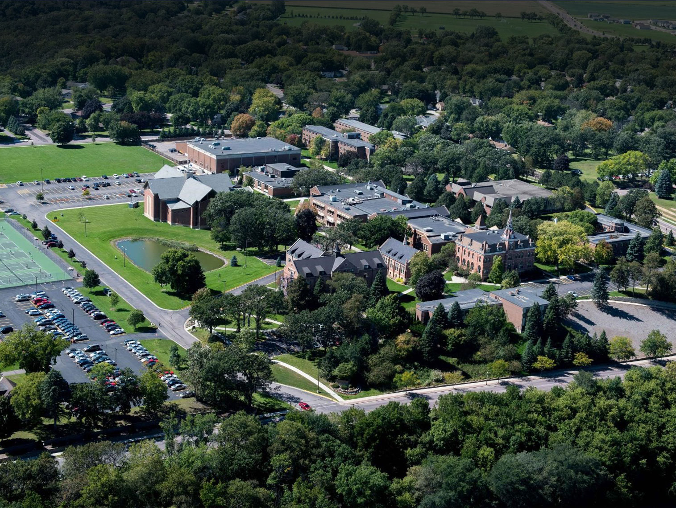
1,800+ TOTAL STUDENTS SERVED

Slide 7
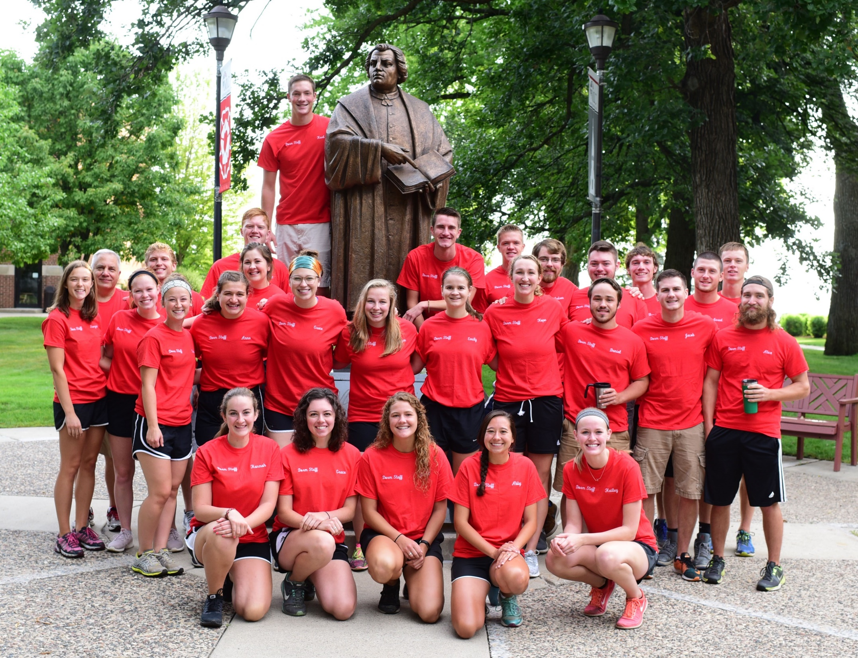
6 COUNTRIES & 35 STATES

Slide 8
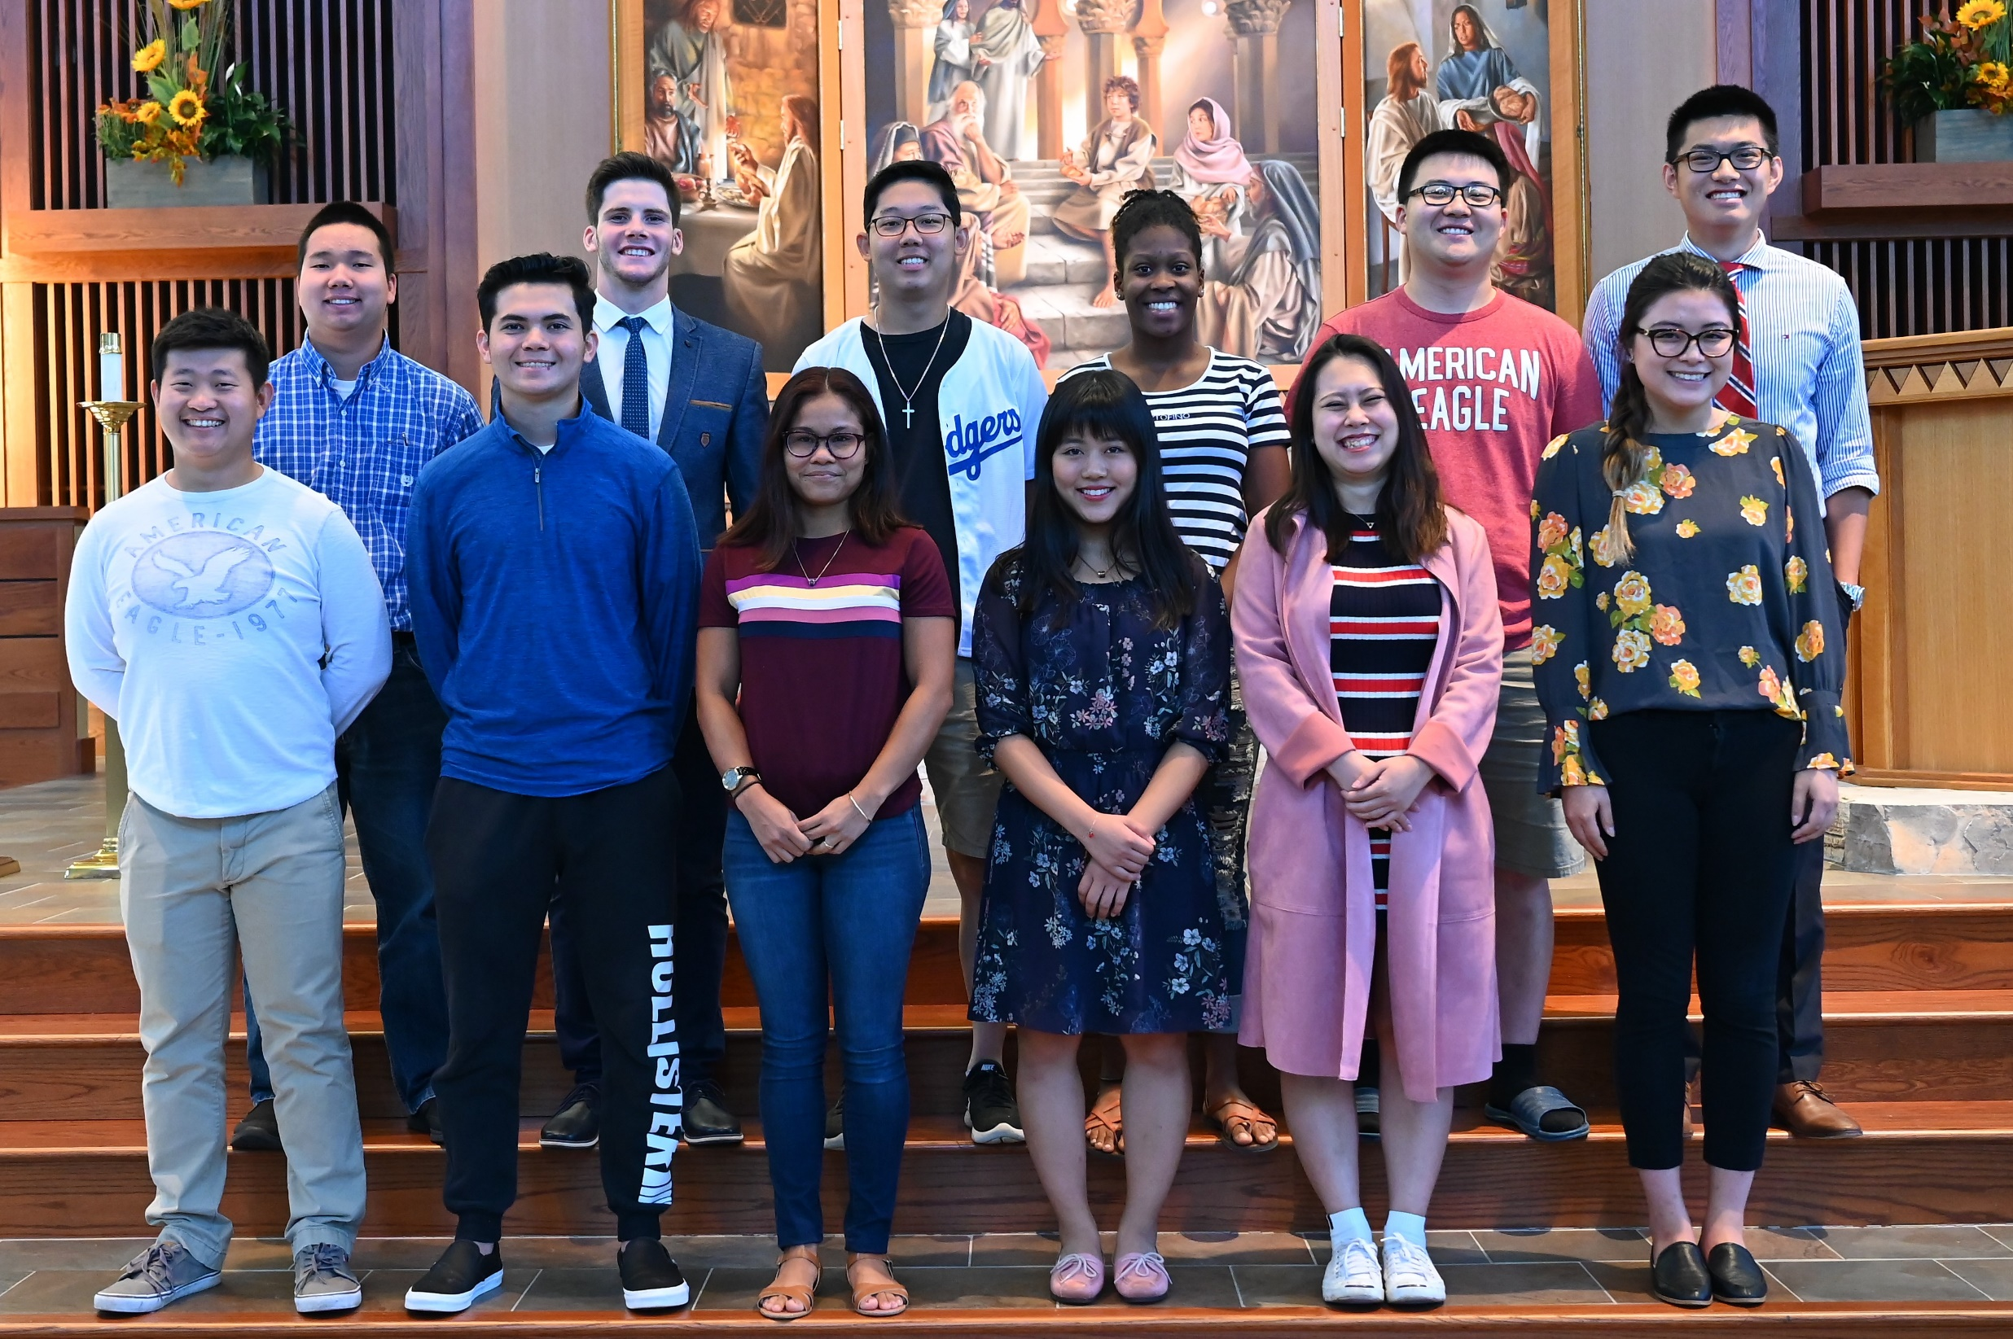

Slide 14
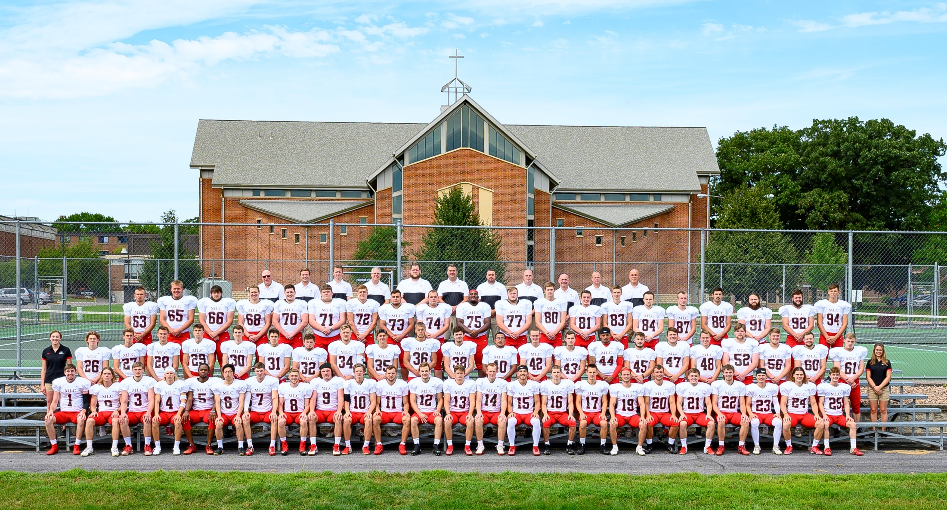
NCAA DIVISION 3

Slide 15
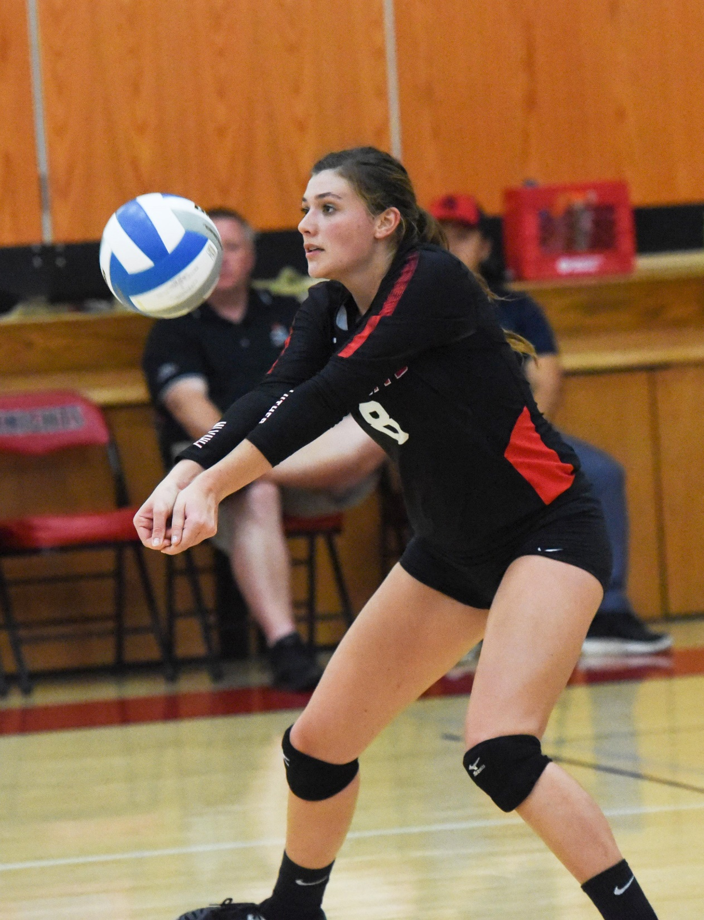

Slide 16
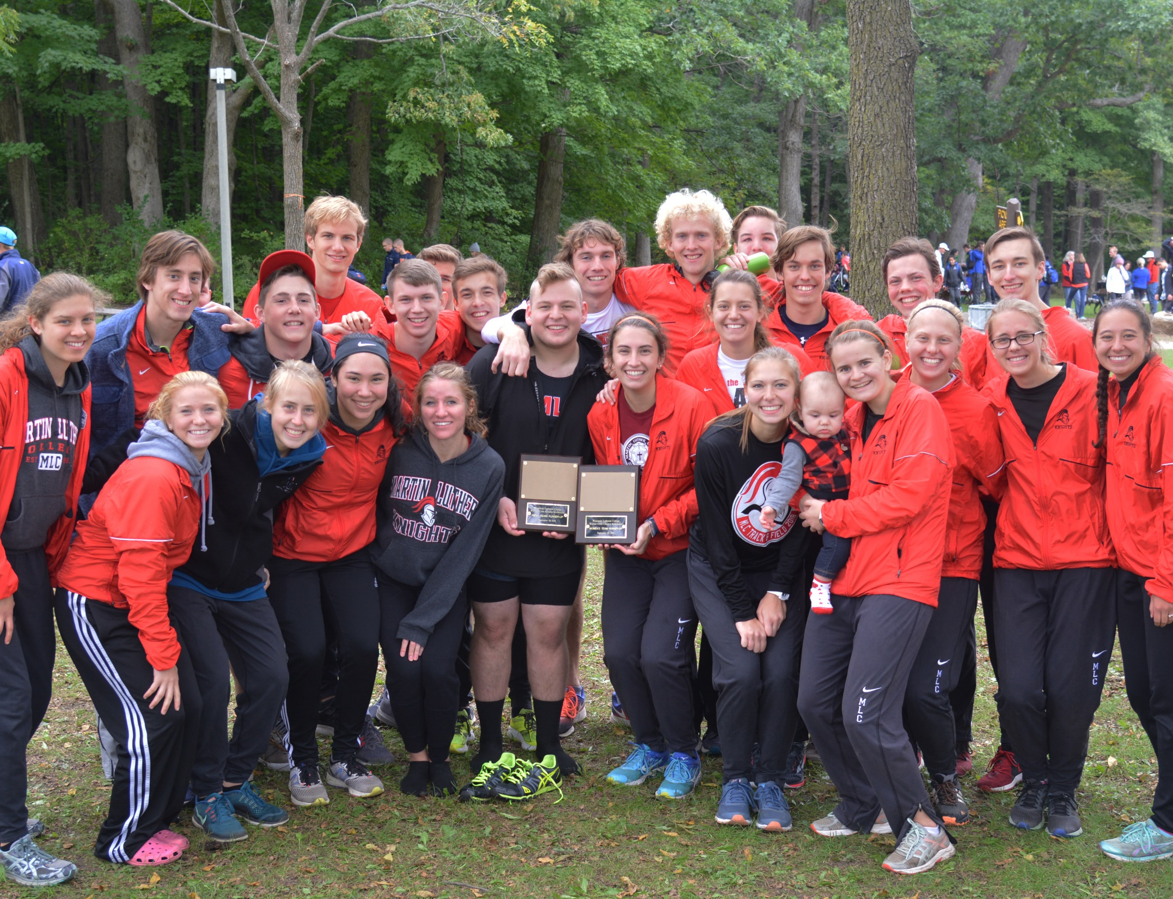
16 INTERCOLLEGIATE SPORTS

Slide 17
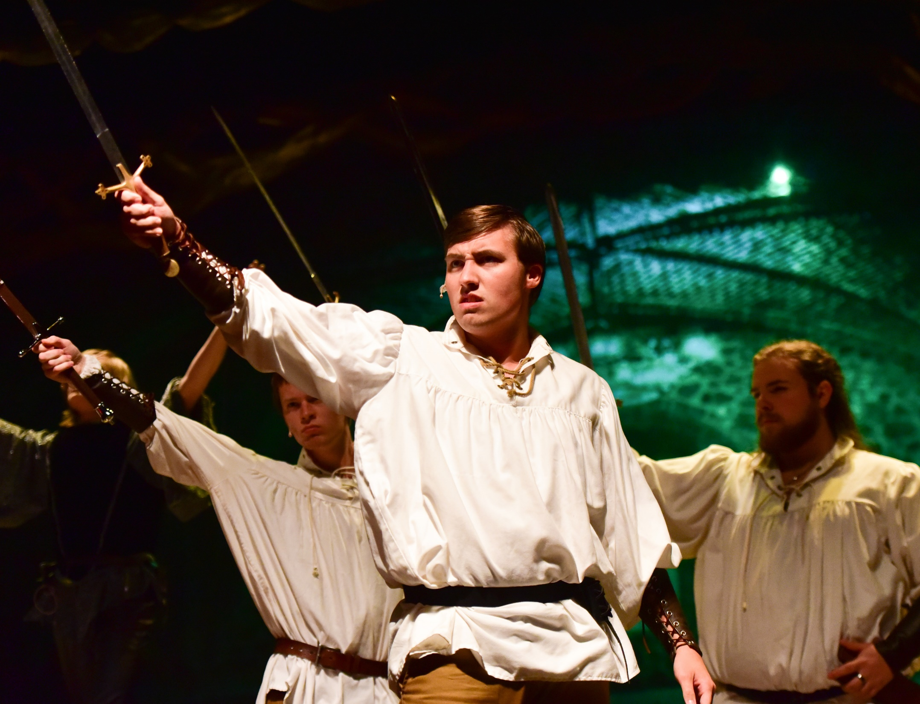
FOUR DRAMATIC
PRODUCTIONS

Slide 19
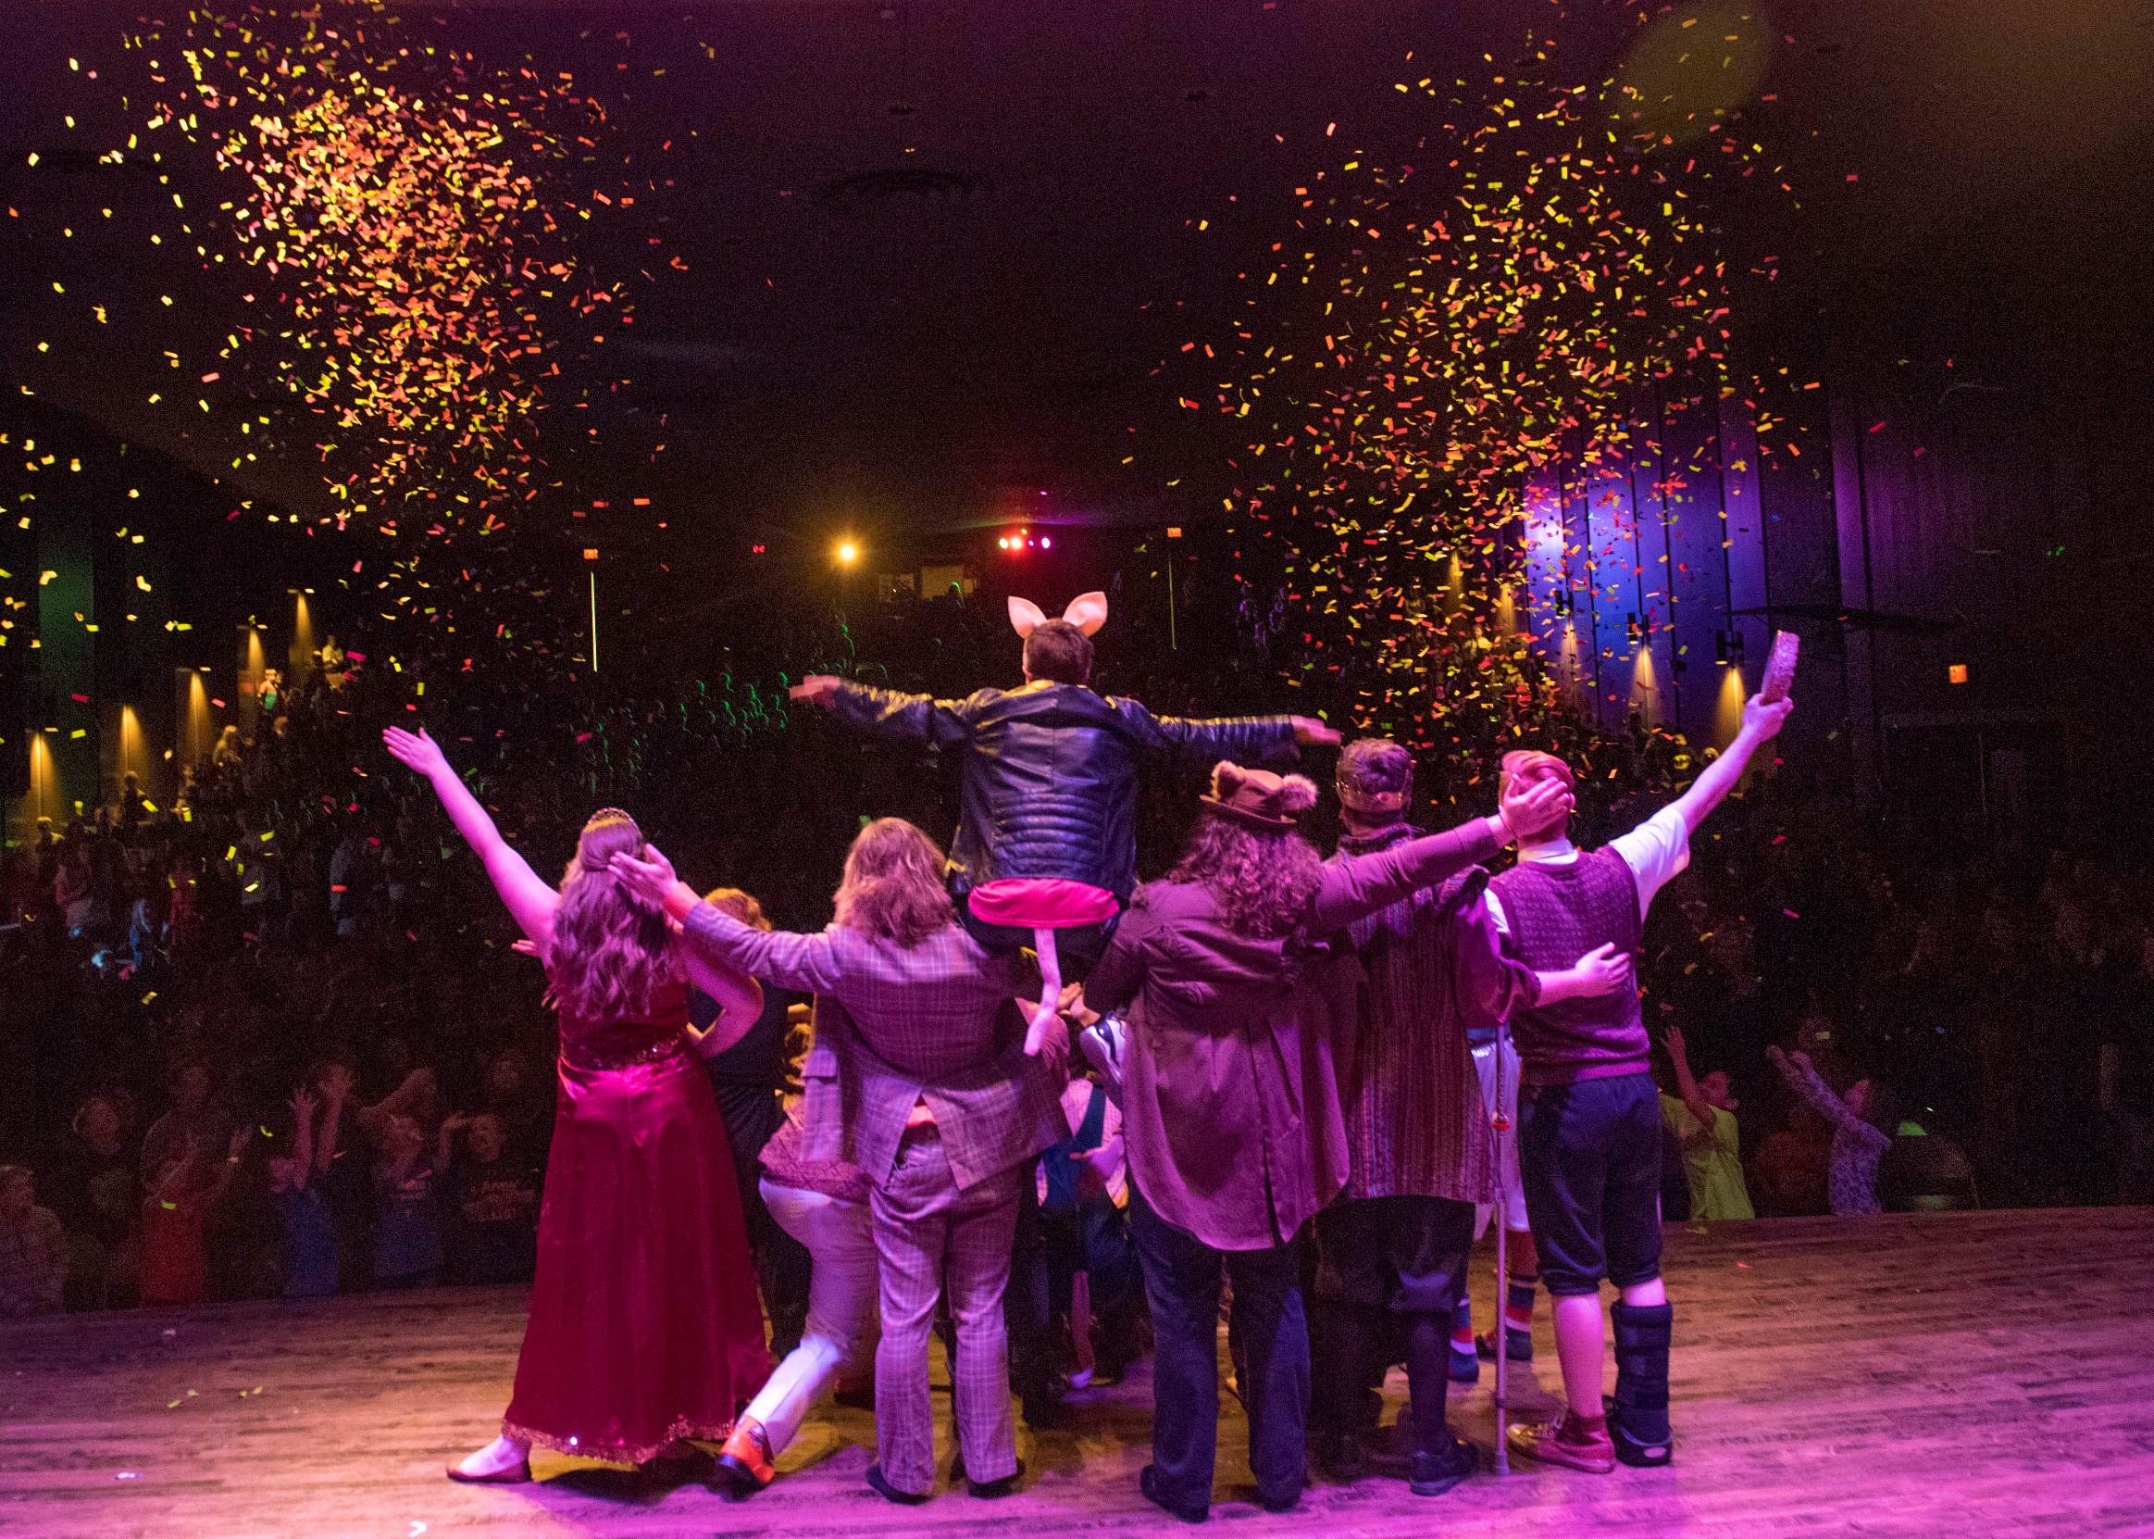
5,000+ ATTEND

Slide 20
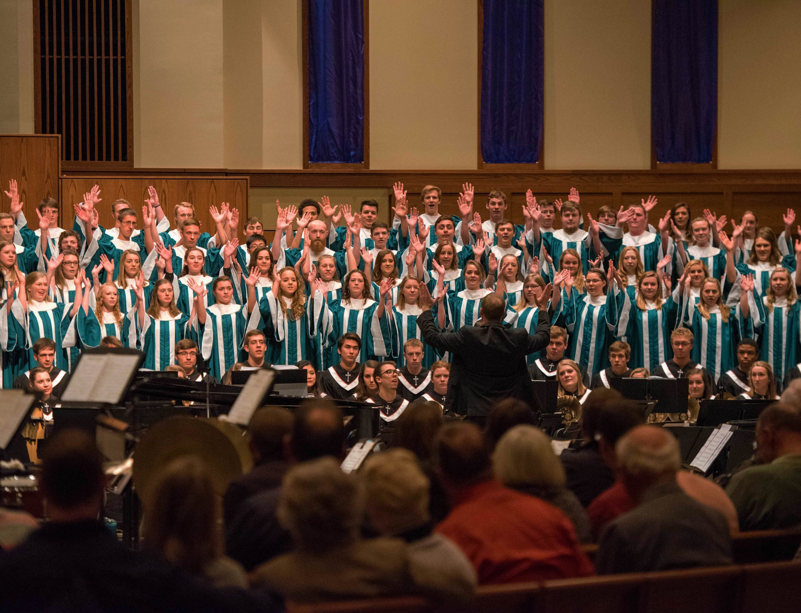
FOUR CHOIRS

Slide 21
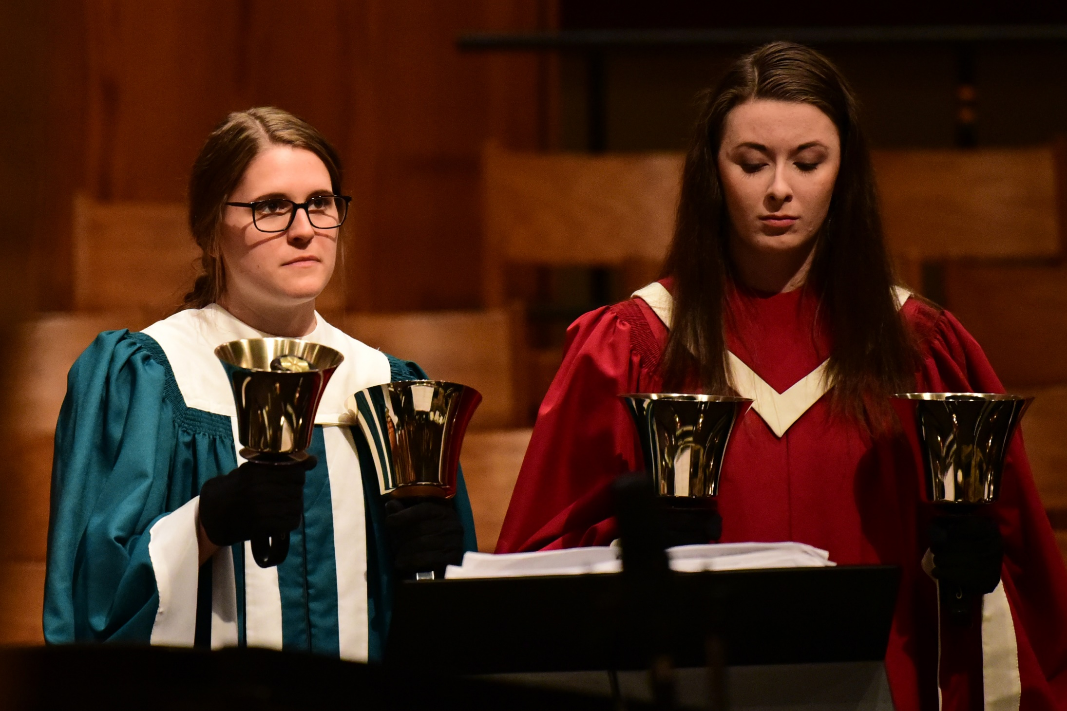

Slide 22
TOURING WIND SYMPHONY

Slide 23
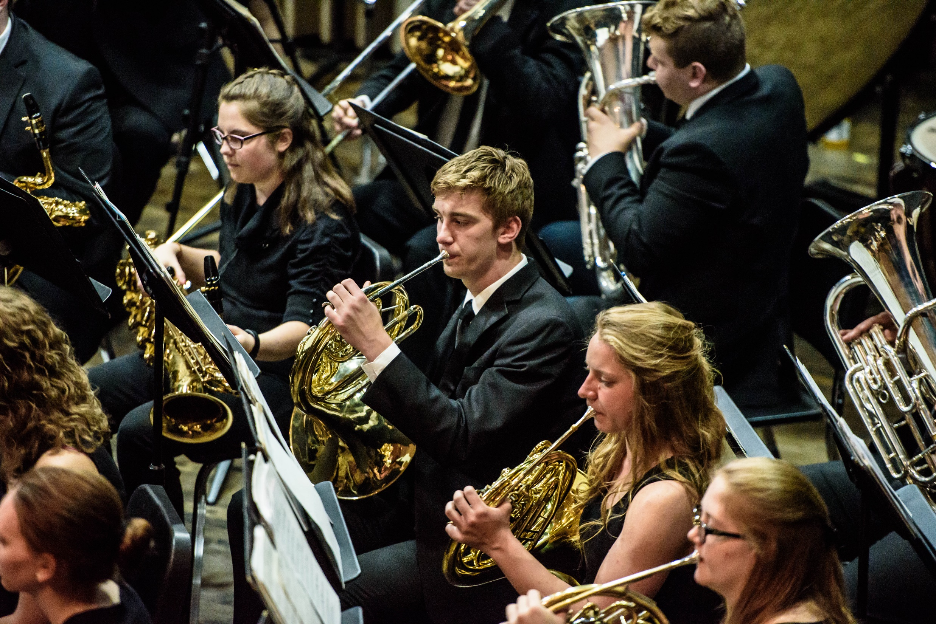

Slide 24
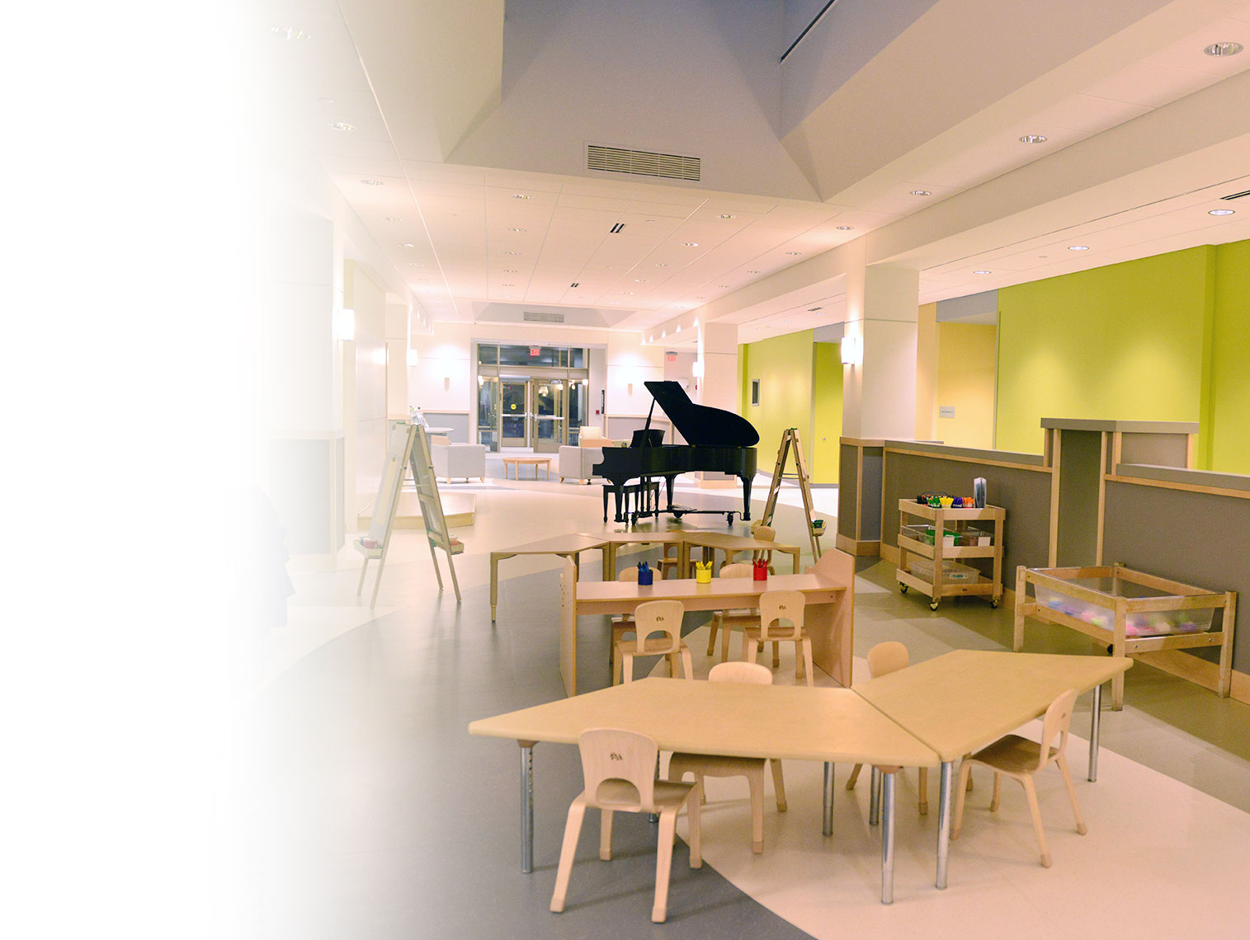
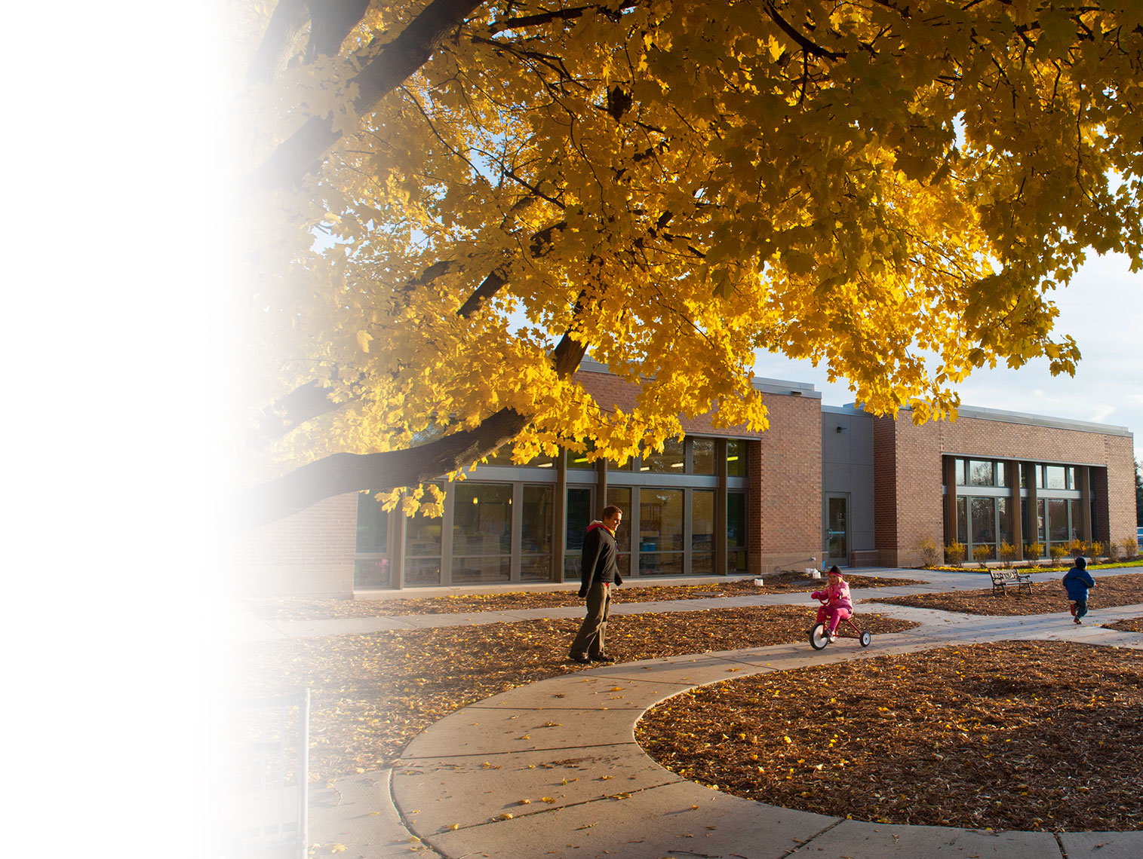
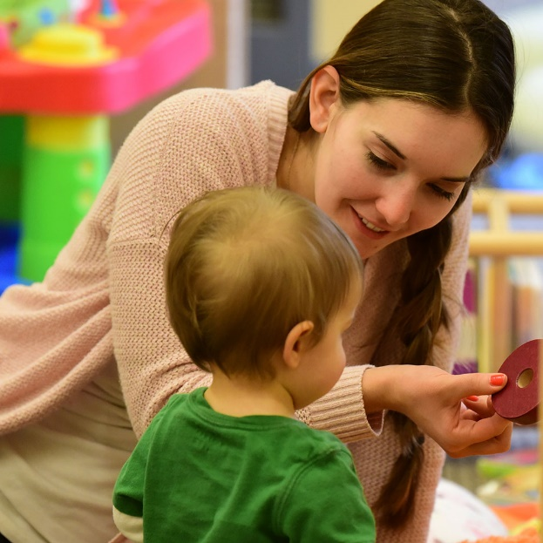
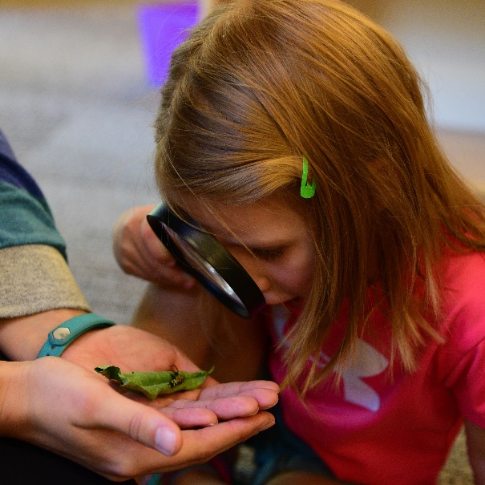
EARLY CHILDHOOD
LEARNING CENTER

Slide 25
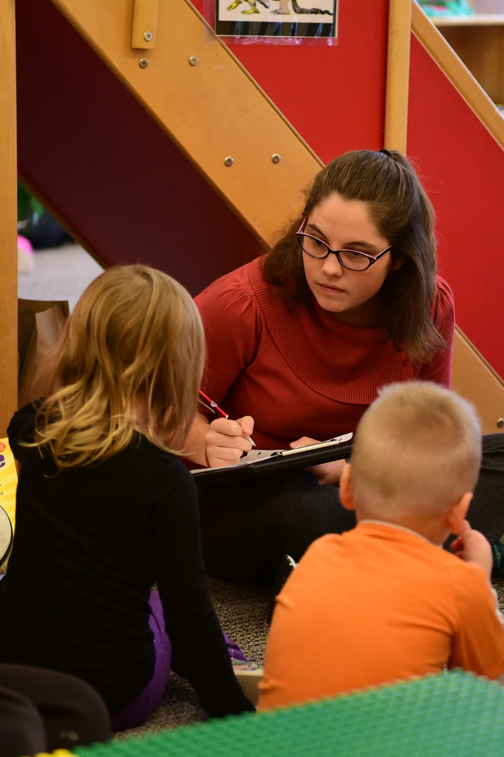

Slide 26
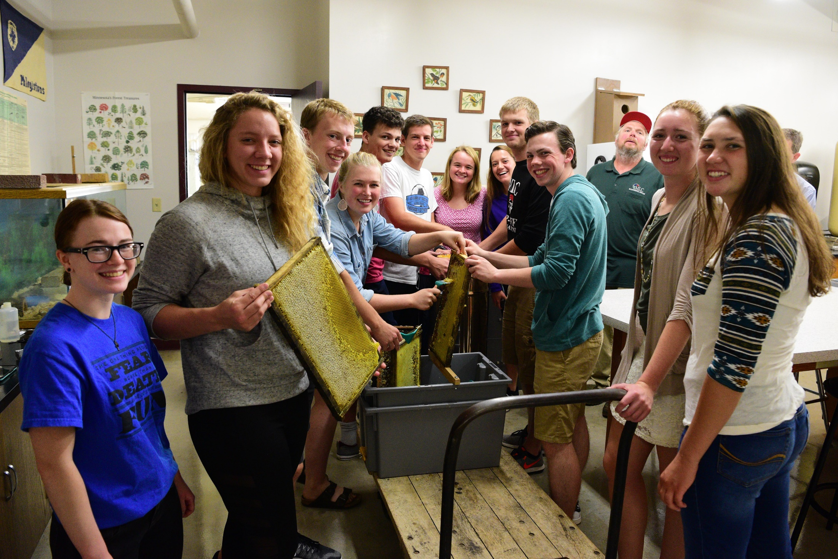
HANDS-ON LEARNING

Slide 27
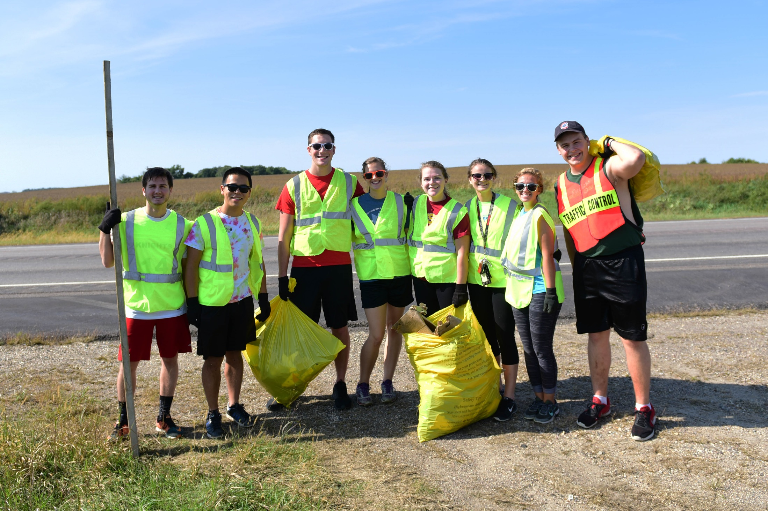
ACTIVE STUDENT GROUPS

Slide 28
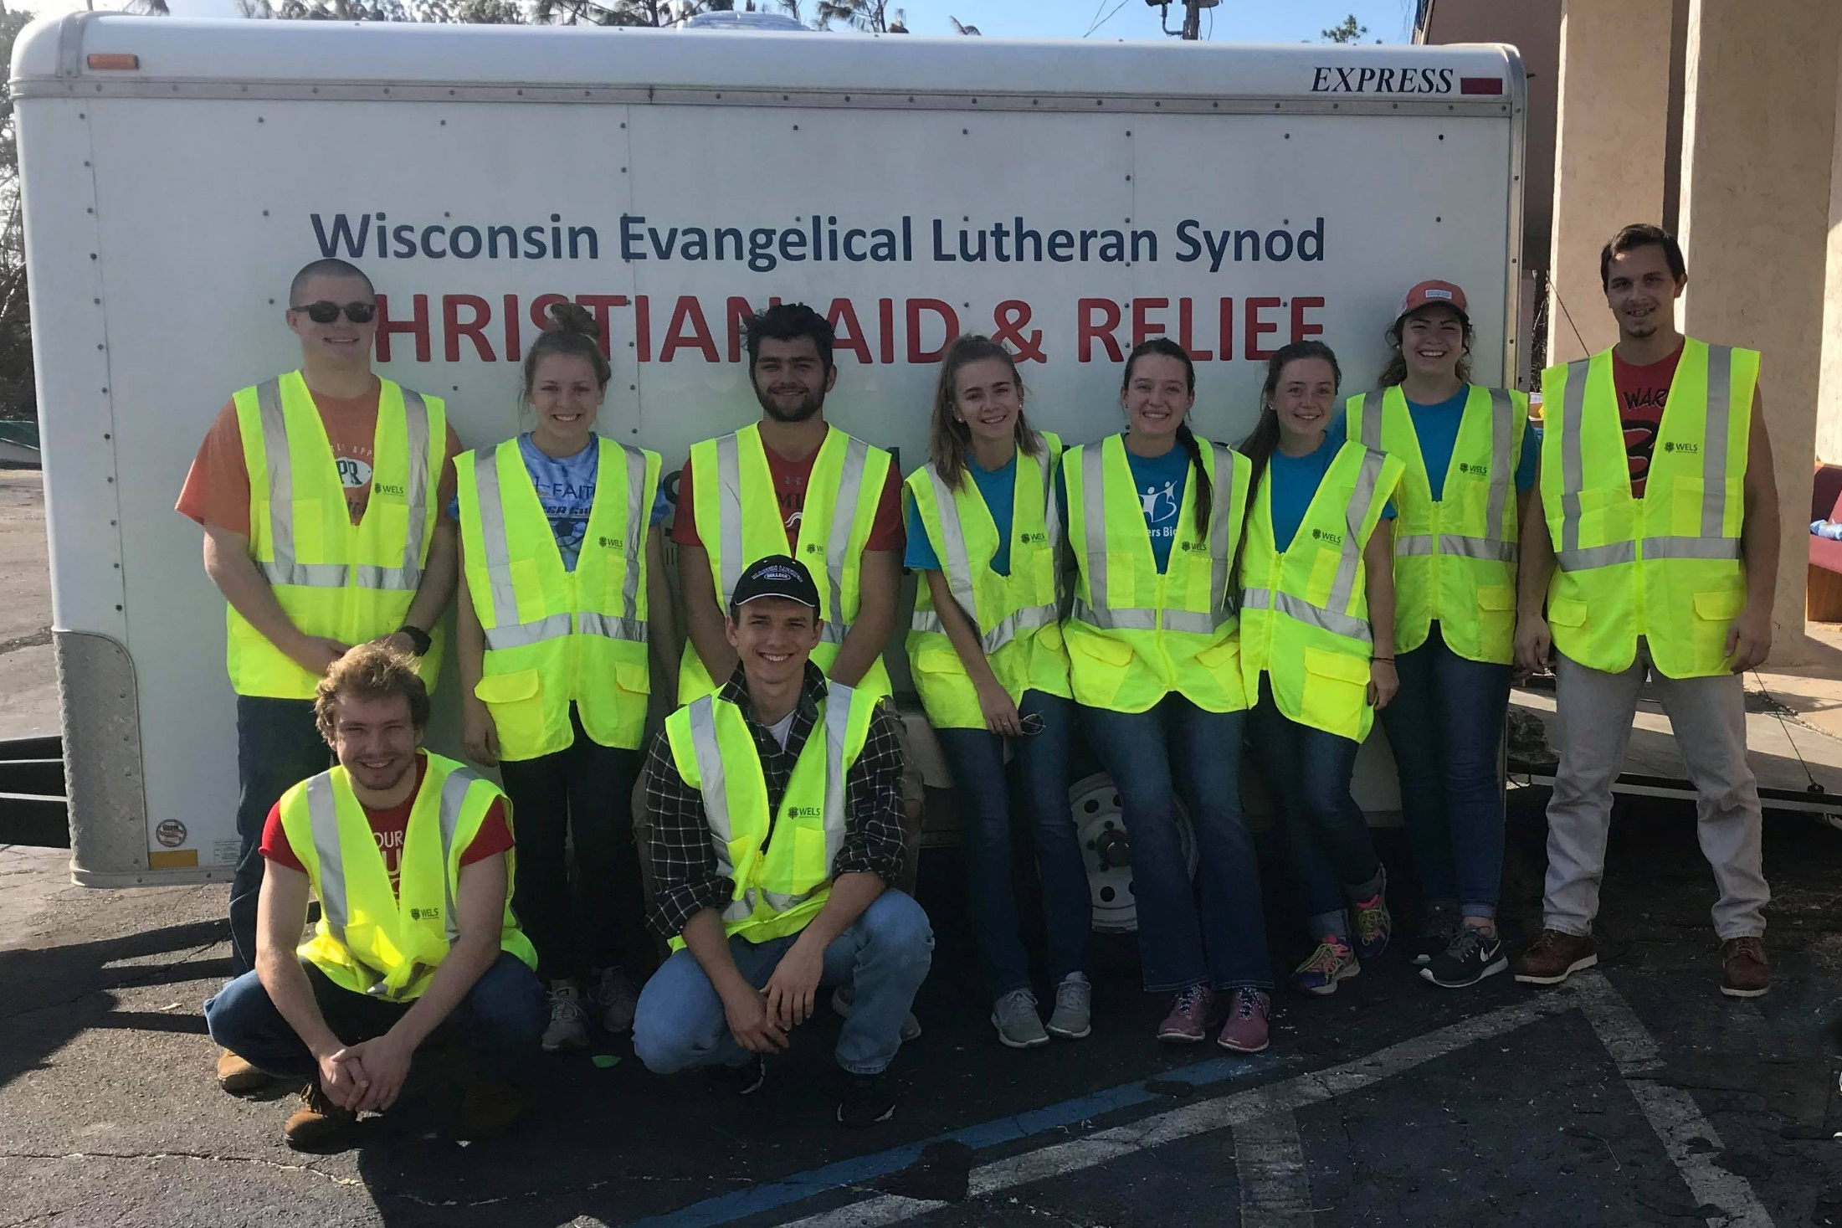

Slide 29
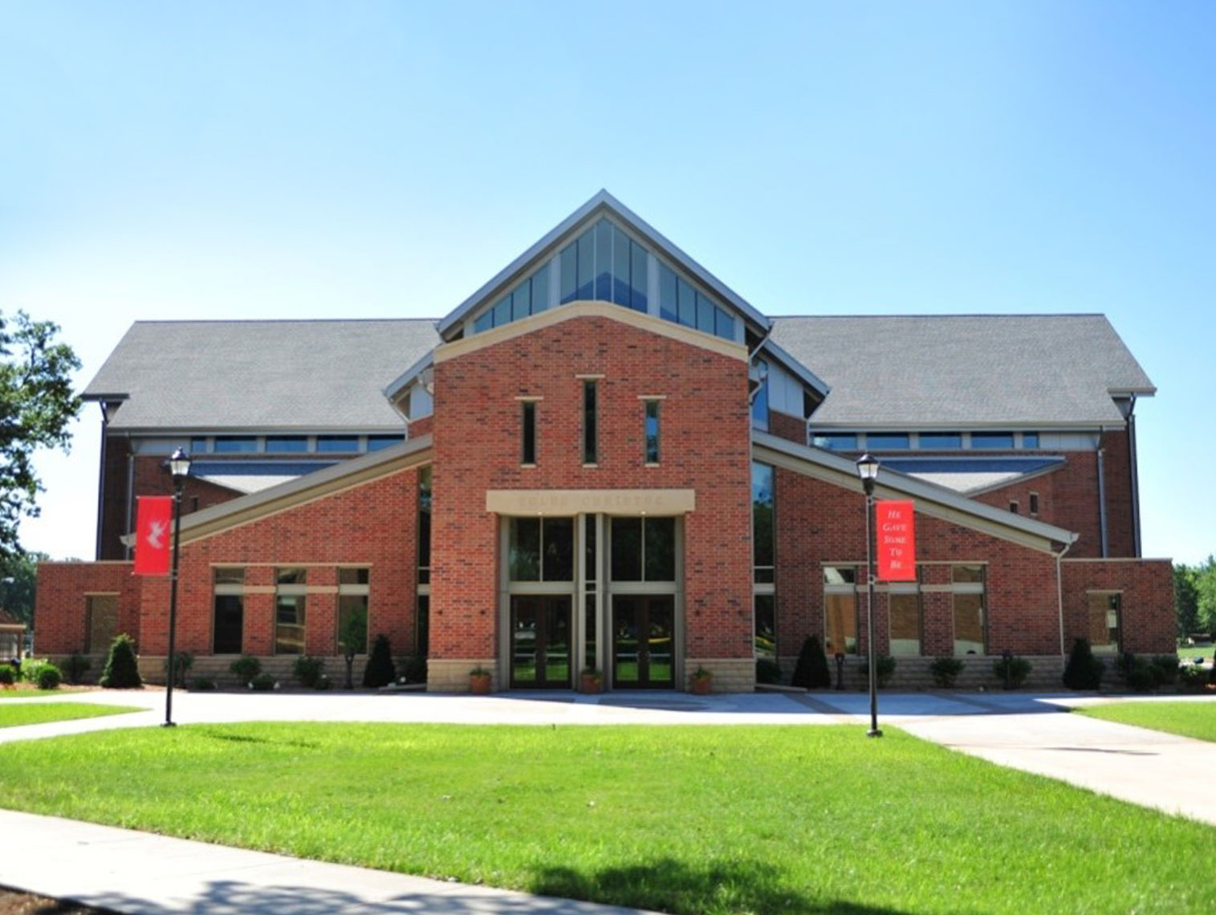
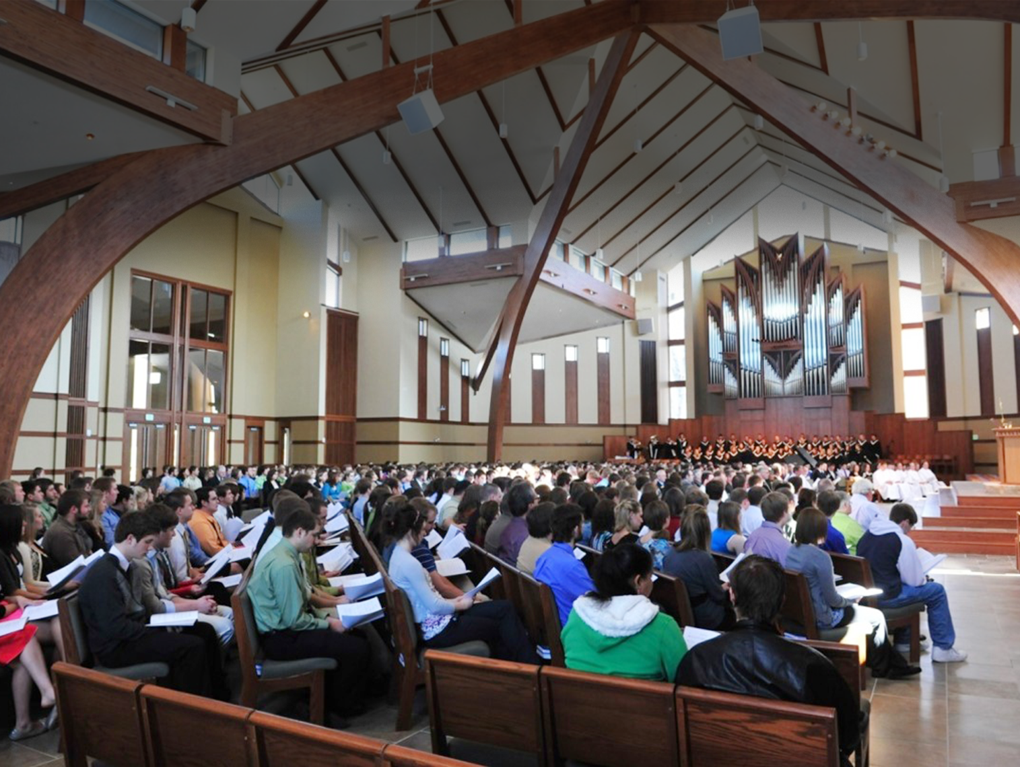
DAILY WORSHIP
Notes:
Talk about what students get to do on campus…
Most important: Worship in chapel twice (to 3x a day!!!)
God’s Word is the center of our campus in class and out.

Slide 30
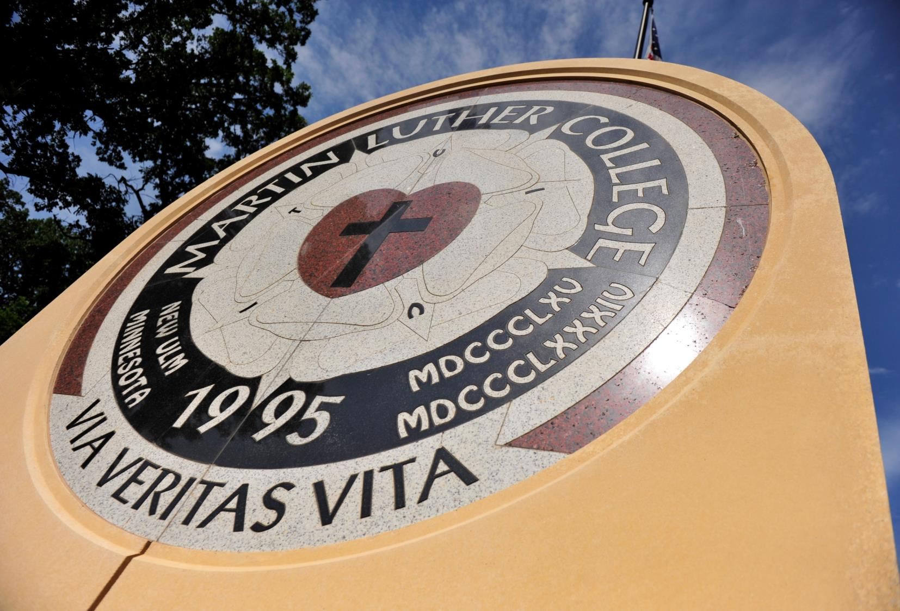

Slide 31
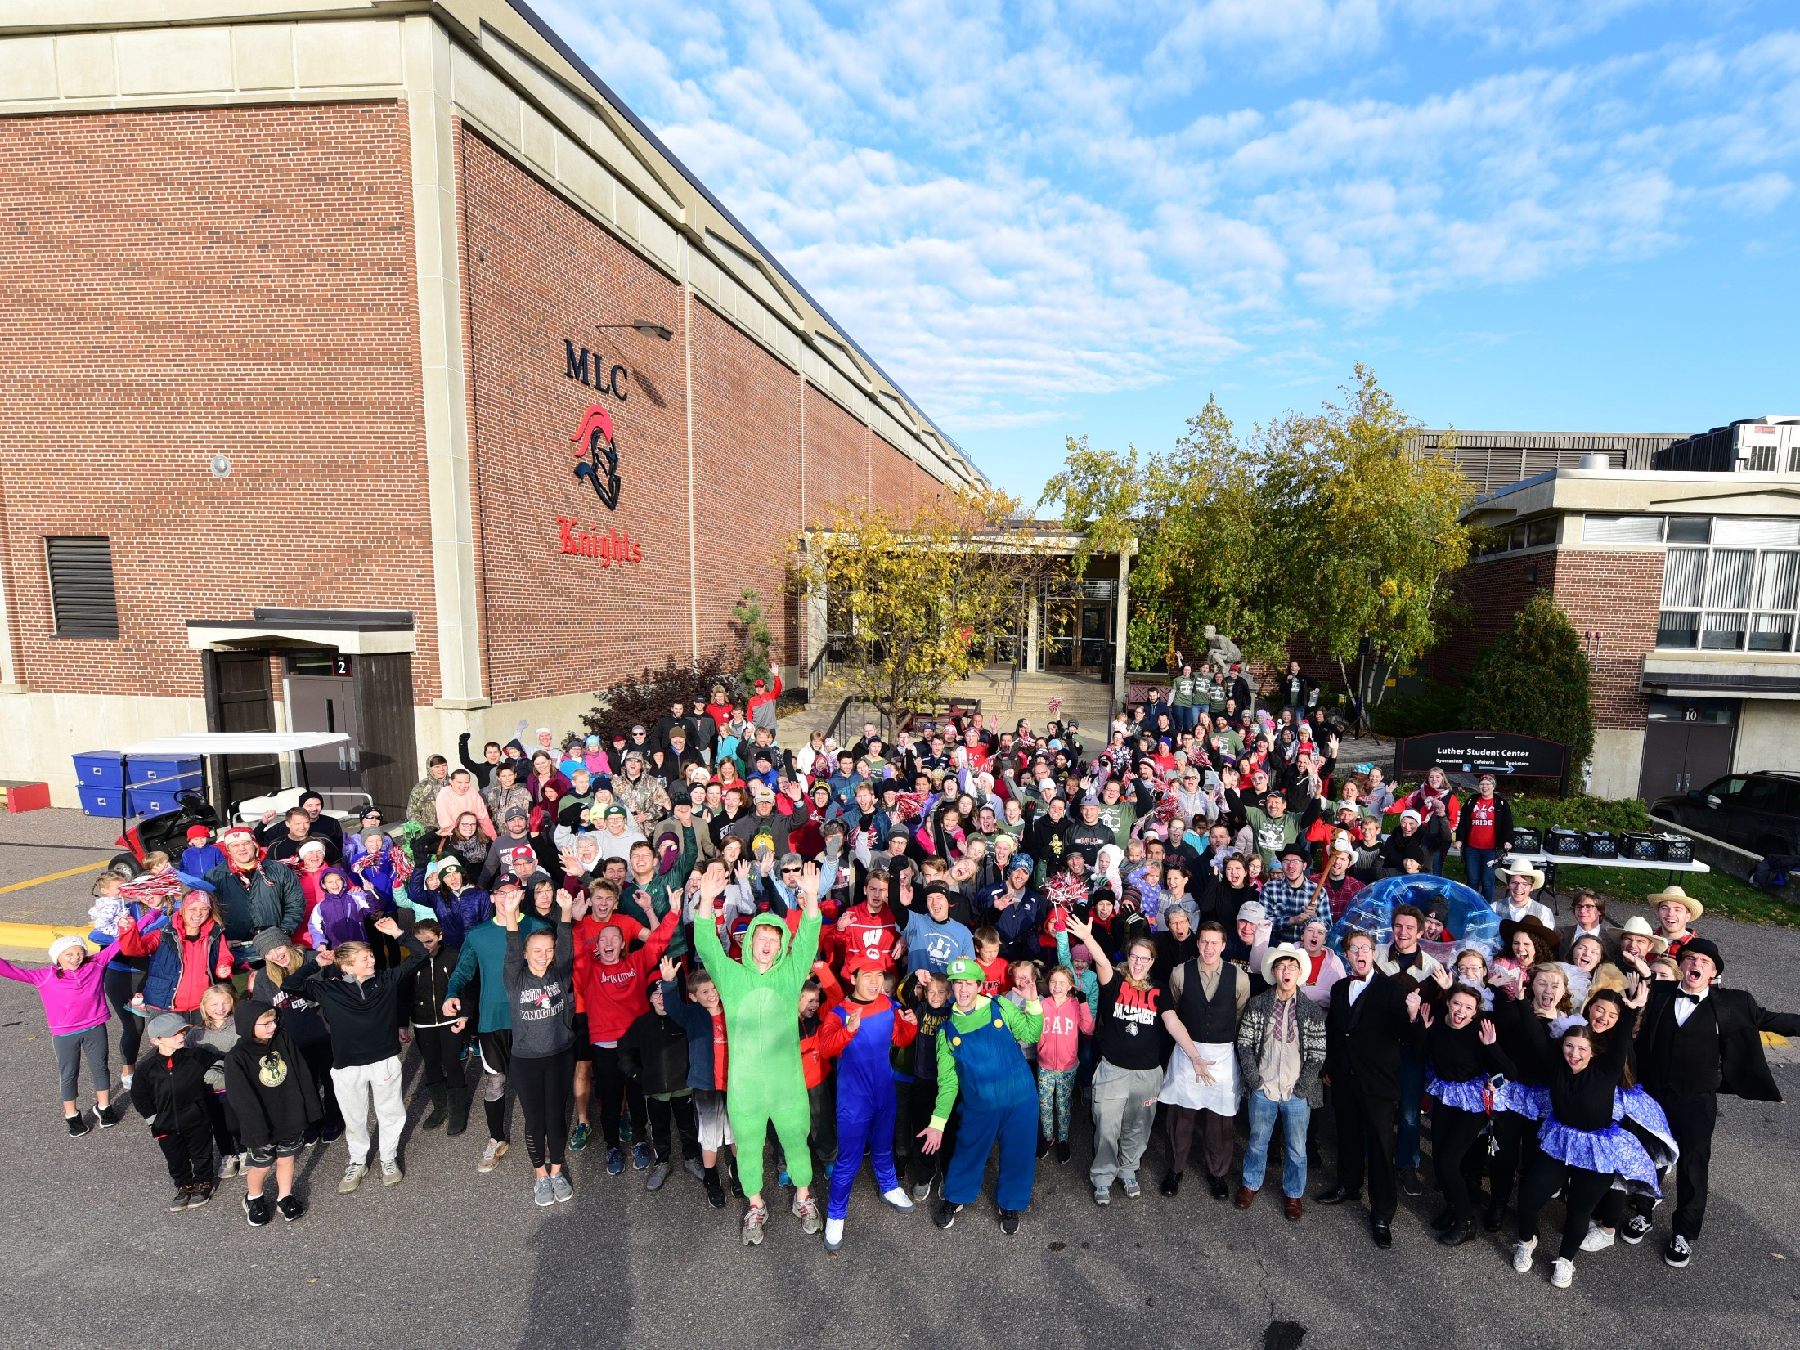
HOMECOMING!

Slide 32
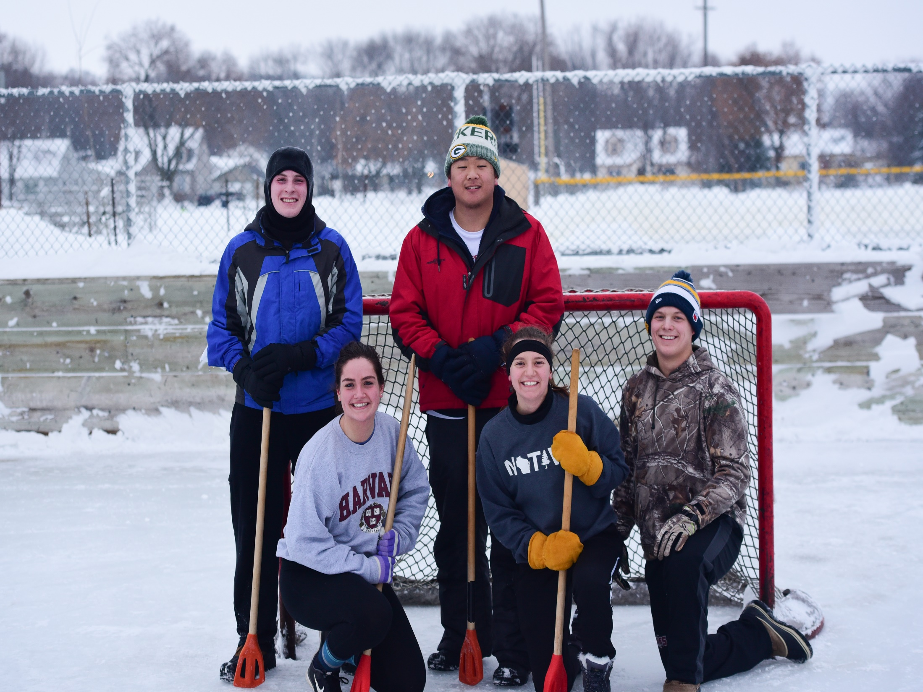
WINTER CARNIVAL!

Slide 33
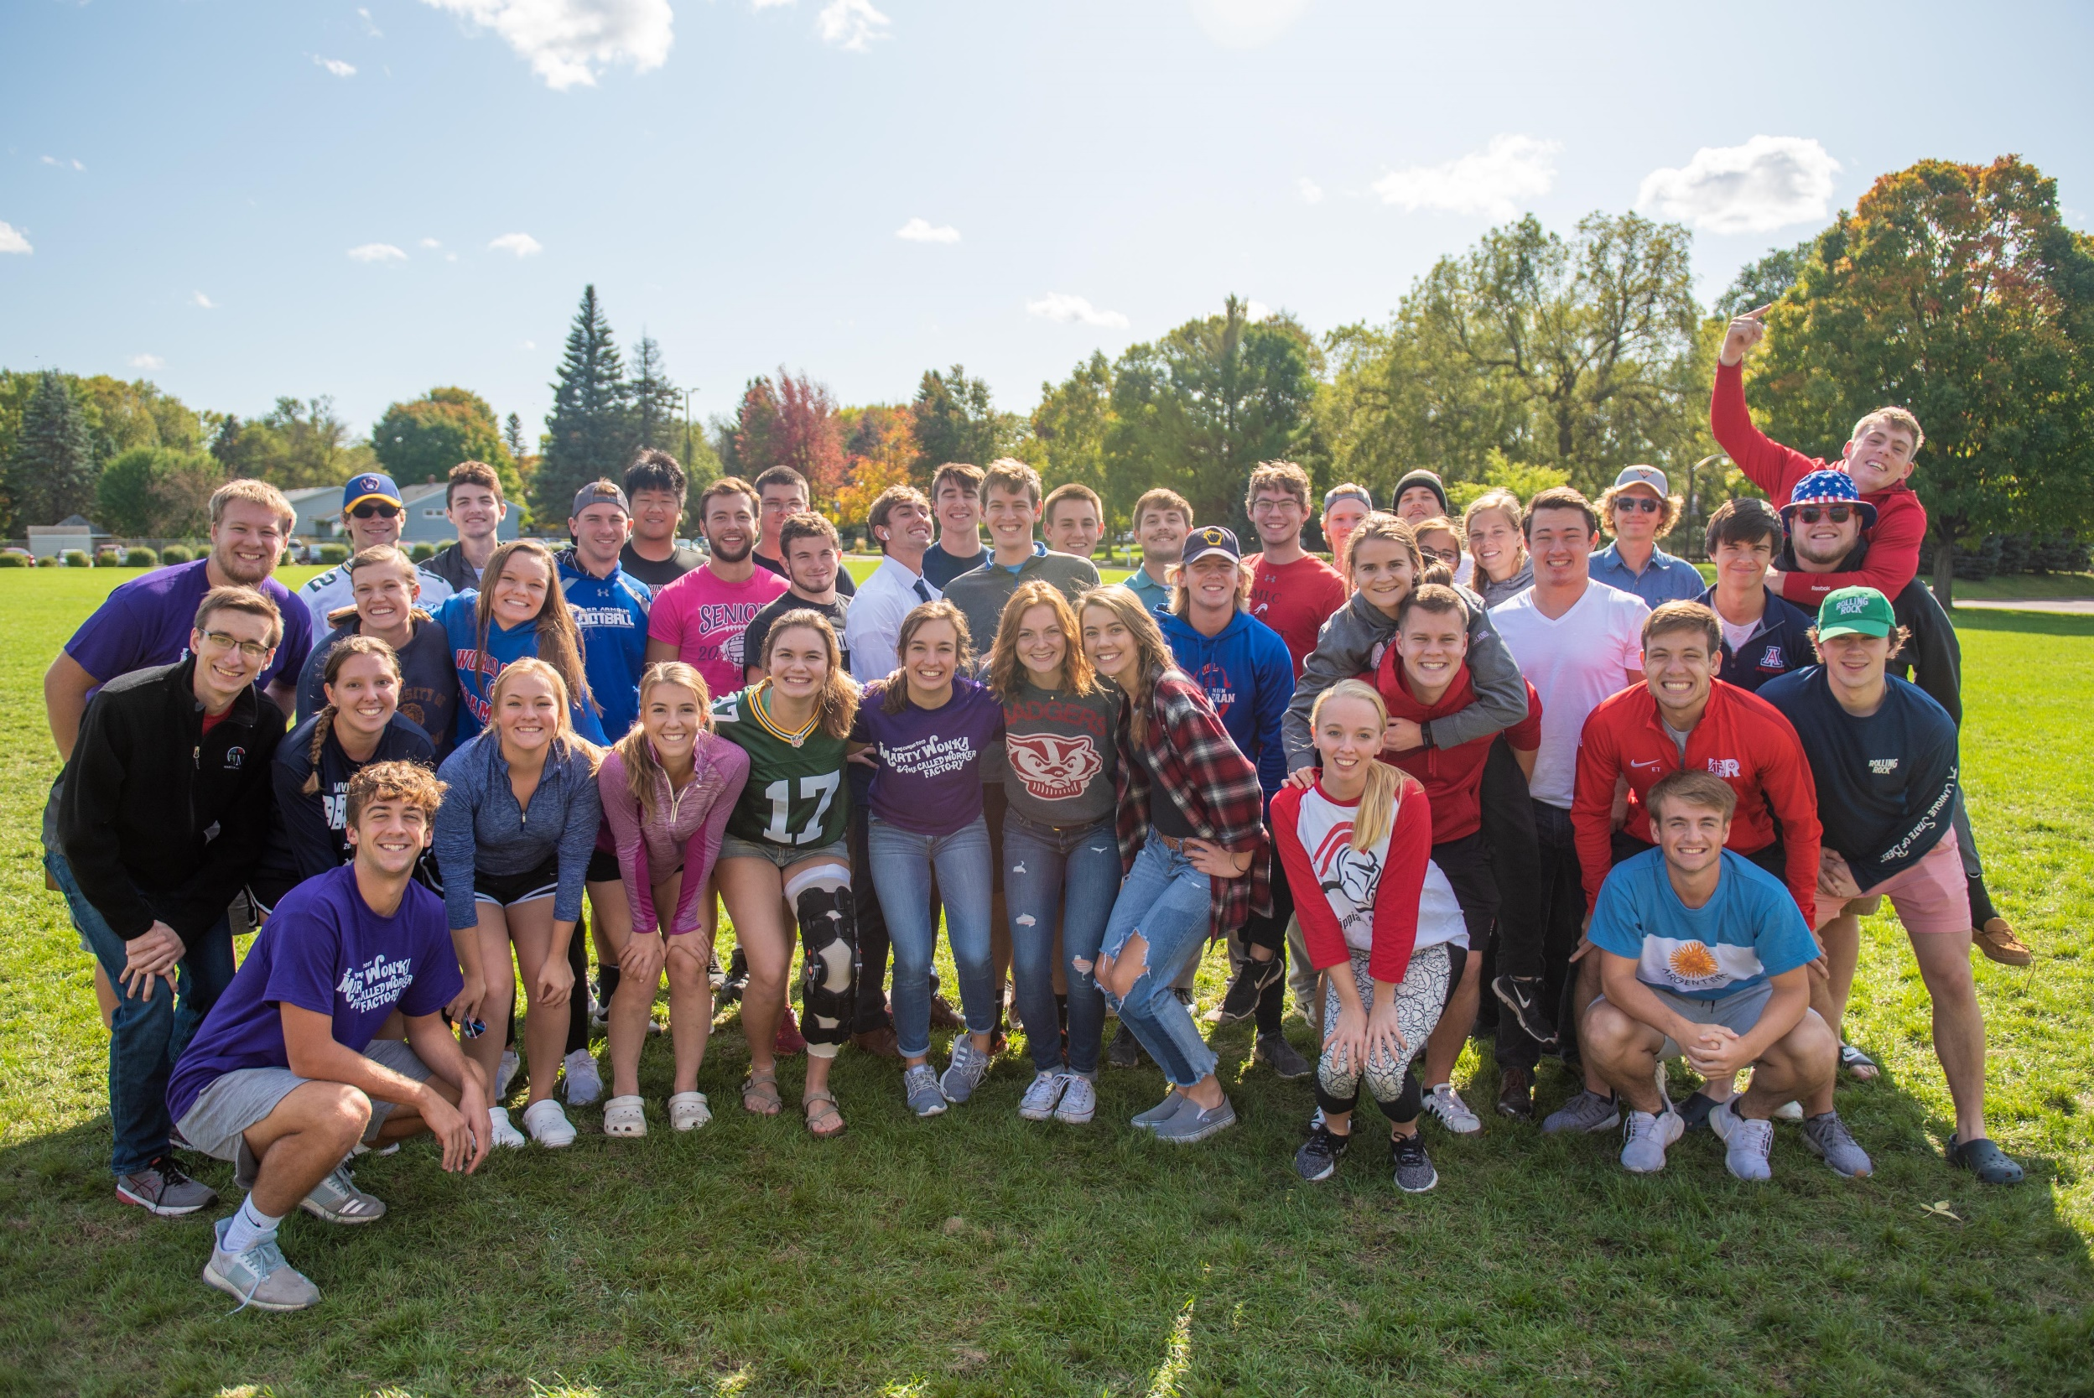

Slide 35
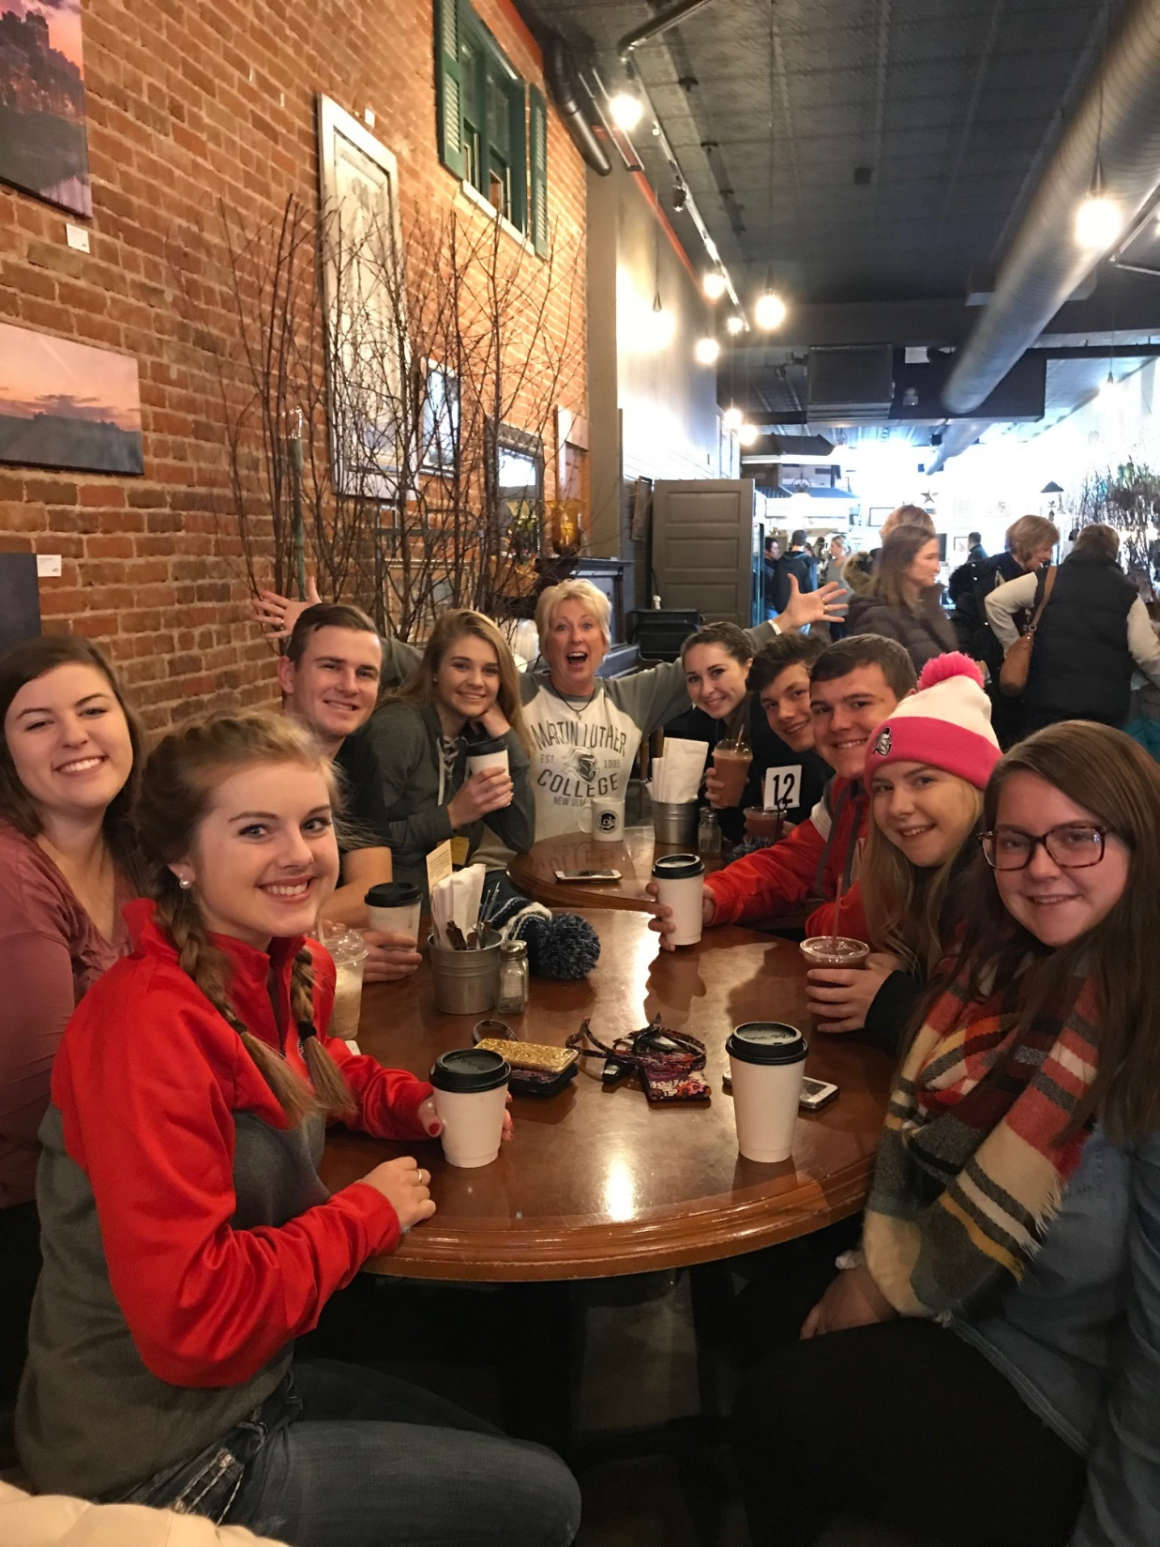
WE LOVE WELCOMING
HIGH SCHOOL VISITORS!

Slide 36
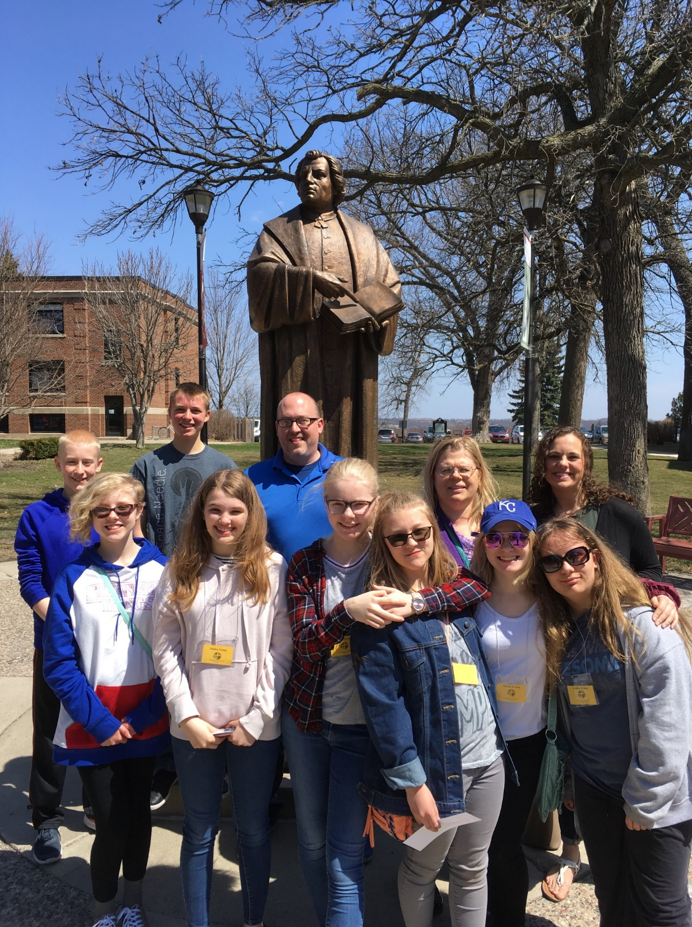
ELEMENTARY SCHOOL GROUPS!

Slide 37
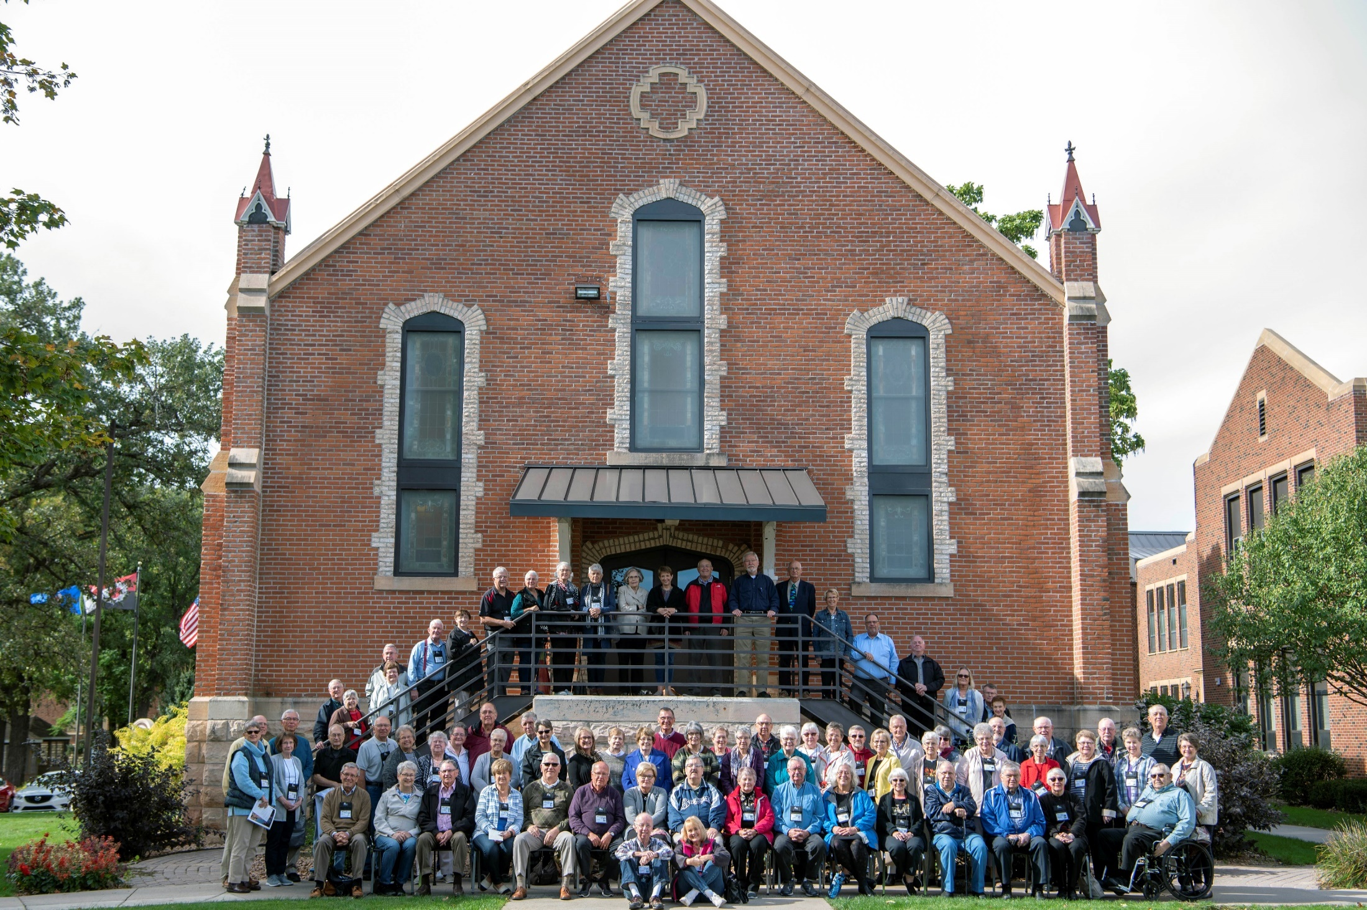
REUNION GROUPS!

Slide 38
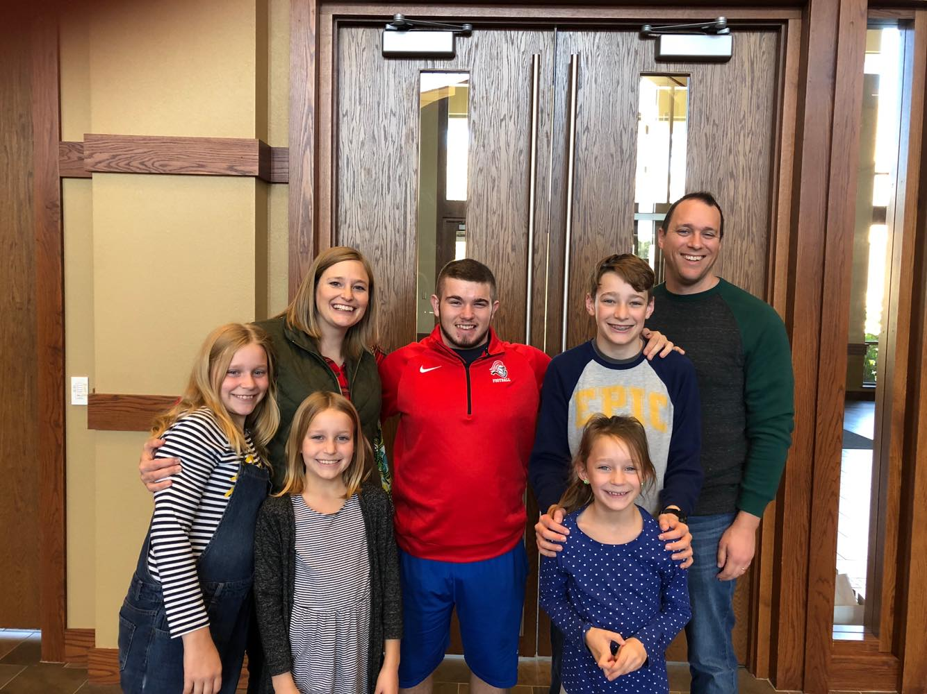
FAMILIES!

Slide 39
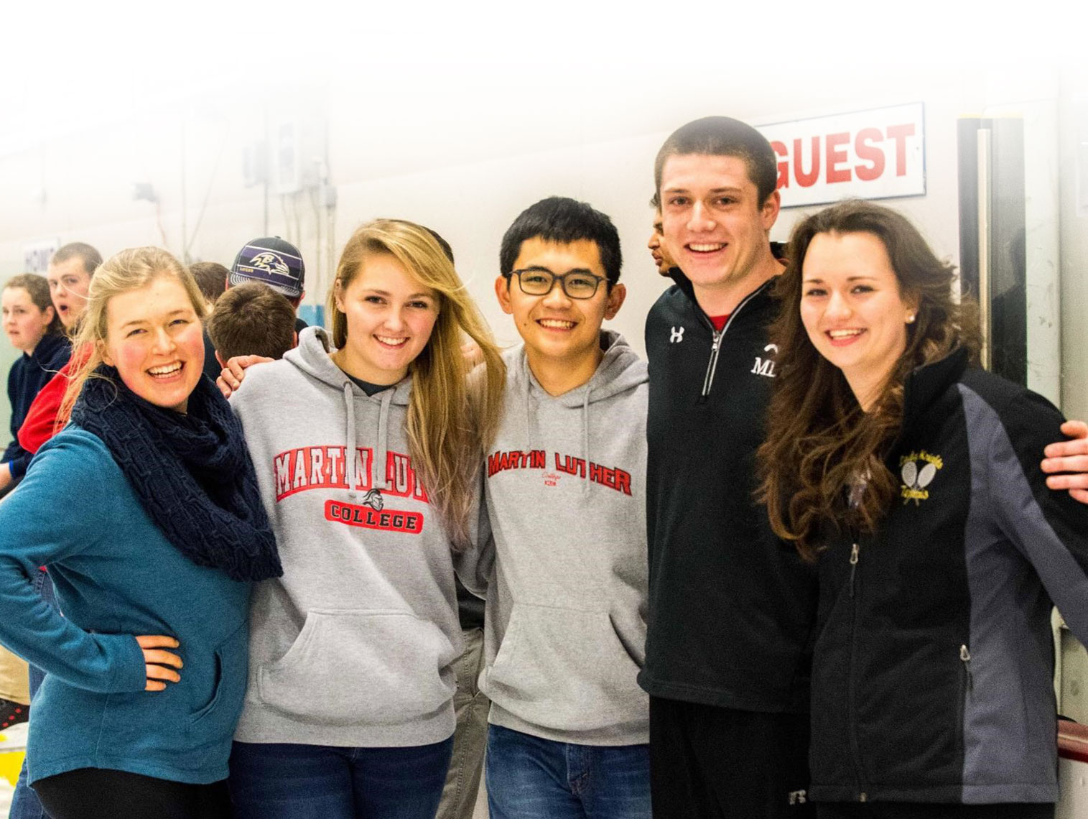
COME SEE US ANY TIME!

Slide 40
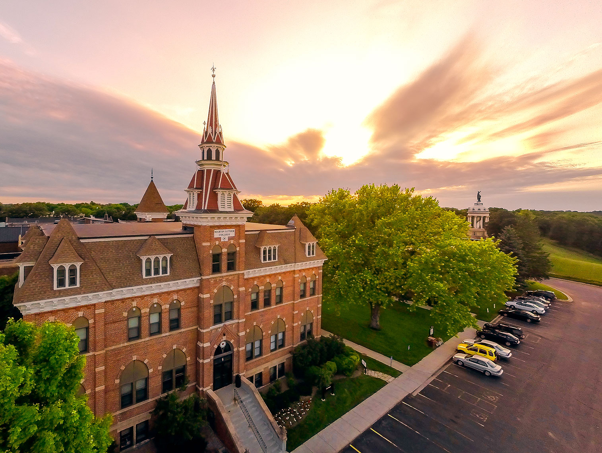

Slide 41
Notes:
I wanted to be in the ministry, and the place to go was Martin Luther College.

