Slide 1
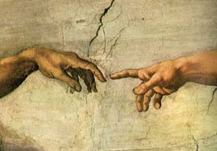
Lesson 2: The Christian (Confessional Lutheran) Worldview—The Standard Against Which to Measure All Others
Eight worldview questions to help in the identification of false worldviews

Slide 2
What is depicted in this scene?
What is the worldly perspective on the story behind the picture?
How does the world reconcile the obvious contradiction between those who don’t accept the Biblical account of this depiction and those who do?
What does the acceptance or rejection of this account say about attitudes toward the Bible?

Slide 3
Question 1
How does the Christian worldview explain the *Prime Reality?
*that which has always existed and explains all other things
Answer (pp. 15-16): The Christian God.
[T]here is one divine essence which is called and is God: eternal, incorporeal, invisible, of immeasurable power, wisdom and goodness, the creator and preserver of all things, visible and invisible. Yet, there are three persons, coeternal and of the same essence and power: the Father, the Son, and the Holy Spirit (Augsburg Confession, Article 1:2,3).

Slide 4
Question 2
How does the Christian worldview understand the source of knowledge and truth? How does it claim to know truth and right from wrong?
Answer (pp. 16-17): The Christian, biblical worldview recognizes two sources for obtaining knowledge: natural knowledge and special revelation (the Bible, Holy Scriptures), with the latter having higher authority.

Slide 5
Natural knowledge
Psalm 19:1-4
Job 12:7-9
Romans 1:18-32
Romans 2:14-16
By use of his reason and senses, by observing creation and making use of his mind, … heart and conscience, man can know …
Since man is finite and sinful, his knowledge is limited and distorted, especially in the knowledge associated with God and salvation.

Slide 6
Special Revelation (Holy Scriptures)
Romans 15:4 and 16:25-26
2 Timothy 3:15
Luke 24:25-27
John 20:31
Romans 10:14-17
Jeremiah 23:25-29
John 14:6
Acts 4:12
I Corinthians 2:13
2 Timothy 3:16
2 Peter 1:20-21
2 Peter 3:15-17
1 Thessalonians 1:5 and 2:13

Slide 7
Question 3
How does the Christian worldview understand and explain the universe? What is the universe and its relation to the Prime Reality?
Answer (p. 18): God created and preserves the universe.
Genesis 1,2
Exodus 20:11
Psalm 104
Acts 14:17

Slide 8
Question 4
How does the Christian worldview understand and explain man and his relationship to the Prime Reality and the universe?
Answer (pp. 18-19): Man was made in the image of God, consisting in knowledge, righteousness and holiness. This image was lost by the fall into sin and partially restored through conversion.
Man is also immortal, rational and appointed to rule over all creation.
Genesis 1:27-28, Ephesians 4:24 and Colossians 3:10
Genesis 9:6 and James 3:9

Slide 9
Question 5
How does the Christian worldview understand and explain evil?
Answer (pp. 19-20): The fall into sin.
Romans 3:9-20; 5:12-21; 6:23; 7:18; 8:7
Ephesians 2:1
Genesis 3:17-19
Matthew 24:12

Slide 10
Question 6
What is the Christian worldview’s solution for evil?
Answer (pp. 21-25): Justification through Christ and sanctification by the Holy Spirit.
Matthew 5:13
Genesis 6:9-11
Acts 14:11-18
Hebrews 11
I John 2:2
John 1:29
2 Peter 2:1
John 3:16-18
2 Corinthians 5:19
Romans 1:17
Romans 2:14,15
Romans 3:9-20
Romans 4:25
Romans 5:1,2

Slide 11
Question 7
How does the Christian worldview understand the future, the final reality, or the “end game”?
Answer (pp. 25-26): The historical reality of the second coming of Christ, the resurrection of all flesh, the final judgment, the end of the universe, and either a believer’s glorification or an unbeliever’s damnation in eternity.
Luke 23:43
Romans 8:18
Revelation 21:4
Matthew 10:28 and 25:41

Slide 12
Question 8
How is the Christian worldview reflected in various disciplines and various media?
Answer (pp. 26-32): See subsequent slides …

Slide 13
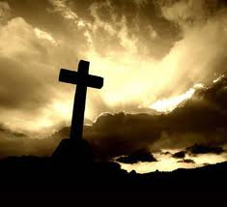
Theology
Christianity is theology (the study of God) as revealed in his Word (special revelation).

Slide 14
Ethics
There are real and transcendent moral principles that apply to all people of all time and that have their source in the one true God.
Romans 2:14,15
Exodus 20

Slide 15
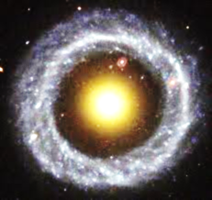
Science
Reason and observation play a crucial role in the study of science, but they must be filtered through special revelation.

Slide 16
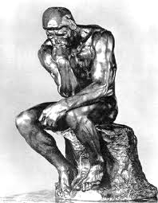
Philosophy
Natural knowledge provides a glimpse of wisdom and truth, but complete and lasting wisdom can only be found in and explained by special revelation.
Colossians 2:8

Slide 17
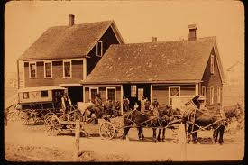
History
History is linear and has a beginning and an end. It is directed and planned by God. Historical facts can be known through both natural knowledge and special revelation. History also includes miraculous and supernatural events.

Slide 18
Art and music
These gifts exist because man was made in the image of God; among God’s creatures, art and music are unique to man.

Slide 19
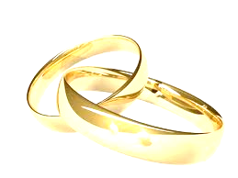
Sociology and politics
The origin, development, behavior, and structure of human societies and individuals are to be understood from the perspective of divinely instituted estates of marriage, government and the church.
Genesis 1:28
Genesis 2:18
1 Corinthians 7:9
Ephesians 5:22-33
Romans 13:1-7
Acts 4:19
Matthew 28:18-20
Matthew 5:13
Luke 12:13,14
Romans 1:16
Romans 3:20-31
John 13:34,35
2 Corinthians 10:5

Slide 20
Selected study questions for chapter 2
Psalm 19 speaks to both natural knowledge and special revelation. Which verses speak to each one? Which—natural knowledge or special knowledge as revealed by God’s Word—is superior?

Slide 21
Selected study questions for chapter 2
What is meant by the magisterial and ministerial use of reason? What is the correct use of reason when it comes to knowledge about God and why?
magisterial – authoritative (fr. L. magister meaning “lord”)
ministerial – acting or serving as an agent (fr. L. minister meaning “servant”)
Reason is to be a servant of God’s Word. It cannot serve as a source for doctrine or as a judge over the teachings of the Bible. Reason can be used to study God’s Word, think about it, treasure it, share it with others, and arrange the scripture in an orderly way to present them to others (God So Loved the World: A Study of Christian Doctrine, Lange, NPH, pp. 14-15)

Slide 22
Selected study questions for chapter 2
What might be the difference between a confessional Lutheran understanding of inerrancy and a nondenominational, “Bible believing” church’s understanding of inerrancy?

Slide 23
Selected study questions for chapter 2
What is the difference between saying that the Bible is the Word of God and the Bible contains the Word of God? What are the consequences if the Bible merely contains the Word of God? Give examples.

Slide 24
Selected study questions for chapter 2
What distinctions can be made between God and the universe (creation)? Between man and the rest of creation? Between man and God? How is it that the Christian worldview (that man is to rule over the earth) actually leads to the best care and use of the earth?
End of lesson 2. Next time: Modernism

